Slide 1
Operational Short and Medium range forecasts
Y.V. Rama Rao

Slide 2
Outline
  Operational NWP system at IMD for Short and Medium Range Forecasting
  Generation of Customized FC Product
  Major Achievements during 2014-15
  Performance of NWP Models
  New Initiatives
  Future Plans

Slide 3
Operational NWP System
Medium Range Forecast
GFS T-574/L64 with GDAS ( 00 & 12 UTC)
MME based District Level Forecast
City Forecast for Major Cities
Short Range Forecast
WRF (ARW) 3D-VAR at 27 km and 9 km
HWRF 3D-VAR GSI at 27/9/3 km
Aviation Products
Nowcast and Very Short Range Forecast
Hourly venue specific forecast- WRF (3 km)
ARPS with assimilation of DWR
WDSS-II Nowcast System with assimilation of DWR
MME Extended Range Forecast

Slide 4
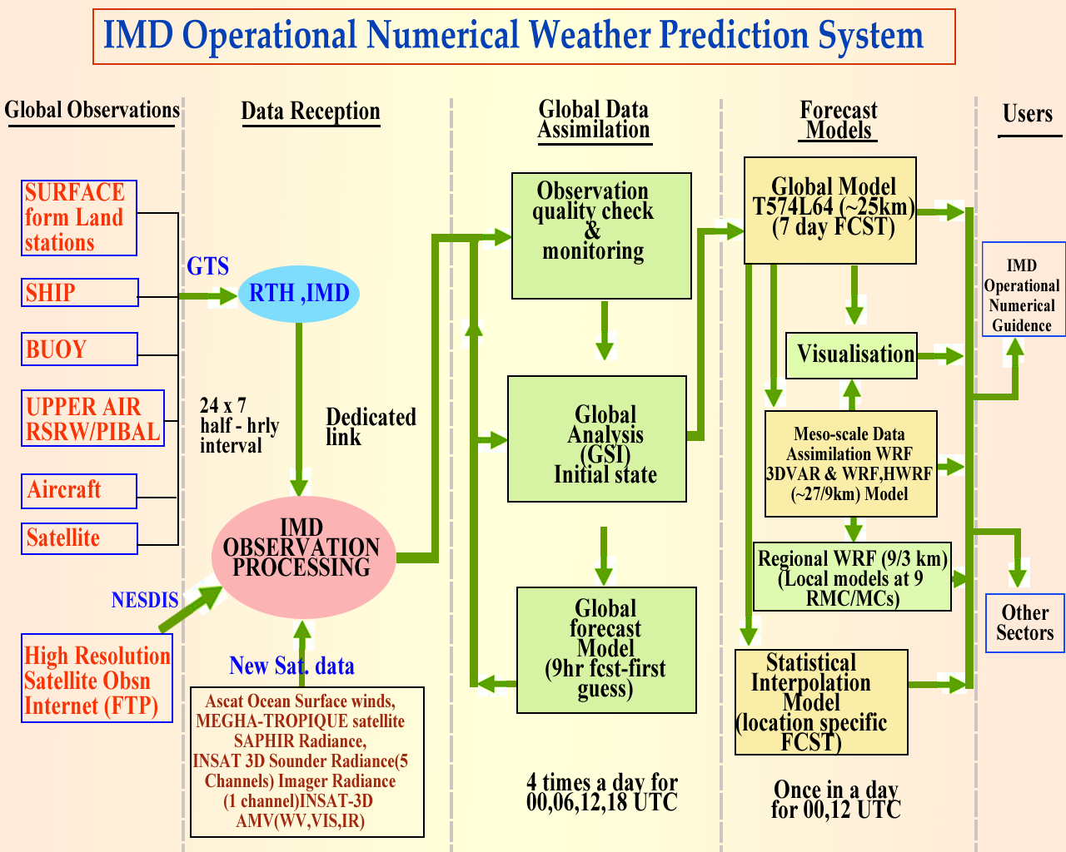

Slide 5
User specific NWP products
S. No. | User Name | Type of Forecasts
1 | Agro-met Services | MME based five days quantitative forecasts of rainfall, max and min temperature, cloud cover, surface humidity and winds at District Level
2 | Cyclone Services | HWRF, Statistical based MME Cyclone track and intensity prediction, genesis forecast
3 | Aviation services | WRF model based weather map of temp and wind for low flying aircrafts, meteograms
4 | Hydrological services | MME/WRF based gridded location specific rainfall forecasts
5 | Public Weather Services | Five days City forecast
6 | Day to day forecast | Weather forecast Data and Graphics Products
Additional satellite Data:
MEGHA-TROPIQUES satellite SAPHIR Radiance (6 channel - WRF)
INSAT 3D Sounder Radiance (5 Channels) Imager Radiance (2 Channel - WRF)
INSAT-3D AMV (WV,MR,IR) in WRF & GFS
QC Multiple DWR data assimilation in WRF model

Slide 6
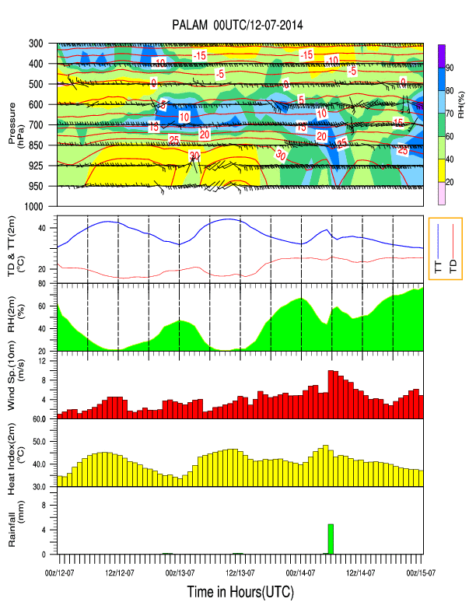
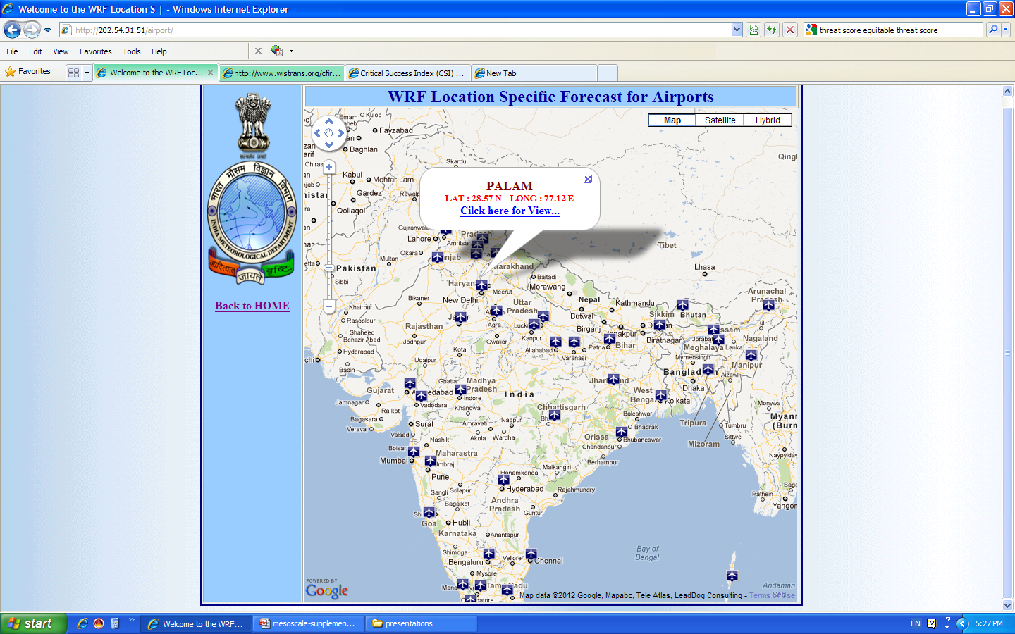
47 Locations

Slide 7
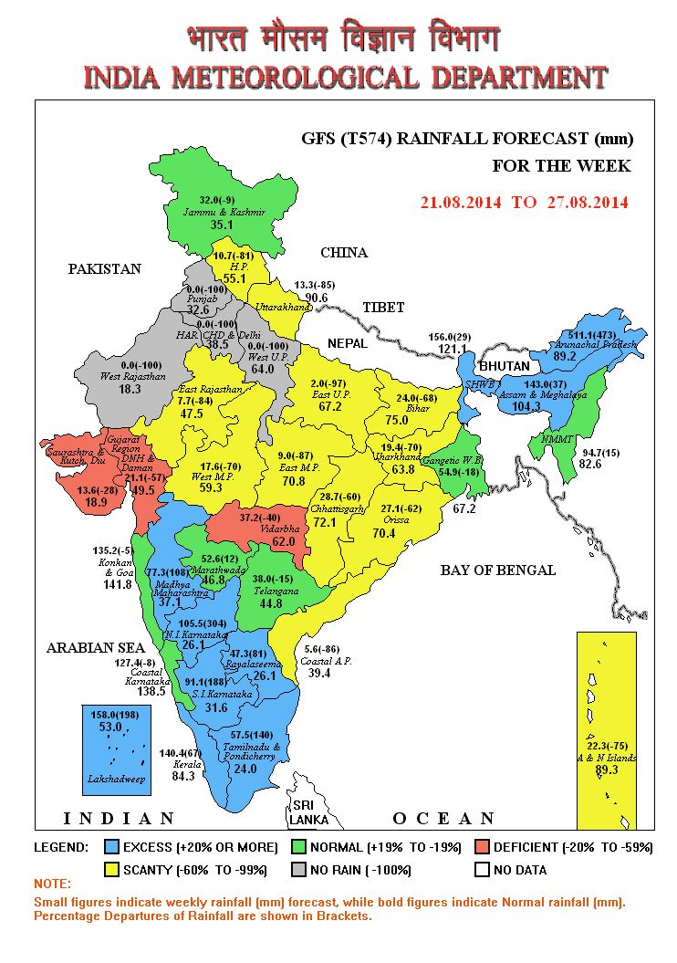
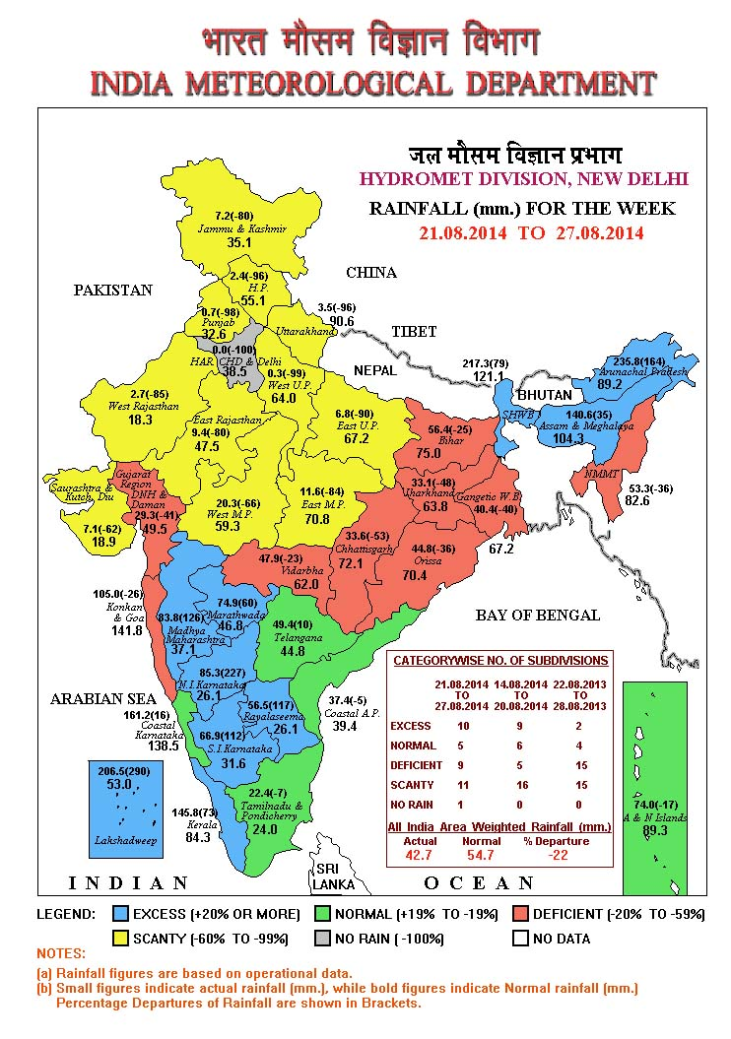
New Initiative: GFS 07 DAYS (WEEKLY) CUMULATIVE SUB-DIV. RAINFALL FORECAST

Slide 8
Radar Data Processing for Nowcasting
Radar data BUFR OPERA/NETCDF/IRIS format
DWR Data
Radar Data server
Data in IRIS format
512/256 Kbps VPN line
LAN- 100MBPS line
HPCS mounted on
NOWCAST Server -I
Radar data GTS headers
TRANSMET
LAN- 100Mbps line
NSSL-NETCDF format
LAN- 100 Mbps line
NWP models
ARPS/WRF
Quality controlled
NOWCAST Server –II
(processing by WDSS-II)

Slide 9
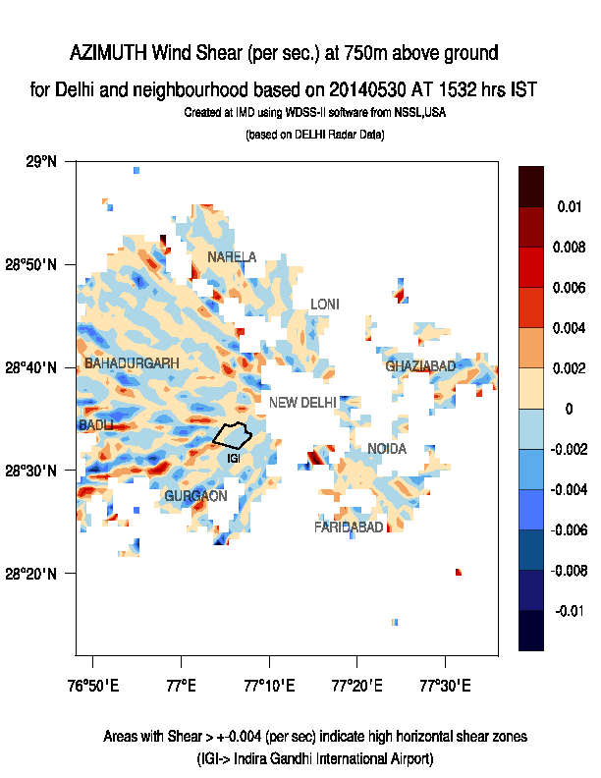
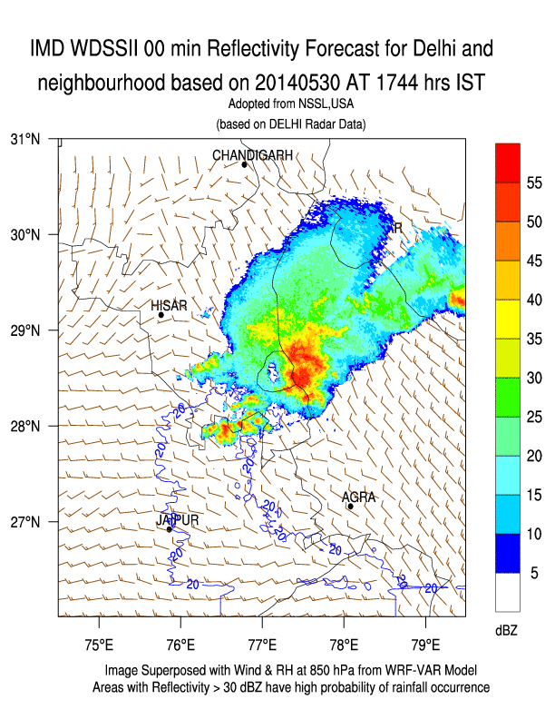
WDSS-II products for Metropolitan City Forecast and Aviation forecast (Single Radar Products)

Slide 10
Major Achievements during 2014-15

Slide 11
Major Achievements
Continuous efforts are made to update the data assimilation in GFS and WRF models by ingesting INSAT 3D AMV in GFS and MEGHA-TROPIQUES satellite SAPHIR Radiance (6 channel) INSAT 3D Imager (2 Channels) and Sounder (5 Channels) Radiance in WRF model.
Quality controlled multiple DWR data assimilation in WRF model started in experimental mode.
HWRF model made operational under MoES-NOAA TC Project for track and intensity prediction of tropical cyclones over NIO with 5-day lead time. Also statistical-dynamical models based MME Cyclone track, intensity prediction and genesis forecast based on GFS model provided during the cyclone situations.
Customised user specific NWP products generated for various services such as Agrometeorological, Hydrometeorological, Aviation and public weather services.
Utilization of NWP products from India and Global centres maximized for Improved Operational Weather forecast at various time scale.

Slide 12
Major Achievements
Improvement in Operational Cyclone Track forecast accuracy by 7.6 km per year and intensity forecast improved by about 20 kmph in past five years and Forecast lead time increased from 3 to 5 days.
Accurate prediction of Hudhud, Nilofer and other cyclonic storms and Region-wise Severe Weather Warnings. Advances in cyclone forecasting and warning is appreciated by Prime Minister address at the 102nd Indian Science Congress on 3rd January, 2015. Also on the occasion of Prawasi Bhartiya Diwas (7-9 Jan 2015) accurate cyclone forecasting is identified as one of the new order of S&T emerging from roots of Indian Knowledge.
Improved skill in operational short and medium range extreme events. Significant improvement in skill of operational forecasts and heavy rainfall warnings.
Nowcast for 130 cities using DWR data and SMS alert. Increased city Forecast to 310 cites, Tourist city Forecast from 87 to 107 destinations and validity of local forecast increased from 5 to 7 days.
District level weather forecast provided to 655 districts and block level weather forecast started experimentally for 6648 blocks. Agromet advisories through SMS and IVR technology are being disseminated to 8.13 million farmers in the country including other modes of dissemination like TV, Radio and Print media.

Slide 13
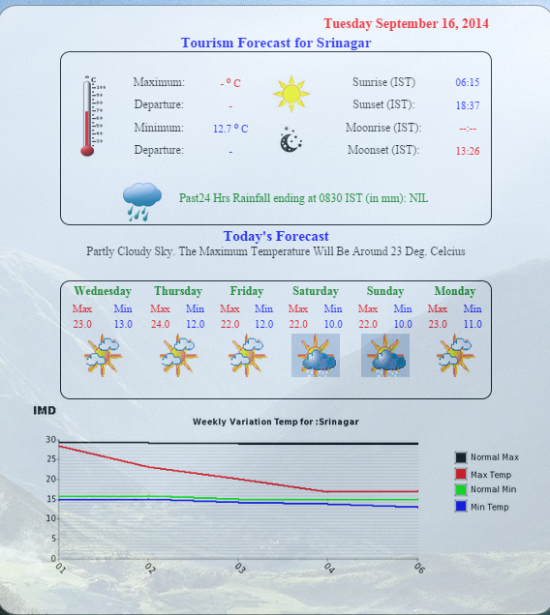
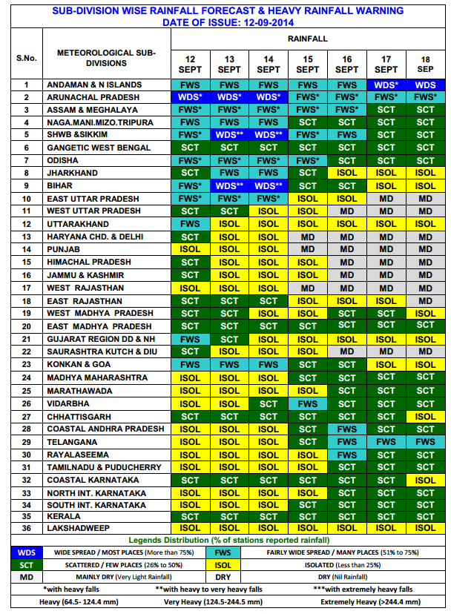
Increased city Forecast to 310 cites
Increased Tourist city Forecast from 87 to 107 destinations.
Validity of local forecast increased from 5 to 7 days.
Introduced 7 days meteorological subdivision-wise weather forecast & warnings in All India Weekly Weather Report and weekly monsoon press release during monsoon 2014

Slide 14
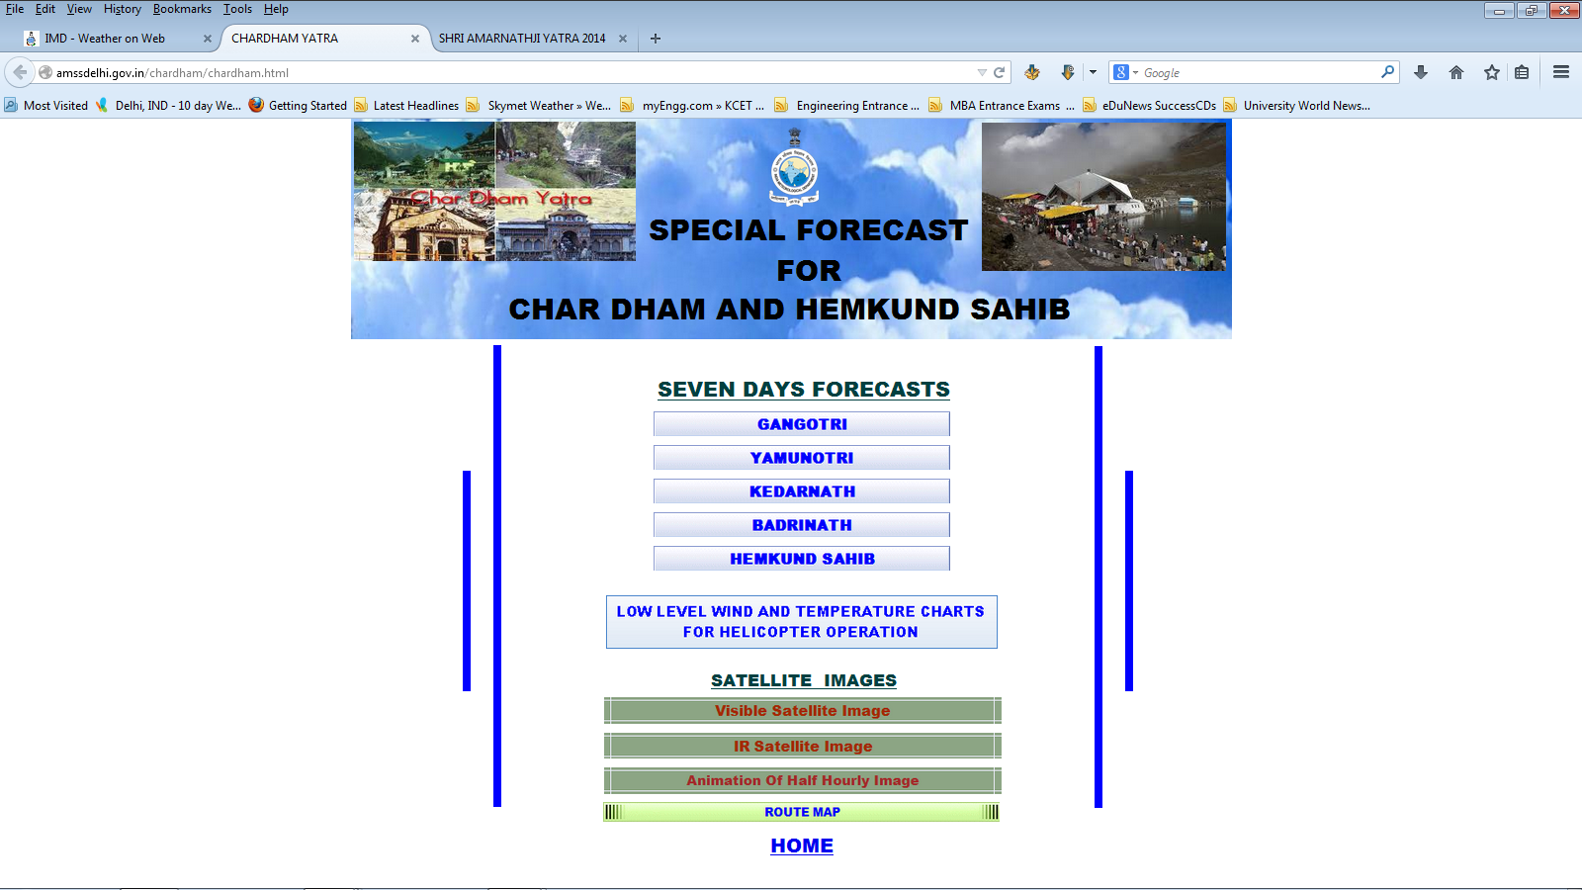
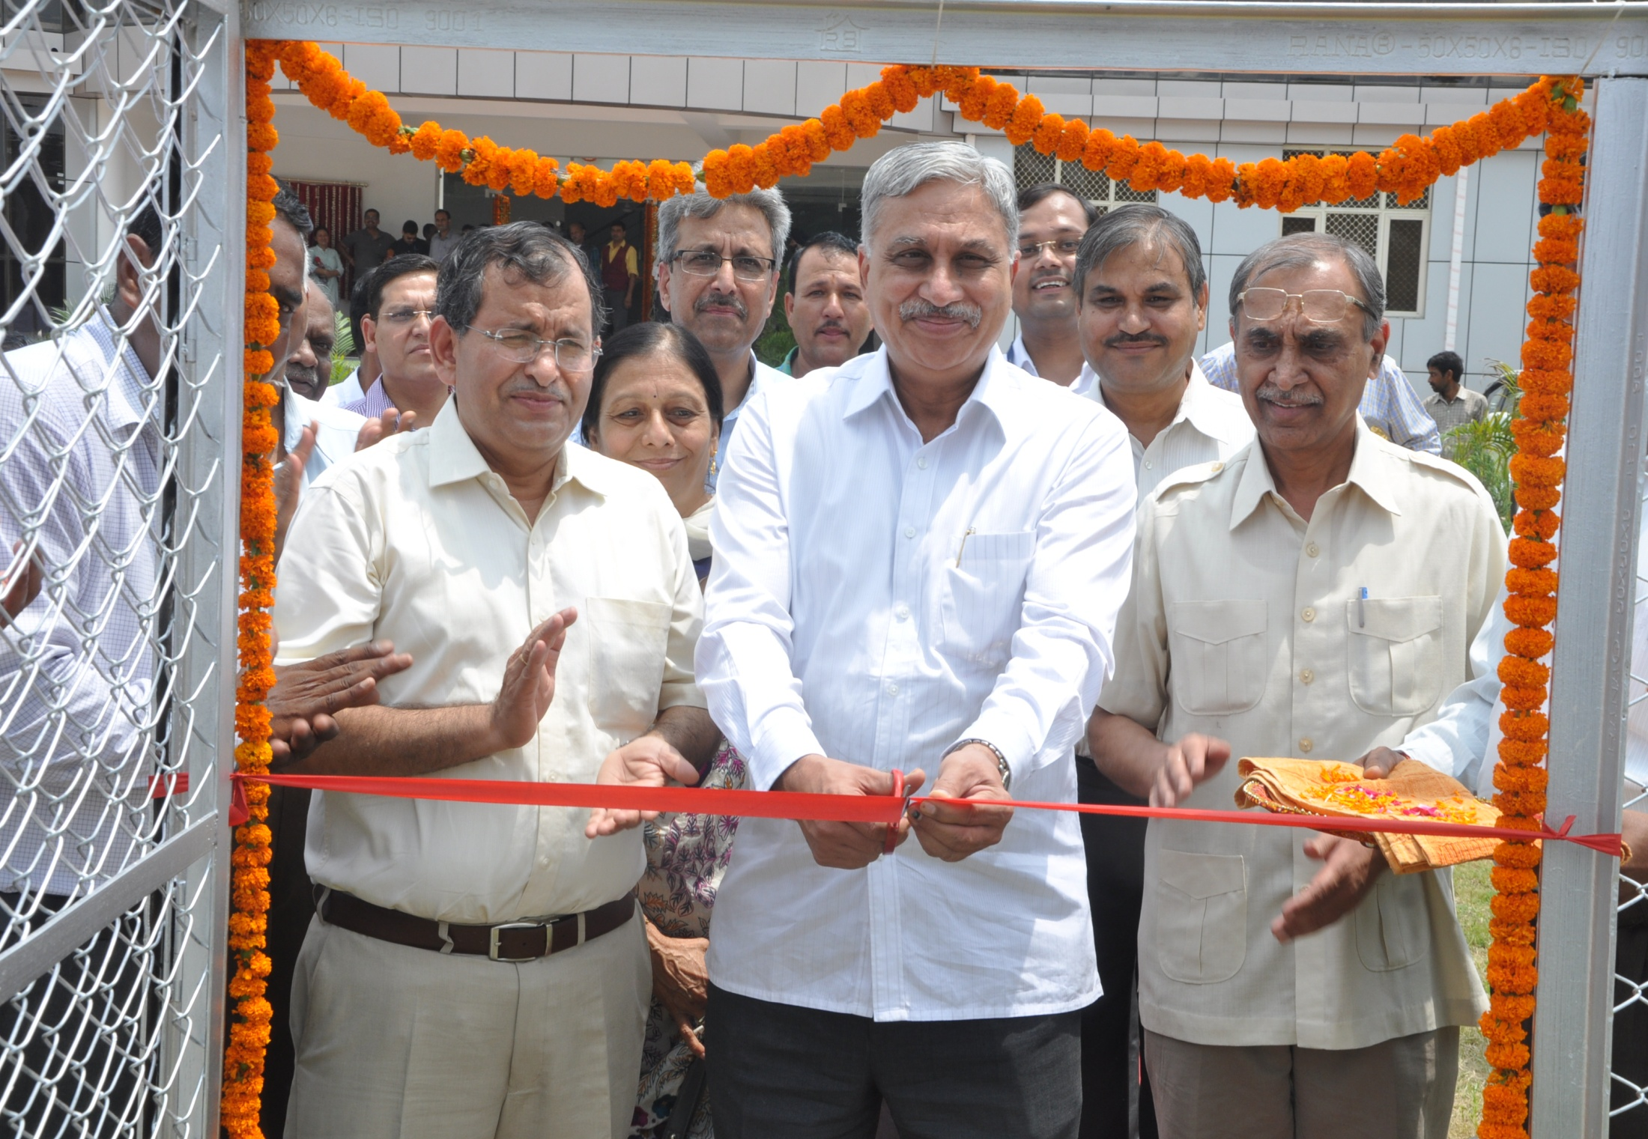
Special Forecasting Services
Special forecasting services for Chardham & Hemkund sahib .
Special forecast for Shri Amarnathji yatra issued and disseminated to users.
Issued mesoscale weather forecast for 15 High altitude stations of Uttarakhand to all concerned state Government authorities by SMS & emails.
New Infrastructure created in Dehradun

Slide 15
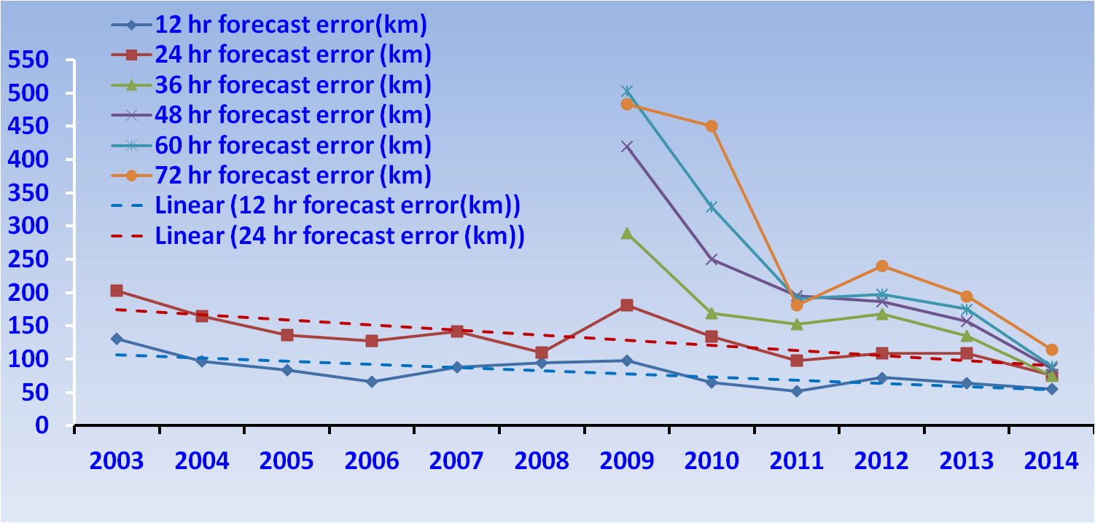
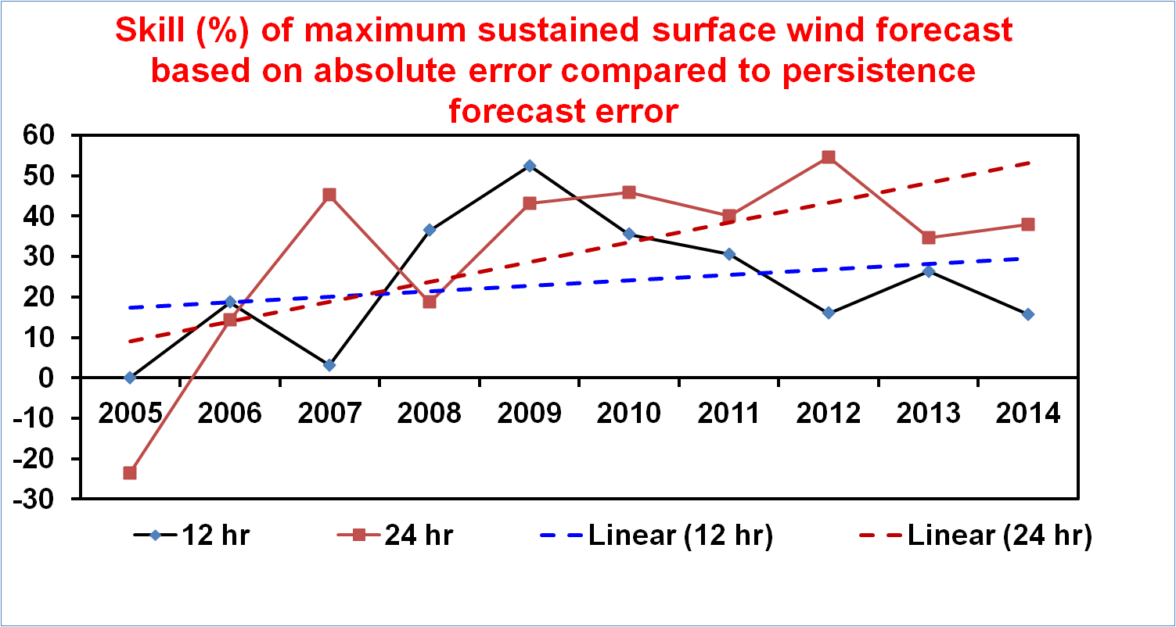
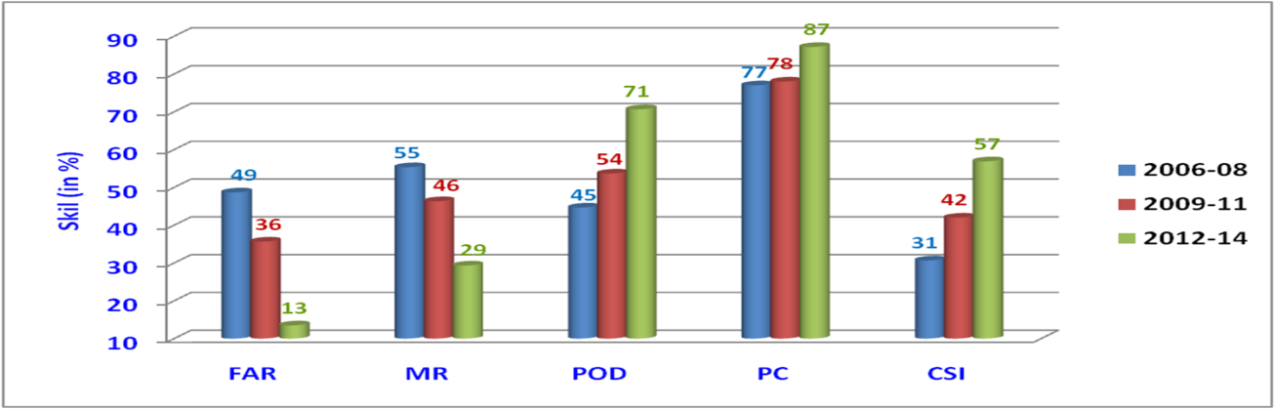
Operational tropical cyclone track forecast.
Heavy rainfall warning forecast skill (%)

Slide 16
Performance of NWP Models

Slide 17
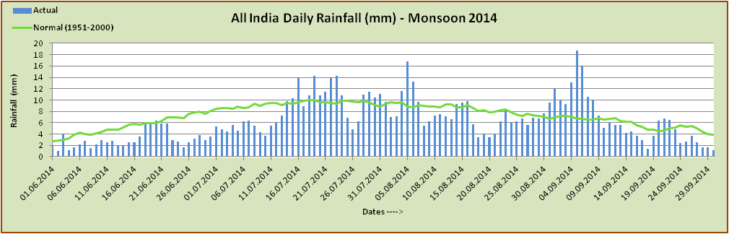
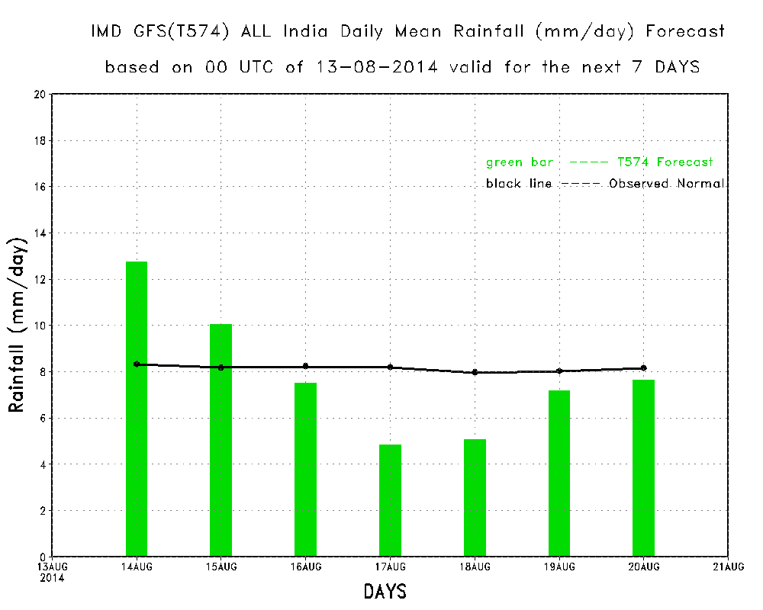
GFS All India daily mean rainfall for monitoring active/weak spell
New Initiative:
Generating all India Mean rainfall along with observed normal for monitoring Weak and active spells during monsoon periods.

Slide 18
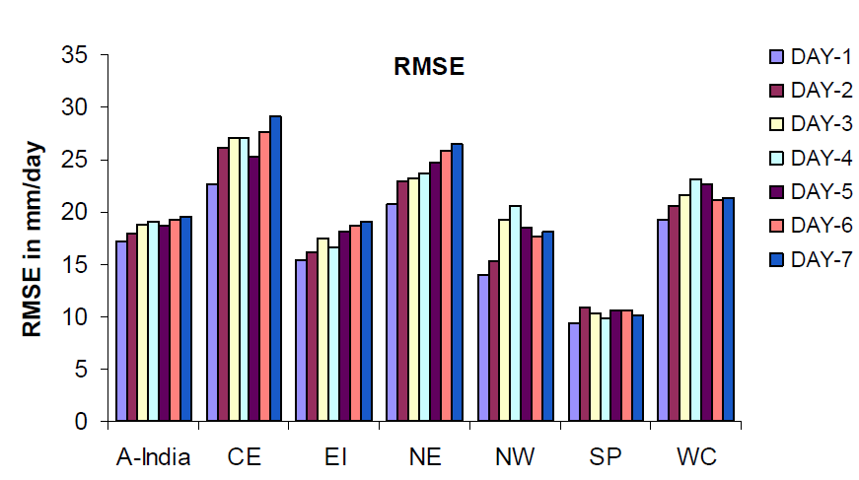
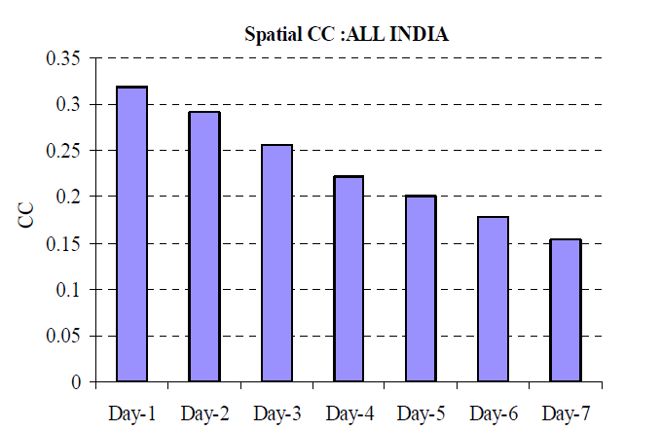
GFS Forecast - Monsoon-2013 Vs. 2014
Monsoon-2013
The comparison of GFS forecast during monsoon-2014 with monsoon-2013 shown, there is a significant improvement in monsoon rainfall special CC around 17% to 28% in day-4 to day-7. Similar significant reduction in RMSE in different homogeneous parts of the country except northeast India. This improvement is mainly due to the availability more observations from various new satellites.

Slide 19
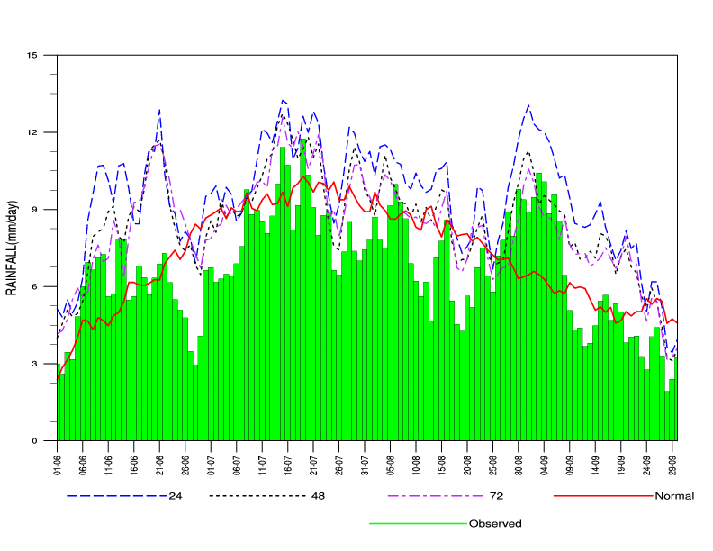
WRF Forecast - Monsoon- 2014
The daily time series of all India rainfall in 24 hour, 48 hour and 72 hour forecasts which are plotted along with observed and normal values of Monsoon – 2014
The active i.e. the peaks in the observed field has never been missed in the model forecasts, however, the model has larger tendencies to overestimate all India rainfall merely throughout the season compared to the obsered.

Slide 20
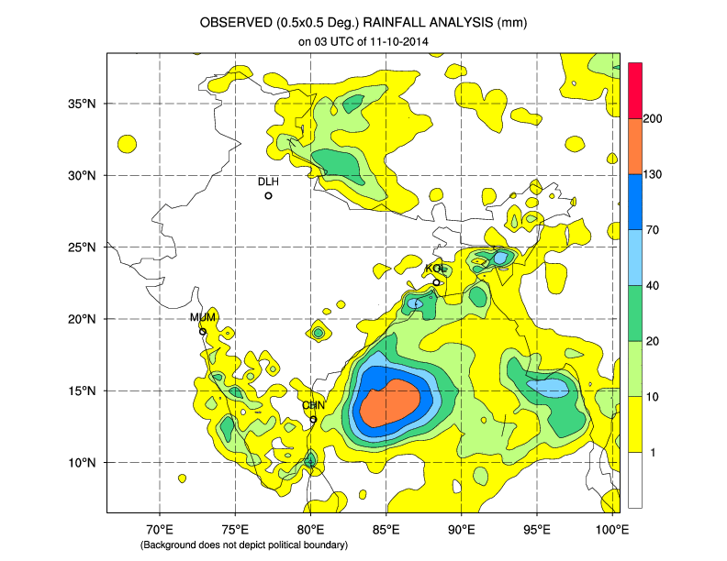
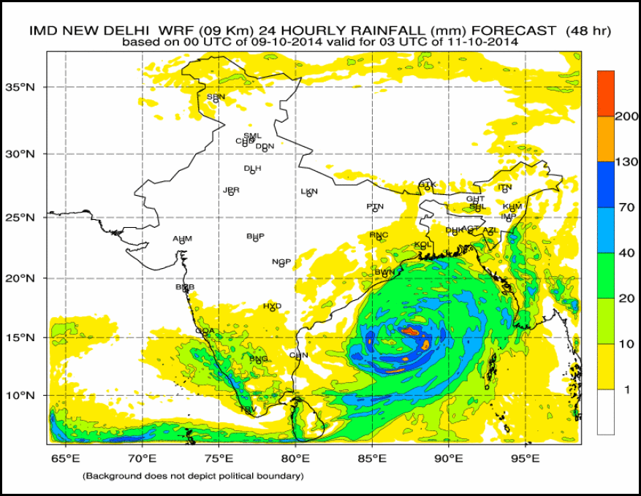
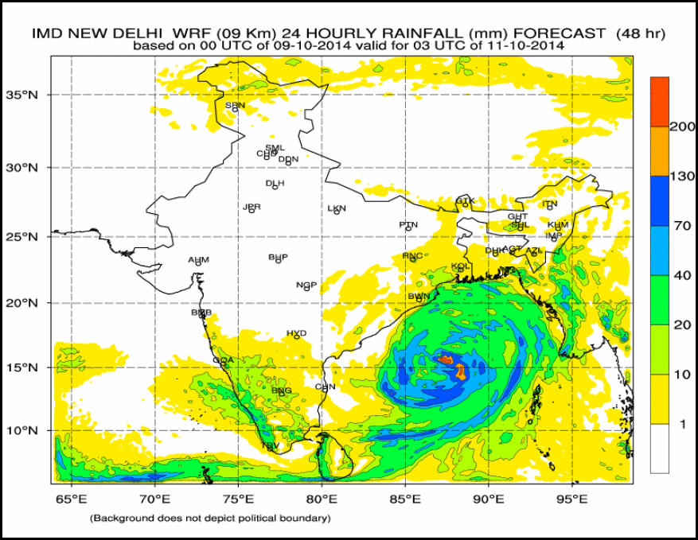
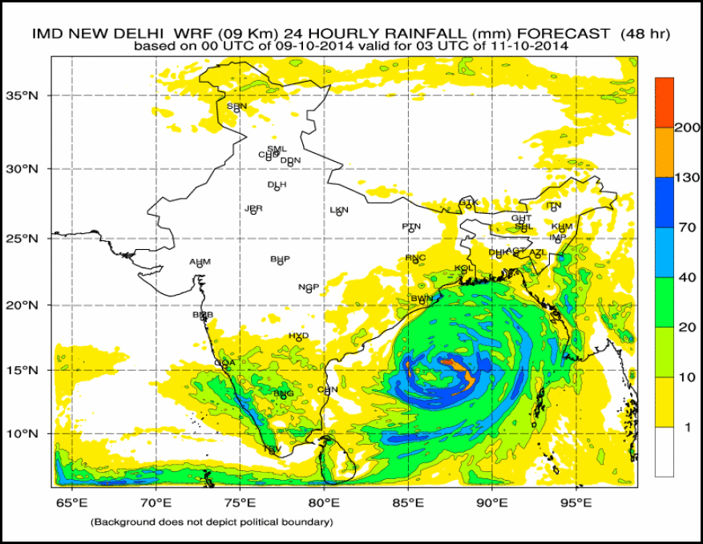
WRFDA Radiance Assimilation (Cyclone HUD HUD)
Day 2 FCST based on 00 UTC 09-10-2014
SAPHIR
OBSERVED
INSAT-3D + SAPHIR
INSAT-3D

Slide 21
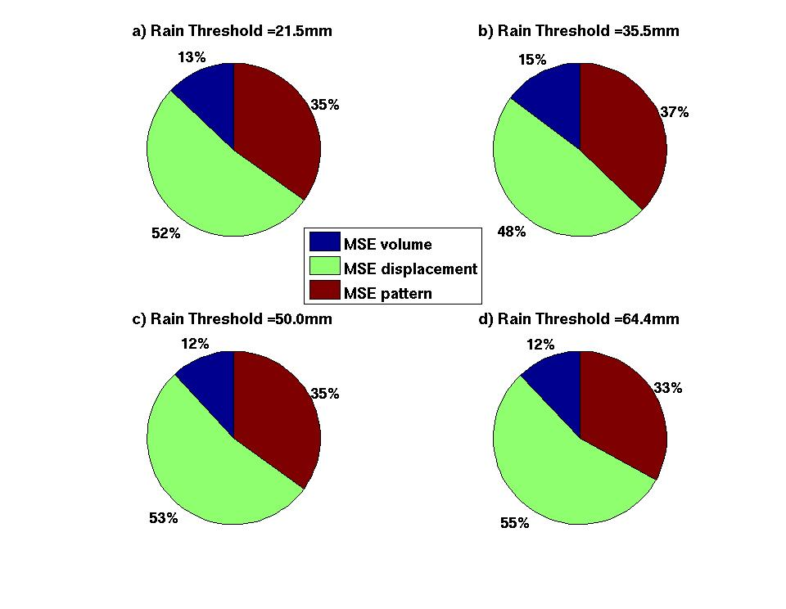
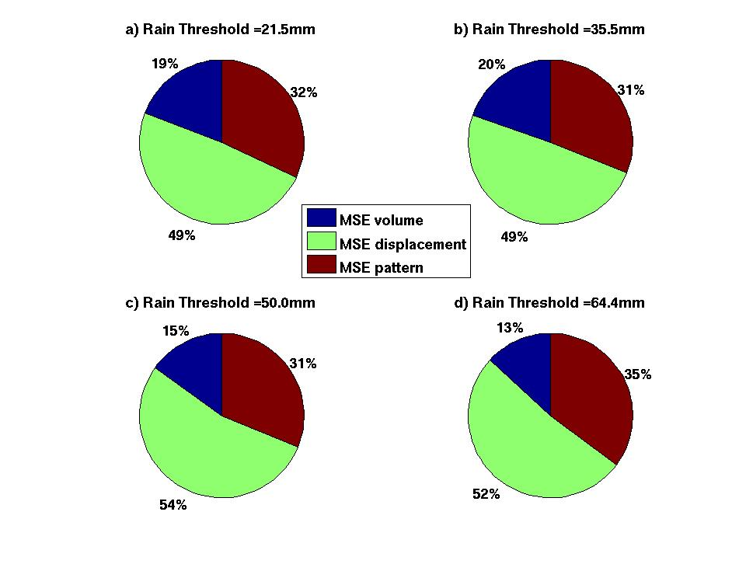
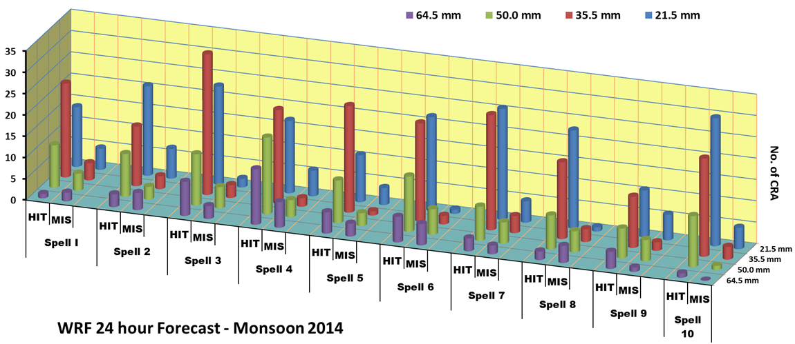
CRA(Continuous Rain Area) Method of Verification: Monsoon 2014
24 hour WRF Forecast
48 hour WRF Forecast

Slide 22
Tropical Cyclone Track Forecast Errors IMD - MME

Slide 23
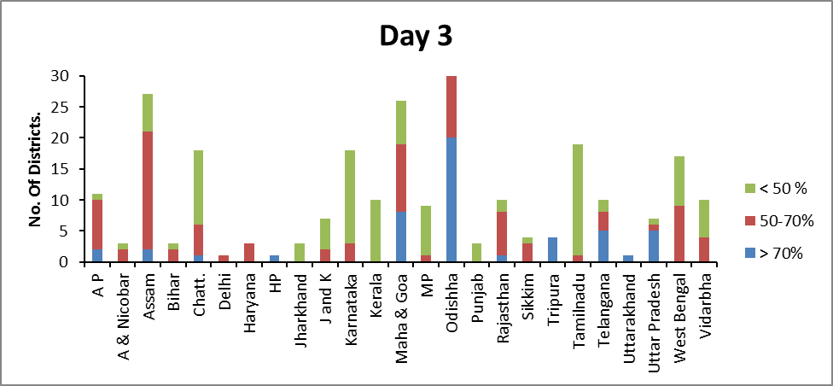
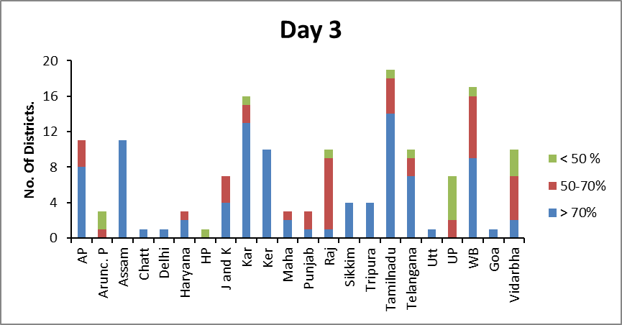
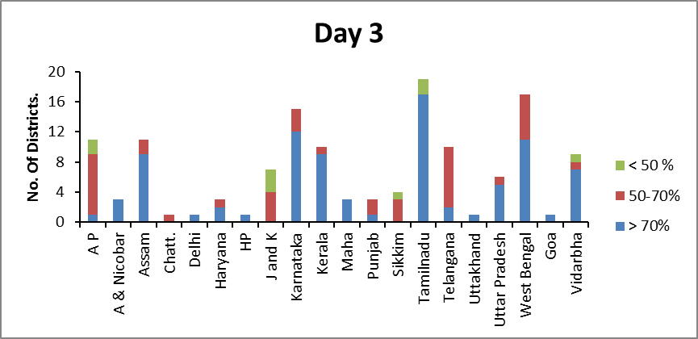
Rainfall (Monsoon season 2014)
Minimum Temperature (Winter season):
District level weather forecast (DLWF)
Qualitatively the model forecast for rainfall is able to predict correctly and capture the event in most of the regions of the country. Quantitatively the accuracy level varied for different regions.
Quantitatively the accuracy level still needs to be improved for some regions of the country, especially Southern (Karnataka, Kerala and Tamil Nadu) and Central India (Madhya Pradesh, Chhattisgarh and Vidarbha) as well as Jharkhand in eastern India.
Compared to rainfall forecast, the accuracy level of Temperature forecast is better for most of the States. However, Maximum Temperature forecast in Andhra Pradesh needs improvement.
There is need to improve forecast skill for fourth and fifth day.
Under the Monsoon Mission Programme, projects are undertaken by IMD for further development of comprehensive bias removal procedure.
Maximum Temperature (Pre monsoon season):

Slide 24
Future Plans

Slide 25
Future Plans
IMD initiated using new IBM HPC facilities at IITM, Pune for operational use through NKN CUC connectivity. These resources are 100 TFlop computing (300 nodes; 4800 processors) and 600 TB disk.
GFS model (T574/L64) and WRF model (27/9 km) installation completed at IITM HPC from analysis to 7-days/3-days forecast and product generation. A parallel system to the existing NWP system at IMD, New Delhi to be established at IITM, Pune by the end of February 2015 to optimize resources utilization to provide uninterrupted NWP product delivery for real-time utilization of NWP guidance.
GFS models upgradation with EnKF (80 mem) GSI analysis, WRF with 9/3 km resolution to cover over RSMC/India region to be taken up from March 2015 and Upgradation of GFS from T574 to T1534 compatible with NCEP modeling system to be taken up from November 2015 after validation of NCEP GFS T1534 model outputs for Indian region during the Monsoon – 2015.
HWRF model (27/9/3 km) installed at IITM, Pune computer. Ocean coupling to HWRF was in progress in collaboration with EMC/INCOIS to make operation from pre-monsoon cyclone season. We are planning to Customize the for high resolution Regional-coupled model to run for all the seasons with data assimilation, Ocean coupling including uniform verification for high impact weather.

Slide 26
Future Plans
Centralized Radar Data Processing for WDSS-II, ARPS and WRF model data assimilation to be implemented at IITM HPC. WDSS-II system to be made operational at remaining 9 DWR stations for Nowcast guidance.
Implementation of Physical Initialization in high resolution WRF model using DWR data for short range prediction of high impact weather and comprehensive bias removal procedure in GFS to be taken up under the Monsoon Mission Programme.
Development of High Impact Severe Weather Warning System with Mesonet Observation Test bed (Supersite) around NCR-Delhi and Eastern India (for Nor’westers) with various surface and upper air observation network including development of high resolution mesoscale model with assimilation of various observations for high impact weather forecast.

Slide 27
Update plans for NWP system
Year | 2014 (Existing) | 2015 | 2016 | 2017
Global Deterministic | GFS- T574/L64 (25km) GSI 3D var | GFS-T574/64L Hybrid EnKF (80 mem ensemble) | GFS-T1534/L64 (13km) Hybrid EnKF
Regional Deterministic | WRF - 27/9 km 38L 3D-Var(12 hr) | WRF-9/3km 51L Hybrid 3D Var (6hr) | WRF-9/3/1km 70L Hybrid 4dVar(3hr)
Cyclone Deterministic | HWRF - 27/9/3 km 42L GSI 3D-Var(12 hr) | HWRF - 27/9/3km 42L (Ocean coupling) Hybrid EnKF (6hr) | HWRF Atmospheric-Ocean coupled - 9/3/1km 70L Hybrid EnKF (3hr)
Local Deterministic | WRF - 3km 38L ARPS-9 km,WDSS-II Nowcast Products | WRF- 3/1km 70L (Semi operation) ARPS-3km,WDSS-II Nowcast Products | WRF - 3/1 km 70L (operational) ARPS-1km,WDSS-II Nowcast Products | WRF - 1km 70L ARPS-1km,WDSS-II Nowcast Products

Slide 28
Thank You

Slide 29
Operational Long Range Forecasting
D. S. Pai

Slide 30
Operational Long Range Forecasts Issued by ESSO-IMD
Sr. No. | Forecast for | Region for which forecast issued | Issued in
1 | Winter Season (Jan- March) Precipitation | Northwest India | December
2 | SW Monsoon Season (June to September) Rainfall | Country as a whole | April
3 | SW Monsoon Season (June to September) Rainfall | Country as a whole | June
4 | South-West Monsoon Onset | Kerala | May
5 | SW Monsoon Season (June to September) Rainfall | Four broad geographical regions: Northwest India, Northeast India , Central India and South Peninsula | June
6 | SW Monsoon Monthly Rainfall for July and August | Country as a whole | June
7 | SW Monsoon Second half of the Season (August- September) Rainfall | Country as a whole | July
8 | September Rainfall | Country as a whole | August
9 | NE Monsoon Season (October to December) Rainfall | South Peninsula | September
The operational forecasts are issued using statistical method

Slide 31
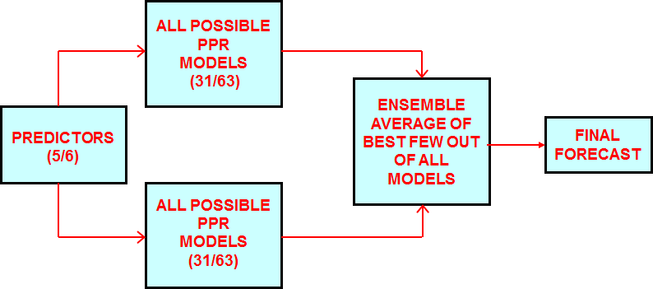
Ensemble Forecasting System for Seasonal Rainfall over Country as a whole:
S.No | Predictor Used | Issued in
1 | Europe Land Surface Air Temperature Anomaly (January) | April
2 | Equatorial Pacific Warm Water Volume (February + March) | April
3 | SST Gradient Between Northeast Pacific and Northwest Atlantic (December +January) | April and June
4 | Equatorial SE Indian Ocean SST (February) | April and June
5 | East Asia Mean Sea Level Pressure (February + March) | April and June
6 | Central Pacific (Nino 3.4) Sea Surface Temp.Tendency (MAM-DJF) | June
7 | North Atlantic Mean Sea Level Pressure (May) | June
8 | North Central Pacific Zonal Wind Gradient 850 hPa (May) | June
Schematic Diagram
The average of the ensemble forecasts from best out of all possible MR (multiple regression) and PPR (projection pursuit regression) models gives the final forecast.
31

Slide 32
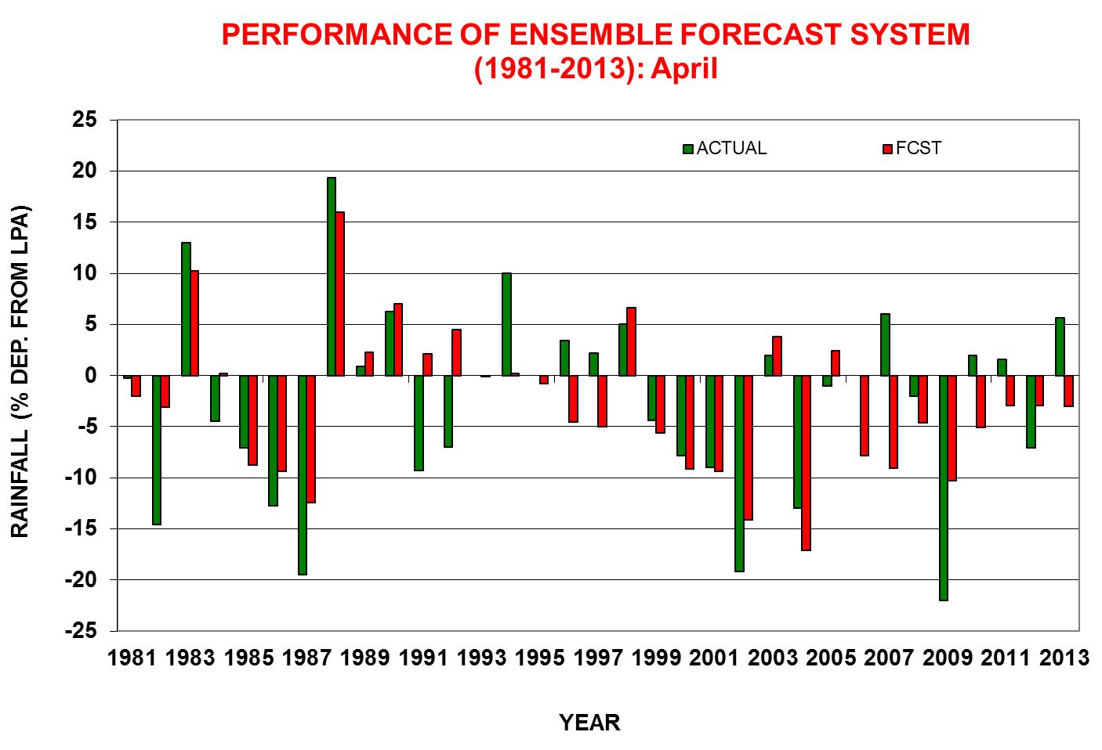
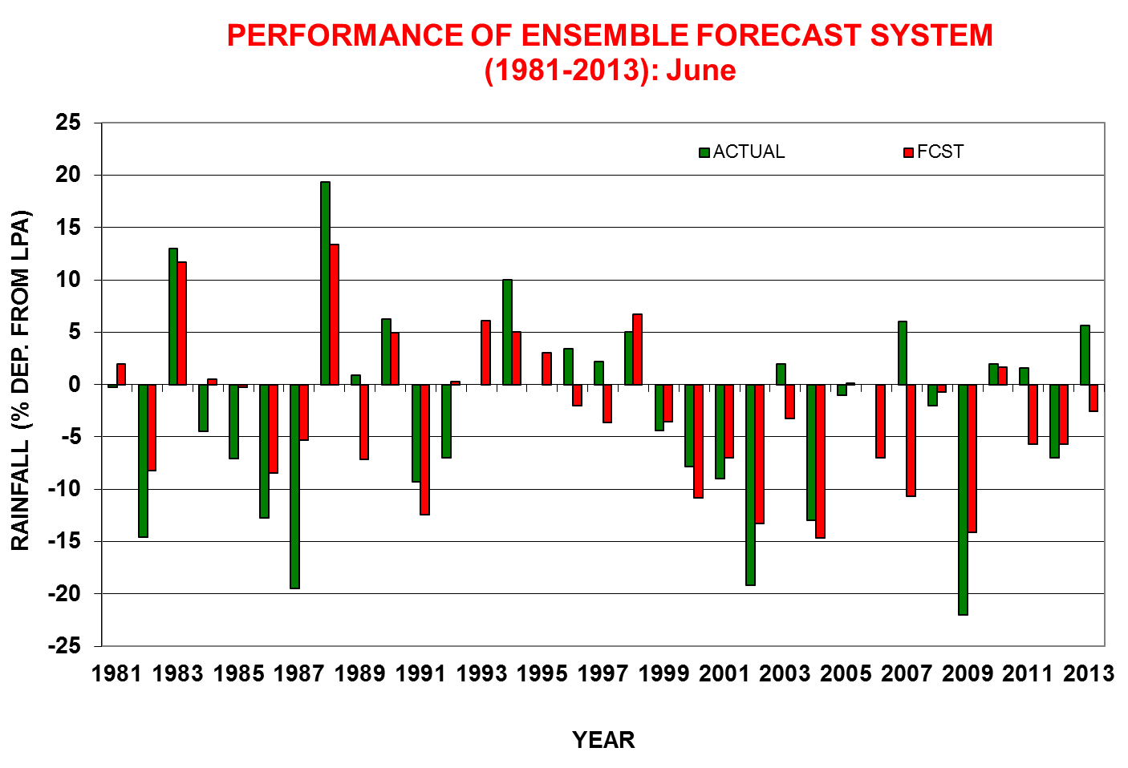
RMSE (1981-2013) = 6.47% of LPA
RMSE (1981-2013) = 6.2% of LPA

Slide 33
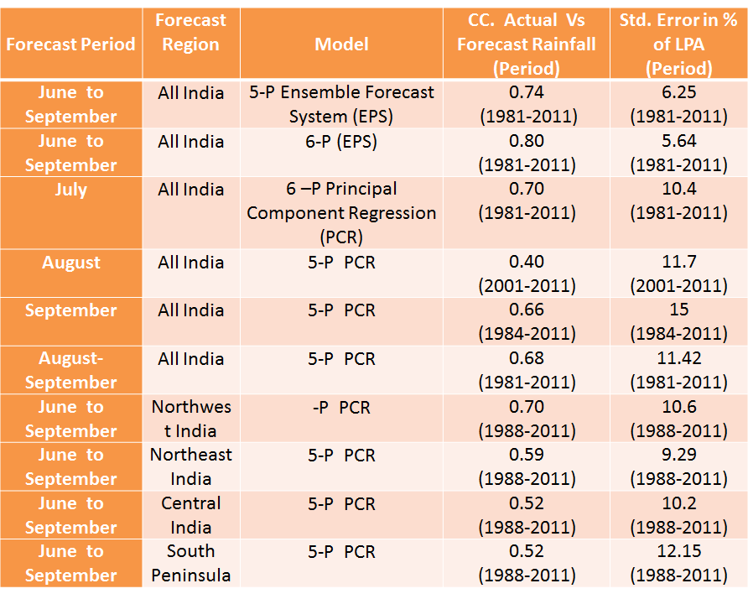
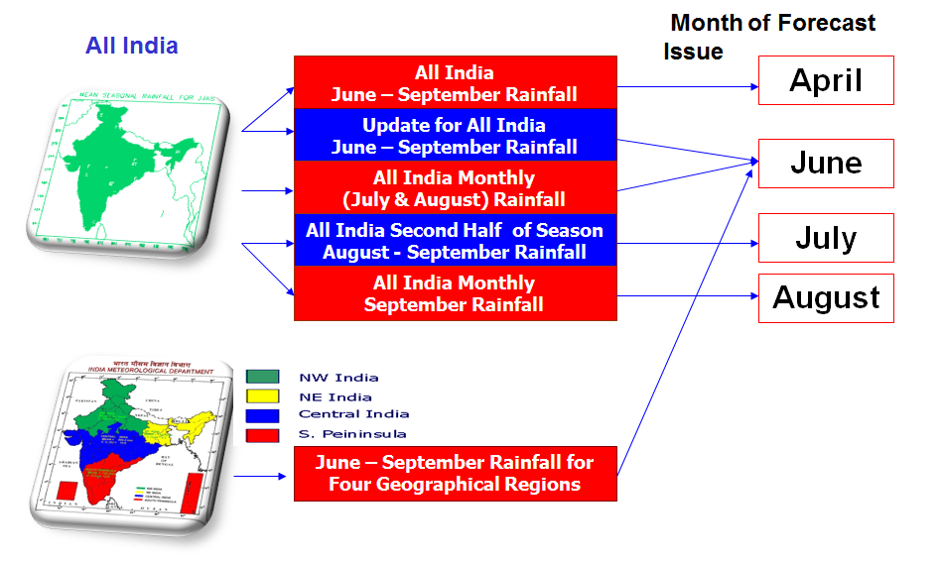
Skill of the statistical models currently used for the operational LRF of Monsoon Rainfall over India

Slide 34
Verification of Operational Long Range Forecasts for the 2014 Southwest Monsoon Rainfall
Region | Period | Forecast(% of LPA) |  |  | Actual Rainfall (% of LPA) Till 28th Sep, 2014
 |  | 24th April | 9th June (1st Update) | 12th August (2nd Update)
All India | June to September | 95 ± 5 | 93 ± 4 | 87 ± 4 | 88
Northwest India | June to September |  | 85 ± 8 | 76 ± 8 | 79
Central India | June to September |  | 94 ± 8 | 89 ± 8 | 90
Northeast India | June to September |  | 99 ± 8 | 93 ± 8 | 88
South Peninsula | June to September |  | 93 ± 8 | 87 ± 8 | 93
All India | July |  | 93 ± 9 |  | 90
All India | August |  | 96 ± 9 | 96 ± 9 | 90
All India | August to September |  |  | 95 ± 8 | 98
The season rainfall over the country as a whole and that over four broad geographical regions (northwest India, central India, northeast India and south Peninsula) were within the limits of the forecasts updated in August and accurate. Similarly, the forecasts for the monthly rainfall (for July and August) as well as that for the rainfall during the second half of the monsoon season over the country as a whole were also accurate.

Slide 35
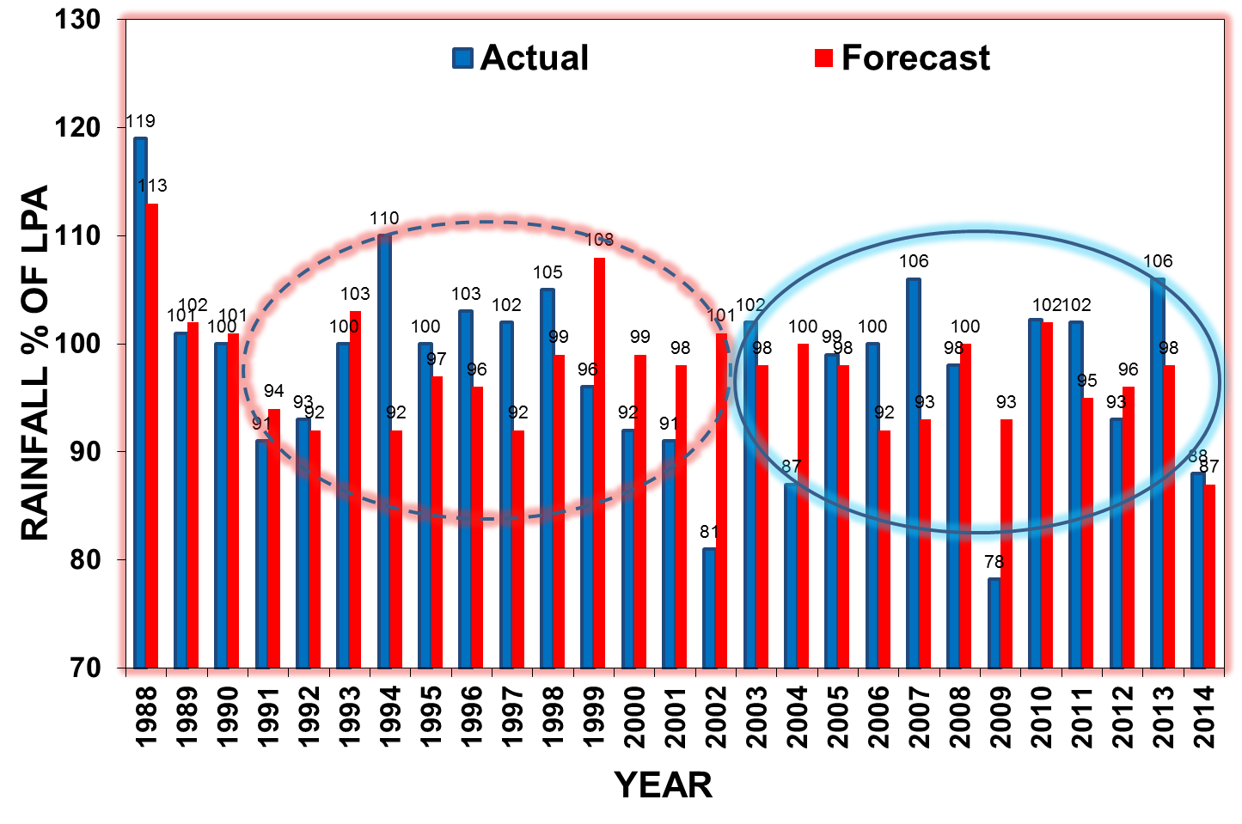
Performance of Operational Forecast (Empirical Model) for All India Seasonal Rainfall (1988-2014):
During 7 years error was ≥ 10% with highest during 2002 (20%) and 1994 (18%). Error during 2009 was 15%.
Average Abs Error of Op. forecasts (1988-2014) =6.67% (1991-2002)= 8.08% of LPA & 2003-2014=6.25% of LPA).
During 1991-2002, the forecast was within the ±8% of actual values during 8 years. with forecast within ±4% of actual values during 4 years.
During 2003-2014, the forecast was within the ±8% of actual values during 9 years. with forecast within ±4% of actual values during 6 years.

Slide 36
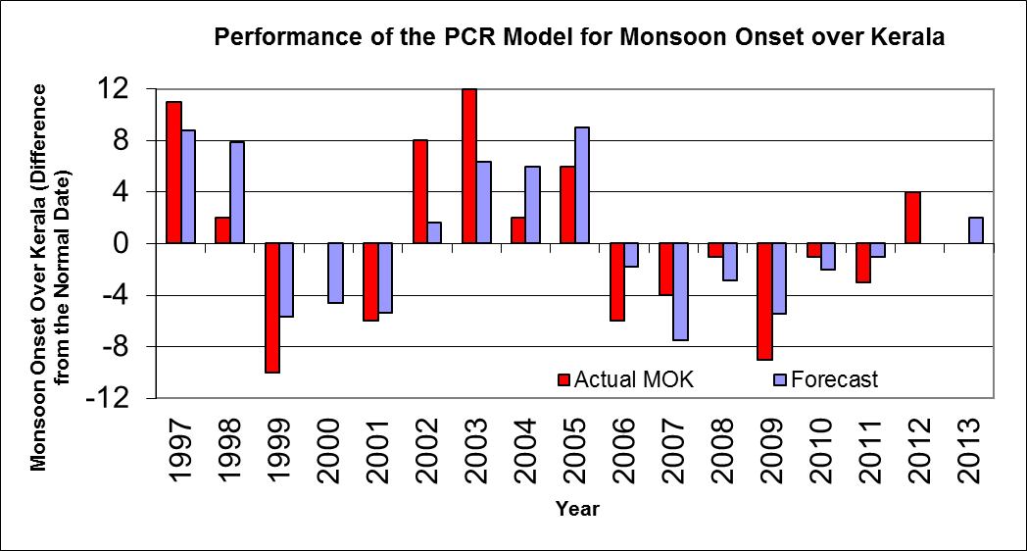
PCR model for the Forecasting date of Monsoon onset over Kerala
No | Name of Predictor | Period | C.C(1975- 2000)
1 | Zonal Wind at 200hpa over Indonesian Region | 16th -30th Apr | 0.48
2 | OLR Over South China Sea | 16th- 30thApr | 0.40
3 | Pre-Monsoon Rainfall Peak Date | Pre-monsoon April-May | 0.48
4 | Minimum Surface air Tem. over NW India | 1st -15th May | -0.37
5 | Zonal Wind at 925hpa over Equatorial South Indian Ocean | 1st -15th May | 0.52
6 | OLR Over Southwest Pacific | 1st -15th May | -0.53
Model error= 4 days
Year | Actual Onset Date | Forecast Onset Date
2005 | 7th June | 10th June
2006 | 26th May | 30th May
2007 | 28th May | 24th May
2008 | 31st May | 29th May
2009 | 23rd May | 26th May
2010 | 31st May | 30th May
2011 | 29th May | 31st May
2012 | 5th June | 1st June
2013 | 1st June | 3rd June
2014 | 6th June | 5th June
The forecast issued for monsoon onset over Kerala have been within the forecast limits and accurate for all the last 10 years (since 2005 when the forecast for the event was started)

Slide 37
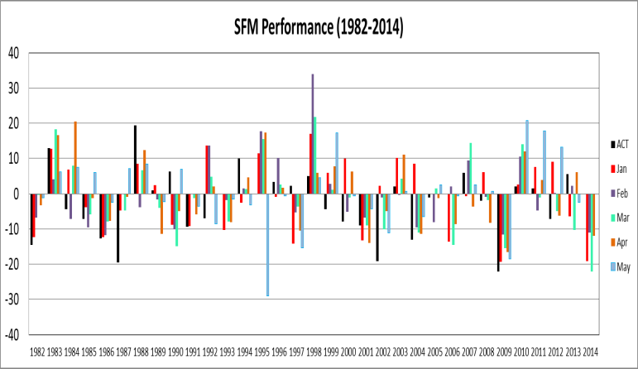
ESSO- IMD’s Experimental LRF System based on
Seasonal Forecast Model (SFM)
Initial conditions of first 10 days of each month (NCEP reanalysis)
Model run for 5 months. For monsoon season - ‘0’ lag to ‘5 months’ lag
IMD SFM
10 members
from each IC
Forecasted SST from NCEP CFSV2 as boundary conditions (40 ensemble member from first 10 days)
The model showed some useful skill for the monsoon season during hindcast mode (1982-2011).

Slide 38
Skill of ESSO- IMD SFM for forecasting monthly and season rainfall over the country as a whole at different lead times: 1982-2011
Forecast issued in | JUN |  | JUL |  | AUG |  | SEP |  | JJAS |  | AUG-SEP
 | C.C | RMSE | C.C | RMSE | C.C | RMSE | C.C | RMSE | C.C | RMSE | C.C | RMSE
January (CFS Jan SST) | -.07 | 21 | -0.01 | 16 | 0.43 | 12 | 0.20 | 22 | 0.33 | 9 | 0.35 | 13
February (CFS Feb SST) | 0.06 | 19 | -0.01 | 16 | 0.31 | 11 | 0.41 | 18 | 0.34 | 9 | 0.49 | 9
March (CFS MAR SST) | 0.04 | 20 | 0.31 | 15 | 0.27 | 14 | 0.39 | 16 | 0.50 | 8 | 0.52 | 10
April (CFS APR SST) | 0 | 19 | 0.15 | 15 | 0.36 | 12 | 0.41 | 18 | 0.46 | 9 | 0.51 | 11
May (CFS MAY SST) | -0.2 | 21 | 0.27 | 16 | 0.09 | 14 | 0.16 | 22 | 0.33 | 9 | 0.29 | 12
JUN (CFS JUN SST) | - | - | 0.37 | 13 | 0.05 | 14 | 0.22 | 21 | - | - | 0.28 | 12
JUL (CFS JUL SST) | - | - | - | - | 0.28 | 13 | 0.44 | 18 | - | - | 0.45 | 11
AUG (CFS AUG SST) | - | - | - | - | - | - | 0.32 | 19 | - | - | - | -

Slide 39
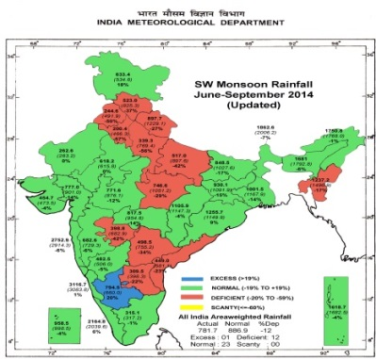
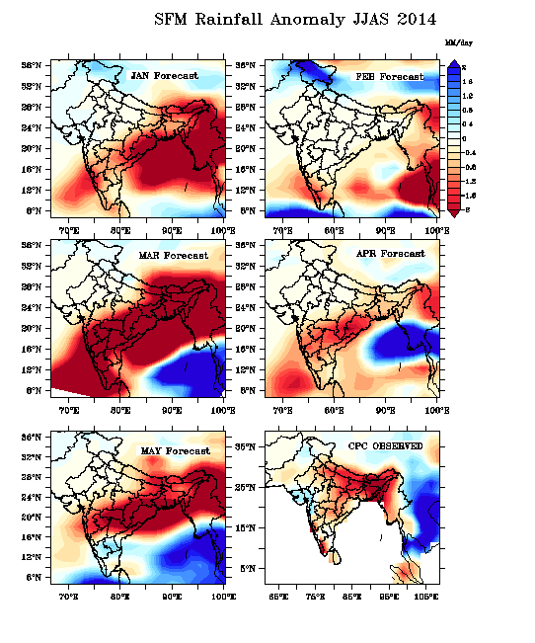
IMD SFM Forecast For 2014
Forecast issued in | Forecast: All India Rainfall (% of LPA)
 | Jun | Jul | Aug | Sep | June - Sep | Aug-Sep
January | 108 | 83 | 77 | 54 | 81 | 71
February | 93 | 89 | 92 | 68 | 89 | 85
March | 105 | 75 | 71 | 55 | 78 | 70
April | 110 | 103 | 83 | 73 | 88 | 83
May | 99 | 83 | 79 | 84 | 85 | 84
June | - | 90 | 106 | 150 | - | 124
July | - | - | 97 | 97 | - | 97
Actual | 58 | 90 | 91 | 108 | 88 | 98

Slide 40
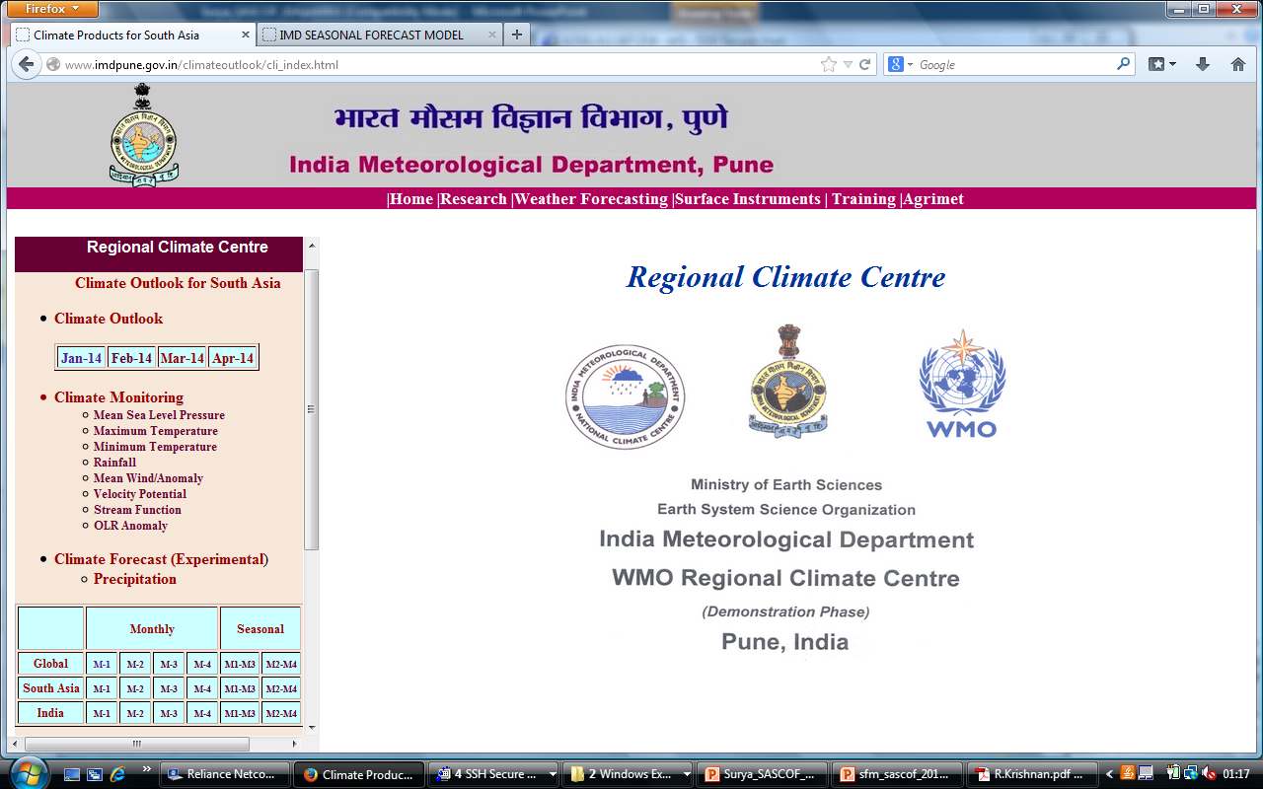
Other Activities: Products Based on IMD SFM
The experimental monthly and seasonal global forecasts of temperature and rainfall for the next four months were prepared by 15th of every month using IMD SFM model and were made available through IMD New Delhi and Pune website.
The monthly and season al forecasts for south Asian region were also provided through IMD, Pune website under Regional Climate Center activity. Under this activity, seasonal outlook of rainfall and temperature for south Asia were prepared uploaded in the IMD, Pune website.
The model forecasts were also regularly provided to ERPS group of IIT, Delhi for preparing subdivision wise monthly and seasonal forecasts.
in in the following link
http://www.imdpune.gov.in/climateoutlook/cli_index.html

Slide 41
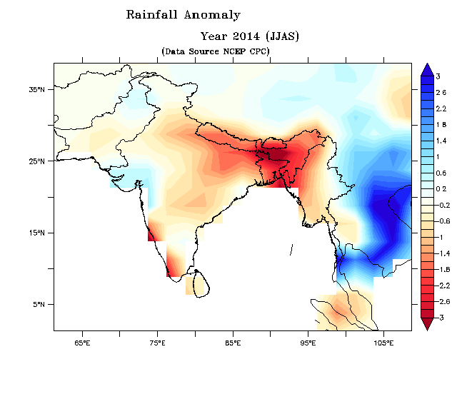
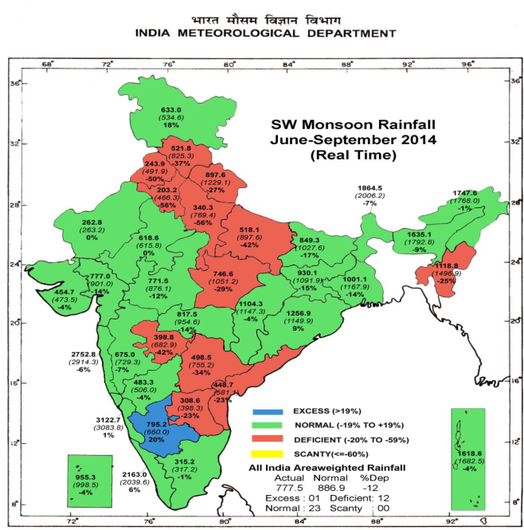
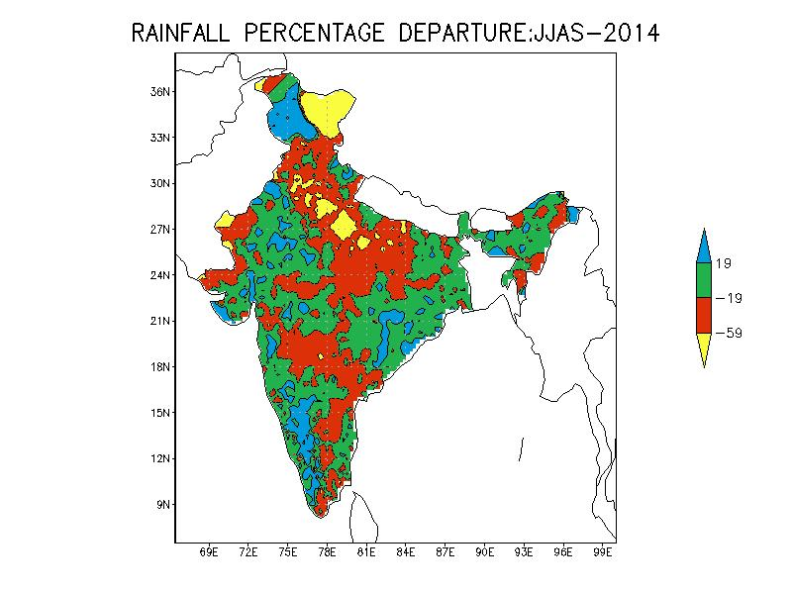
Consensus Forecast for South Asia - 2014
Below-normal to normal rainfall is most likely during the 2014 summer monsoon season (June – September) over south Asia as a whole. Below-normal rainfall is likely over broad areas of western, central and southwestern parts of South Asia and some areas in the northeastern-most parts of the region. Normal rainfall is likely over broad areas of northwestern and eastern parts and some island areas in the southernmost parts of the region.

Slide 42
Future Plans
For further improvement of forecasting system, a review of the existing operational models will be carried out and modifications will be included wherever necessary.
Preparation of skill score maps as per WMO standard verification system for IMD dynamical LRF system based on AGCM (SFM) for monthly and seasonal forecast for throughout the year.
Analysis of IITM CFSV2 hindcast and forecasts for developing a dynamical forecasting system to generate monthly and seasonal forecast for rainfall and temperature for India and other south Asian countries throughout the 12 months of the calendar year.
Notes:
The main obstable is the suitable man power

Slide 43
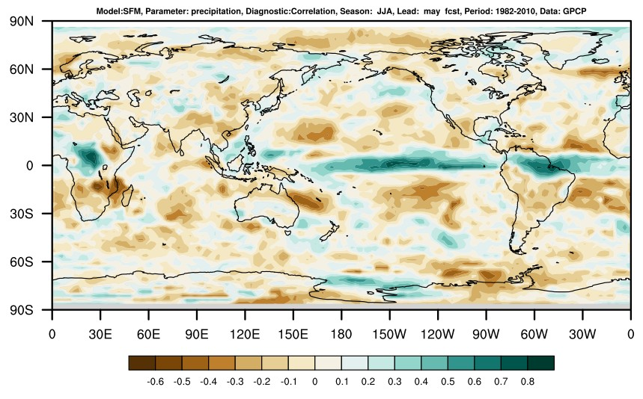
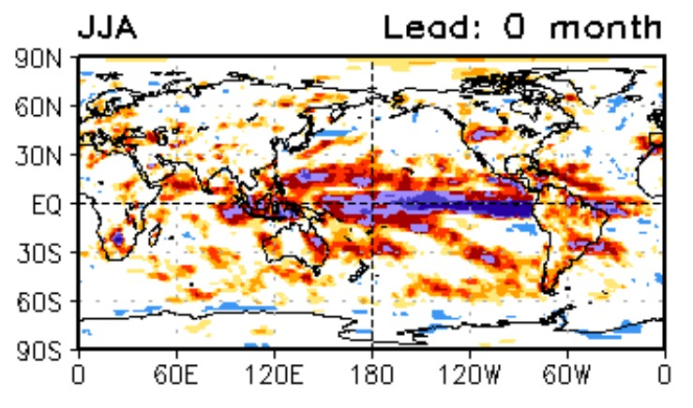
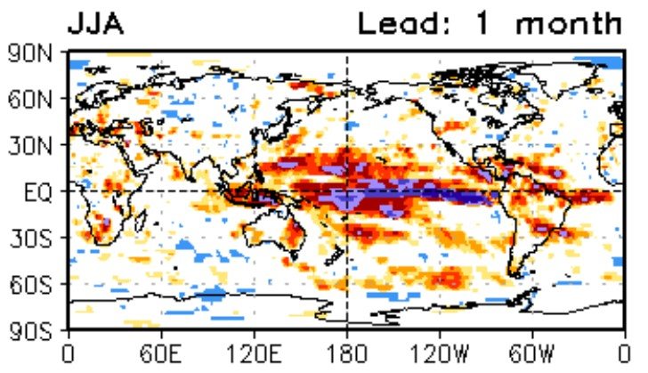
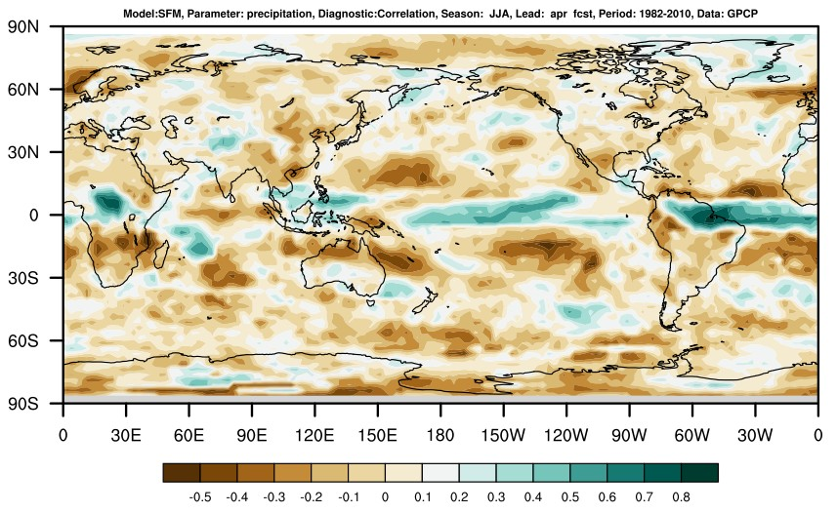
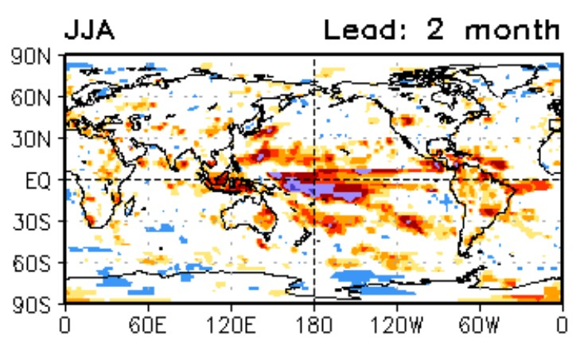
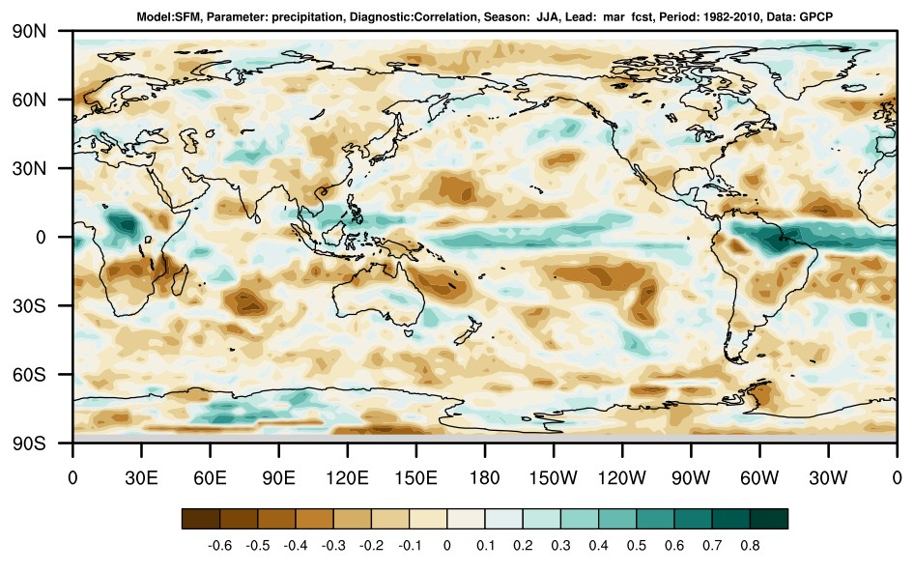
Forecast and Observed Correlation JJA

Slide 44
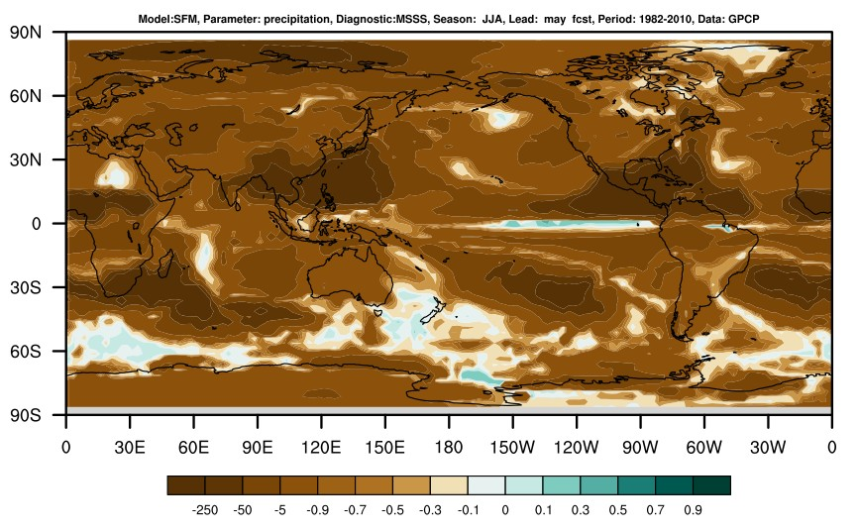


Mean Squared Skill Score (MSSS)
Lead_0
Lead_1
Lead_2

Slide 45



Mean Squared Skill Score (MSSS1)
Lead_0
Lead_1
Lead_2

Slide 46



Mean Squared Skill Score (MSSS2)
Lead_0
Lead_1
Lead_2

Slide 47



Mean Squared Skill Score (MSSS3)
Lead_0
Lead_1
Lead_2

Slide 48

Thank you
48

