Slide 1

Experimental Extended Range Forecasts
Dr. A. K. Sahai
Extended Range Prediction Group
Indian Institute of Tropical Meteorology, Pune – 411 008, INDIA
E-mail: sahai@tropmet.res.in
Contributors: S. Abhilash, S. Joseph, R. Chattopadhyay, N. Borah, S. Sharmila, R. Mandal, A. Dey
Notes:
1

Slide 2
IITM strategy for Extended Range Prediction using NCEP CFSv2
(15-20 day prediction) or
3-4 pentad prediction

Slide 3
Highlights: Development Work
Indigenous method for generating Ensemble forecast has been developed.
Developed bias correction technique in CFSv2 forecasted SST to force stand-alone GFSv2
A rigorous verification scheme of CFSv2/GFSv2bc forecast has been developed.
Operational implementation has been done for monitoring large scale low-frequency Monsoon Intraseasonal Oscillation (MISO) in real-time.
Developed a criterion for forecasting monsoon onset over Kerala (MOK).
Operational requirements are given priority in generating the forecast and data dissemination.

Slide 4
Time Line of development of IITM ERPS using CFSv2
2011: Perturbation Technique developed
2012: SST Bias Correction strategy implemented
2013: High Resolution T382 implemented
2014: MME

Slide 5
EPS Strategy for real-time prediction
Model | Resolution | Forecast Lead | Hindcast period
CFSv2 | T126~100km | 45 days (11 member) | 2001-2012 (16May, 21May,….,28Sep. Total 28 start dates after every 5 day in one year during monsoon season)
CFSv2 | T382~35km | 45 days (11 member) | -do-
GFSv2bc (Forced by Bias corrected CFSv2 SST) | T126 | 25 days (21 member) | -do-

Slide 6
Inter-annual variation in skill of individual models
CFS
As far as Users are concerned, Forecast consensus is very much Important
GFSbc
When forecasts were given from CFS126 and GFSbc independently, at times, both the models gave consistent forecast and some times, they differ.
Notes:
6
6
6
6
6
6
6

Slide 7
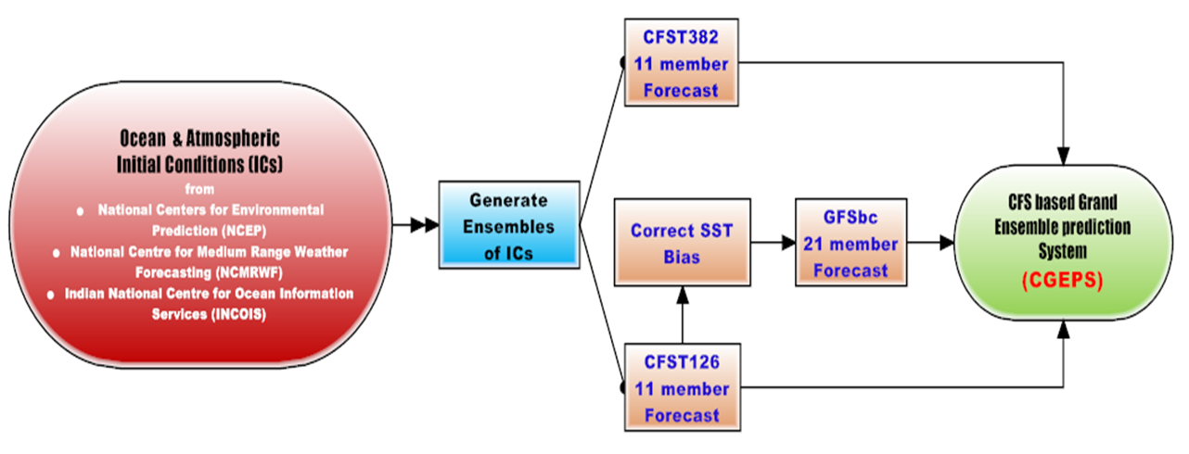
Generation of Multi-model Ensemble (MME) Forecasts from CFS Grand Ensemble Prediction System (CGEPS) using CFST126, CFST382 & GFSbc
For forecast consensus, MME has been formulated from CGEPS using 21 ensembles of GFSbc, 11 ensembles each of CFS126 and CFS382.
Hence, total 43 ensemble members were produced independently from 3 variants of CFS model to generate the CGEPS and forecast consensus is done by making simple average among the members.
Abhilash et al. 2015, conditionally accepted

Slide 8
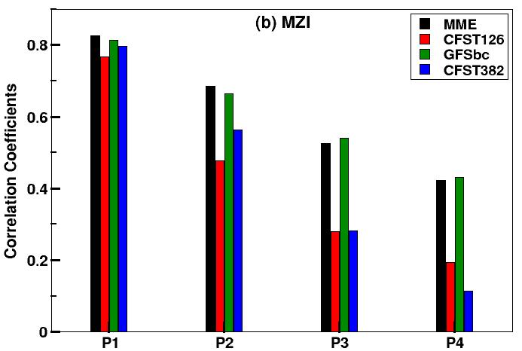
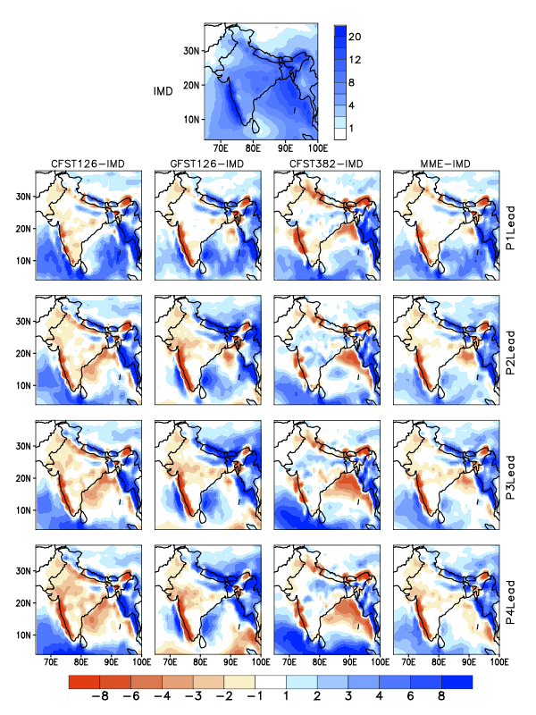
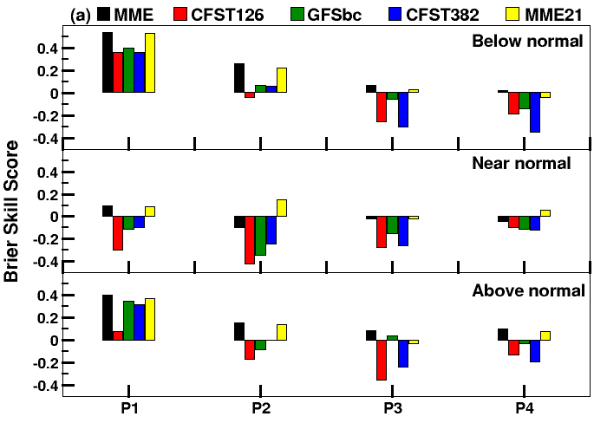
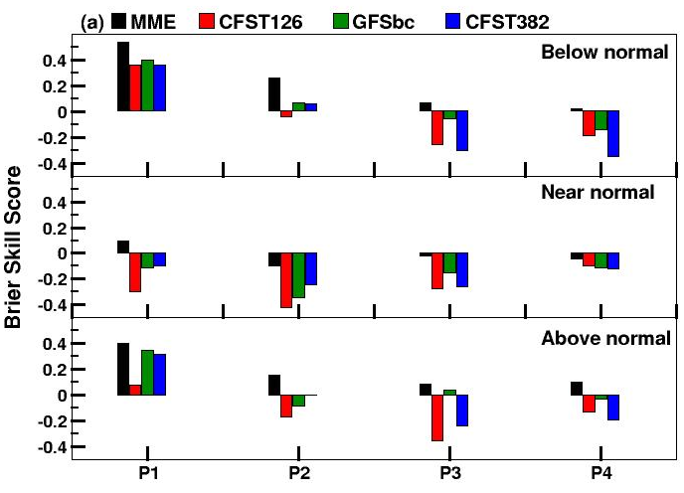
Deterministic prediction Skill
Seasonal mean and difference from OBS
OBS
IMD
CFS126-IMD
GFS126-IMD
CFS382-IMD
MME-IMD
Spatial pattern correlation over 40°E-120°E and 40°S-40°N
 | CFS126 SME | CFS382 SME | GFSbc SME | MME
P1 Lead | 0.87 | 0.84 | 0.87 | 0.89
P2 Lead | 0.85 | 0.85 | 0.81 | 0.88
P3 Lead | 0.83 | 0.82 | 0.78 | 0.87
P4 Lead | 0.79 | 0.80 | 0.76 | 0.86
Probabilistic Prediction Skill
Abhilash et al. 2015, conditionally accepted
Notes:
Brier skill score: skill score w.r.t its own climatology. A positive value indicates a better-than-climatology forecast.

Slide 9
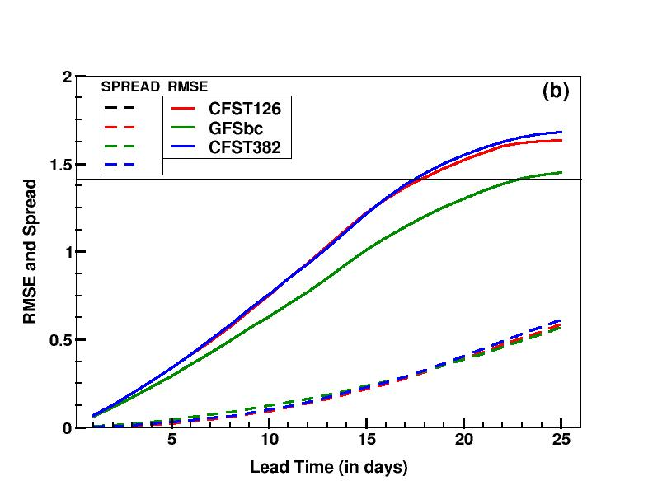
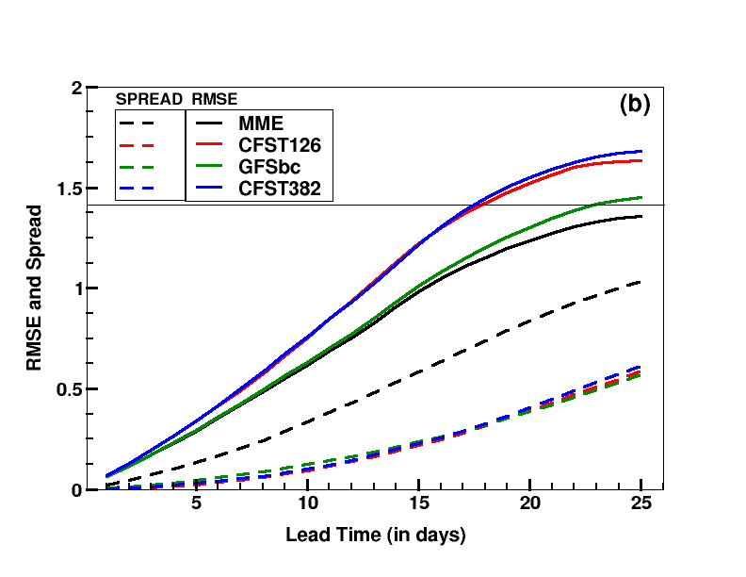
RMSE and spread of MISO indices
Considerable improvement in MME is contributed from the increased spread, which overcomes the under-dispersive nature of the individual models in EPS system.
Abhilash et al. 2015, conditionally accepted
Notes:
RMSE: w.r.t obs. Spread: std dev of individual models w.r.t ensemble mean. For a better model, the spread should be maximum and rmse should be minimum. This is the improvement of MME.

Slide 10
Development of a Criteria for forecasting Monsoon Onset over Kerala (MOK)

Slide 11
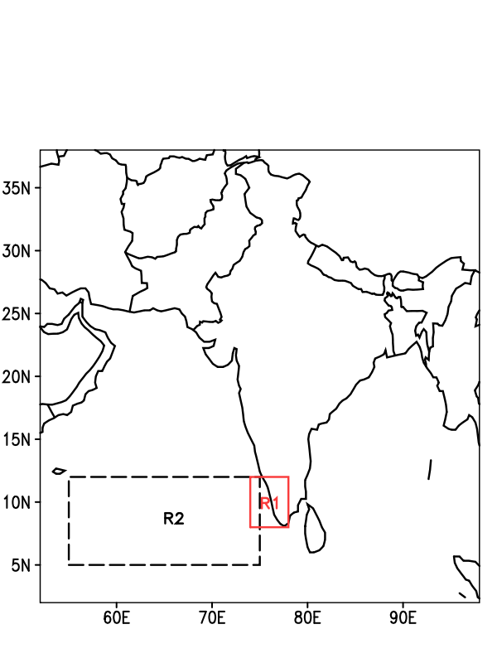
Criteria for forecasting Monsoon Onset over Kerala (MOK)
Regions for calculating indices
The emphasis is to devise a criterion from circulation as well as rainfall in the CGEPS to predict MOK.
For this, two indices are defined – one from rainfall over Kerala (ROK) and another based on the strength of Low level Jet (LLJ).
ROK is defined as the rainfall area averaged over 74°-78°E; 8°-12°N (R1); whereas LLJ is defined as the zonal wind at 850 hPa averaged over 55°-75°E; 5°-12°N (R2).
30 day average values of forecasted ROK and LLJ starting from 17 May has been calculated. MOK is defined on the date on which both ROK and UARAB exceed 50% of their mean, and one of them surmounts 70% of its mean, for 5 consecutive days, provided the depth of westerlies is maintained till 600hPa. The ensemble mean MOK date (of all 43 members) is treated as the final predicted MOK date. In this way, the uncertainties arising from the differences in the evolution of monsoon in individual ensemble members are taken care of.
Joseph et al. 2015, under revision

Slide 12
Forecasted and actual MOK for the years 2001-2014
Year | Actual MOK | Forecasted MOK | SD among ensemble members | Difference between actual and forecasted MOK
2001 | 23 May | 25 May | 2 | 2
2002 | 29 May | 21 May | 5 | 8
2003 | 08 Jun | 30 May | 5 | 9
2004 | 18 May | 18 May | 1 | --
2005 | 05 Jun | 05 Jun | 3 | --
2006 | 26 May | 25 May | 2 | 1
2007 | 28 May | 02 Jun | 8 | 5
2008 | 31 May | 01 Jun | 7 | 1
2009 | 23 May | 24 May | 2 | 1
2010 | 31 May | 30 May | 5 | 1
2011 | 29 May | 01 Jun | 2 | 3
2012 | 05 Jun | 04 Jun | 4 | 1
2013 | 01 Jun | 29 May | 2 | 3
2014 | 06 Jun | 05 Jun | 6 | 1

Slide 13
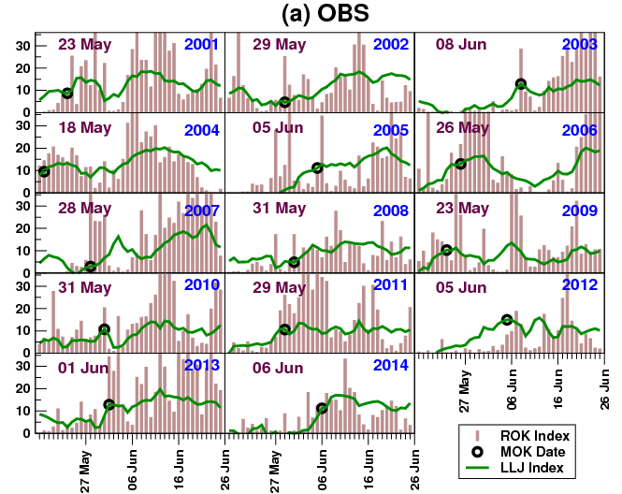
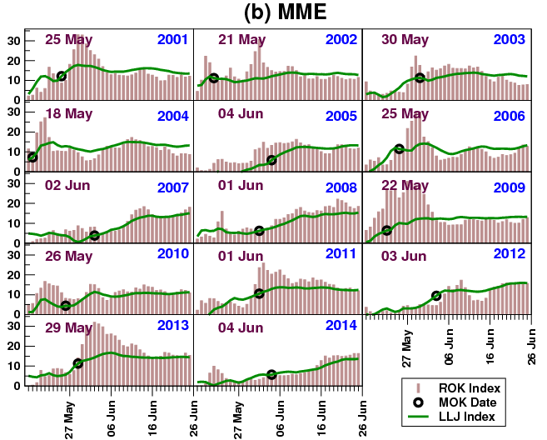
Evolution of ROK index and LLJ index during 2001-14

Slide 14
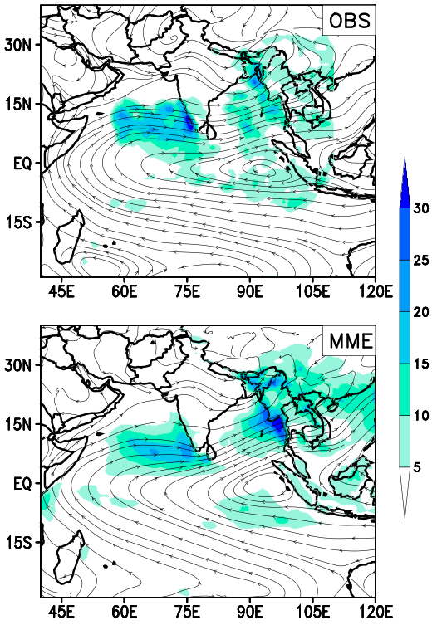
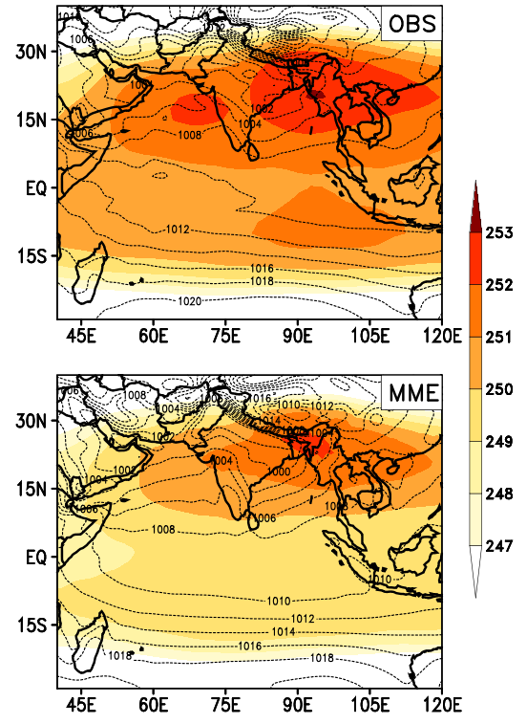
MOK Composite
Precip (mm/day)and 850 hPa wind(m/s)
TT (K) and MSLP (hPa)

Slide 15
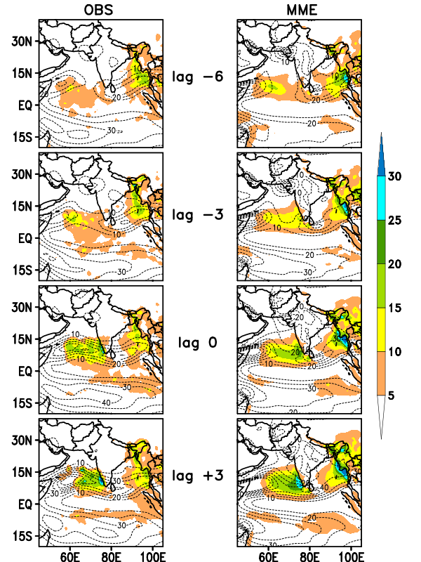
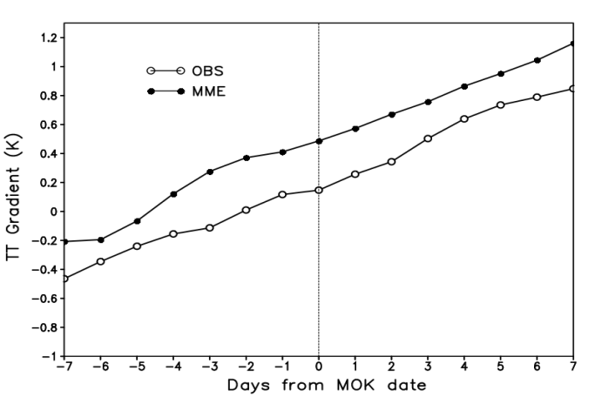
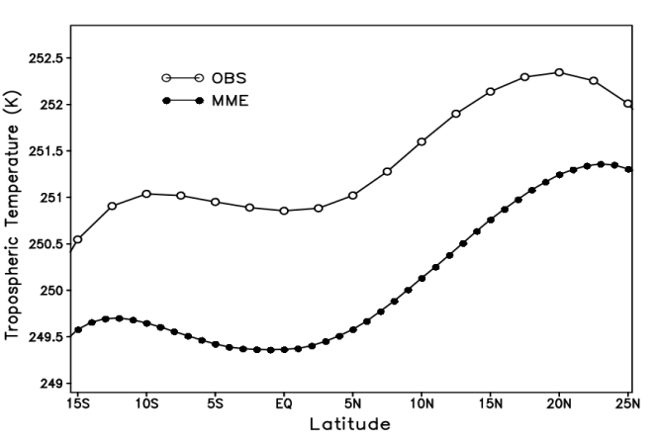
Evolution of Precipitation (mm/day) and kinetic energy of 850 hPa rotational wind (m²/s²)
TT Gradient:
<TT>₆₀₀₋₂₀₀ (40°-100°E; 5°-35°N)
– <TT>₆₀₀₋₂₀₀ (40°-100°E; 15°S-5°N)
Meridional profile of TT <65-95E> on MOK date
Precipitation values are comparable for both OBS and MME.
KE of rotational wind is much stronger in MME, and much along the Somali coast, compared to OBS.
TT is weak for MME, but its gradient is stronger than OBS

Slide 16
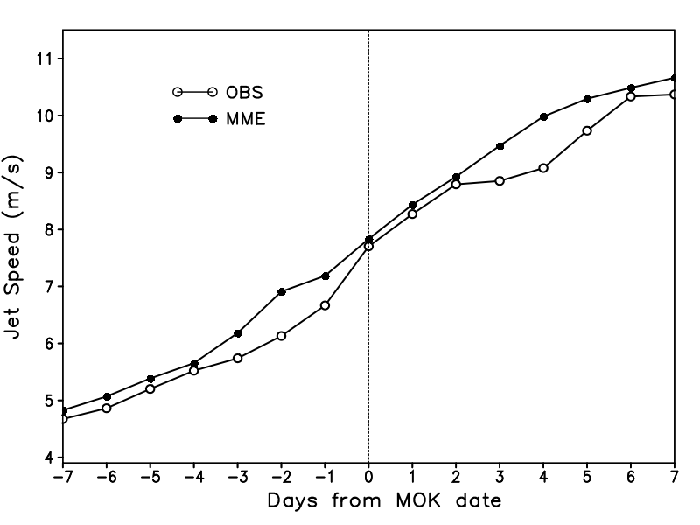
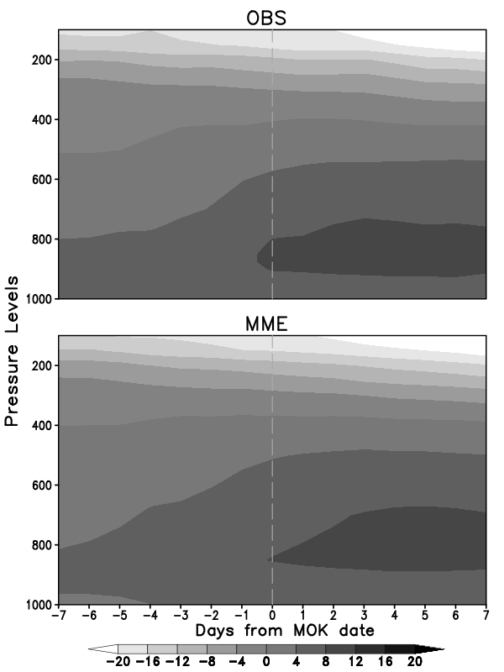
Time-height evolution of zonal wind (m s⁻¹) during MOK. Observational wind data is from MERRA. The MOK date (day 0) is demarcated by thin dash line.
Temporal evolution of Somali Jet Speed Index (m s⁻¹) during MOK. Observational wind data is from MERRA.

Slide 17
Real time Extended Range prediction during 2013 & 2014:
Onset
Progression
Active/Break cycle
Withdrawal
Extreme Weather Events

Slide 18
ONSET

Slide 19
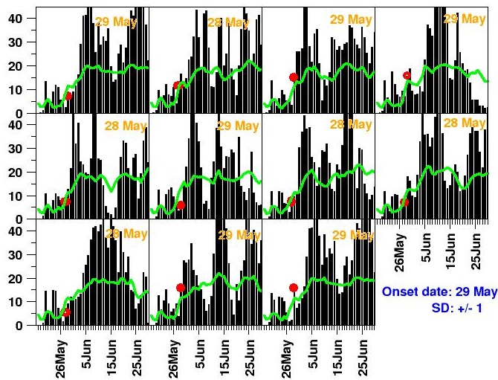
Forecast of Monsoon Onset over Kerala:2013
Based on 16 May 2013: 29 May
Onset declared by IMD: 01 June
Onset date forecasts are obtained from each 11 member of CFSv2 45 day forecast. Then ensemble mean is given as the final forecasted onset date.
Y axis on each panel is in mm/day for rainfall (bars) and m/s for 850hPa wind(green line). Red circle is the onset date and also written at the top of each panel
Notes:
19
19

Slide 20
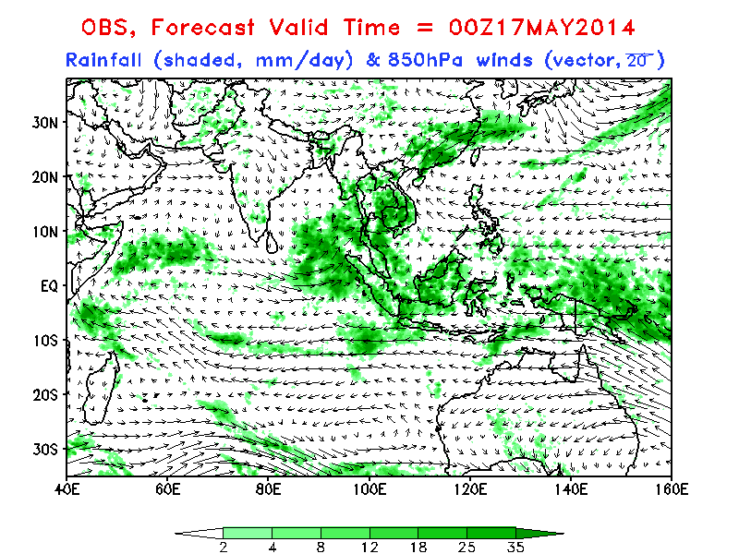
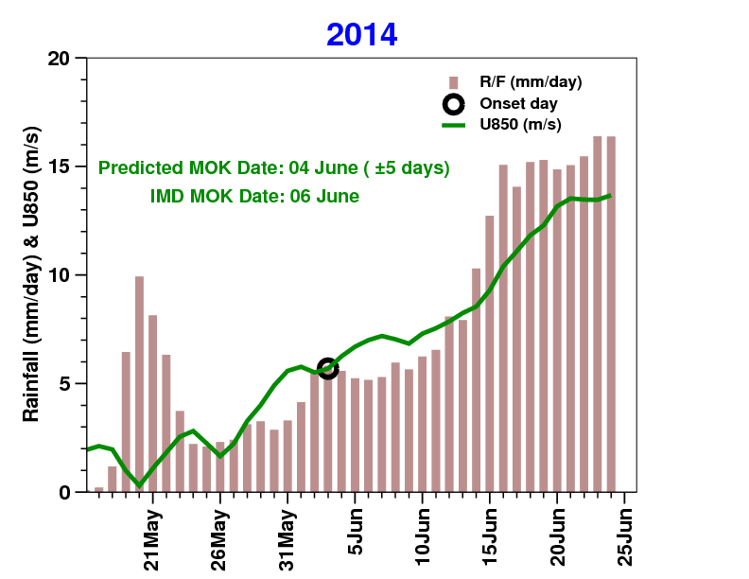
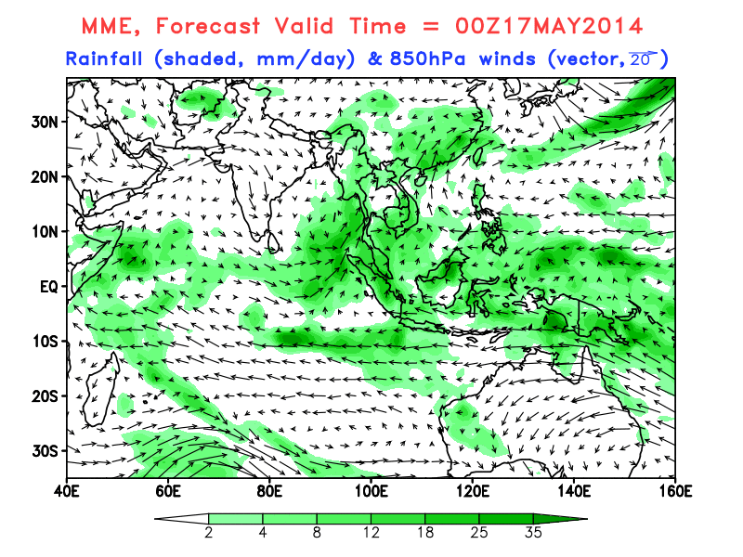
MOK forecast of 2014 based on IC: 0516
Monsoon Onset over Kerala
Keypoints from the forecast:
A low pressure system might form over Bay of Bengal around 25 May 2014 and move northwards.
South-west monsoon of 2014 would make its onset over Kerala on 04 June.
However, the strengthening and progression of the monsoon might be slackened till 15 June due to the presence of a low-level anticyclonic circulation over central India. Afterwards, monsoon might strengthen and progress.

Slide 21
PROGRESSION

Slide 22
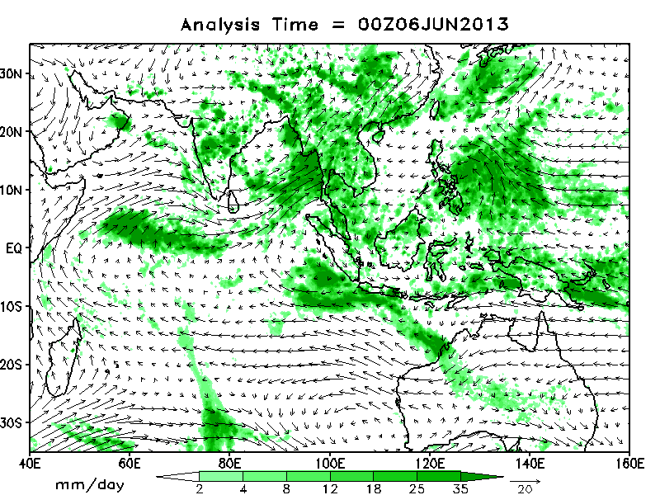
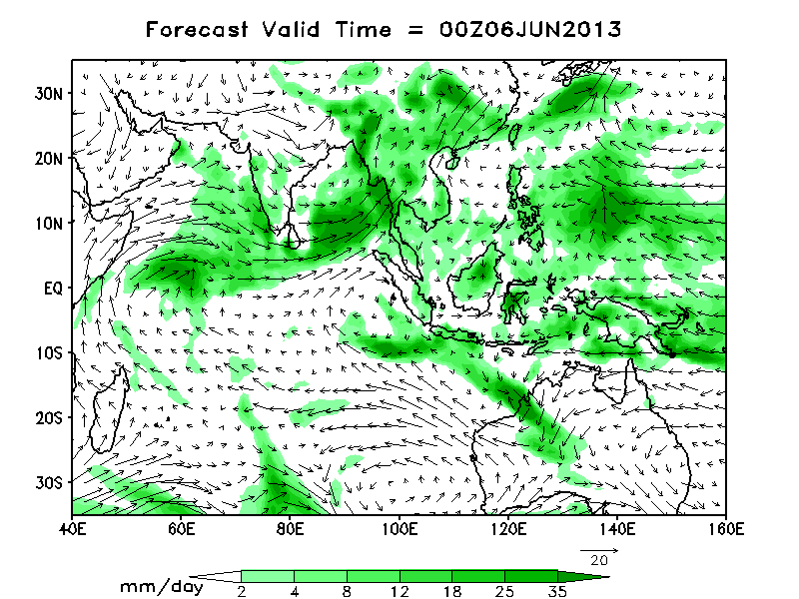
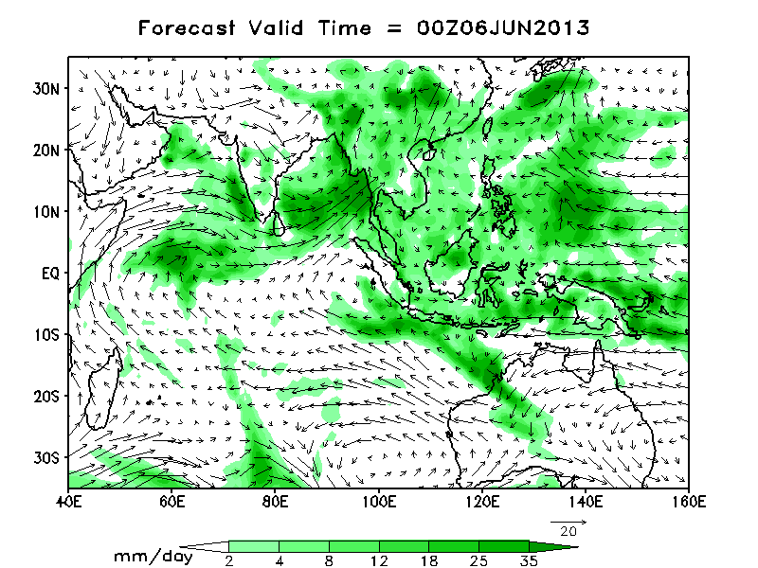
Rapid advancement of 2013 monsoon from IC: 5 Jun
Keypoints from the forecast:
NCEP/TRMM Analysis
The low level cross-equatorial flow has strengthened both in CFSv2 and GFSbc. Both CFSv2 and GFSbc show that rainfall over monsoon zone of India (MZI) would start to intensify from 13th Jun onwards. This intensification of rainfall is likely due to the formation of a system over BOB.
Real time forecast for MISO shows that fresh evolution of MISO is eminent with a prominent northward propagation from both CFSv2 and GFSbc.
CFSv2
GFSbc
Notes:
22
22
22

Slide 23
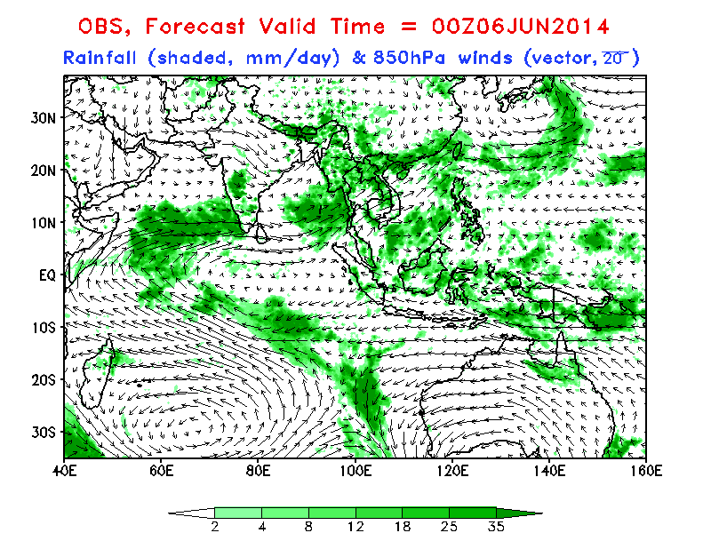
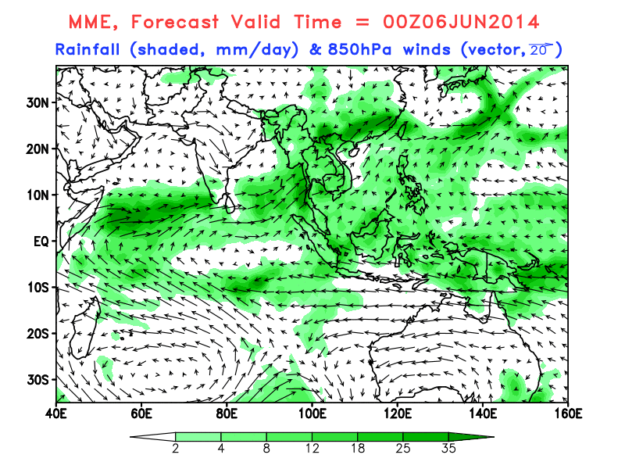
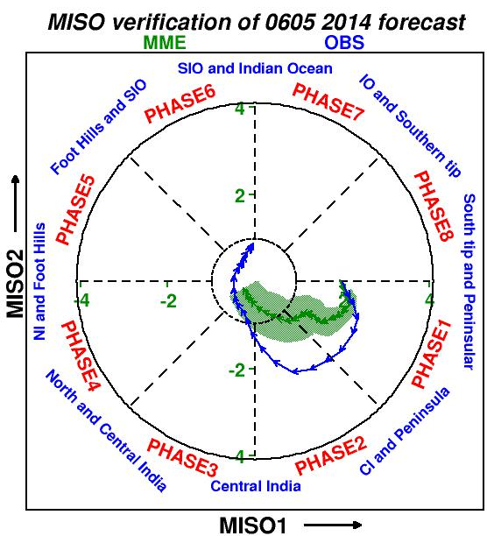
Delayed progression of
ISM 2014
IC: 0605
Keypoints from the forecast:
The rainfall would be confined to west coast and NE India up to 20 June.
The surface pressure gradient pattern and low level circulation indicates that the presence of ridge east of western Ghats (anticyclonic circulation over central India) will hamper the establishment of monsoon over Indian land.
Thus, the strengthening and progression of the monsoon seems to be slackened till 20 June and monsoon would reach central India afterwards as a feeble current.
Large scale MISO forecast also suggests that it will be over peninsular India for the next 25 days.
Overall, monsoon activity in June will be mainly confined to west coast, NE India and southern peninsula.

Slide 24
ACTIVE/BREAK CYCLES

Slide 25
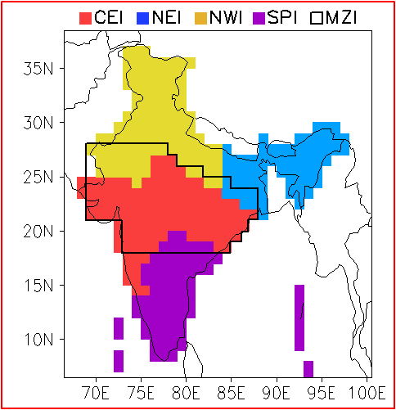
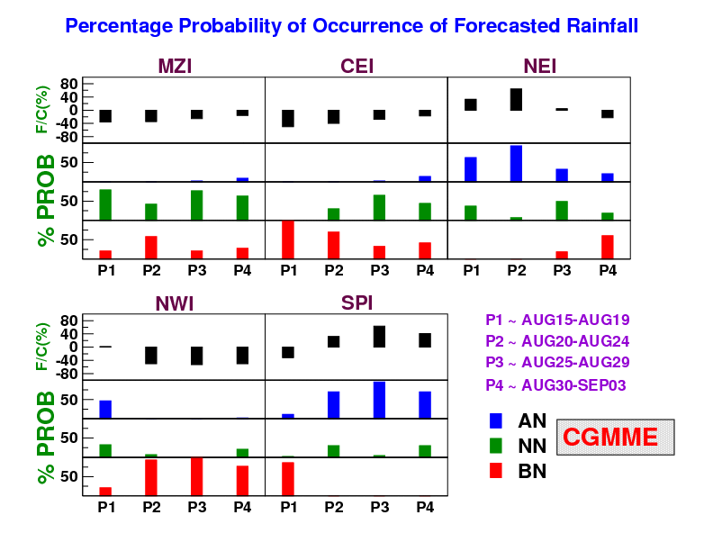
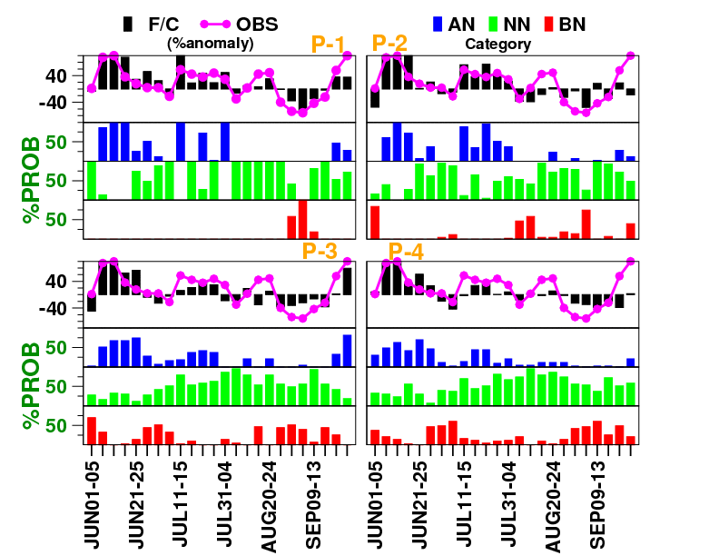
Forecast of 2013 monsoon over MZI
 | CC | RMSE (%)
P1 | 0.83 | 29
P2 | 0.66 | 41
P3 | 0.75 | 34
P4 | 0.64 | 39

Slide 26
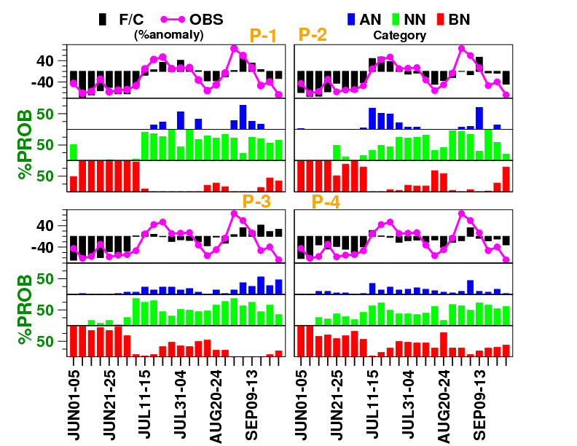
Forecast of 2014 monsoon over MZI
 | CC | RMSE (%)
P1 | 0.82 | 31
P2 | 0.79 | 34
P3 | 0.57 | 46
P4 | 0.72 | 38

Slide 27
Observed June Rainfall during 2001-14
Year | June Rainfall | Departure from Mean
2001 | 219.0 | 35.6
2002 | 180.1 | 9.4
2003 | 179.9 | 9.8
2004 | 158.7 | -0.8
2005 | 143.2 | -9.5
2006 | 141.8 | -12.7
2007 | 192.5 | 18.5
2008 | 202.0 | 24.3
2009 | 85.7 | -47.2
2010 | 138.1 | -15.6
2011 | 183.5 | 12.2
2012 | 117.8 | -28.0
2013 | 219.8 | 34.4
2014 | 92.4 | -43.5

Slide 28
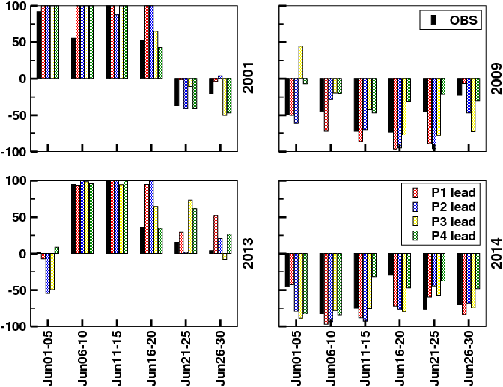
ERP of June extremes by CGEPS MME
The model has remarkable skill in predicting the June extremes !!!

Slide 29
WITHDRAWAL

Slide 30
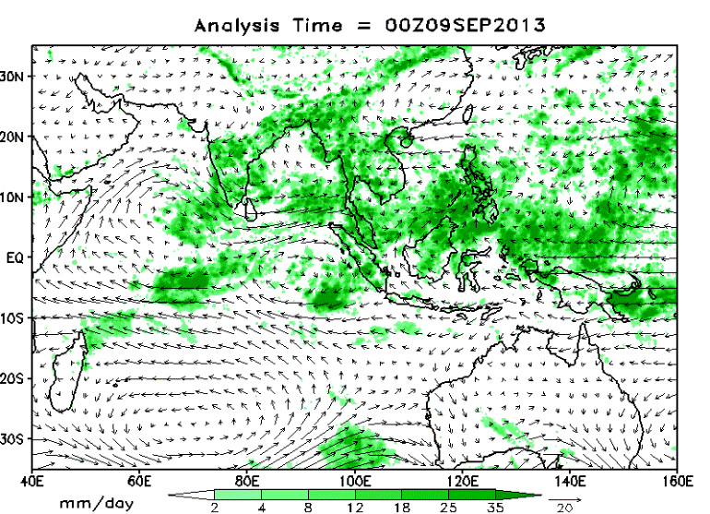
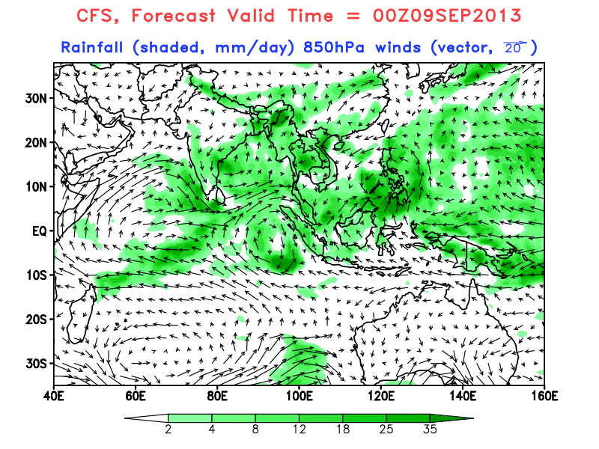
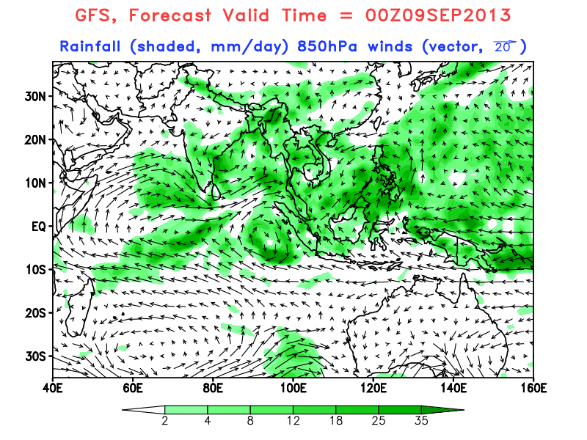
Revival of monsoon was well predicted from 08 September IC, which helped IMD in declaring the withdrawal of monsoon
2013
CFST126
OBS
GFSbc
Keypoints from the forecast:
It is expected that monsoon will revive in next few days. Forecast shows that rainfall activity is likely to be near normal to above normal over Peninsula in P1 and over Central and North India in P2-P3.
Real time forecast for MISO shows that associated convective activity is likely to propagate from Peninsula to North India through Central India.
Notes:
30
30

Slide 31
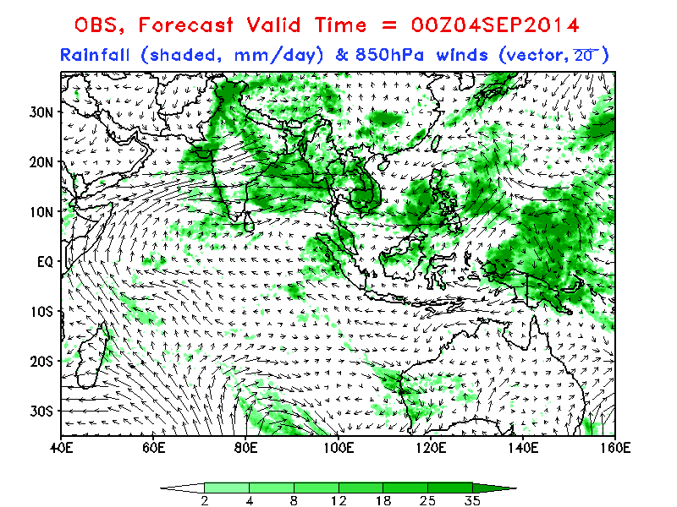
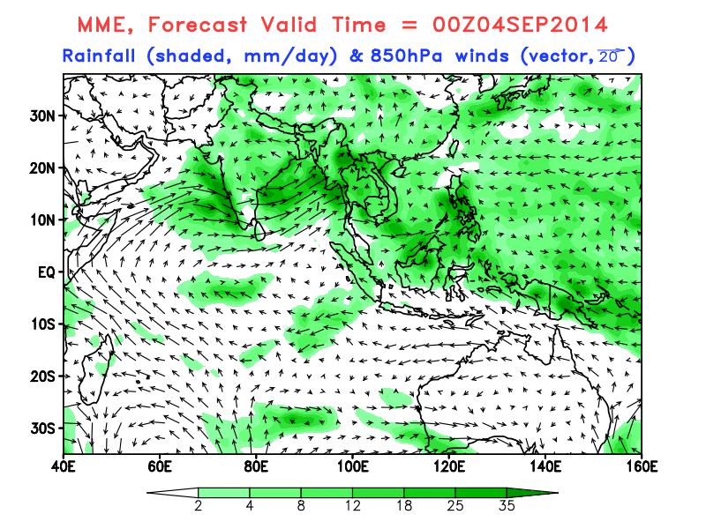
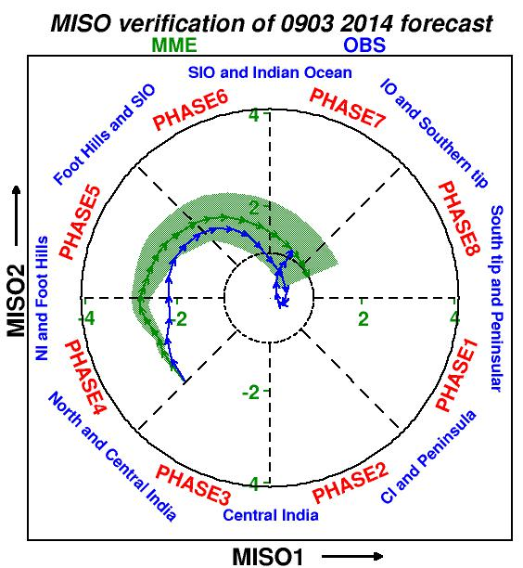
Withdrawal of ISM 2014
IC: 0903
Keypoints from the forecast:
Although monsoon activity will be normal over northern India (with increased amplitude over northwest India) for the next 5-10 days, conditions of withdrawal is expected to occur 20 September onwards.
Large scale MISO activity is shifting towards the foothills and will be active over northern India for the next 10-15 days.

Slide 32
EXTREME EVENTS

Slide 33
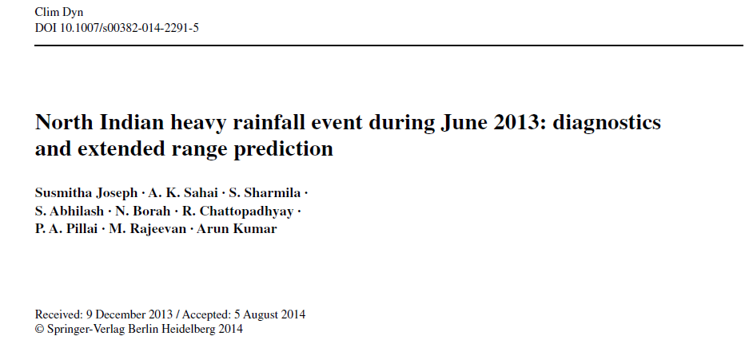
Performance of Extended Range Prediction System for Uttarakhand extreme rainfall event in June 2013
Joseph et al. (2014) Climate Dynamics

Slide 34
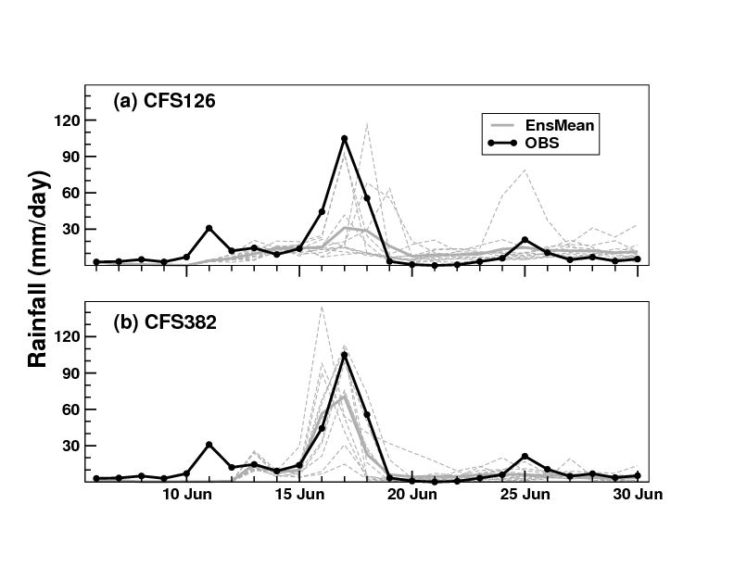
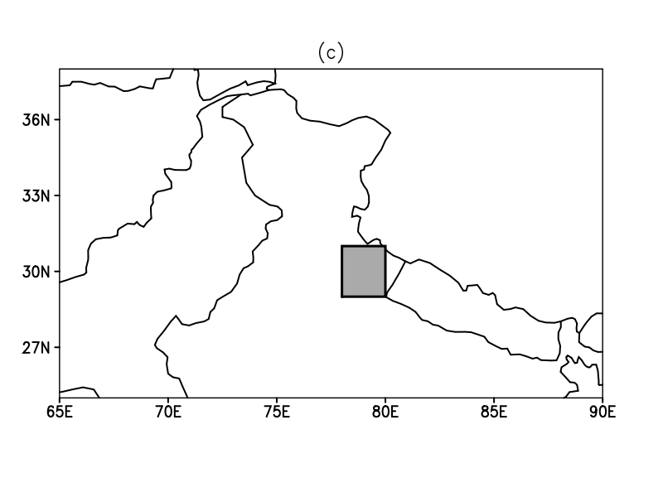
Extended range prediction of Uttarakhand rainfall event by
(a) CFS126 and (b) CFS382 from 05 June initial condition.
The heavy amount of rainfall (~110mm) over Uttarakhand was predicted somewhat reasonably (~70mm) by CFS382; however, the amount (~30-35mm) is underestimated by CFS126
The region where rainfall values are averaged

Slide 35
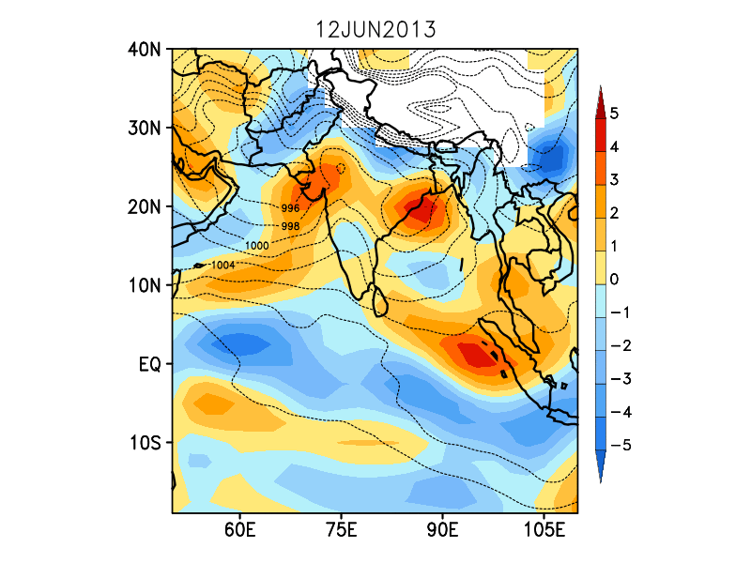
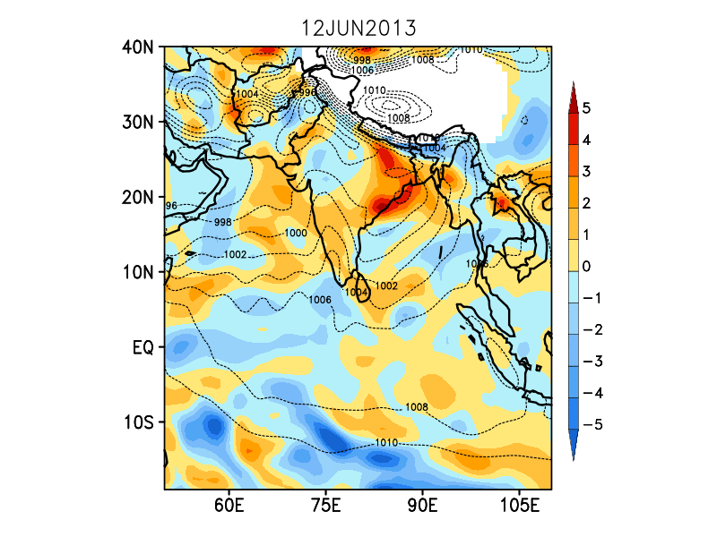
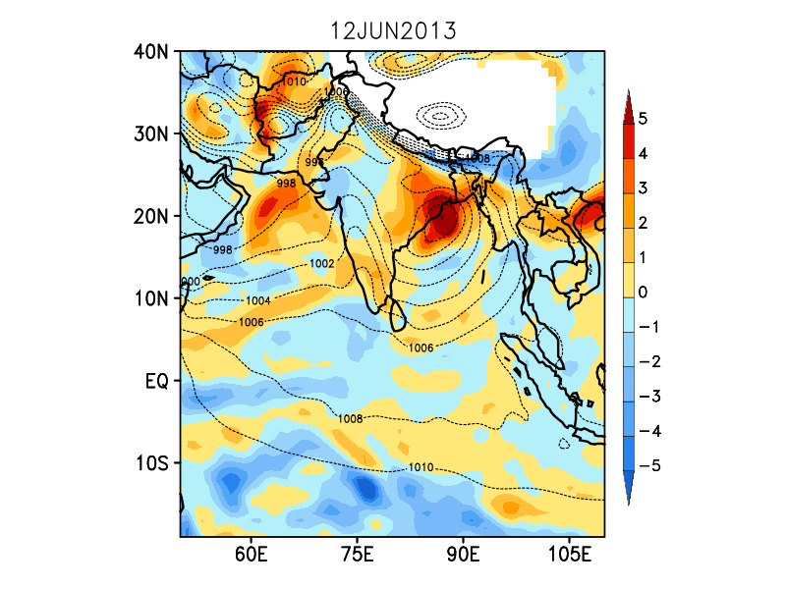
Evolution of Potential Vorticity (PV; x10⁻⁷ s⁻¹) anomalies at 700 hPa and mean sea level pressure
OBS
The development and northwestward movement of the low pressure system in BoB is predicted reasonably well by both CFS126 and CFS382, with CFS382 performing slightly better.
CFS126
CFS382

Slide 36
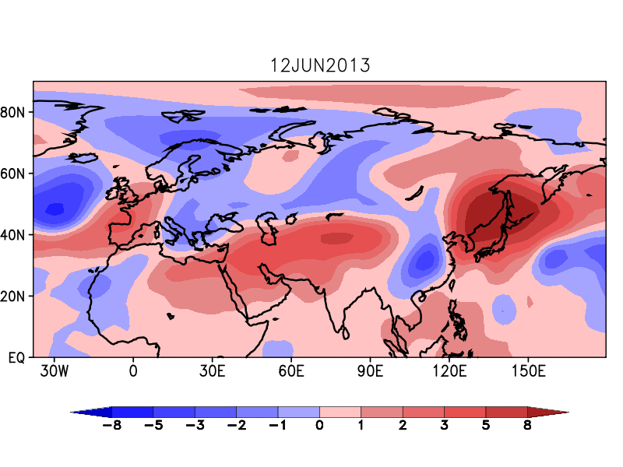
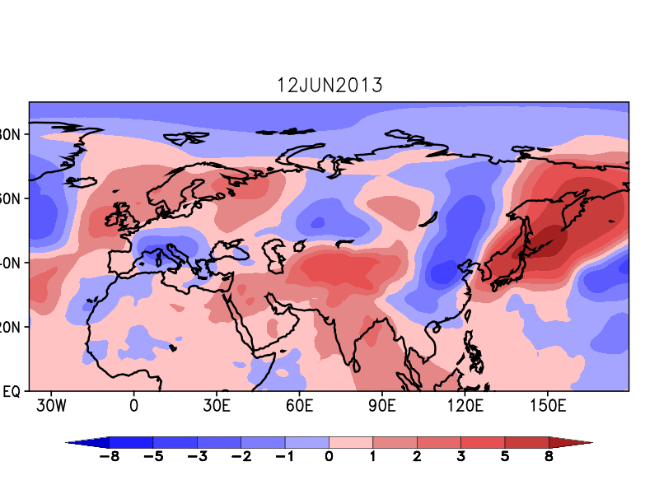
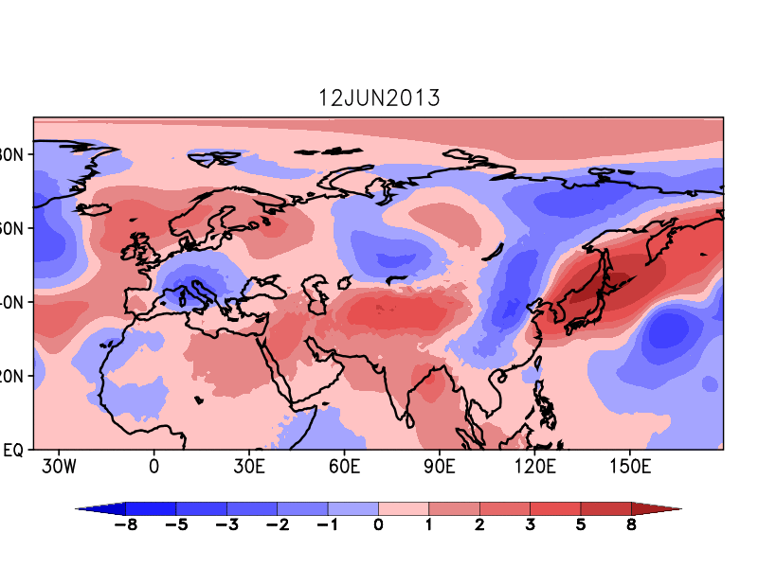
Evolution of TT anomalies in OBS, CFS126 & CFS382
OBS
CFS126
CFS382
Midlatitude influence involving cold polar air intrusion is absent in the models!

Slide 37
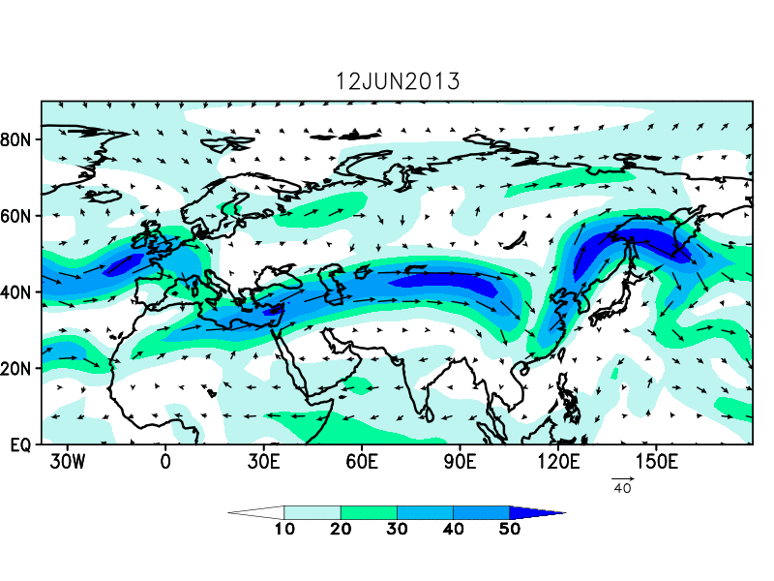
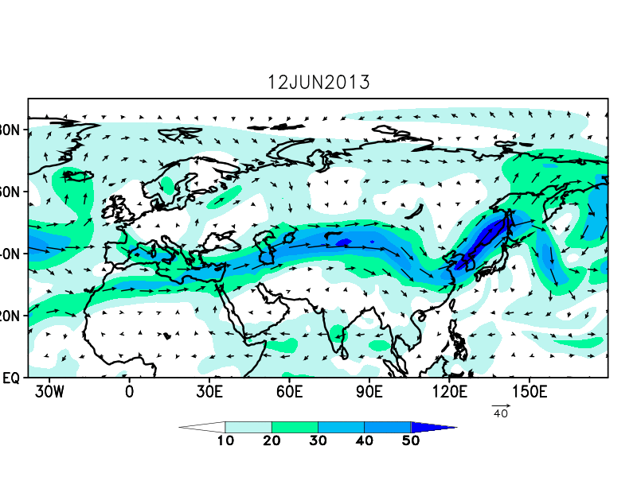
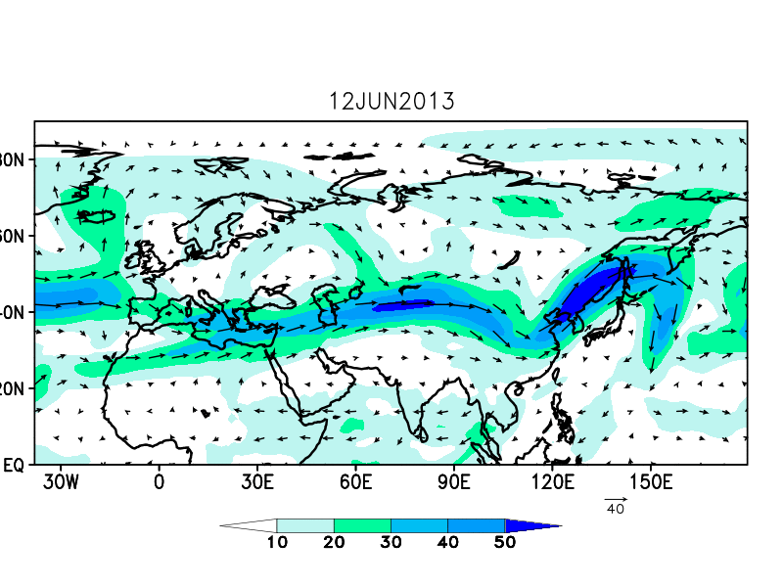
Cold polar air intrusion interacts with the midlatitude westerlies and deepens the trough, causing it to intrude southward.
OBS
Evolution of 200hPa wind in OBS, CFS126 & CFS382
CFS126
CFS382

Slide 38

Midlatitude influence over Uttarakhand region
Anomalies of Potential Vorticity (PV; x10⁻⁷ s⁻¹; shaded) and omega (pressure vertical velocity multiplied by -1.0; hPa s⁻¹; contour)
The vertical velocity is very strong over Uttarakhand region in CFS382, indicating the role of orographic lifting in giving enormous amount of rainfall over the region, compared to CFS126

Slide 39
Results
Cold air intrusion in the presence of humid atmophere can trigger wet spells (Li and Fu 2006). During 14-16 June, the upper tropospheric midlatitude westerly trough intruded southwards, bringing in cold polar air along with it. Simultaneously, the low pressure system that developed in BoB around 12 June, moved northwestward to the Indian land, bringing in huge amount of moisture. The interaction between the monsoonal low pressure system and the westerly trough has helped the monsoon to cover the entire country by 16 June. Since this interaction happened in the vicinity of mountainous region, the orographic uplift also contributed to the enormous amount of rainfall received over the region.
Factors that favoured the events in CFS126 and CFS382:
Mechanism | CFS126 | CFS382
Cold air intrusion | N | N
Westerly trough | N | N
Low Pressure System | Y | Y
Orography | N | Y

Slide 40

Performance of Extended Range Prediction System for J&K extreme rainfall event in September 2014
Observed and Forecasted R/F
Unfortunately, the ERP system could not predict the Kashmir flood event.

Slide 41

IC: 0824
Surprisingly, high resolution model performance is pathetic.
GFSbc is showing slightly better performance.

Slide 42


CFS126
To examine the impact of IC on the prediction, two additional experiments have been carried out for 0824.
Atmospheric IC from NCMRWF and ocean IC from NCEP
Atmospheric IC from NCMRWF and ocean IC from INCOIS
CFS382

Slide 43
J &K flood event seems to be purely driven by monsoon systems (mid-latitude influence is not seen).
The NCEP IC could not capture rainfall over J&K.
NCMRWF/INCOIS IC could capture the LPS movement and upto some extent rainfall over J&K.
The GFSbc which has shown slightly better performance with NCEP IC is expected to give even better with NCMRWF/INCOIS IC. Since hindcasts are not available and hence SST bias is not known for NCMRWF/INCOIS IC, the skill of GFSbc could not be evaluated.

Slide 44
Stake holders of ERP and their response

Slide 45

Use in Agromet Division of IMD

Slide 46

Application of ERP in Hydrometeorology

Slide 47

Appreciation from PMO

Slide 48

Letter of Appreciation from IMD

Slide 49

Letter from DG (IMD)

Slide 50


Slide 52




The PCs, spatial propagation and life cycle of MISO are generated through a clustering technique using the time-lagged SOM algorithm. The PCs (RPC1 & RPC2) of daily rainfall data are obtained by projecting the daily data onto the SOM-derived feature maps or ROFs those are related to MISOs.
  The amplitude of RPC1 and RPC2 are plotted in a PC1/PC2 phase space similar to Wheeler Hendon (2004) to get an idea of the evolution of ISO and its strength.

Slide 53




Development, Testing, tuning and reliability of EPS
Perturbation is added to the analysis based on the tendency of the model state variables
Tuning with different amount of perturbation
High and Low
perturbation
Sensitivity of Humidity
Perturbation
Abhilash et al., 2013a
Without Q perturbed
With Q perturbed

Slide 54



SST Bias from Long Simulation
Sahai et al (2013)
Current Sciences
SST Bias
20 day Lead
Northward propagation of ISO
Lead
Dependant
Bias
Abhilash et al., 2013
Notes:
54
54
54
54
54

Slide 55





Skill Statistics: CC at different pentad lead over MZI, CEI, NWI, NEI, SPI
T382 skill is
Better over NEI
Sahai et al., 2014
Notes:
55
55

