Slide 1





UCLA
Advancing Monsoon Weather-Climate Fidelity in the NCEP CFS through Improved Cloud-Radiation-Dynamical Representation
Principal Investigator: Duane Waliser^{1,2}
Co PIs: Jui-Lin (Frank) Li^{1,2} , Xianan Jiang^{1,2} Baijun Tian^{1,2}
Postdoctoral Researcher: Neena Joseph Mani^{1,2}
¹Joint Institute for Regional Earth System Sci. & Engineering / UCLA, USA
²Jet Propulsion Laboratory, California Institute of Technology, USA
Co PIs: Parthasarathi Mukhopadhyay, Anupam Hazra
Indian Institute of Tropical Meteorology, Pune, India
Shrinivas Moorthi
Environmental Modeling Center, NOAA National Weather Service, Maryland, USA

Slide 2
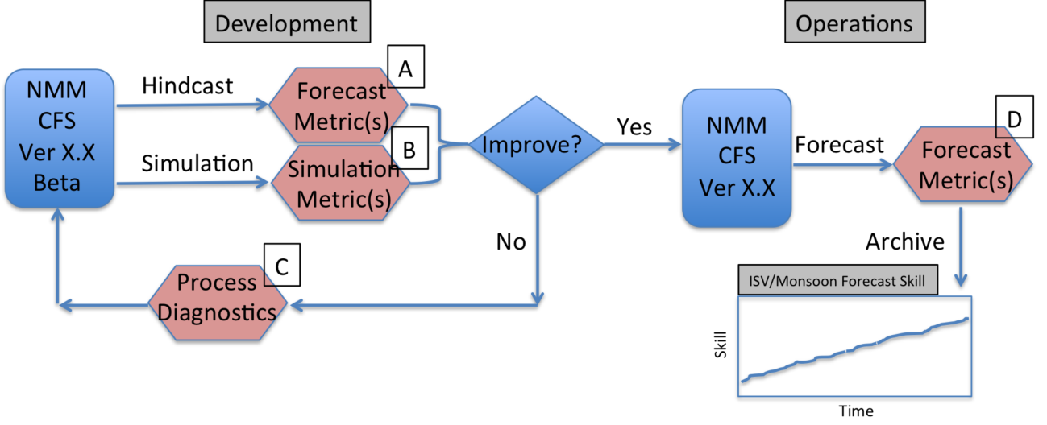
Main Objective :
Realizing the necessity of a proper evaluation framework for monsoon and its intraseasonal variability (ISV), we proposed to develop an evaluation framework for the simulation and prediction of mean and ISV of Indian summer monsoon
Our efforts would support the modeling efforts being carried out at IITM and NCEP as part of the National Monsoon Mission initiative.
Proposed Work Plan
Duration of Project: 3 years, started December 2014

Slide 3
Targets Achieved - Year-1
Proposed target | Status
Develop diagnostics for BSISV, based on the MJO Working Group Diagnostics, MJO Task Force as well as on a number of satellite- based vertical structure quantities, such as TRMM latent heating, AIRS temperature and humidity, GPS temperature, and CloudSat cloud characteristics. | Similar to the MJO diagnostics, a set of simulation metrics were developed for the monsoon ISV. The evaluation metrics and process diagnostics were tested with the GASS-YOTC diabatic heating project multimodel output. (Article in preparation). Ongoing. More metrics to be augmented. Three cloud ice water content products were developed using Cloud Sat and Calipso retrievals.
Gather codes and data sets to initial evaluation framework design and develop working implementation. | Codes for the evaluation framework were developed and applied to observational data and multimodal output.
Apply evaluation framework to NCEP CFSV2 to provide baseline capability. | The simulation metrics were applied to the NCEP CFS v2 T126 climate simulations and the baseline evaluation is partially completed.
Begin application of simulation metrics (B) and process-diagnostics (C) to the SP-CFS development version. | SP-CFS output is not yet available. Target carried over for the second year.

Slide 4





Vertical Structure and Diabatic Processes of
the MJO: Global Model Evaluation Project
MJO Task Force/YOTC and GASS
www.ucar.edu/yotc/mjodiab.html
Model Experiment
Science Focus
Exp. POC
I.
20 Yr Climatological Simulations
(1991-2010 if AGCM)
6-hr, Global Output
Vertical Structure, Physical Tendencies
Model MJO Fidelity
Vertical structure
Multi-scale Interactions:
(e.g., TCs, Monsoon, ENSO)
UCLA/JPL
X. Jiang
D. Waliser
II.
2-Day MJO Hindcasts
YOTC MJO Cases E & F (winter 2009)*
Time Step, Indo-Pacific Domain Output
Very Detailed Physical/Model Processes
Heat and moisture budgets
Model Physics Evaluation
(e.g. Convection/Cloud/BL)
Short range Degradation
Met Office
P. Xavier
J. Petch
III.
20-Day MJO Hindcasts
YOTC MJO Cases E & F (winter 2009)*
3-hr, Global Output
Elements of I & II
MJO Forecast Skill
State Evolution/Degradation
Elements of I & II
NCAS/Walker in.
N. Klingaman
S. Woolnough
*DYNAMO Case TBD
Commitments: About 20 Modeling Groups with AGCM and/or CGCM

Slide 5
Participating GCMs for Climate Simulation (Experiment Component I)
 | Model | Horizontal Resolution | Vertical Resolution | Cumulus Scheme | Notes
1 | 01_NASAGMAO_GEOS5 | 0.625º lon x 0.5º lat | 72 | RAS (RAS; Moorthi & Suarez 1992)
2 | 03a_SPCCSM (CAM3 + POP) | T42 (~2.8º) | 30 | Super-parameterization (Khairoutdinov & Randall 2003)
3 | 03b_SPCAMP_AMIP | T42 | 30 | (Khairoutdinov & Randall 2001) | 1986-2003
4 | 04_GISS_ModelE2 | 2.75º lon x 2.2º lat | 40 | Kim et al. (2012), Del Geino et al. (2012)
5 | 05_EC_GEM | ~1.4º | 64
6 | 07_MIROC | T85 (~1.5º) | 40 | Chikira scheme (Chikira and Sugiyama 2010) | AMIP SST 1986-2005
7 | 10_MRI-GCM | T159 | 48 | (Pan and Randall 1998)
8 | 11_CWB_GFS | T119 (~1º) | 40 | (RAS; Moorthi & Suarez 1992)
9 | 14_PNU_CFSv1 | T62 (~2º) | 64 | (RAS; Moorthi & Suarez 1992)
10 | 16_MPI_ECHAM6 (ECHAM6 + MPIOM) | T63 ( ~2º) | 47 | (Tiedtke 1989; Nordeng 1994)
11 | 17_MetUM_GA3
12 | 21_NCAR_CAM5
13 | 22_NRL_NAVGEMv.01 | T359 (37km) | 42 | (Hong and Pan 1996; Han and Pan 2011)
14 | 24_UCSD_CAM | T42 (~ 2.8º) | 30 | (Zhang & McFarlane 1995)
15 | 27_NCEPCPC_CFSv2 | T126 (~ 1º) | 64 | (Hong & Pan 1998)
16 | 31a_CNRM_AM | T127 (~1.4º) | 31 | Bougeault (1985)
17 | 31b_CNRM_CM (CNRM_AM+ NEMO)
18 | 31c_CNRM_ACM
19 | 34_CCCma_CanCM4 | T63(?) | 35(?) | (Zhang & McFarlane 1995)
20 | 35_BCCAGCM2.1 | T42 (~2.8 deg) | 26 | (Wu et al 2011)
21 | 36_FGOALS2.0-s | R42 (2.8ºlonx1.6ºlat) | 26 | (Tiedtke 1989; Nordeng 1994)
22 | 37_NCHU_ECHAM5-SIT | T63 | 31 | (Tiedtke 1989; Nordeng 1994)
23 | 37b_NCHU_AGCM
24 | 39_TAMU_Modi-CAM4 (CCSM4) | 2.5 º lon x 1.9 º lat | 26 | (Zhang & McFarlane 1995) | Idealized tilted heating
25 | 40_ACCESS (modified METUM) | 1.875º lon x 1.25º lat | 85 | (Gregory and Rowntree 1990)
26 | 43_ISUGCM | T42 (~ 2.8º) | 18 | (Zhang & McFarlane 1995)
27 | 44_LLNL_CAM5ZMMicro
28 | 45_SMHI_ecearth3 | T255(80km) | 91 | IFS cy36r4

Slide 6
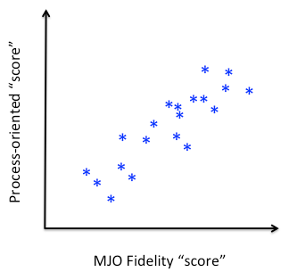
Primary Goal of the Climate Simulation Component
Petch, J., et al., (2011), A global model intercomparison of the physical pro- cesses associated with the Madden–Julian oscillation, GEWEX News, August, 5.
Jiang, et al., (2015), Vertical structure and physical processes of the madden–julian oscillation: Exploring key model physics in climate simulations, J. Geophys. Res., Under Revision
Klingaman, et al., (2015), Vertical structure and physics processes of the Madden–julian oscillation: Linking hindcast fidelity to simulated diabatic heating and moisten- ing, J. Geophys. Res., submitted.
Xavier, P. K., (2015), Vertical structure and physical processes of the madden–julian oscillation: Biases and uncertainties at short range, J. Geophys. Res., submitted.
MJO Fidelity “score”
Process-oriented “score”
Exploring the MJO fidelity score against the skill scores corresponding to different process diagnostics will help us identify key processes essential for high quality MJO representation
Using the suite of model output from GASS YOTC MJO diabatic heating experiment, we try to develop an evaluation framework and explore some process oriented diagnostics for the Boreal Summer ISV.

Slide 7
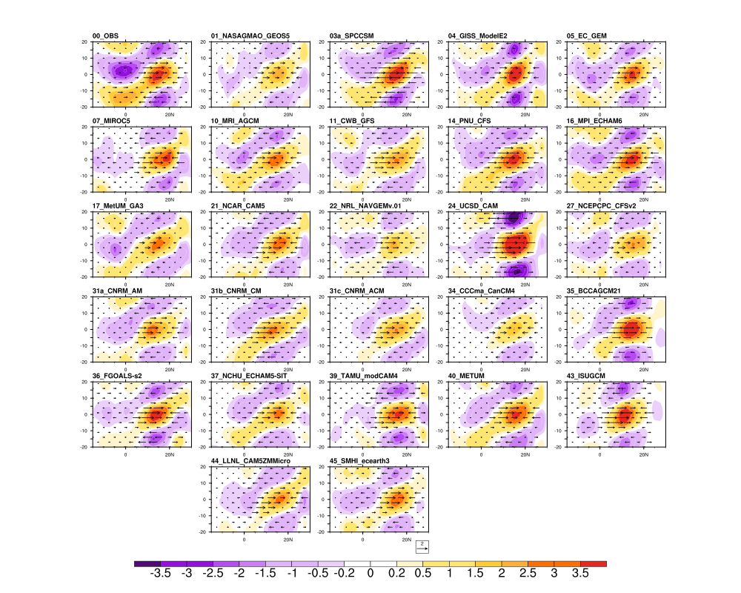
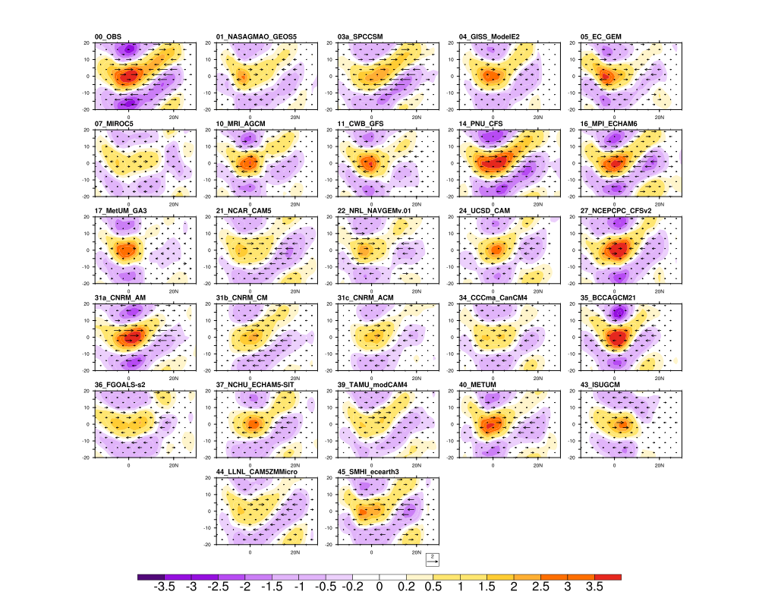
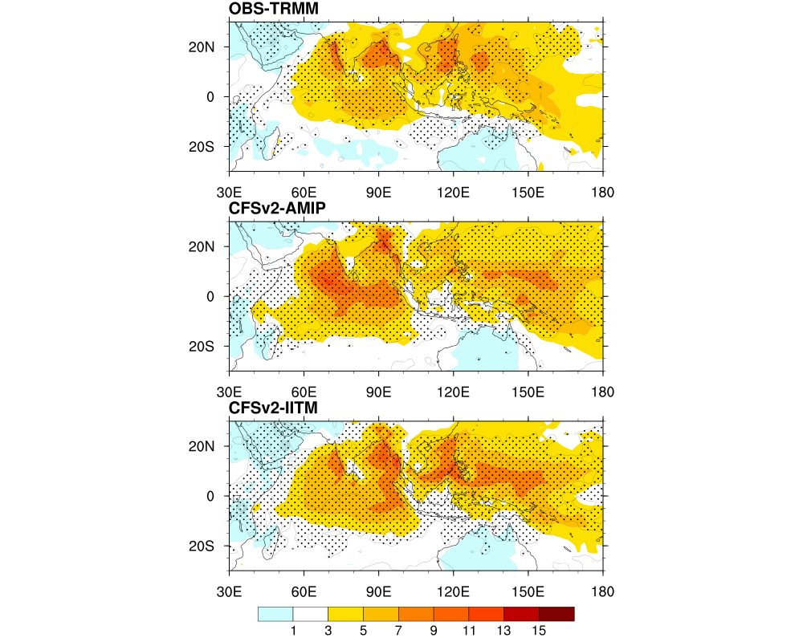

Northward propagation of Boreal Summer Intraseasonal Variability
Lag regression of 20-90 day filtered rainfall anomalies against itself at an off-equatorial base point 85-95E, 10-20N
Lag regression of 20-90 day filtered rainfall anomalies against itself at an equatorial base point 75-85E, 5S-5N
Regression coeff. averaged between 70E-90E
Regression coeff. averaged between 80E-100E

Slide 8
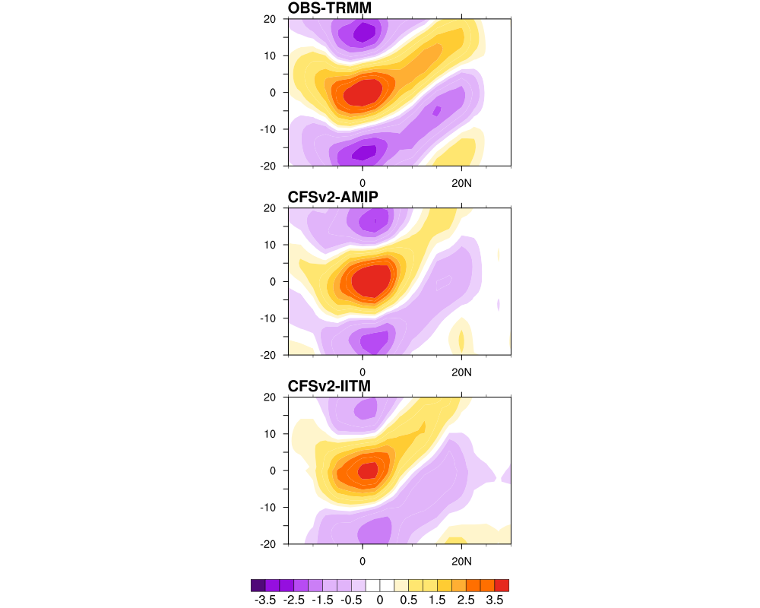
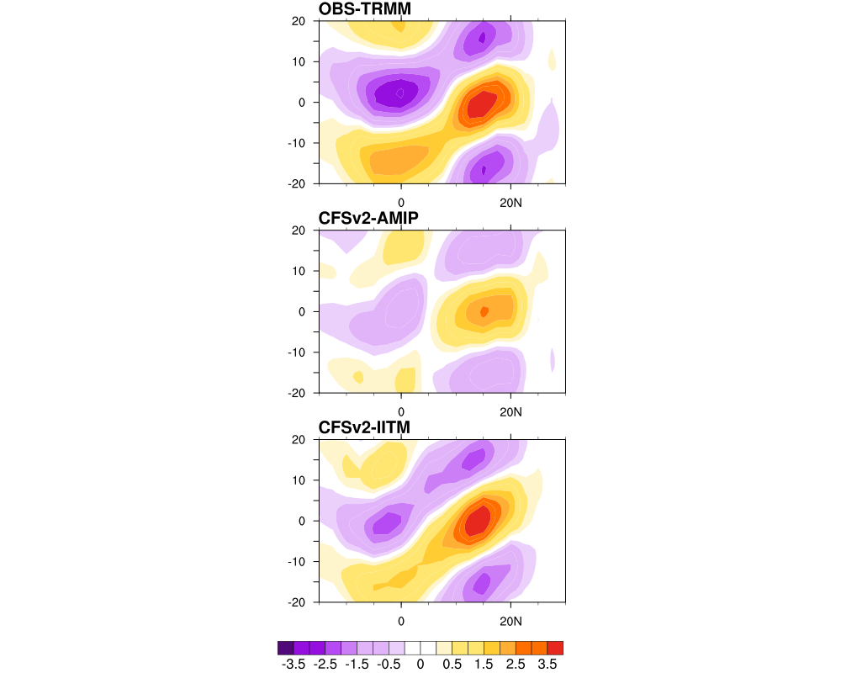
Northward propagation of BSISV in CFS v2
Regression w.r.t equatorial base point
Regression w.r.t off-equatorial base point

Slide 9
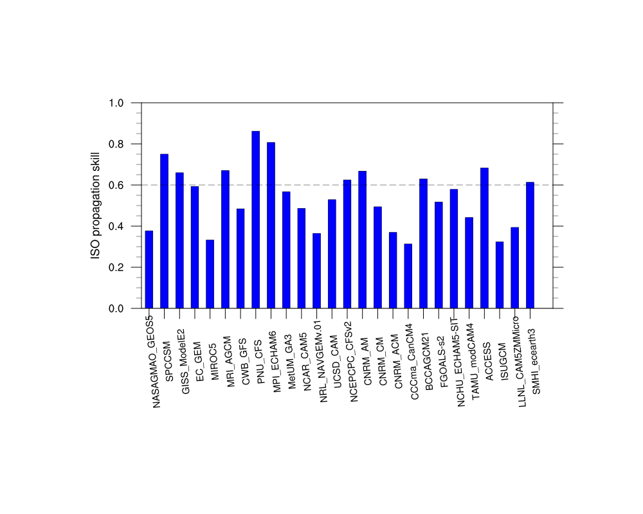
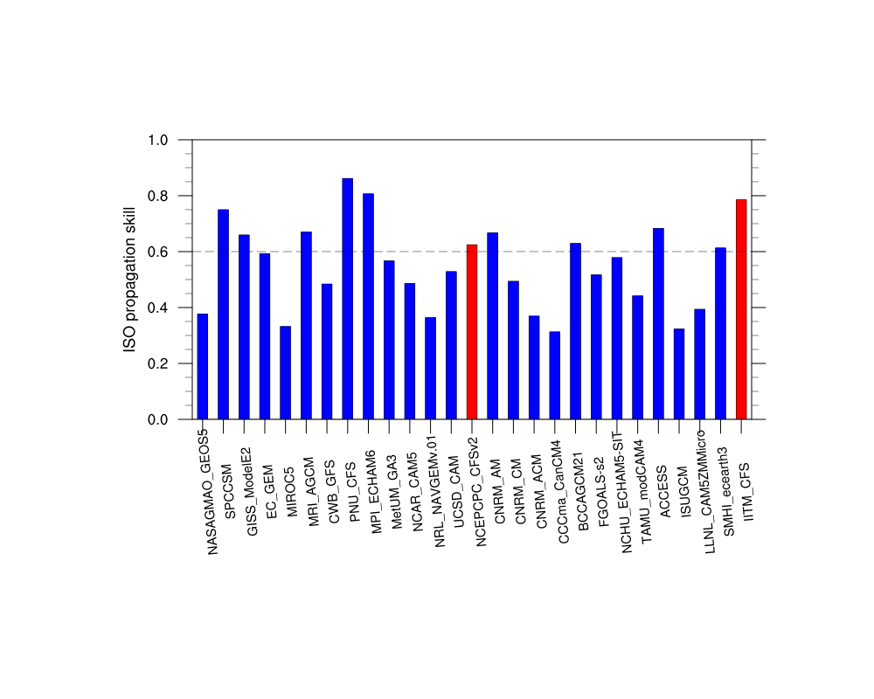
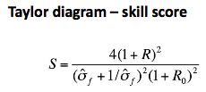
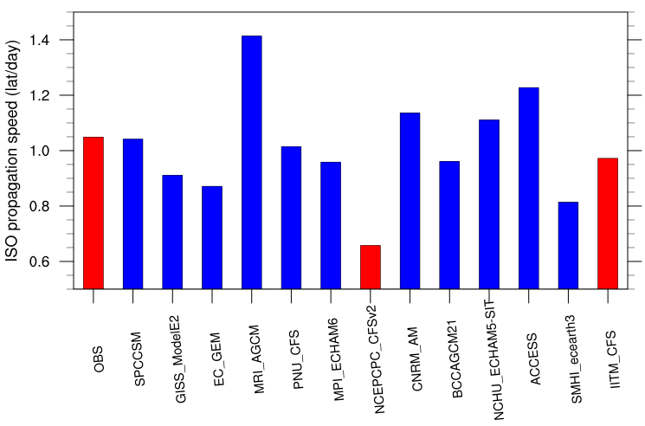
Skill score based on northward propagation of BSISV
is the ratio between model simulated and observed standard deviation. R is the pattern correlation and R0 the upper limit for pattern correlation.
Northward propagation speed
Combined pattern correlation from the two previous plots

Slide 10
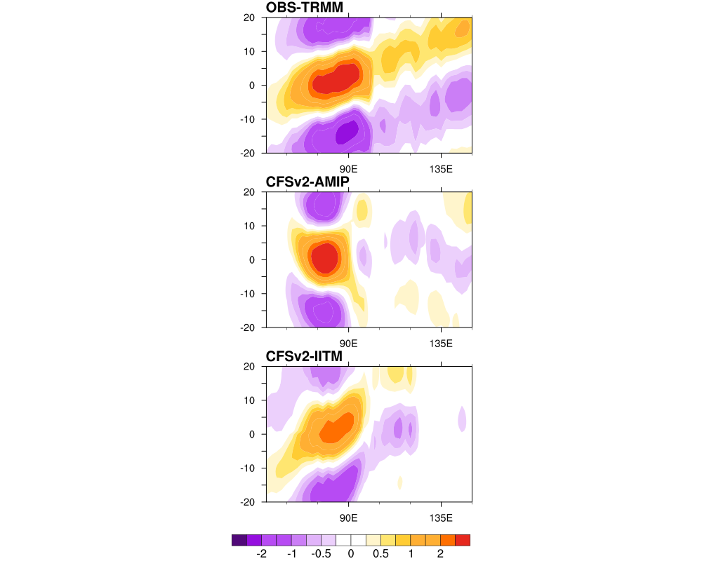
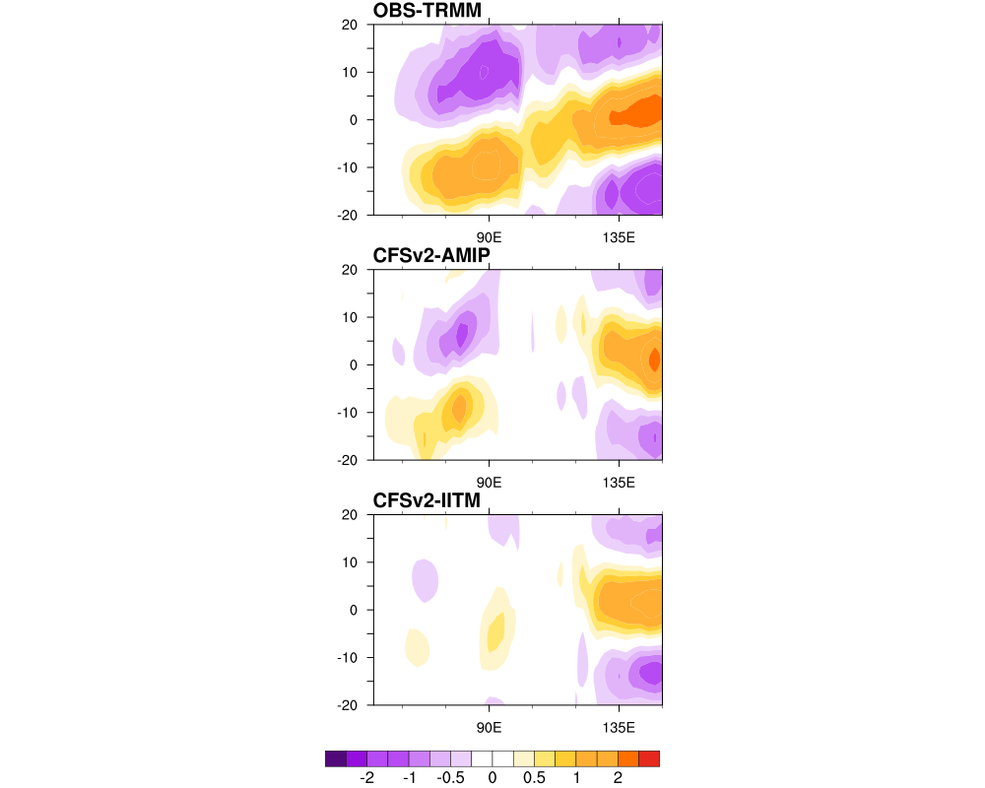
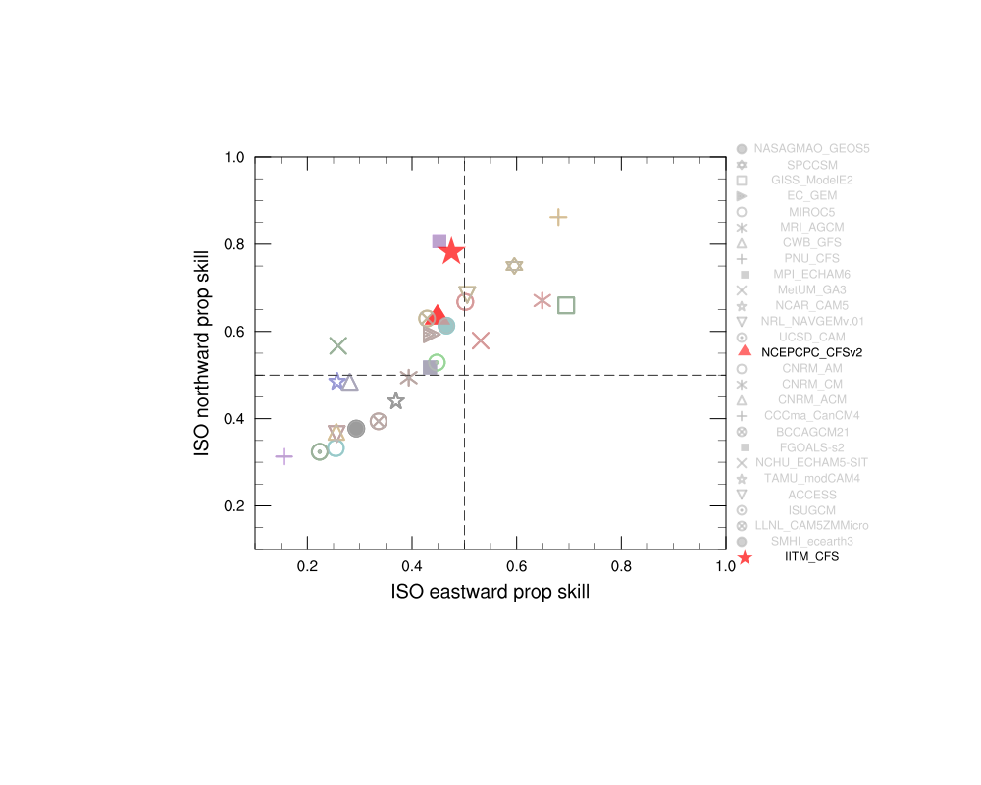
Association of BSISV northward propagation with equatorial eastward propagation
Regression w.r.t Indian Ocean base point
Regression w.r.t W.Pacific base point
Models skill in simulating the northward propagation clearly linked to its skill in simulatin equatorial eastward propagation.
CFS seems to be more skillful in simulating northward propagation
Regression coeff. averaged between 10S-10N
Corr 0.836

Slide 11
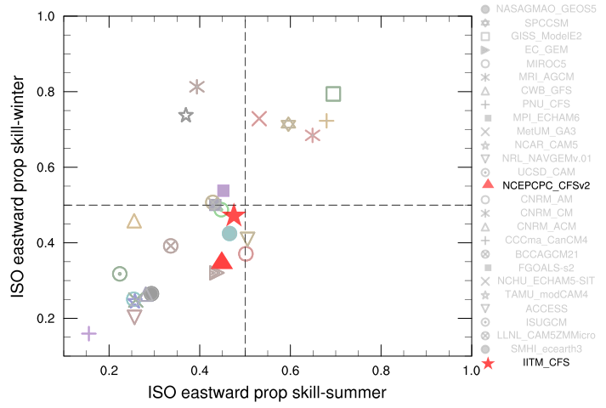
Relative performance of models in simulating equatorial eastward propagation of ISV during summer Vs winter
Corr 0.75
Most models do not show much seasonal variation when it comes to simulating the ISV eastward propagation.
Even then, the winter ISV skill is better in most models than that for summer

Slide 12
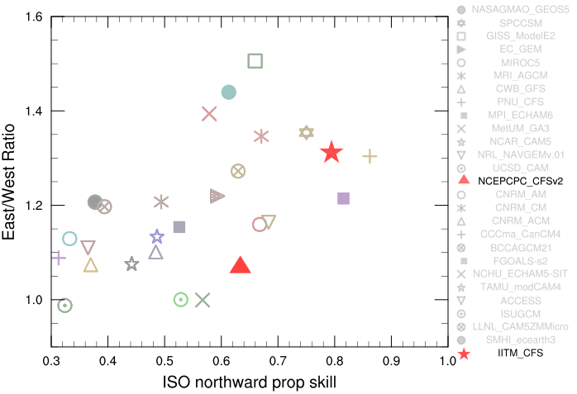
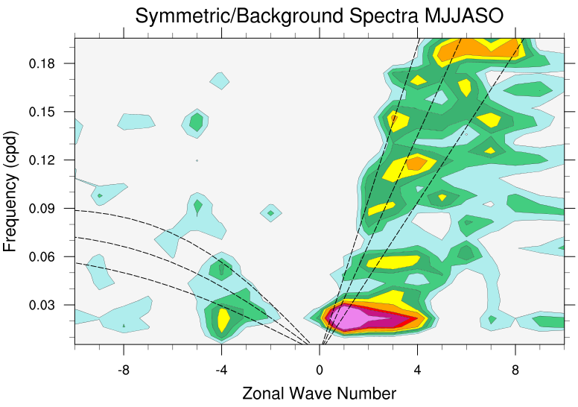
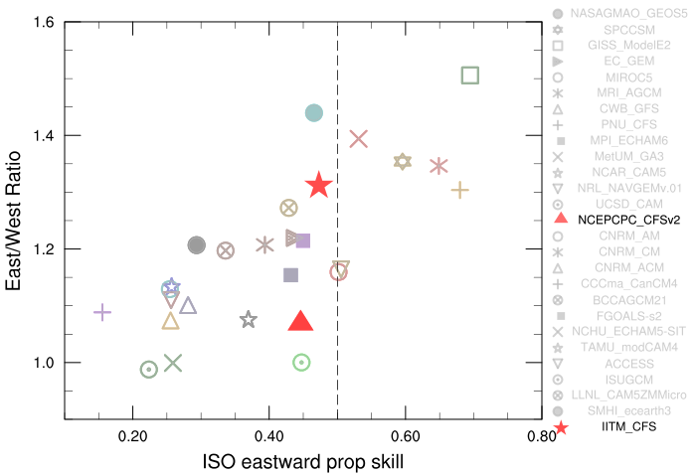
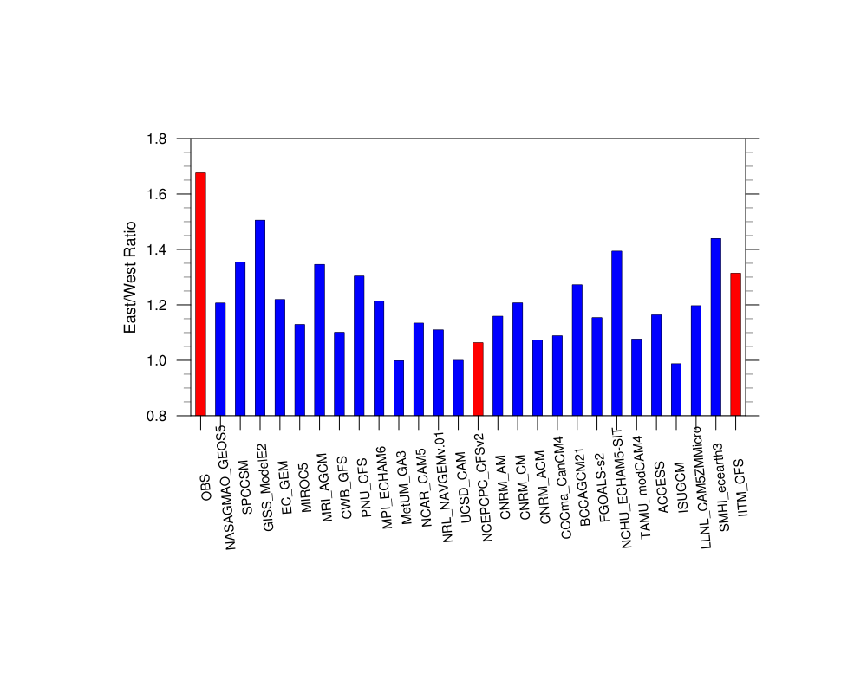
East/West Spectral Power ratio to assess BSISV
The ratio of spectral power in the 30-60 day time scale for eastward and westward wave numbers 1-3 is a popular metric for assessing winter MJO
Corr 0.53
Corr 0.73
Is it a useful metric for assessing BSISV in models?
The East West spectral power is a useful indicator for BSISV eastward propagation, but it does not give a good measure of its northward propagation.
While we earlier saw a clear relationship between skill scores for BSISV eastward and northward propagation, the relationship is not robust with the East /West Ratio

Slide 13
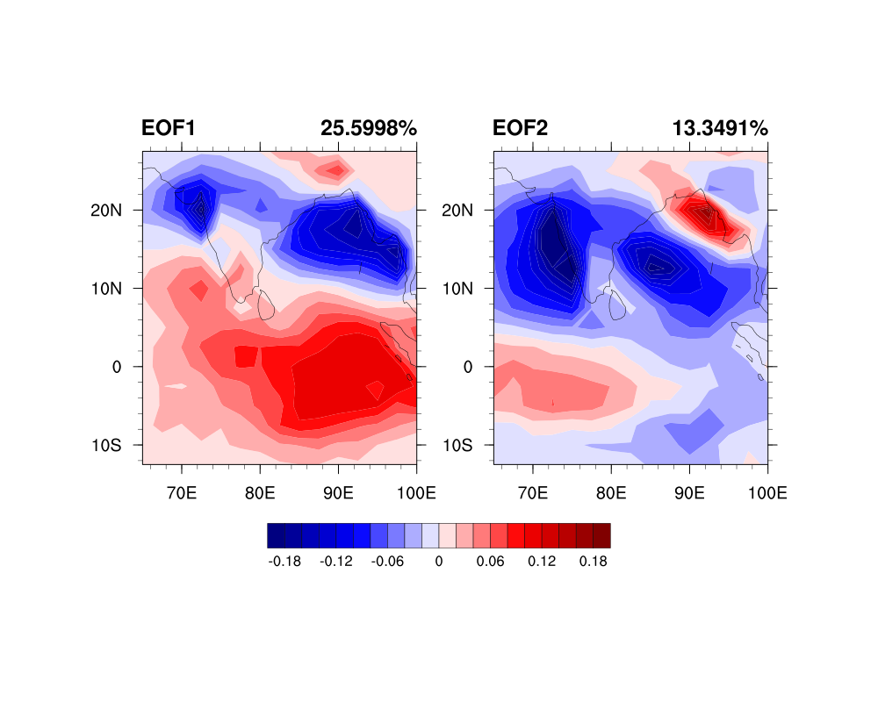
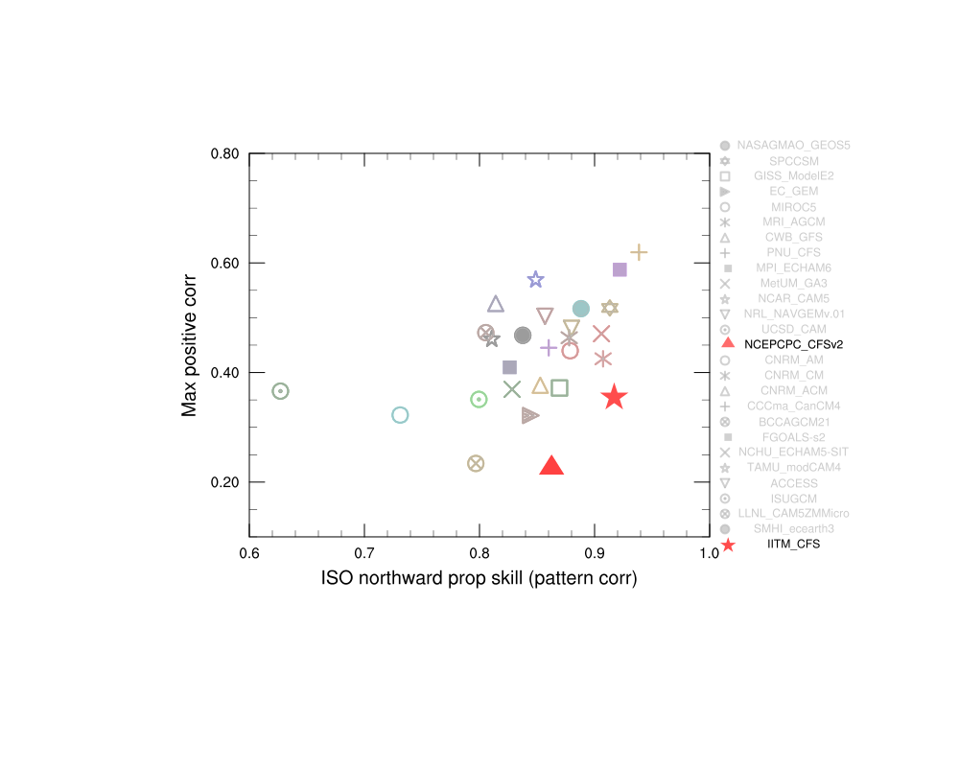
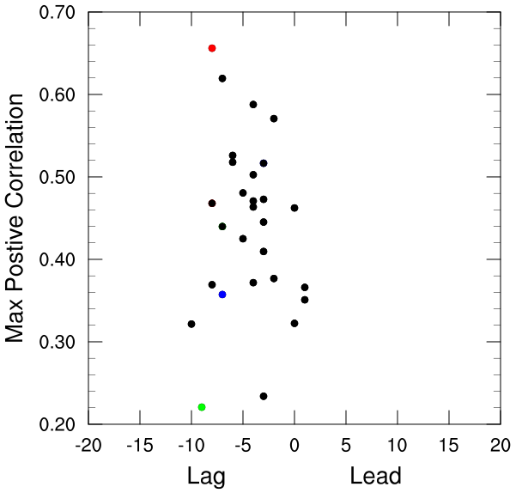
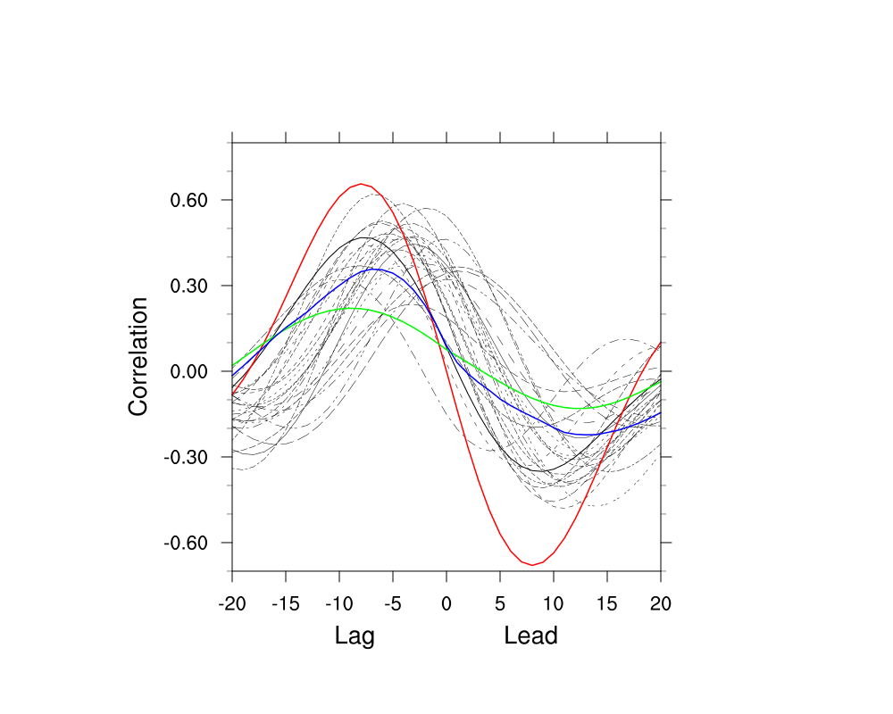
A Simple metric for BSISV northward propagation
EOF 20-90 day filtered precipitation
Following Sperber and Kim, 2012
Model simulated precipitation anomalies (filtered), projected onto observed EOF modes.
Lag relationship between PC1 and PC2 gives an indication of the ISV propagation
Corr 0.48
Obs
CFS AMIP
IITM CFS

Slide 14
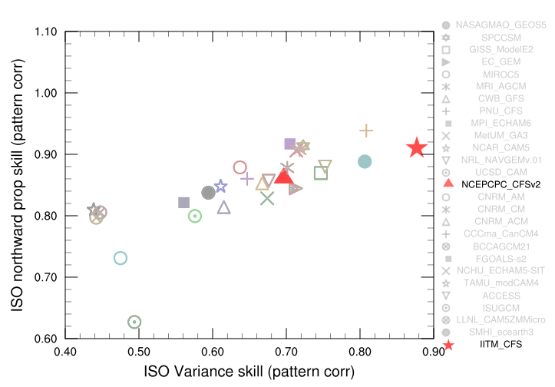
Amplitude and propagation of BSISV
Corr 0.758
In general a model capturing the spatial structure of intraseasonal variance also represents the northward propagation character reasonably.
But, the magnitude of average intraseasonal variance over the South Asian domain is no indicator for the northward propagation fidelity.

Slide 15
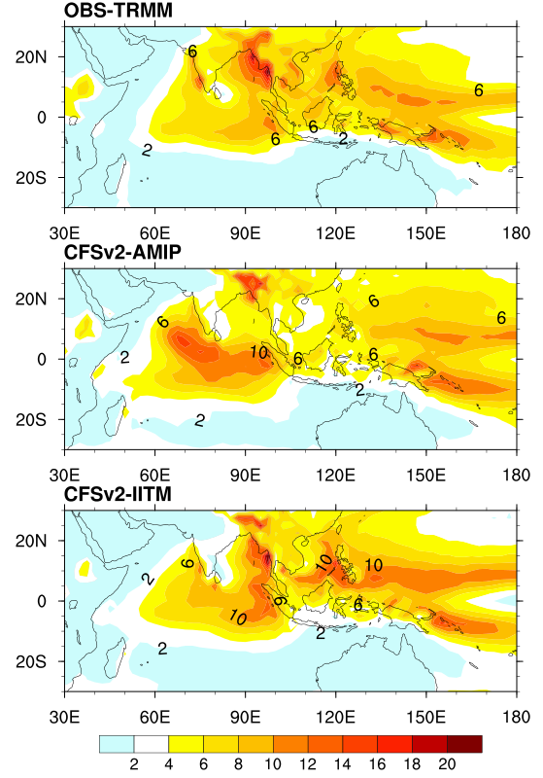
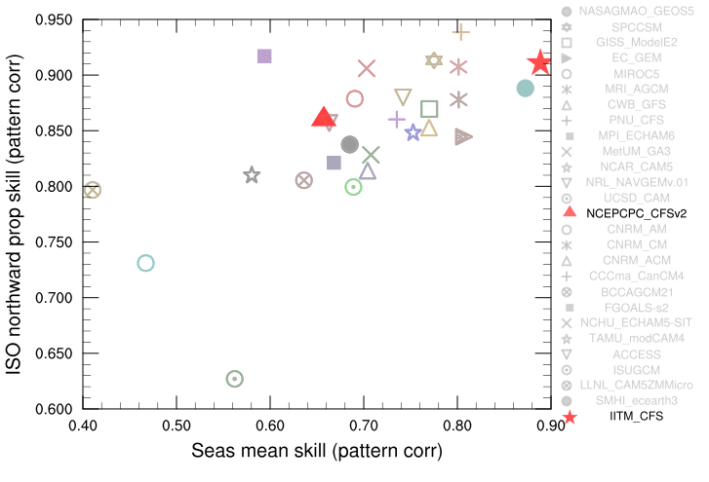
Seasonal mean and BSISV northward propagation
Corr 0.61
Models capturing the ISV northward propagation reasonably, also shows better representation of seasonal mean.
Also, contrary to some earlier study, (Kim et al, 2011) we do not find an increased seasonal mean bias between Indian Ocean and W. Pacific in models with better representation of ISV.

Slide 16
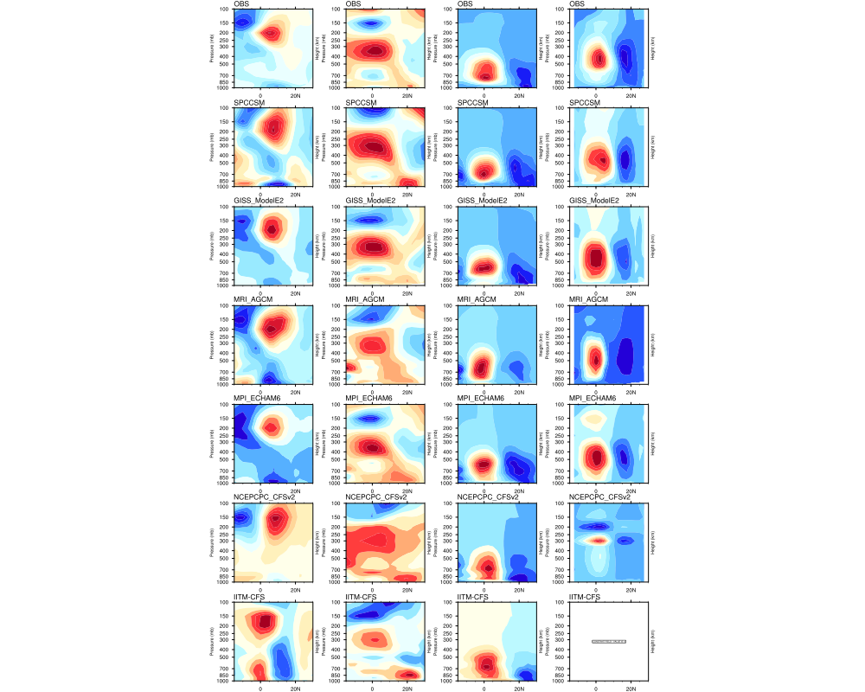
Zonal wind
Temperature
Sp.Hum
Diabatic Heating Q1
Time-Latitude Profiles of Dynamic and Thermodynamic variables
Daily anomalies of U, T,q and Q regressed on to the 20-90 day filtered precipitation at the Indian Ocean Base point.
5 models with good representation of northward propagation of BSISV shown along with CFS

Slide 17
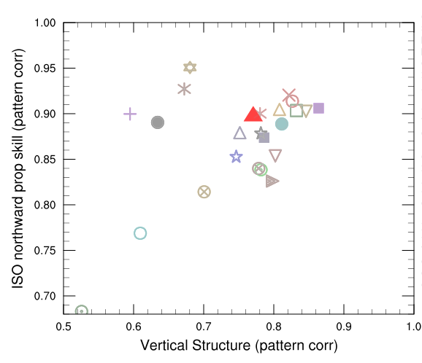
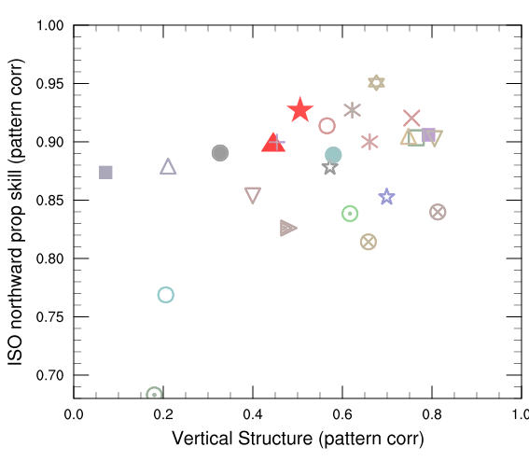
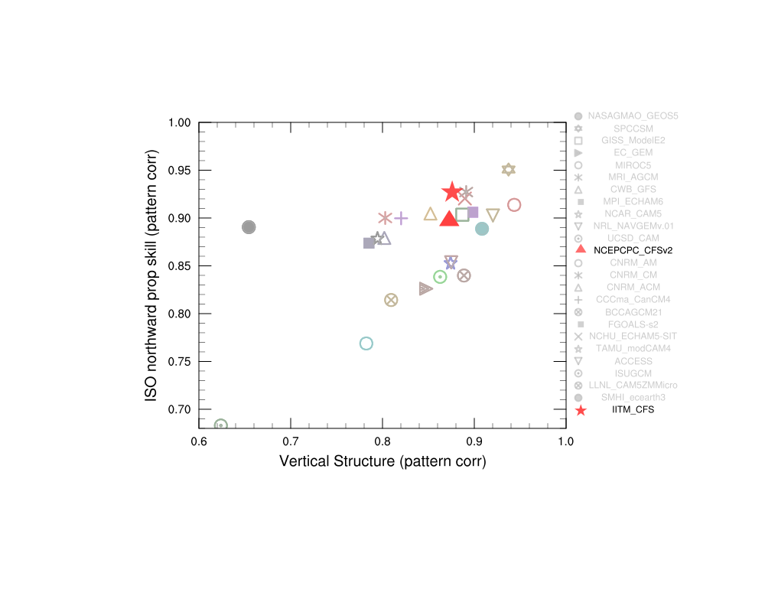
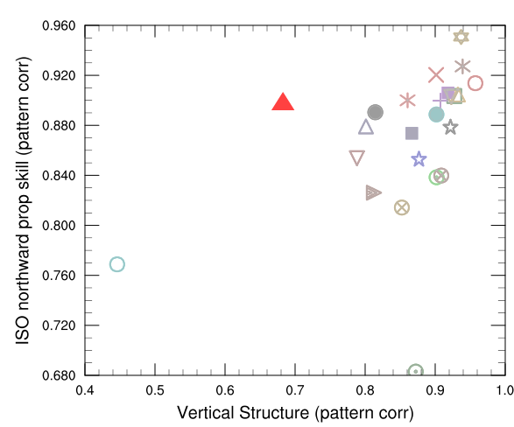
Zonal wind
Temperature
Corr 0.51
Corr 0.47
Sp.Hum
Diabatic Heating Q1
Corr 0.62
Corr 0.44

Slide 18
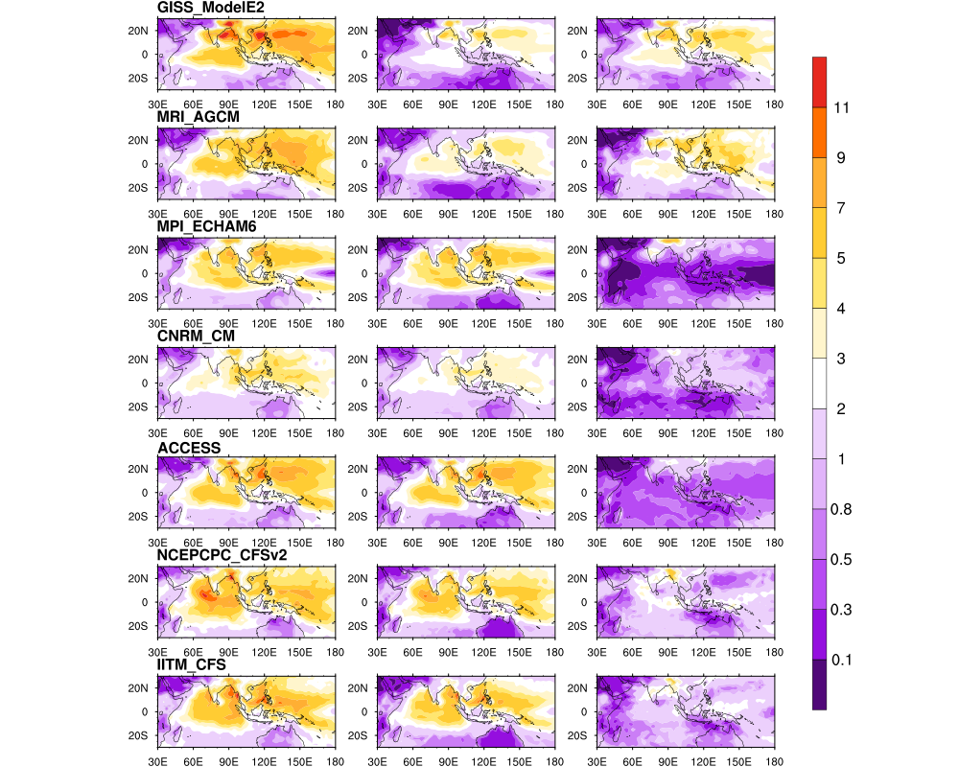
Intraseasonal variance in convective and Large scale precipitation fields
Total
Convective
Large scale
Large scale rainfall is known to be critical for producing a top heavy heating structure and its representation is thought to be one of the factors limiting the ISV representation in models.
5 models with good representation of northward propagation of BSISV shown along with CFS

Slide 19
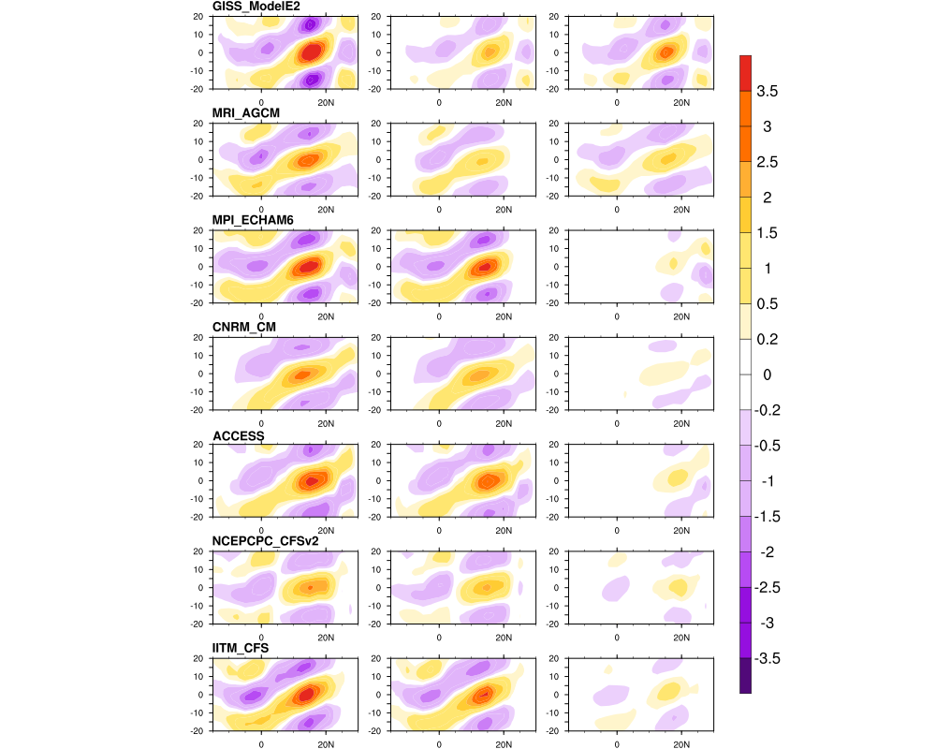
Intraseasonal variance in convective and Large scale precipitation fields
Total
Convective
Large scale
Comparable contributions of convective and larges cale rainfall are only seen in two of the 5 good models.
Large scale rain fraction is much lower in CFS

Slide 20
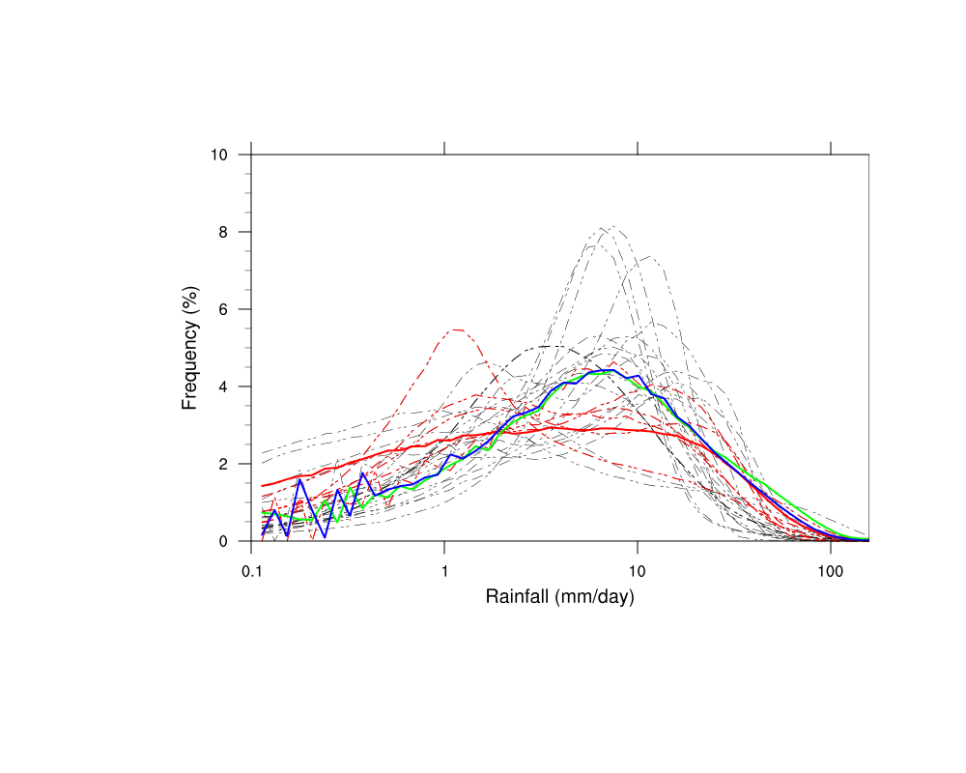
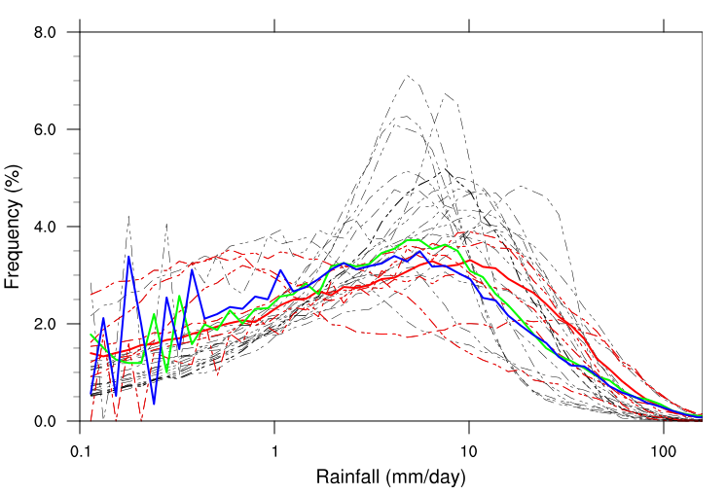
Probability distribution of rainfall intensity
Eq Indian Ocean
Obs
CFS AMIP
IITM CFS
Total Rainfall in each grid point is binned into 51 bins of precipitation intensity and the fraction of rain events in each bin is estimated.
Shown in red dashed lines are the pdfs for 5 good models
Monsoon trough
The frequency of high intensity events is very high in most models with weaker ISV representation.

Slide 21
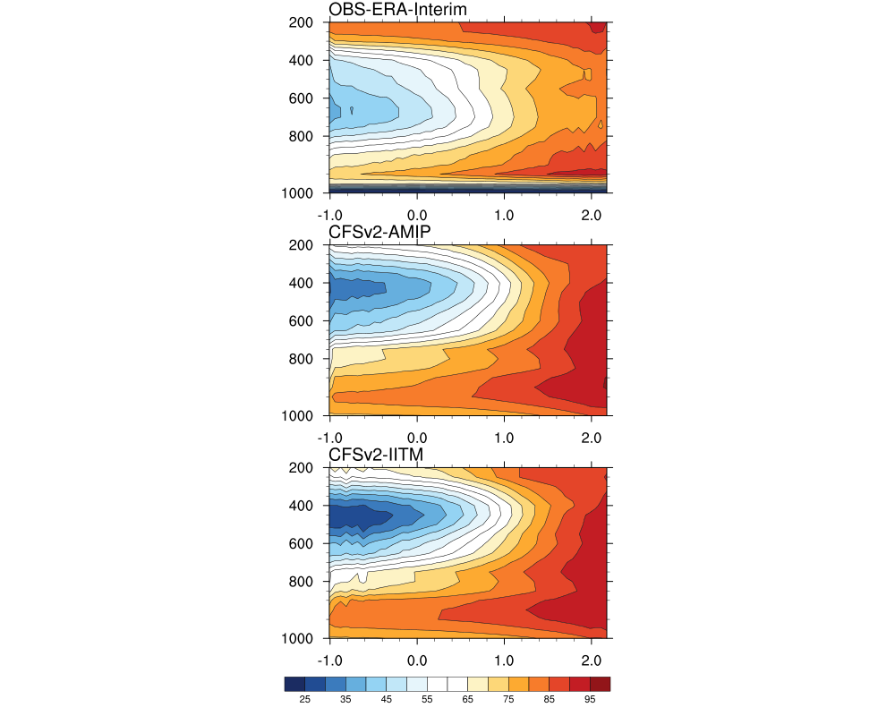
Moisture-Convection relationship
A strong relationship between the spread in low-level RH between the top tier and bottom tier of precipitation events and the model skill in representing the ISV was noted in different studies [Thayer-Calder and Randall, 2009, Kim et al, 2014, Maloney et al., 2014]
RH is composited at different vertical levels for each precipitation bin shown in the previous figure. (x axis – Log of precipitation intensity)
Higher values of Relative humidity in lower to mid troposphere for high intensity precipitation events in models.
Box: 10S-10N, 60-90E

Slide 22
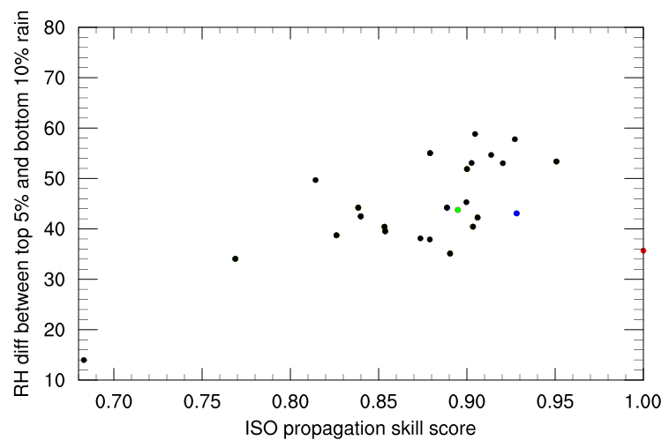
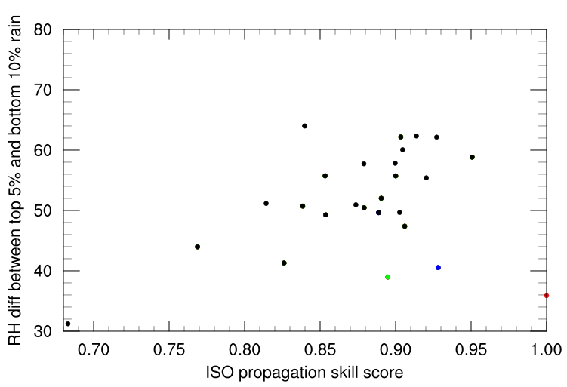
Relative Humidity Diagonostic
Eq Indian Ocean
Corr 0.77
RH difference in lower-mid tropospheric RH (850-500hPa) between the top 5% and bottom 10% precipitation events plotted is plotted against ISO northward propagation skill.
Corr 0.65
Monsoon trough
Stronger convection- moisture sensitivity tend to produce stronger BSISV

Slide 23
Future plans
Apply the evaluation framework to SP-CFS simulations, IITM CFSV2 version with modified microphysics, NCEP CFSV3 and any other developmental version of CFS available in the coming year. Augment the set of evaluation metrics and process diagnostics with more metrics based on the developments and outcomes from the MJO Task Force and MJOTF-GASS YOTC multi-model experimental results. Develop Forecast metrics for monsoon ISV and apply it to CFSV2 hindcasts being made at IITM. Explore development of metrics/diagnostics based on cloud properties and cloud-precipitation-radiation feedbacks over the monsoon domain, using CloudSat, CALIPSO and TRMM products.

Slide 24
Thank You!
NMM Directorate
Ministry of Earth Sciences
Indian Institute of Tropical Meteorology
University of California, Los Angeles

Slide 25
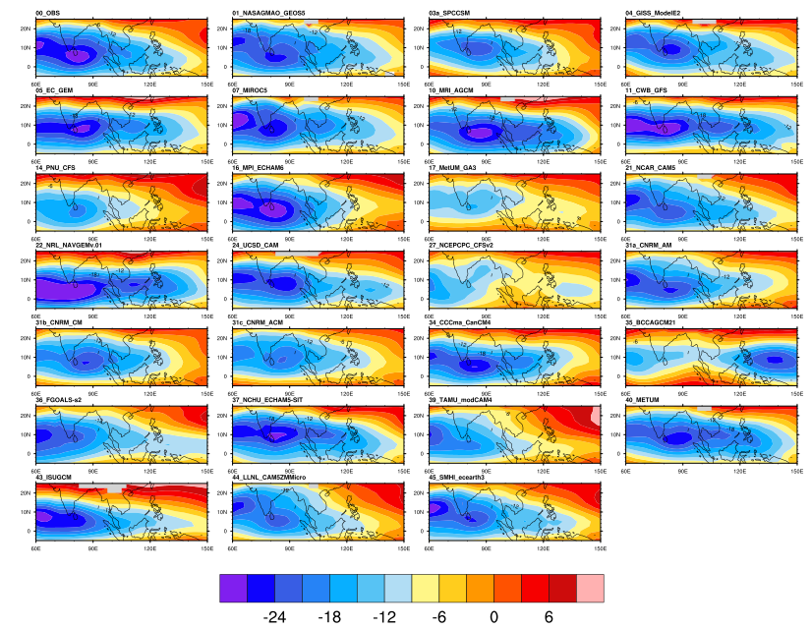
Vertical wind shear between 850 hPa and 200hPa

Slide 26
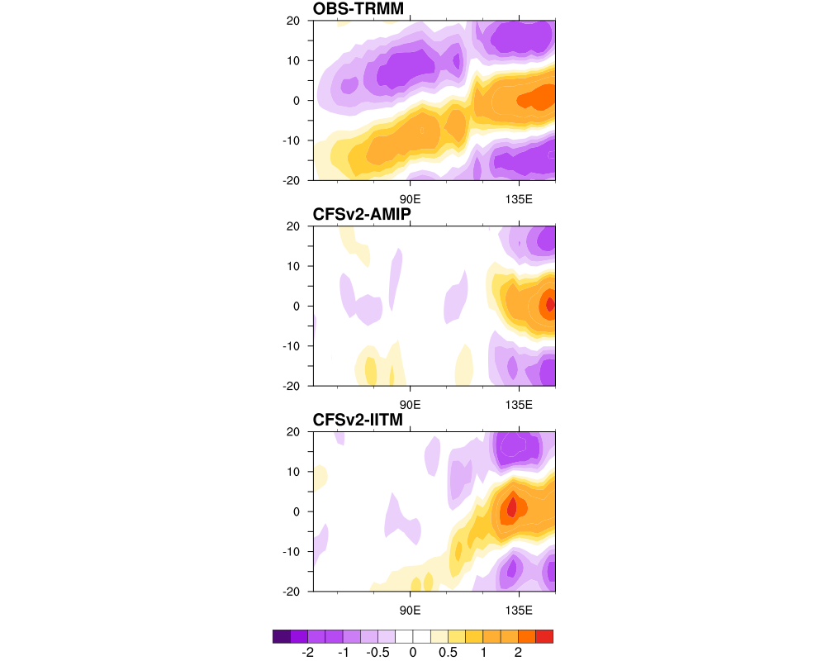
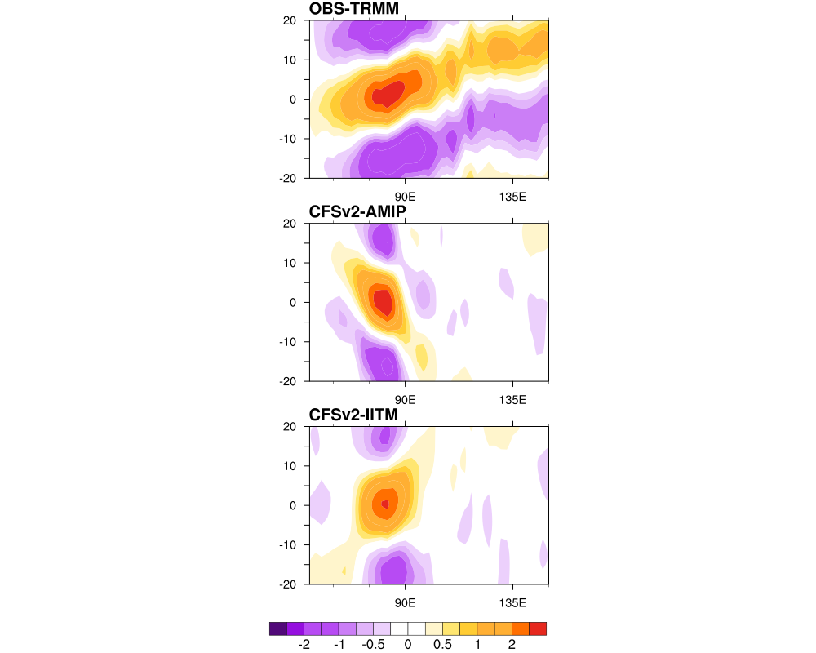
WP
Winter
IO

