Slide 1
Recent Model Development Activities at NCEP
(GFS/CFS/GEFS)
And
Monsoon Desk
Presented by :
Partha S Bhattacharjee
I.M. Systems Group
Environmental Modeling Center (EMC)
NOAA/NWS/NCEP
Acknowledgements : Glenn White, Fanglin Yang, Shrinivas Moorthi, Mark Iredell, Suranjana Saha, Yuejian Zhu, Hendrik Tolman (NWS/NCEP/EMC)
IITM Monsoon Mission Review meeting, 18-20 Feb, 2015

Slide 2
Outline
Implementation of new GFS at NCEP
Major changes
Physics upgrades and issues
next implementation
CFS plans (Draft)
Ensemble forecast updates with GEFS
Monsoon desk
Future work

Slide 3
Global Forecast System (GFS)
14th January, 2015 NCEP implemented a new GFS (T1534) with semi-
Lagrangian dynamics (uses Hermite interpolation in both horizontal and vertical
direction) (Sela, 2010)
It still remains spectral model with equivalent grid spacing improves :
- 27 km to 13 km for first 240 hours
- 84 km to 35 km from 240 – 384 hours
DA system equivalent grid spacing reduced from 62 to 27 km (T574 analysis for
T1534 deterministic)
Uses 5 minute daily Real-time Global (RTG) Sea-surface Temperature (SST) to
replace 1.0 degree Reynolds 7day SST analysis
Multi-sensor Snow and Ice Mapping System (IMS) ice analysis data at 4 km
resolution use to initialize ice at inland lakes (in NH) (remove unfrozen lake in
winter)
Replace model snow depth update by direct use of Air Force Weather Agency
(AFWA) depth data with blend of the model first guess depth and AFWA depth

Slide 4
Global Forecast System (GFS)
Monte-Carlo Independent Column Approximation (McICA) for RRTM radiation
Use divergence damping in the stratosphere to reduce noise
Added Eddy Diffusivity Mass Flux (EDMF) scheme in PBL scheme and
Turbulent kinetic Energy (TKE) dissipative heating
Ice and water cloud conversion rates retuned ; background momentum diffusion
and drag coefficients for high wind speeds are reduced
Stationary convective gravity wave drag is added
Added dependence of the ratio of the thermal and momentum roughness on
vegetation type
Replace 1.0 degree bucket soil moisture climatology with CFS/GLDAS
climatology at T574 resolution.

Slide 5
Global Forecast System (GFS)
GDAS/GFS Hybrid 3D-VAR Ensemble Kalman Filter (EnKF) DA :
Hourly GOES and EUMETSAT satellite winds
Assimilate SSMIS UPP LAS and Metop-B IASI radiances
SSMIS 10-m wind, precipitable water, rain rate and cloud liquid
CRTM v2.1.3 improves specifications of MW sea surface emissivities
(analysis over near surface temperature over water over Southern Oceans)
Use stochastic physics in EnKF ensemble forecasts
T574L64 EnKF ensembles
Improvements to satellite DA over water and sea ice

Slide 6
Global Forecast System (GFS)
Output product changes :
Added 0.25 degree gridded output
Various new product fields : Ozone at 400, 350, 300, 250, 200 and 150 mb ;
2m dew point, wind chill and heat index ; instantaneous precipitation types
(rain/frozen/snow/ice) etc.
Output in GRIB2 ; change in naming convention.
Visit this link to see all changes in GFS : http://www.emc.ncep.noaa.gov/GFS/impl.php
Link to the production version of model codes :
http://www.nco.ncep.noaa.gov/pmb/codes/nwprod/

Slide 7
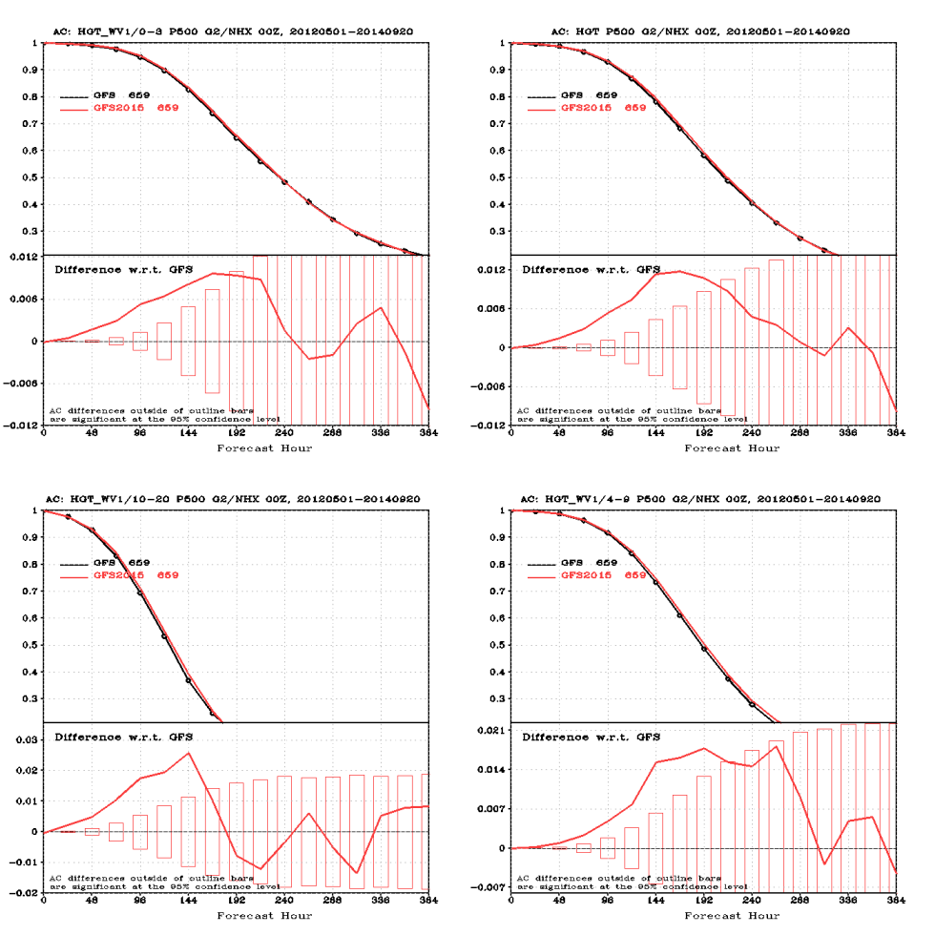
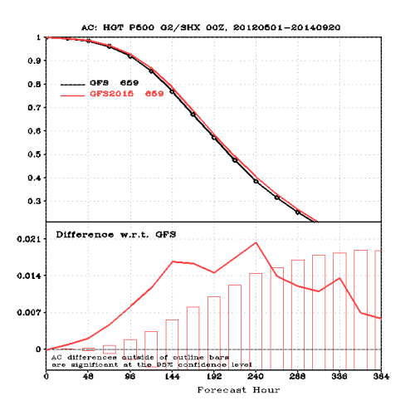
GFS improvement result : merged 2012/2013/2014 run
T1534 tested for 32 simulated months (covering all seasons) and 4 hurricane seasons
(2011-2014)
Northern Hemisphere
Southern Hemisphere
Verification Statistics : http://www.emc.ncep.noaa.gov/gmb/wx24fy/vsdb/gfs2015/
(Courtesy : Fanglin Yang ; EMC)

Slide 8
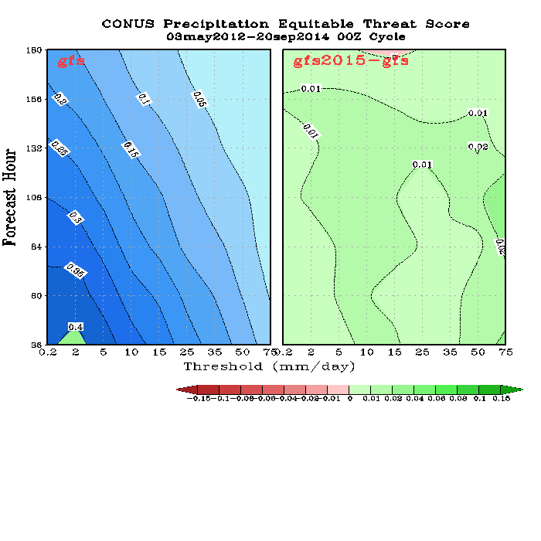
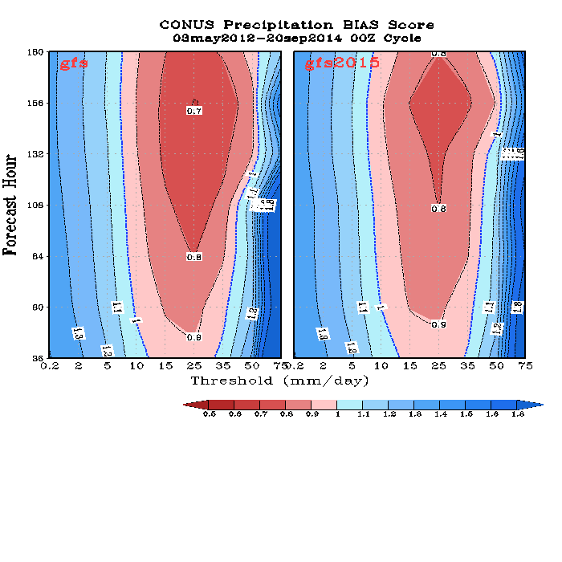
Precipitation Skill Scores, 00Z Cycle
Merged 2012/2013/2014
ETS
BIAS
Improved ETS score and reduced forecast BIAS for all intensity and forecast lead time.
Usefulness of GFS synoptic forecast improved by 3h in NH and 4.4h in the SH
24-h half-inch per-day precipitation threat forecast improved ~4% over CONUS
(Courtesy : Fanglin Yang ; EMC)

Slide 9
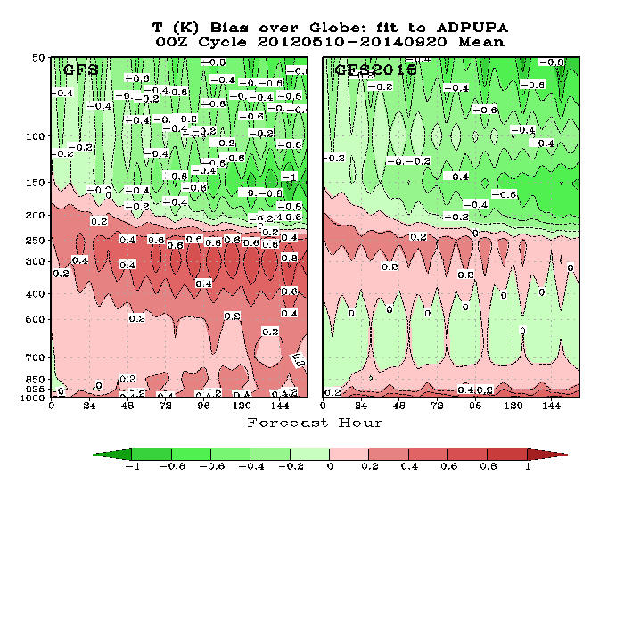
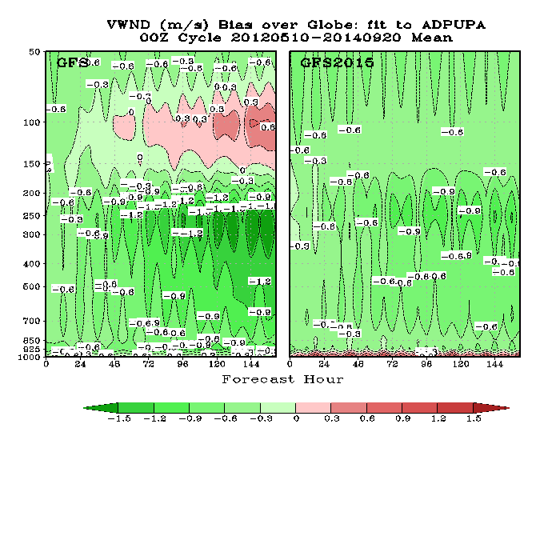
Fit to RAOBS, Bias
Merged 2012/2013/2014
Global Mean Temperature Bias
Global Mean Wind Bias
Reduced tropospheric warm bias, increased near surface warm bias
Strengthened tropospheric wind, slightly weakened stratospheric wind
(Courtesy : Fanglin Yang ; EMC)

Slide 10
Clouds, microphysics and radiation in GFS
Prognostic cloud condensate implemented into GFS in 2001 (Moorthi et al., 2001, T170L42)
Cloud cover is calculated based on Xu and Randall (1996) ; Maximum cloud overlapping in both
LW and SW (RRTM) radiations ; convective clouds not considered in radiation
Grid-scale cloud condensation and evaporation is based on Zhao and Carr (1997) and Sundqvist et
al., (1989)
GFS deep cumulus convection schemes uses Simplified Arakawa-Schubert (SAS) ; Pan and Wu
(1995) and with some modifications in Han and Pan (2011) scheme
Cloud condensate mixed by the turbulent mixing process in the boundary layer
Deep convection and shallow convection contribute to total cloud condensate through detrainment
No mixed phase cloud ; Cloud water and ice are partitioned based on temperature and the cloud
condensate at the upper layer
Conversion of the condensate (if water) to rain uses Sundqvist et al., (1989); ice to snow based on
Lin et al (1983) ; rain and snow evaporation are included as well as melting of snow
Precipitation falls instantly (not stored in the atmosphere); rain and snow are distinguished.

Slide 11
Updates : GFS PBL scheme
Before January 2015 implementation, a K-profile method with a non-local counter-gradient mixing term (γ_{h}) is used (large non-local convective eddies), so called as eddy-diffusivity counter-gradient (EDCG) PBL scheme (Troen & Mahrt, 1986; Hong & Pan, 1996)
Vertical heat flux
In July 2010 upgrade, the PBL scheme is revised to enhance turbulence mixing in stratocumulus regions (Han & Pan, 2011)
Surface and cloud top driven eddy diffusivities
In January 2015 upgrade, an eddy-diffusivity mass-flux (EDMF) PBL scheme is implemented for the strongly unstable PBL. And the heating by turbulent kinetic energy (TKE) dissipation (ε) is also parameterized (Han et al., 2015?)
(Courtesy : Jongil Han ; EMC)

Slide 12
Upcoming modifications for GFS T1534 :
1) cloud base mass flux (m_{b}) calculation
A: cloud work function (~CAPE [Convective Available Potential Energy])
Current:
Update:
Full CAPE elimination closure
D: cloud depth
a=1.0
(Courtesy : Jongil Han ; EMC)

Slide 13
2) Upcoming modification in rain/snow conversion rate
Current :
for both deep and shallow convections
Update:
for shallow convection
for deep convection
(Lim & Hong, 2012)
It is derived based on cloud resolving model results for a convective storm.
Change in autoconversion rate coefficients in the microphysics scheme:
Ice to snow: 6.0×10⁻⁴ => 8.0 × 10⁻⁴
Liquid water to rain: 1.0 × 10⁻⁴ => 2.0 × 10⁻⁴
(Courtesy : Jongil Han ; EMC)

Slide 14
GFS physics : Current efforts and future
We are in the process of extensive moist physics upgrades through Climate Program Office
and Climate Test Bed supported Climate Processes Teams (CPTs) and NGGPS-R2O program
The work will involve both improving existing physics and importing advanced scale-aware
physics form other institutions and Universities. External collaborators on these projects
include Chris Bretherton (U. Washington), Joao Teixeria (JPL), Steve Krueger (U. Utah),
Dave Randall (CSU), Robert Pincus (ESRL/U. Colorado), Arlindo DaSilva (GSFC),
Sarah Lu (SUNY Albani) and others.
List of areas include boundary layer, shallow convection, deep convection, microphysics,
aerosols, cloud-aerosol-radiation interaction etc.
(Courtesy : S. Moorthi and others, EMC)

Slide 15
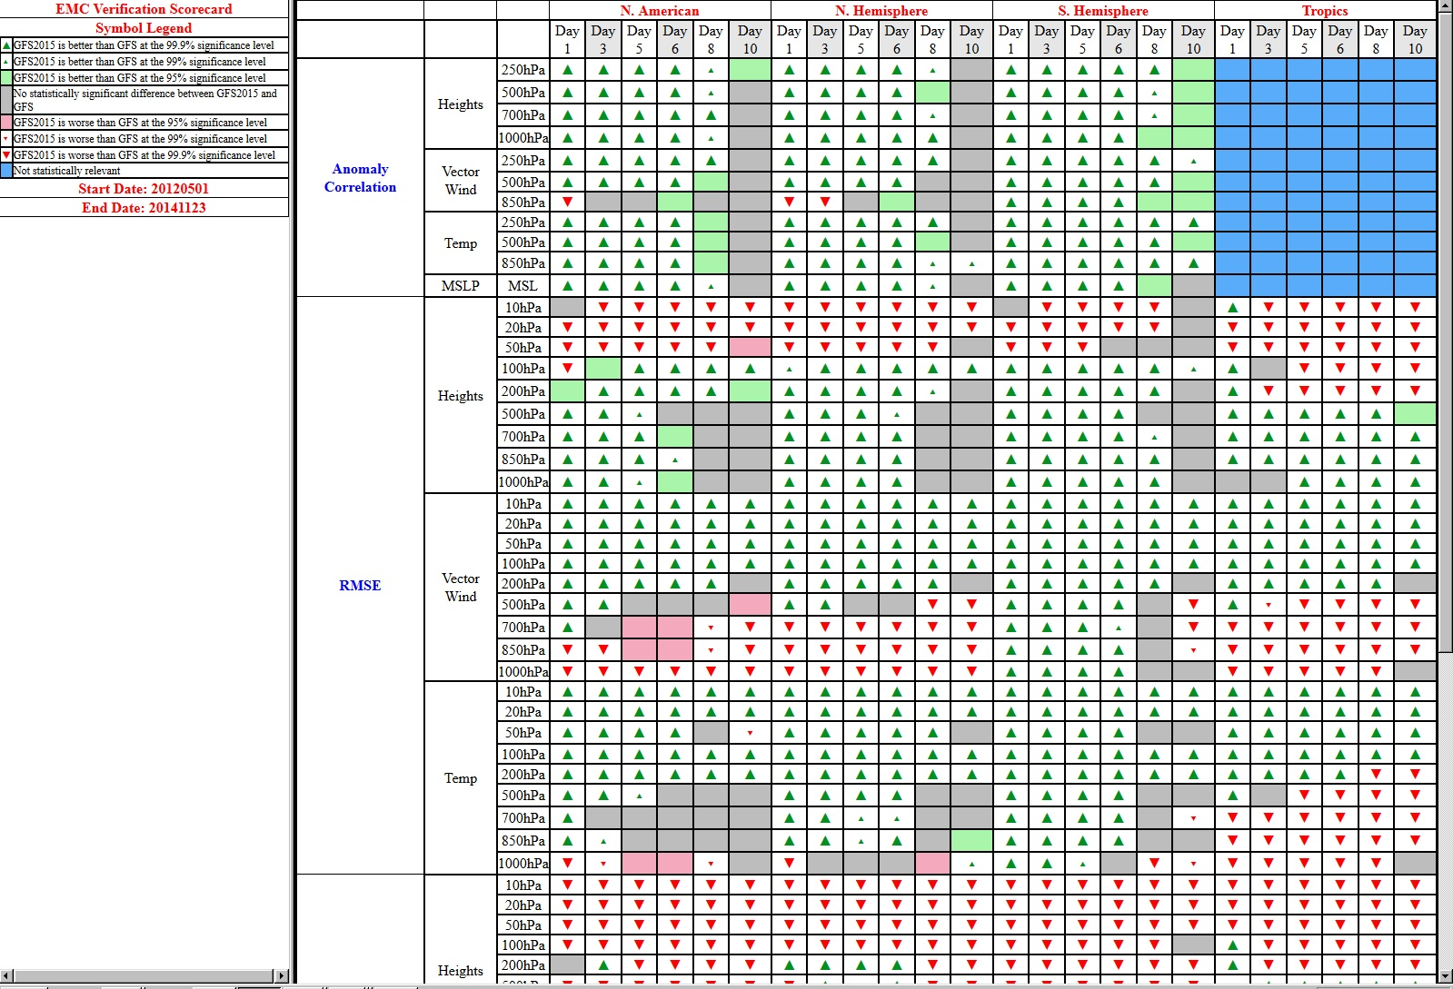
GFS Score card
Daily update : http://www.emc.ncep.noaa.gov/gmb/wx24fy/vsdb/gfs2015/www/scorecard/mainindex.html
(Courtesy : Fanglin Yang ; EMC)

Slide 16
GFS Model biases
Model Evaluation Group (MEG at EMC) listed some of the model issues (mostly over
CONUS). Glenn White and Geoff Manikin (EMC) prepared the following list:
Late afternoon (between 21z and 0) 2m cold (boundary layer collapse) ; cold wet bias in
Eastern USA
GFS moisture initialization (no use of 2m dew point observation)
Too weak GFS inversions
Low level winds too strong over CONUS (Land surface group currently testing this issue)
Too warm 12z 2m temperature over Southern Plains
CONUS precipitation skill biases : too dry medium amounts, popcorn pattern in west
during summer
Bogus hurricanes in Central America : CAPE closure convection. Bogus hurricanes vs.
detecting actual genesis
Forecasts fail to maintain ascent in western equatorial Pacific, Indonesian region ; failure
to maintain MJO in west Pacific in forecasts
Indian participation in MEG meeting in seasonal basis ?

Slide 17
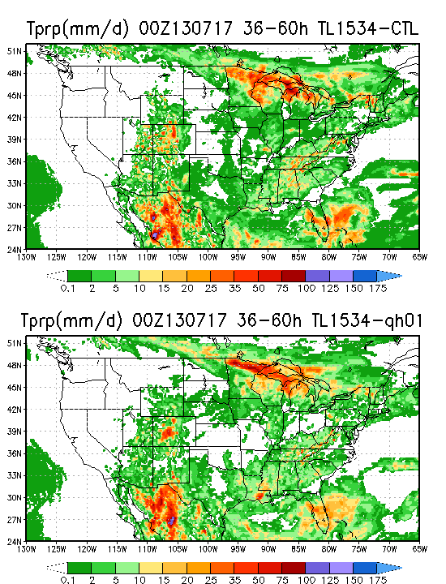
Improving GFS precipitation
Control run
Experiment with modified trigger function (especially with convective inhibition (CIN) reduce popcorn-like precipitation. No trigger if CIN < -120 m²/s²
(Courtesy : Jongil Han ; EMC)

Slide 18
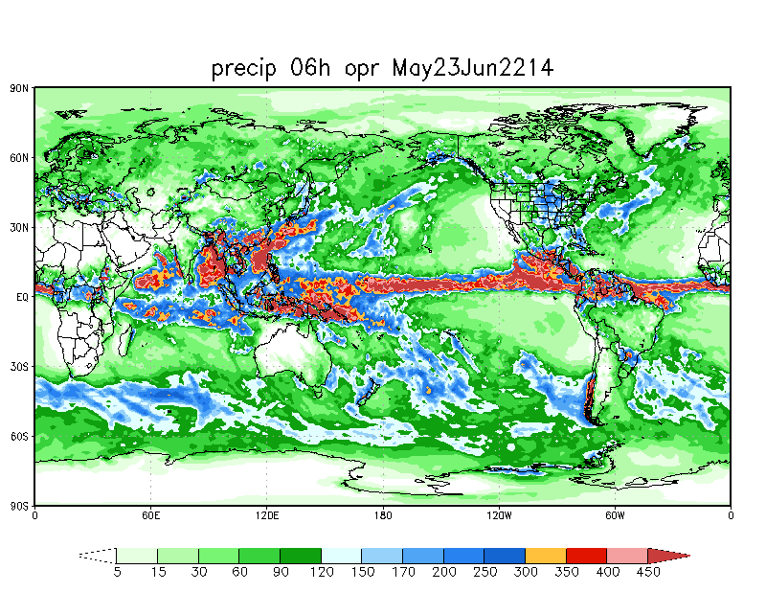
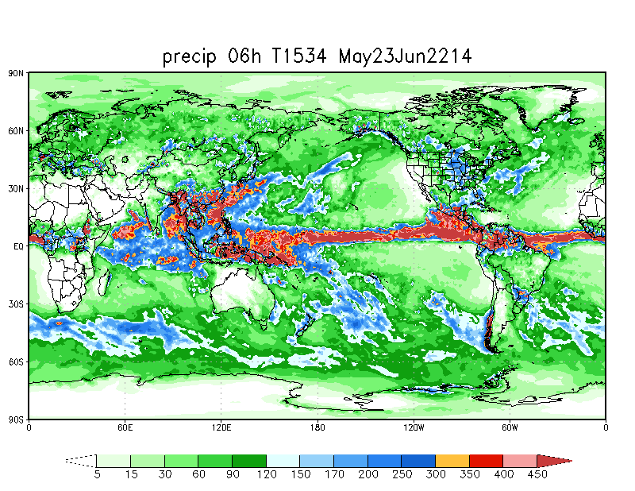
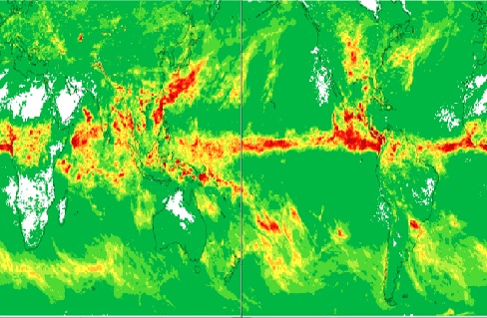
Precip 06h, T574, May23Jun22, 2014
Precip 06h, T1534, May23Jun22, 2014
NOAA/NCEP/CPC CMORPH
Accumulated precipitation :
12z May 22 – 12z Jun 15, 2014
GFS generally forecasts too much of convection along the SW coast of India when the surface
flow impinging along the SW coast of India is around 20 kt
(Courtesy : Stan Benjamin, ESRL)

Slide 19
Implementation plan for December 2015 GFS upgrade
Major software infrastructure upgrade : NOAA Environmental Modeling System (NEMS)
enable coupling to other components (ocean, sea-ice, wave, aerosol, land, atmosphere,
ionosphere)
  Unifies GFS infrastructure and unifies gridded I/O (NEMSIO), removing requirement
  for spectral transforms in ancillary codes
  Hybrid 4D-EnVAR : The ensemble-derived background error as well as the GSI analysis
  increment will vary in time over the -3 hour to +3 hour assimilation window
Semi-implicit improvements to increase numerical stability
Cumulus convection improvements
  Land and Surface physics implementation : address seasonal (summer warm/dry, winter
  cold/wet) and diurnal (sunset cold, sunrise warm) biases
(Courtesy : Mark Iredell; EMC)

Slide 20
Summary of upcoming changes in GFS (tentative)
Changes | Comments
DA Change : 4D hybrid | Time consistency and accuracy
Model change
NEMS with nemsio | Infrastructure
Cumulus convection update | Precipitation score and fewer false alarms
Enhanced Semi-implicit stability | Larger dt, less noise, less dissipation
Land changes | Summer warm/dry bias, winter cold/wet bias over CONUS
Sea ice change | Consistency with CFS, better ice representation
New radiation package | Call radiation at every time step
Surface layer and PBL physics | Cold sunset bias, warm sunrise bias
(Courtesy : Mark Iredell; EMC)

Slide 21
CURRENT Dual-Res Coupled Hybrid
Var/EnKF Cycling
member 1
forecast
Generate new ensemble perturbations given the latest set of observations and first-guess ensemble
member 1
analysis
T254L64
member 2
forecast
EnKF
member update
member 2
analysis
recenter analysis ensemble
member 3
analysis
member 3
forecast
Ensemble contribution to background error covariance
Replace the EnKF ensemble mean analysis
and inflate
GSI 3D
Hybrid Ens/Var
T574L64
high res
forecast
high res
analysis
P^{b} =(β^{b}_{f} )⁻¹ P^{b}_{f} +(β^{b}_{e} )⁻¹ P^{b}_{e} ; (β_{f} )⁻¹ : static weight and (β_{e} )⁻¹ ensemble weight
Previous Cycle
Current Update Cycle
** implemented in GDAS/GFS in May, 2012
(Courtesy : Daryl Kleist; UMD/EMC)

Slide 22
3D EnVar to 4D EnVar
Tentative schedule to be part of GDAS/GFS upgrade in late 2015
Natural extension to operational 3D EnVar
  Uses variational approach with already available 4D ensemble perturbations
No need for development of maintenance of TLM and ADJ models
  Makes use of 4D ensemble to perform 4D analysis
  Modular, usable across a wide variety of models
Highly scalable
  Aligns with technological/computing advances
Computationally inexpensive relative to 4DVAR (with TL/AD)
  Estimates of improved efficiency by 10x or more, e.g. at Env. Canada (6x faster than 4DVAR on half as many cpus)
Compromises to gain best aspects of (4D) variational and ensemble DA algorithms
Other centers exploring similar path forward for deterministic NWP
  Canada (potentially replace 4DVAR), UKMO (potentially replace En4DVar)
(Courtesy : Rahul Mahajan , EMC)

Slide 23
Climate Forecast System (CFS)
Upcoming changes in CFSv2 :
CFSv2.1.9 fixed bugs and accommodate changes in GDAS (implemented with GFS T1534
release)
Major upgrade will be in CFSv2.2.0 to install GSI Rel-5.0.0 and upgraded GLDAS system
Upgrade to CRTM v2.1.3
Assimilate new radiances : F17 and F18 SSMIS, MetOp-B IASI, correct bug in AMSU-A
cloud liquid water bias correction term
Turn off known bad channels : Aqua AIRS channels 321, NOAA-19 AMSUA channel 7
Modernization of several diagnostic codes
All these changes to support serviceability for CFSv2 for the next 5 years
(Courtesy : Suru Saha; EMC)

Slide 24
Proposed changes in CFSv3
Implementation in 2018
T382 Eulerian dynamics/T574 Semi-Lagrangian dynamics for forecast component
128 hybrid sigma-pressure levels
Modularize the code with ESMF (NEMS infrastructure)
Using GOCART aerosols (instead of OPAC 5 x 5 degree climatology)
MOM/HYCOM Ocean models ; installed in NEMS
WAVEWATCH III spectral wave model for wind waves
Use T1534 Semi-Lagrangian dynamics for the forecast background guess and use
hybrid-EnKF (4D?)
Upgrade GLDAS using NASA LIS (uses land DA tools EnKF)
* Still in initial phase, yet to be finalized
(Courtesy : Suru Saha; EMC)

Slide 25
Global Ensemble Forecast System (GEFS)
 | V10.0.0 (OPR) | V11.0.0 (PARA)
GFS Model | Euler, 2012 (21 members) | Semi-Lagrangian, April 2015 (21 members)
Resolution 0-192 h | T254 (52km) L42 (hybrid) | T_{L}574 (34km) L64 (hybrid)
Resolution 192-384h | T190 (70km) L42 (hybrid) | T_{L}382 (52km) L64 (hybrid)
Computational Cost | 84 nodes (+ postprocess) | 300 nodes 1st segment 250 nodes 2nd segment
Execution time | 55 min | 35 min 1st segment 30 min 2nd segment
Output resolution | 1^{O} x 1^{O} | 0.5^{O} x 0.5^{O} for 0-8 days 1^{O} x 1^{O} the rest
Output frequency | 6h | 3h the first 8 days; 6h the rest
(Courtesy : Yeujian Zhu; EMC)

Slide 26
GEFS update will include :
Moving from Breeding Vector (BV-ETR) method to EnKF : major
scientific shift
Unification of DA and Ensemble generation : direct link to the hybrid
3D-Var EnKF DA system
Perturbations are 6h forecasts EnKF adjustments : tropical storm
relocation
Stochastic perturbation (STTP) upgrade
Expected improvements in extreme weather events, Hurricane forecast
GEFS configuration/verification website at EMC
http://www.emc.ncep.noaa.gov/gmb/yzhu/html/imp/201412_imp.html
(Courtesy : Yeujian Zhu; EMC)

Slide 27
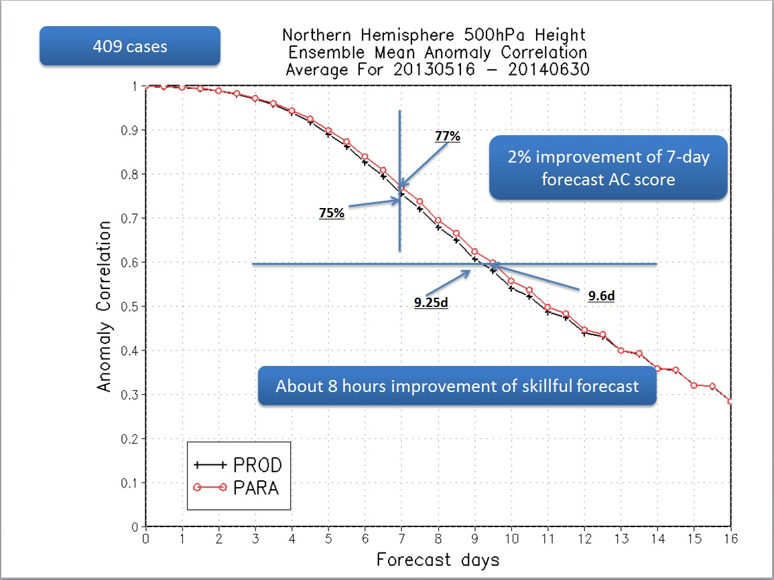
Skill improvement in GEFS
(Courtesy : Yeujian Zhu; EMC)

Slide 28
Monsoon Desk at NCEP
Established in 2011 to provide operational numerical forecast software, training
visitors from the MoES institutes and also to serve as a key scientific foci to
advance prediction skills for monsoon variability
Last 1 year, answered various technical queries related to running and implementing
CFS (IITM), GFS (NCMRWF) (Thanks to Moorthi, Xingren at EMC who provided
help)
Current operational GEFS source code given to IITM (includes initial, output and
runlog files of some of the GEFS members)
Updated CFSv2.1.6 download link provided to IITM
GFS (REL-FY15) given to IITM upon their request and sorting run time error issues
INSAT-3D coefficients for CRTM.v2.0.x sent to NCMRWF (Paul Van Delst at EMC)
Periodic updates in terms of past monsoon reports (updated to 2014), publications
provided by IMD, IITM, NCMRWF regularly updated at Monsoon Desk website.
Visit : http://www.emc.ncep.noaa.gov/monsoondesk/.php

Slide 29
Future work with IITM
EMC looks forward to continuing to work with our Indian partners
EMC is impressed by the work of IITM to improve and develop CFSv2
EMC requests greater feedback from our Indian partners on the performance of the forecast
systems provided to our partners in the tropics, particularly in the Indian region
EMC is beginning the development of CFSv3. It will serve as the basis of a coupled unified forecast system at NCEP (NGGPS). EMC is looking for active partners in working on and developing the CFSv3 code. EMC would welcome thorough diagnostics by our Indian partners of this unified system’s performance over the tropics and the India region in particular and desires extensive feedback on the results of their diagnostics of our model’s performance. EMC would welcome extended visits by Indian scientists and welcome collaboration on model physics in NGGPS.
Community model Community collaborative effort (lines of HWRF and WW)
Are our Indian partners interested in participating in EMC MEG effort, providing feedback periodically on our systems performance in the Indian region ?
GEFS team looks forward to working with our Indian partners and would very much like to know what is being done and planned with the GEFS, particularly how they are going to use GEFS for applications (e.g. precipitation fields).

Slide 30
Backup Slides
IITM Monsoon Mission Review meeting, 18-20 Feb, 2015

Slide 31
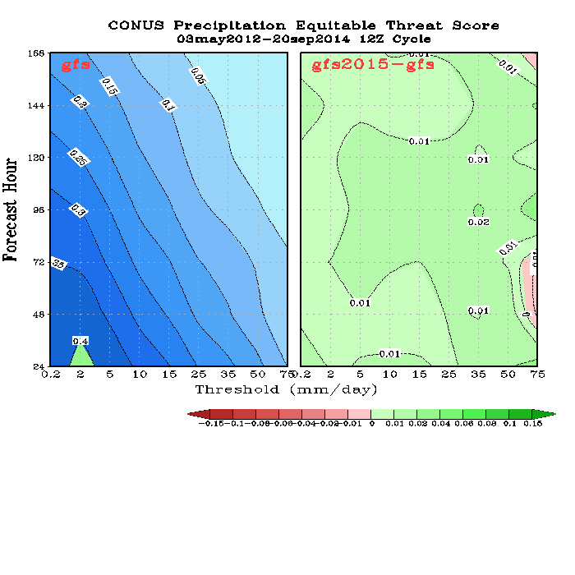
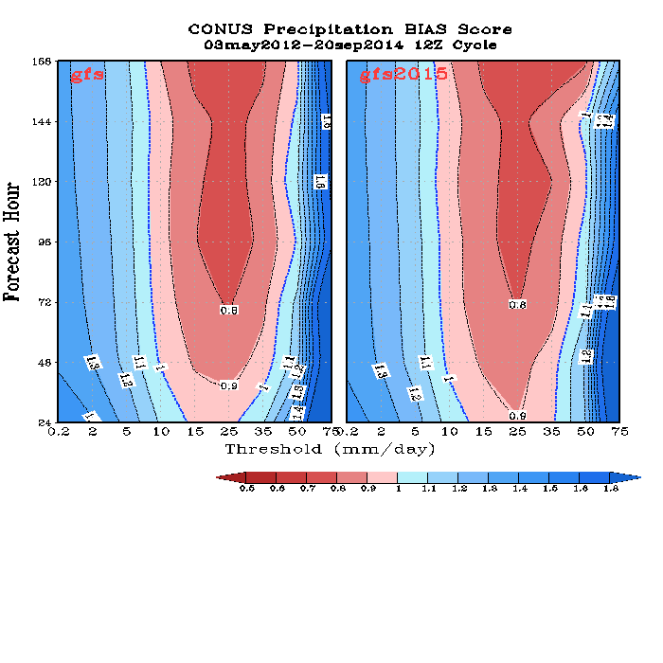
Precipitation Skill Scores, 12Z cycle
Merged 2012/2013/2014
Improved ETS score and slightly reduced forecast BIAS for all intensity and forecast lead time.
(Courtesy : Fanglin Yang; EMC)
IITM Monsoon Mission Review meeting, 18-20 Feb, 2015

Slide 32
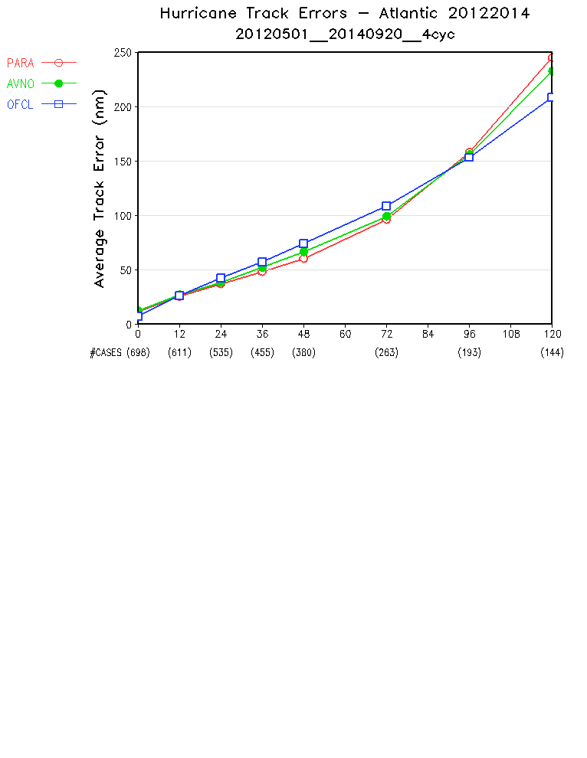
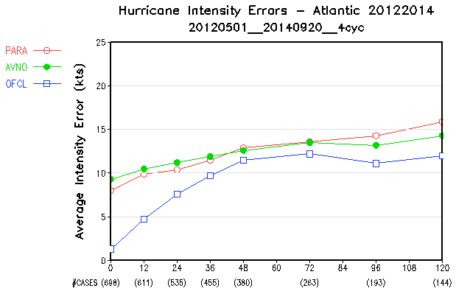
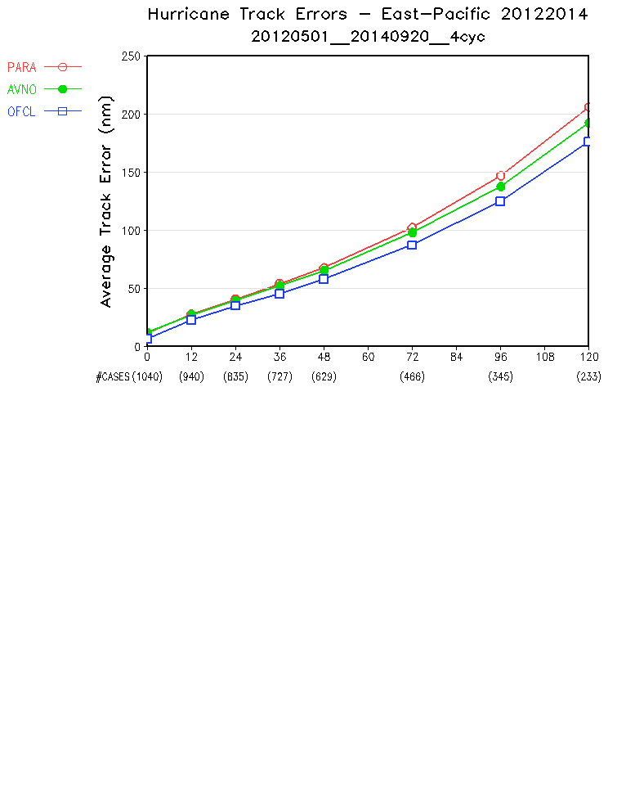
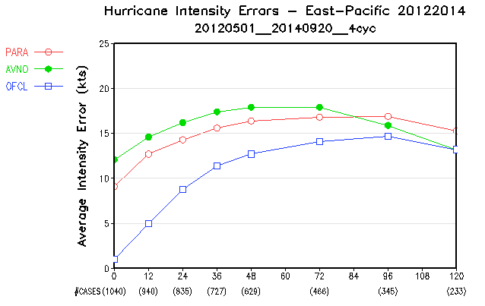
Hurricane Verification 2012/2013/2014
Atlantic Track
Atlantic Intensity
Eastern Pacific Track
Eastern Pacific Intensity
(Courtesy : Fanglin Yang; EMC)
IITM Monsoon Mission Review meeting, 18-20 Feb, 2015
32

Slide 33
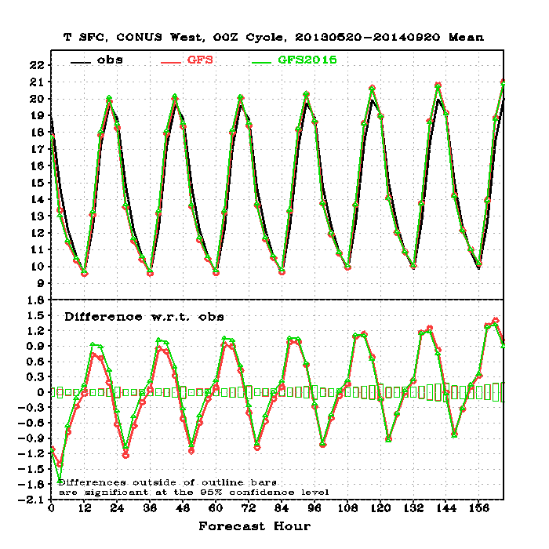
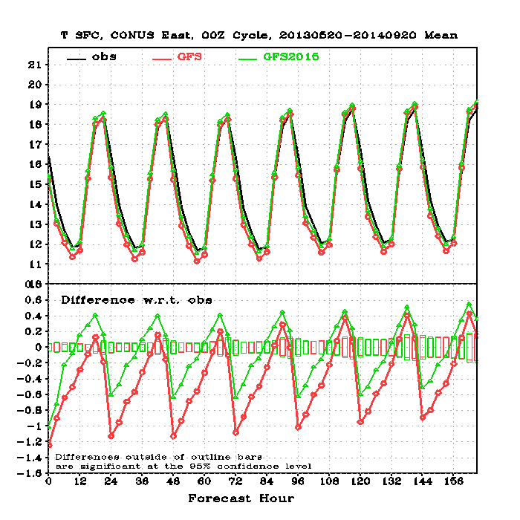
Fit to Surface Observation
Merged 2013/2014
CONUS West
CONUS East
T2m
Reduced CONUS East nighttime cold bias
(Courtesy : Fanglin Yang; EMC)
IITM Monsoon Mission Review meeting, 18-20 Feb, 2015
33

Slide 34
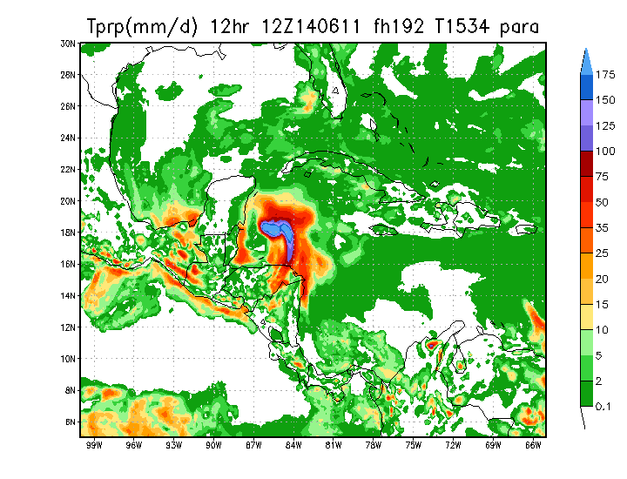
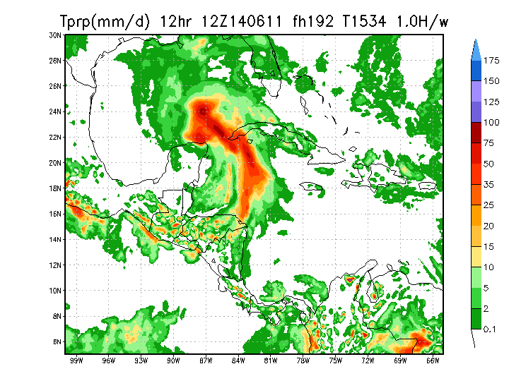
Tests for false alarm tropical storms (8 day forecast)
CTL: Operational GFS (13km)
Updated convection schemes
(Courtesy : Jongil Han ; EMC)
IITM Monsoon Mission Review meeting, 18-20 Feb, 2015

Slide 35
Improvement after inclusion of EDMF and TKE dissipation in PBL ;
submitted to Weather and Forecasting
Fig. 7. Mean difference in anomaly correlations of 500 hPa height for the forecasts with the new scheme with respect to the control forecasts in (a) Northern Hemisphere (20º-80ºN) and (b) Southern Hemisphere (20º-80ºS) during July 7 – October 31, 2012. The differences outside the rectangle bars are statistically significant at the 95% confidence level.
(Jongil Han, EMC)
IITM Monsoon Mission Review meeting, 18-20 Feb, 2015

