Slide 1
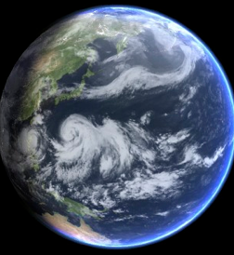
MoES-UKMO Cooperation and model development activities at UKMO
Richard Renshaw\
E N Rajagopal, Ashis Mitra
Sean Milton, Gill Martin, Richard Levine, Keir Bovis, ...

Slide 2
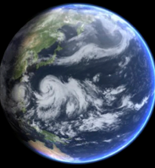
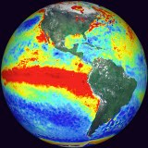
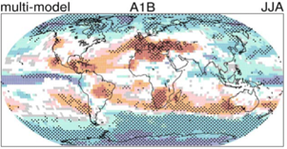
Global Physical Modelling
Unified Prediction across Timescales
Hours Days Weeks Months Seasons Decades Centuries
NWP - Atmosphere, Ocean, Waves
Climate Change & UKESM1
Deterministic
MOGREPS
GloSea
Decadal
Component Models
GA6 , GL6, GO5, GSI6
Coupled AOIL Model
GC2.0
WaveWatch III

Slide 3
GA/GC Development Process
Model
Assessment
- across timescales
Top 10
problems
Annual Implementation
cycle
Model
Development
Parametrizations & Dynamics
Process Evaluation
Groups (PEGs)
Research Cycle Progress
Reviewed annually
© Crown copyright Met Office
© Crown copyright Met Office

Slide 4
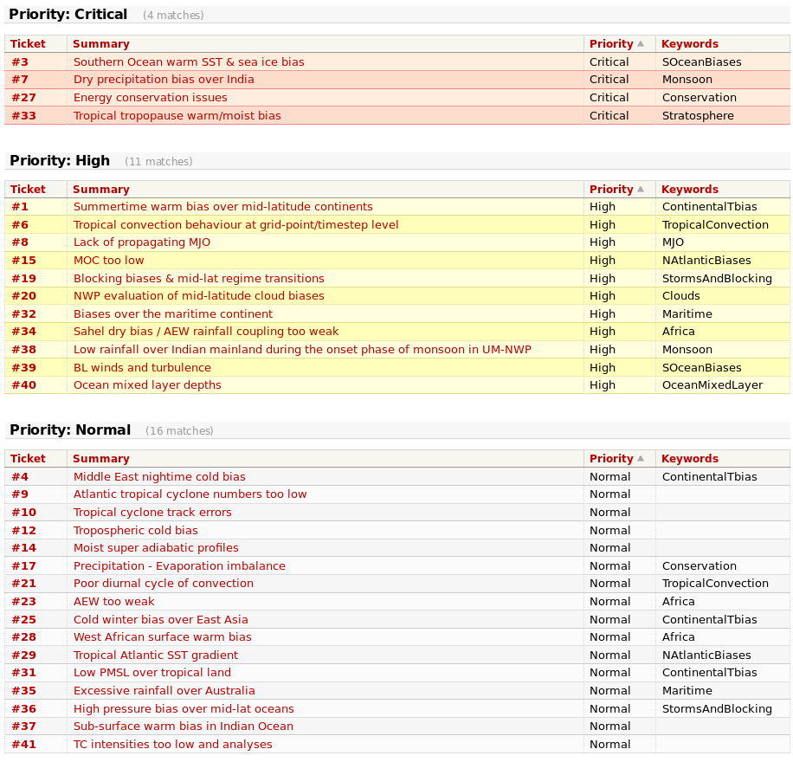
Current agreed key model errors See (http://collab.metoffice.gov.uk/trac/ModelEval)
© Crown copyright Met Office

Slide 5
Met Office/NCAS-Climate MonWG Monsoon Working Group
Formed in June 2006 in response to ongoing problems with simulating Indian summer monsoon (following 2 EU-funded projects SHIVA and PROMISE).
Draws on variety of expertise in Met Office, NCAS-Climate, U Exeter, U Leeds, and UM partners (NCMRWF, KMA, CAWCR)
Meets ~ every 2 months, alternately at MO and Reading. Regular video-conference with NCMRWF.
Engaged with various collaborative projects supported by National Monsoon Mission.

Slide 6
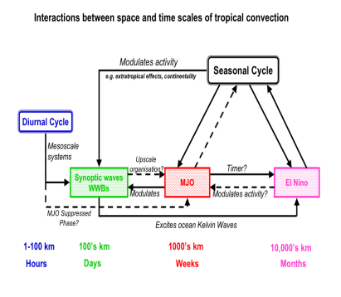
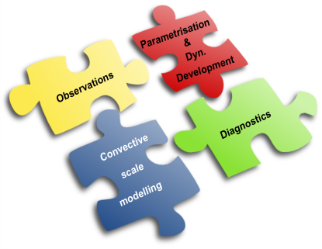
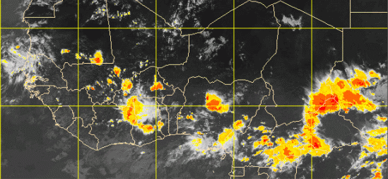
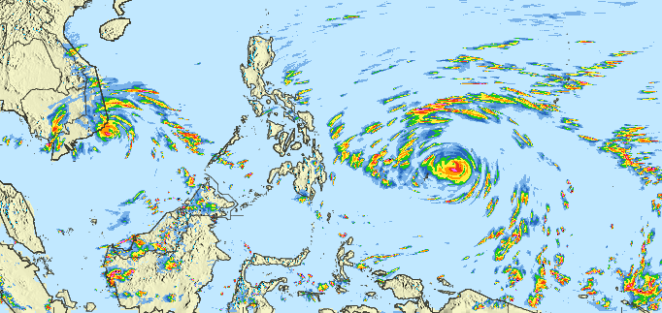
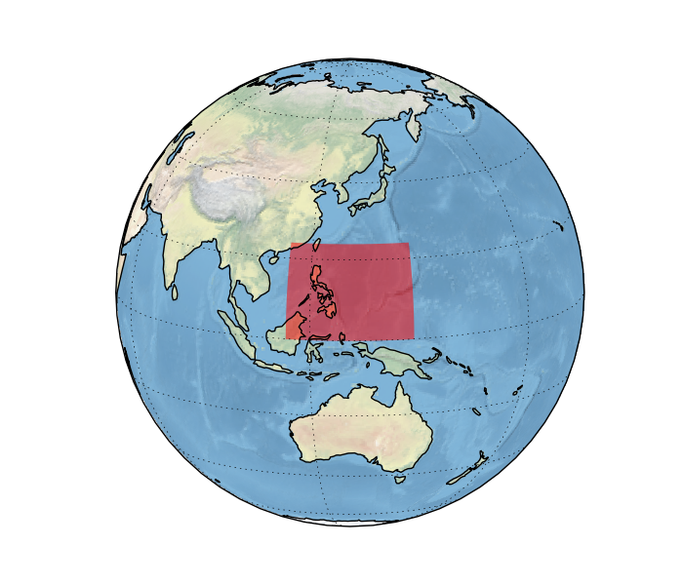
Work to develop and improve the UM in the tropics
There are a range of projects specifically focused on evaluating and improving global and convective scale forecasting in tropical regions
These are funded by a combinations of direct contracts with local NMSs, U.K Government regional development funds, Met Office investment and contributions from Met Office science partners –U.K. and international
Projects consider…
Evaluation of convective scale modelling systems for high impact weather
Convective scale Data Assimilation development
Evaluation and improvement of global modelling systems
Understanding role of global model performance on convective scale models
Utilizing convective scale models and observations to improve global models
Focusing on some key high impact weather types…
Tropical cyclones
Convective precipitation from isolated convective storms
Organised convection over large continents such as Africa
Organised convection and the role of land-sea contrasts
The Madden-Julian Oscillation and the role of the Maritime continent

Slide 7
GA6 - ENDGame dynamics Even Newer Dynamics Nigel Wood
Evolution of New Dynamics
Same equation set & variables (θ-π)
Same horizontal staggering (Arakawa C-grid)
Same vertical staggering (Charney-Phillips)
(Iterative) Semi-implicit semi-Lagrangian
Improved (iterative) solution procedure:
More implicit, approaching Crank-Nicolson
⇒ Improved robustness, accuracy and variability
Improved scalability (change variable held at poles)
Option for improved conservation via SLICE (not in GA5)

Slide 8
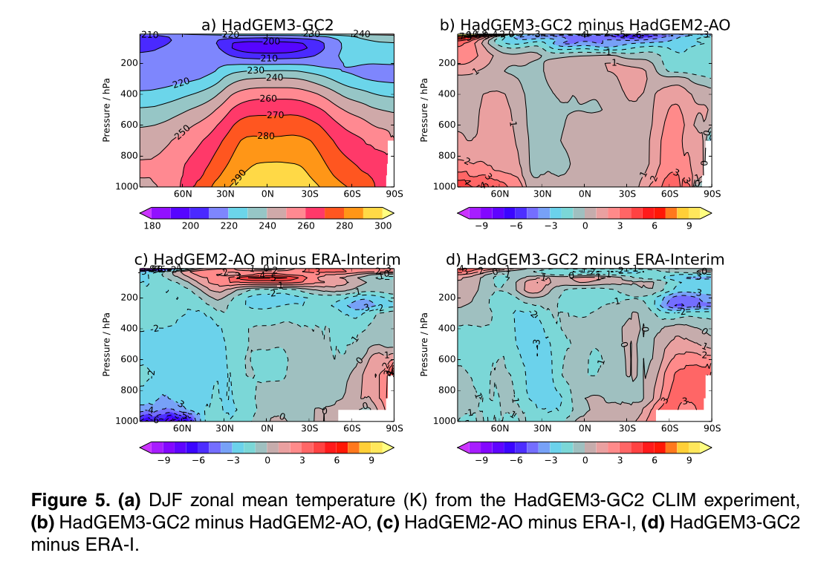
GC2: Reduced [Temperature] Biases

Slide 9
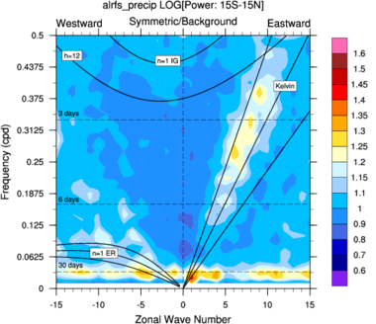
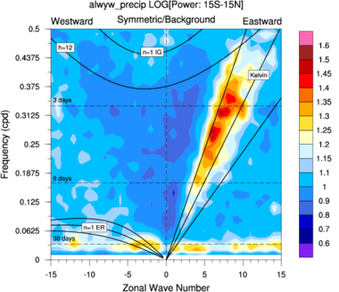
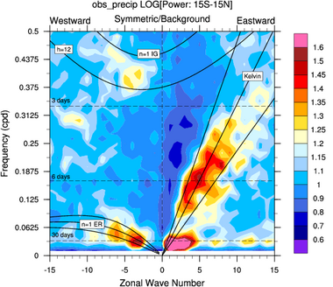
Impact of ENDGAME on Tropics
Equatorial Kelvin waves Improved
Kelvin Waves
New Dynamics
ENDGame
GPCP
Wave number frequency Spectrum : Tropical Precipitation
MJO
Prince Xavier

Slide 10
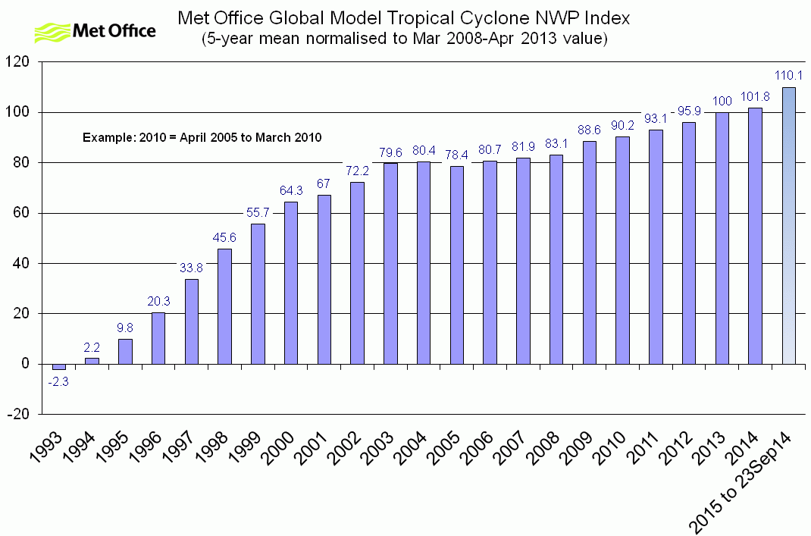
Tropical Cyclone Track Forecasts – GA6 Physics & ENDGame
Global Model Tropical Cyclone NWP Index is based on a 5-year running mean of track forecast errors
2010-15 figure to 23 Sep sees biggest rise in 15 years

Slide 11
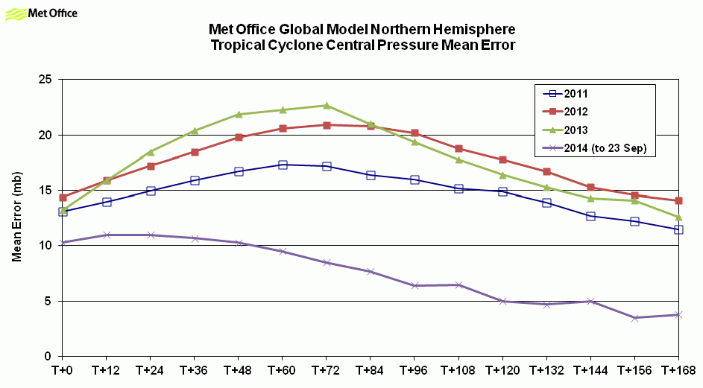
Tropical Cyclone Intensity Forecasts
GA6 introduced:
New dynamical core (ENDGAME)
More stable
Less diffusive – so effectively much higher resolution for same grid length
New physics package developed within ENDGAME
Increased resolutions
Important for the convective scale models through better initial values and boundary forcing
Mean central pressure error in NH tropical cyclones
2014 (to 23 September)

Slide 12
Horizontal Resolution Plans - NWP Current Future
Benefits
Orographic forcing
Detail in land-surface
Deeper cyclones
surface weather
Eddy resolving
Improved dyn transport
better air-sea interaction – wind stress-SST
Improved spread?
Capturing extremes
Deterministic Global NWP -2016+
17km (N768) (60 nh)
12km (N1024) or 10km (N1280)?
Cost – x5 (300 nh)
FOAM – 2016+
ORCA 1/4 degree ocean
ORCA 12th degree ocean
Cost – x50 (175 nh)?
MOGREPS:G
N400 (33km) 24 member ensemble
N512 or N640 - 18 mem. every 6hrs
Cost - ??

Slide 13
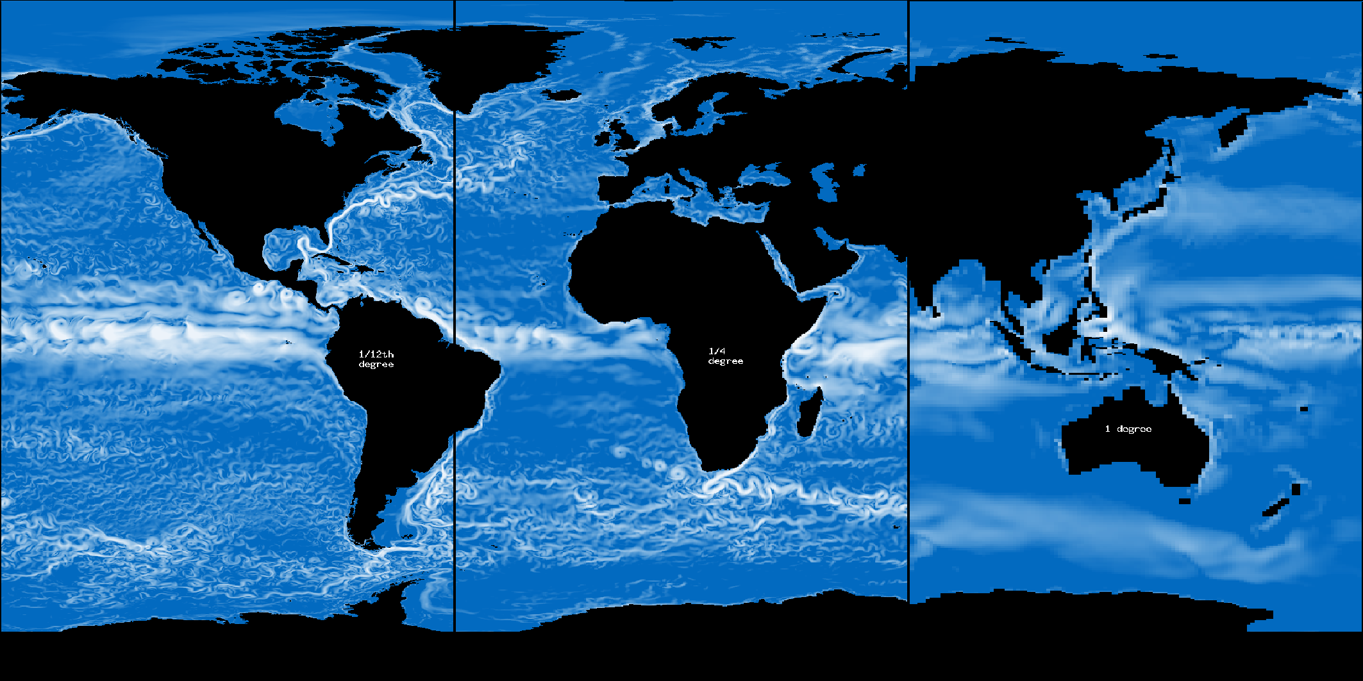
Ocean Model Resolution
1/12°
1/4°
1°
Notes:
Unprecented level of detail in ORCA12 compared to its predecessors ORCA1 and ORCA12

Slide 14
Unified Model Levels
2014-15 Research project to evaluate increased vertical resolution across timescales - L120, L180…L800 AMIP tests
L70(50_{t},20_{s})₈₀
L85(50_{t},35_{s})₈₅
L38(29_{t},9_{s})₄₀
L50(29_{t},21_{s})₆₅
Stratopause
Stratopause
Tropopause
Tropopause
NWP 2002
NWP 2005
NWP 2009
Current
Climate
© Crown copyright Met Office
Notes:
MOGREPS-15 system (N216L70)
24 members (1 cntl &23 perturbed members)
Perturbations to initial conditions are calculated using ETKF and derived from a combination of the random parameters, stochastic convective vorticity and stochastic kinetic energy backscatter schemes.
30 day free running forecasts (no DA)
Ensemble expts: N216L85 and N216L38
MOGREPS-Met Office Global and Regional Ensemble Prediction System
L85 model top: 85km
L38 model top: 40km
Horizontal resolution ~54km at 55°
ETKF: Ensemble Transform Kalman Filter: initial condition uncertainty
RP: It represents the uncertainty due to the empirically-adjustable parameters present in any of the physical parameterizations
SCV: The effects of any sub-grid scale processes are typically calculated in a deterministic way by conventional parameterisations schemes depending on local resolved-scale variables, but no representation of the sub-grid variability is included. This scheme attempts to include this variability in the representation of mesoscale convective systems.
SKEB: The energy sink implied by numerical advection and horizontal diffusion in NWP models is unrealistically large. This scheme is used to inject energy from sub-grid scale sources back into the model in the near-grid scales.

Slide 15
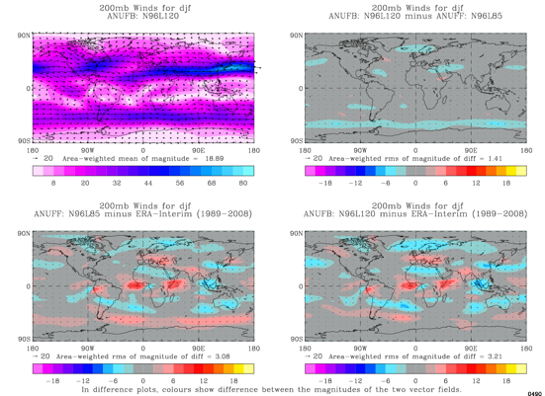
120 Levels N96 AMIP
Preliminary results
200hPa
Winds
L120
-
L85
L85
L120
© Crown copyright Met Office
Notes:
MOGREPS-15 system (N216L70)
24 members (1 cntl &23 perturbed members)
Perturbations to initial conditions are calculated using ETKF and derived from a combination of the random parameters, stochastic convective vorticity and stochastic kinetic energy backscatter schemes.
30 day free running forecasts (no DA)
Ensemble expts: N216L85 and N216L38
MOGREPS-Met Office Global and Regional Ensemble Prediction System
L85 model top: 85km
L38 model top: 40km
Horizontal resolution ~54km at 55°
ETKF: Ensemble Transform Kalman Filter: initial condition uncertainty
RP: It represents the uncertainty due to the empirically-adjustable parameters present in any of the physical parameterizations
SCV: The effects of any sub-grid scale processes are typically calculated in a deterministic way by conventional parameterisations schemes depending on local resolved-scale variables, but no representation of the sub-grid variability is included. This scheme attempts to include this variability in the representation of mesoscale convective systems.
SKEB: The energy sink implied by numerical advection and horizontal diffusion in NWP models is unrealistically large. This scheme is used to inject energy from sub-grid scale sources back into the model in the near-grid scales.

Slide 16
Monsoon Depressions Richard Levine
16

Slide 17
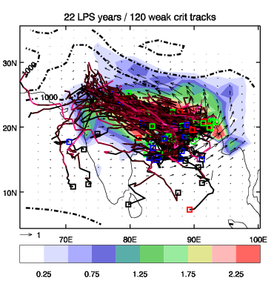
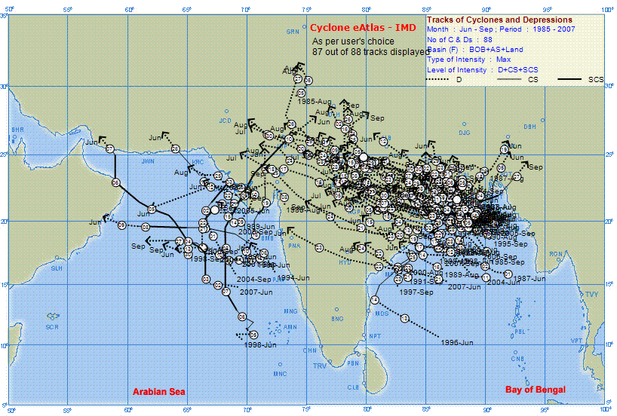
Monsoon depressions and lows diagnosed in ERA interim re-analysis compared to IMD e-Atlas of MDs and TCs
TRACK:
ERA interim
IMD e-Atlas
Method picks up most monsoon depressions and stronger monsoon lows (not included in IMD e-Atlas), however, difficulty diagnosing stationary systems in N Bay of Bengal / NE India
Notes:
Using TRACK software (Kevin Hodges, Univ Reading) for Tropical Cyclone tracking
Tracking performed on 6-hourly 850hPa vorticity fields, with parameters re-tuned for monsoon depressions and lows (e.g. threshold relative vorticity)
Procedure:
1) Pre-tracking filtering of data to remove unwanted noise, related to sub-synoptic-scale
Global model data filtered to T42 resolution (approx. 2.8 degrees)
Regional model data re-gridded to 2.5x2.5 degrees and 20-day high-pass filter applied
2) Post-tracking criteria applied:
i) Lifetime >= 2 days
ii) Minimum displacement of 5 degrees
iii) 60% of lifetime spent within [70-95E, 10-30N]
iv) Cyclonic re-circulation within depression length-scale (10x10 degree box)
3) Rainfall associated with system calculated over depression length-scale, taken as 10x10 degree box surrounding vorticity centre of system)

Slide 18
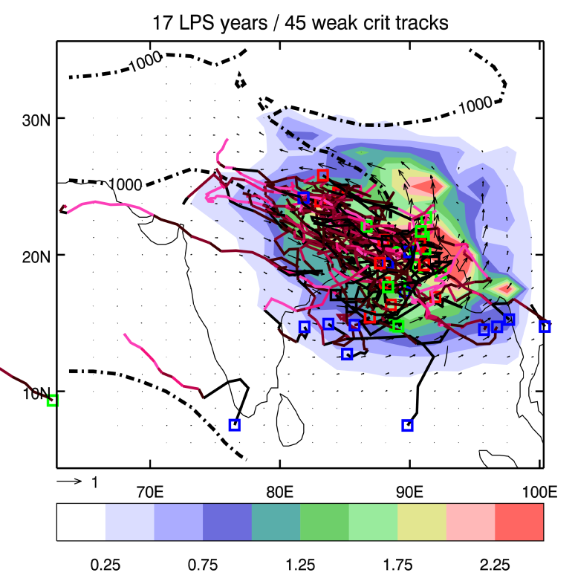
Monsoon low pressure systems in MetUM global climate simulations and sensitivity to resolution
Number of systems diagnosed using TRACK software
compared to
IMD depression e-atlas
TRACK:
ERA interim
1) Number of systems and associated rainfall increases with
resolution, largest change from N96 to N216, coincides with
strengthening of mean state monsoon over India 2) Systems form in correct position, but die out quickly after landfall
3) Number of systems still too low even at N512
4) “Realistic” numbers in Sept: TCs due to early retreat of monsoon
TRACK:
GA6 N512

Slide 19
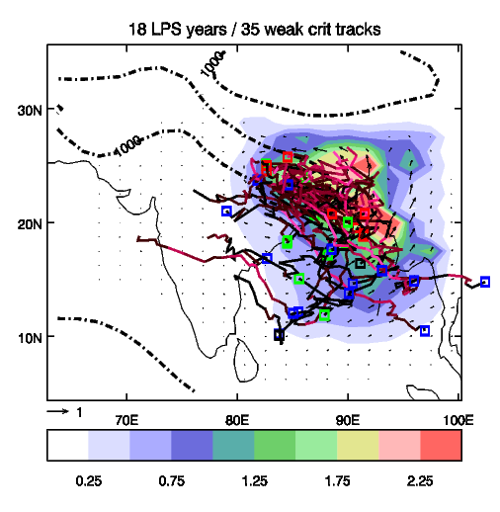
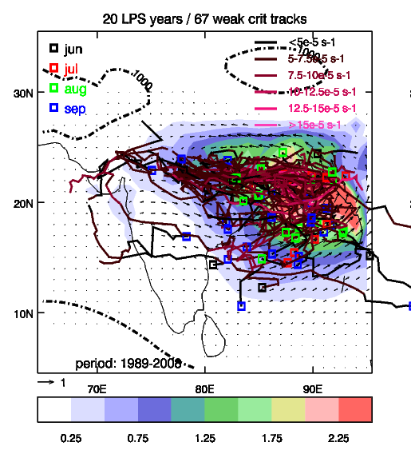
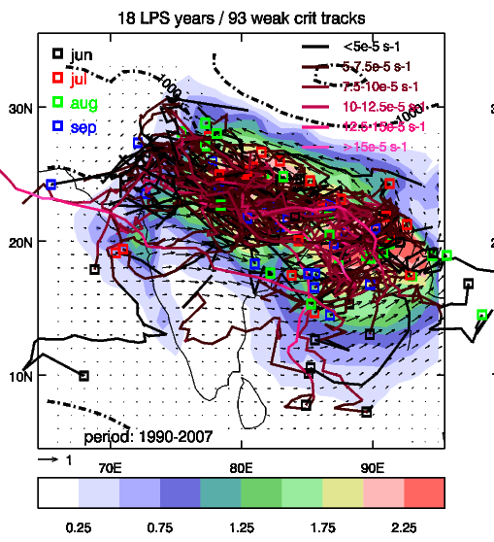
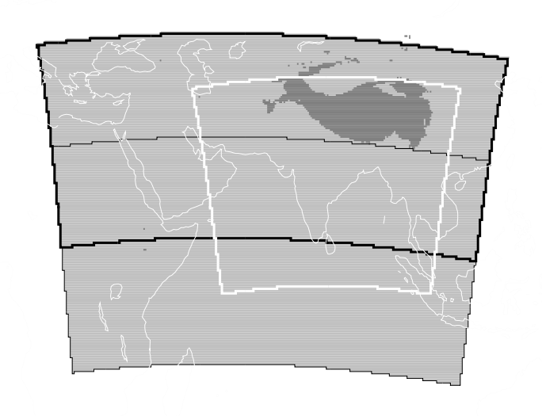
Sensitivity to domain size / large-scale forcing Global (N216~60km) vs Regional (0.44°~50km) climate simulations
global
domain 1
domain 2
domain 2
domain 1
Once provide SASM region with realistic circulation and moisture then model can produce reasonable depressions and lows which help spatial distribution of Indian rainfall
Again, increase in depressions coincides with strengthening of mean state monsoon over India
ERA interim

Slide 20
Progress towards GA7
Gill Martin

Slide 21
Package testing for GA7 – still underway
Changes include:
Improved updraught numerics in the 6A convection scheme
CAPE closure for deep & mid-level convection dependent on large-scale vertical velocity
Include heating due to gravity-wave dissipation
New ice particle size distribution
Revised cloud top entrainment
New ice optical properties
Convective cores seen by radiation
New warm rain microphysics scheme
Include forced shallow convective clouds
Replace fixed RH crit profile with a variable one
Turbulent production of liquid water in mixed phase clouds

Slide 22
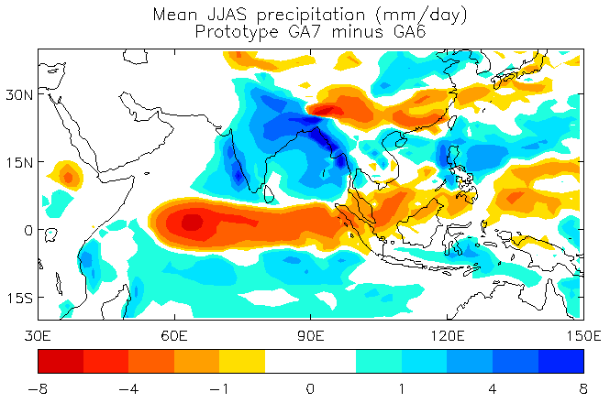
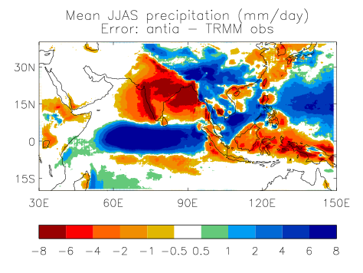
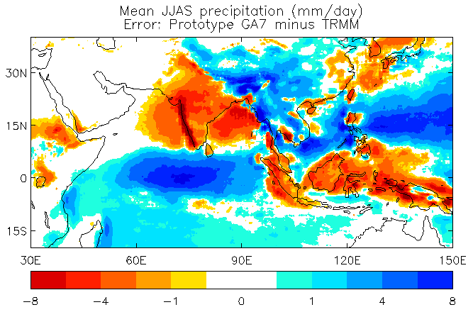
Prototype GA7 test (AMIP-mode)
Proto-GA7 – GA6 AMIP diff
GA6 AMIP bias
Proto-GA7 AMIP bias

Slide 23
GC3 Coupled Model development
Expected release Summer 2015 - Will form physics basis of UK-ESM1 Some highlights:
GA7:
Internally mixed (UKCA-Glomap-mode) aerosol scheme
Improved numerics within convection (improves some long-standing biases)
Standardised stochastic physics package (across timescales)
Package of cloud/radiation improvements
GL7:
Implement multilayer snow scheme (improved heat transfer through snow)
Lake scheme?
GO6:
Under ice shelf capability
Non-linear free surface
Lagrangian icebergs
GSI7/8:
Improved meltponds (improve albedos)
Salinity-dependent freezing point
Multilayer thermodynamics?
Notes:
23

Slide 24
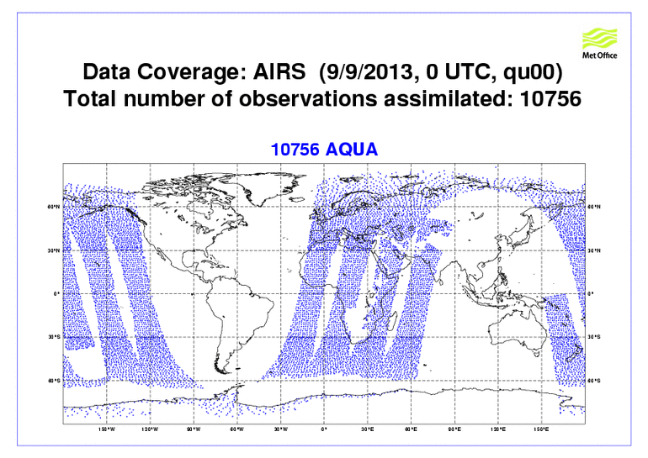
Global DAE/SA Highlights: 2012-2014
>50% increase in satellite data.
4DVar resolution: 60km -> 40km.
MOGREPS-G ensemble size, resolution to 44 members, 33km.
Extended Kalman Filter DA for land_surface.
Dust (MODIS AOD) assimilation.
Forecast Sensitivity to Observation (FSO) tool developed.
Mineral Dust Difference (DA-NoDA)
Error
Spread

Slide 25
Common infrastructure - shared repositories and trac environments
Core capabilities/milestones
Delivery of a shared repository capability delivered by Met Office with production licence by November 2014.
Shared repository available for configuring projects under subversion and fcm.
Migration of UM9.3 to shared repository in November 2014.
Migration of remaining key systems to shared repository completed by March 2015.
© Crown copyright Met Office
Notes:
25
Implementation of a shared code repository is an important capability being delivered by a project team made-up of staff from across the Met Office
Delivery of this capability will allow scientists to share and collaboratively develop scientific code with other scientists outside the Met Office.

Slide 26
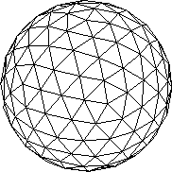
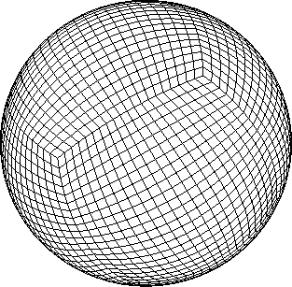
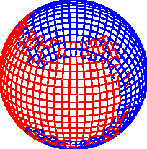
GungHo!
Globally
Uniform
Next
Generation
Highly
Optimized
“Working together harmoniously”
© Crown copyright Met Office

Slide 27
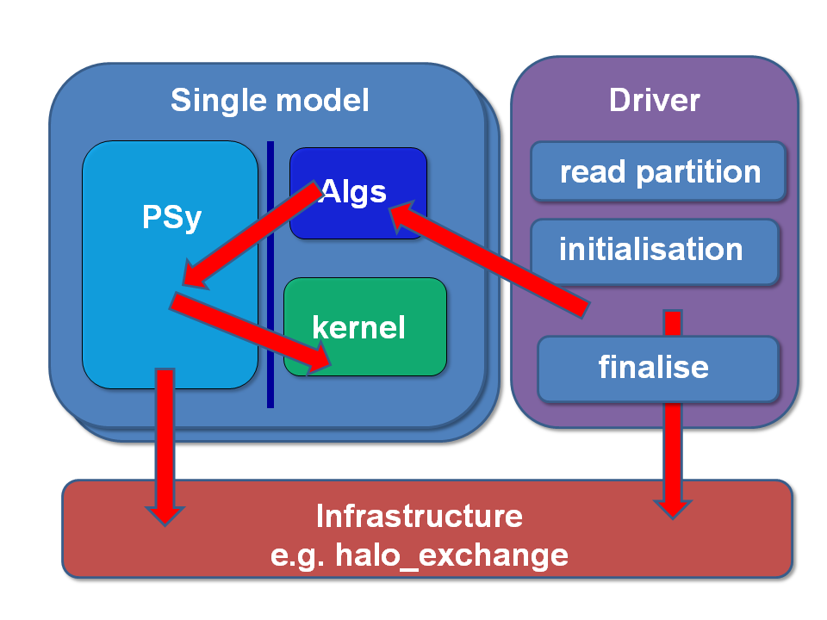
From GungHo to LFRic
GungHo:
Mixed Finite-Element
Non-orthogonal, not lat-lon grid (most likely cubed-sphere)
Indirect addressing in horizontal
F2003
UM infrastructure 20+ years old
New code base = LFRic
© Crown copyright Met Office

Slide 28
When?
Phase 1: 2012-2016
Delivery of GungHo dynamical core
Design of LFRic infrastructure
Phase 2: 2016-2019
Delivery of an LFRic atmosphere
Results must be promising enough to commit to operational implementation stage
Significant resource issue as period of developing very different model from scratch while still developing UM
Phase 3: 2019-2022
Move to operational implementation
Ramp down UM development to zero

Slide 29
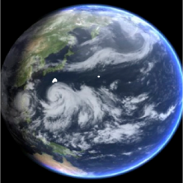
Global Model Development Activities
2014/15 GA6/GC2 Coupled Model Development - ENDGame dynamical core Implemented in all models in 2014/15
End 2015 GA7/GC3 - Under development - basis for next earth system model UKESM1.
2016 GA8 Physics upgrade - Microphysics, Convection
2017 Enhanced horizontal resolution 12km or 10km17
Enhanced vertical resolution - 140L
2018 Coupled Ocean-Atmosphere
2018+ More Prognostic aerosols for Global NWP - Prognostic dust with data assimilation already implemented
2020+ Gung-Ho – Next Generation Dynamical Core Next generation NEMO ocean

Slide 30
Thank you
Notes:
30

