Slide 1



Evaluation and improvement of Indian monsoon sub-seasonal to seasonal forecasting in GloSea5
Stephanie J. Bush¹, Jayakumar Pillai², Andrew Turner¹, Gill Martin³, Steve Woolnough^{1,} E. N. Rajagopal²
¹NCAS-Climate, University of Reading
²NCMWRF
³Met Office
Notes:
1

Slide 2

Talk overview
Team:
  PRDA: Stephanie Bush
  PI: Andy Turner
  Co-I: Steve Woolnough
  Visiting scientist (three months): Jayakumar
Current work (9 months into project): GloSea5 GC2 assessment
  Mean state and seasonal cycle biases
  Seasonal forecast skill (correlations)
  ENSO teleconnection
    Overall relationship
    Case study years
  Assessment of active/break cycles
Future work:
  Wind stress or heat flux correction experiments

Slide 3
Hindcast for assessment
GloSea5 as described in MacLachlan et al. (2014) QJRMS:
  GC2 version operational as of February 3, 2015
  MetUM atmosphere (HadGEM3), N216 (approx. 0.8°x0.5°) L85 (stratosphere resolving)
  NEMO ocean at ¼°, L75
  3-hourly coupling frequency
  CICE sea-ice, including assimilation of sea-ice concentrations and initialization from observations
  Atmosphere and land initialized from ERA-Interim (soil moisture uses anomaly approach)
  3D ocean assimilation from NEMOVAR
GloSea5 GC2 hindcast set
  14 years – 1996 to 2009
  Three initialization dates (04/25, 05/01, 05/09)
  Three ensemble members each date, for nine members each year
  140 day hindcasts
Notes:
Operational (should double check):
2 seasonal and 2 subseasonal members a day
A hindcast set per week (number of ensemble members?)

Slide 4
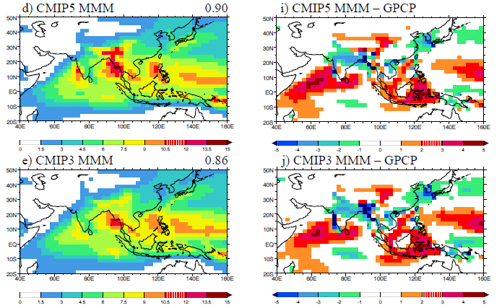
Multi-model mean monsoon precipitation biases in CMIP/5
CMIP3 and CMIP5 models show large dry biases over India but wet biases over the WEIO and Maritime Continent in boreal summer.
Reds: rainfall excess
Blues: rainfall deficit
Sperber, Annamalai, Kang, Kitoh, Moise, Turner, Wang and Zhou (2013) Climate Dynamics.
Notes:
Also make the point that CMIP3 models should not be discarded due to age.

Slide 5
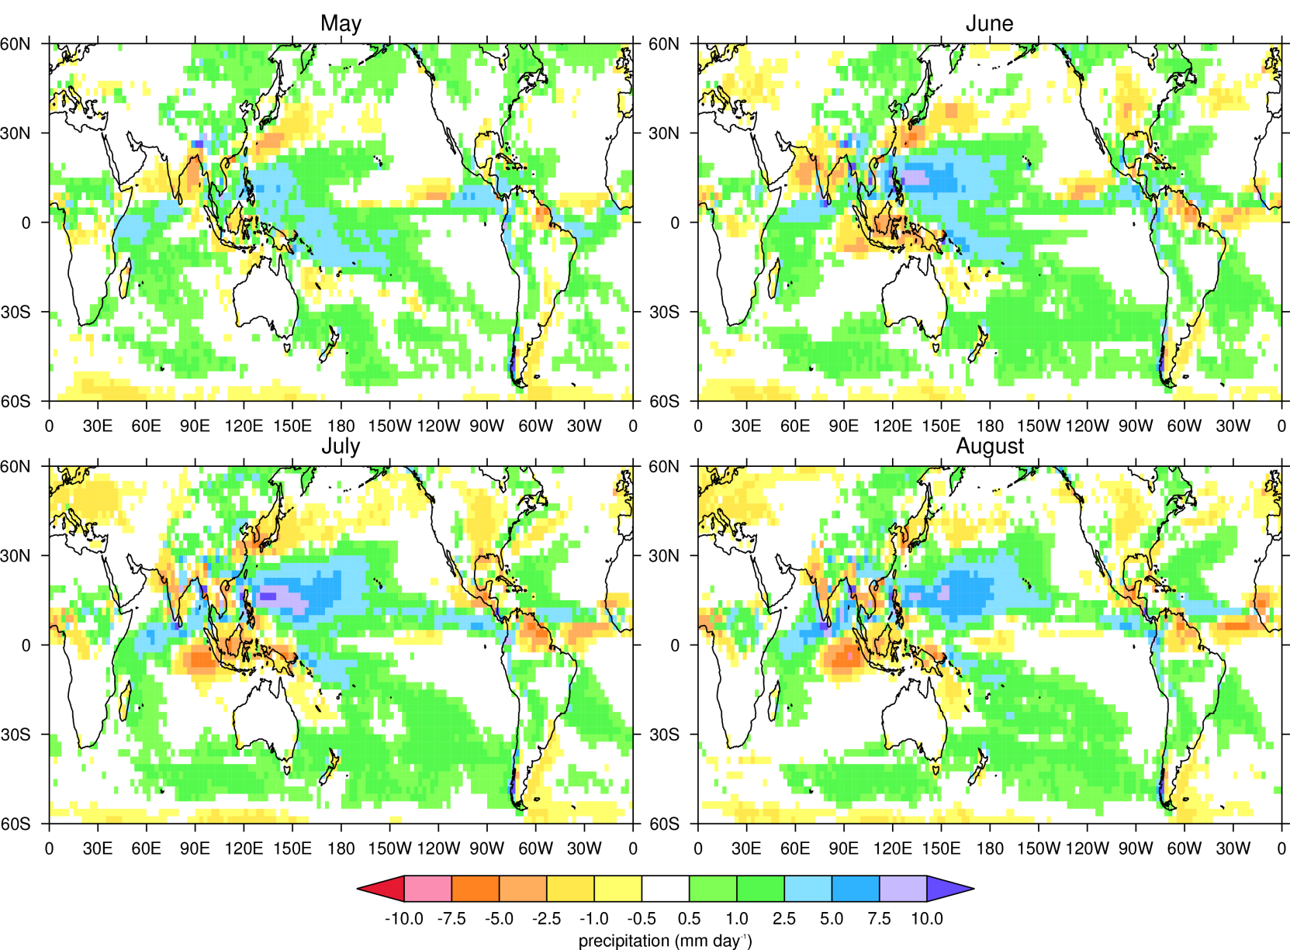
GloSea5 GC2 Monthly Ensemble Mean Precipitation Bias
Reference observations: GPCP

Slide 6
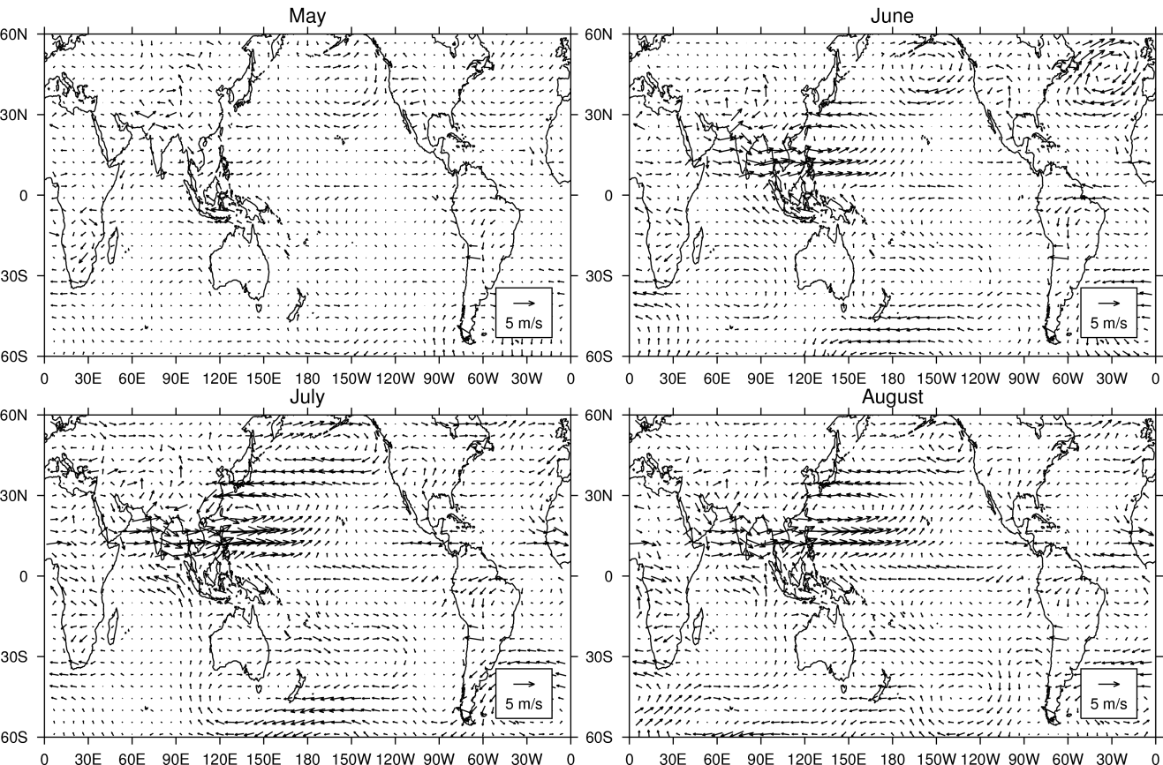
GloSea5 GC2 Monthly Ensemble Mean 850 hPa winds bias
Reference observations: ERA-Interim

Slide 7
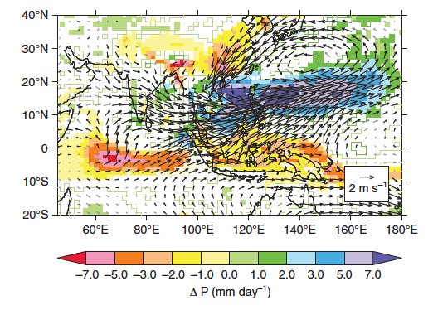
WEIO bias... And its connection to ISM and elsewhere
Precipitation change when GA3 entrainment profile increased by 50%
Entrainment profile is increased in GA6 (GC2) compared to earlier versions of the MetUM (25% since GA3)
We can reduce the JJAS WEIO precipitation bias (and, partially, the ISM bias) by increasing entrainment
While has a positive effect on the WEIO bias, this does not necessarily reduce the overall bias in South Asia
Bush et al., 2015, QJRMS

Slide 8
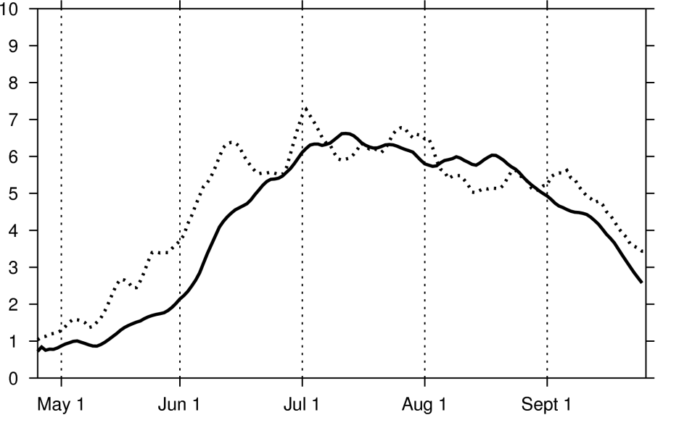
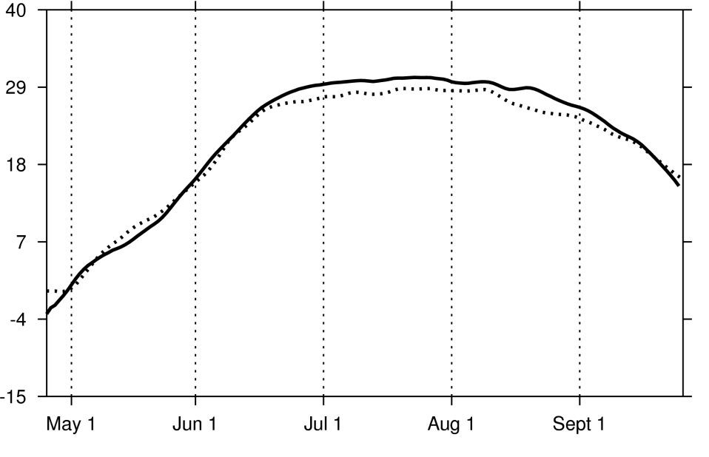
GloSea5 GC2 seasonal cycle biases
Precipitation over India
Webster-Yang Dynamical Monsoon Index
(Vertical shear)
Precipitation (mm/day)
Wind difference (m/s)
GloSea5 ensemble mean climatology
GloSea5 ensemble mean climatology
GPCP climatology
ERA-Interim climatology
GloSea5 shows late onset of monsoon precipitation, common in CMIP5 models, related to Arabian Sea cold bias (Levine & Turner, 2012, Levine et al. 2013)
Dynamical onset has correct timing, but strong westerlies lead to overly strong shear during JJA

Slide 9
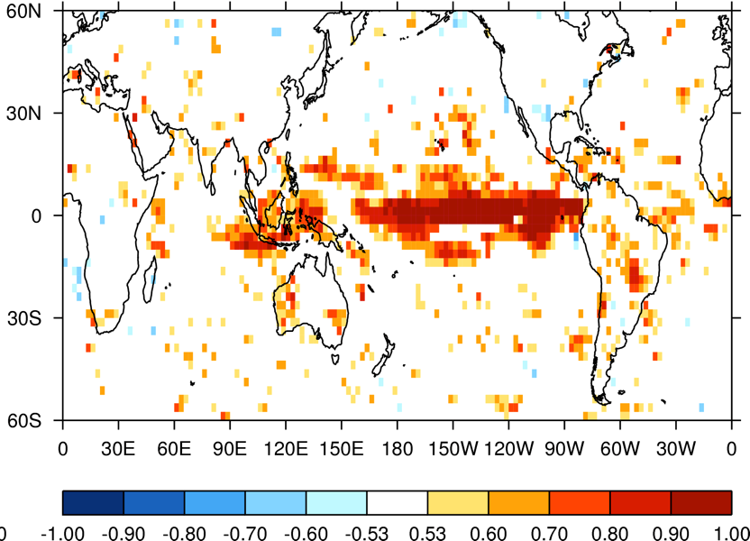
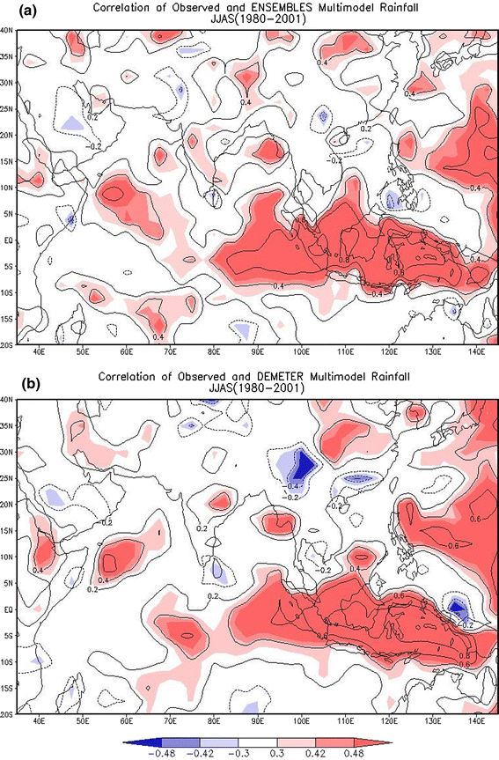
Prediction skill of JJA All-India rainfall
AIR interannual correlation very sensitive to years evaluated
  GPCP correlation (includes 1997 El Nino forecast bust) 1996 – 2009: 0.39
  TRMM correlation 1998 – 2009: 0.68
Correlation maps show significant (p > 0.05) skill over the Maritime Continent and equatorial Pacific
GloSea5 and GPCP JJA precipitation correlation map
(Note: white where not significant: 0.53)
Ensembles MMM and CMAP JJAS precipitation correlation map
Rajeevan et al 2011

Slide 10
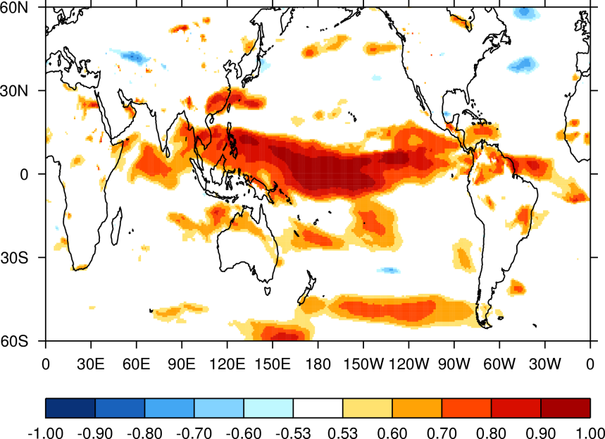
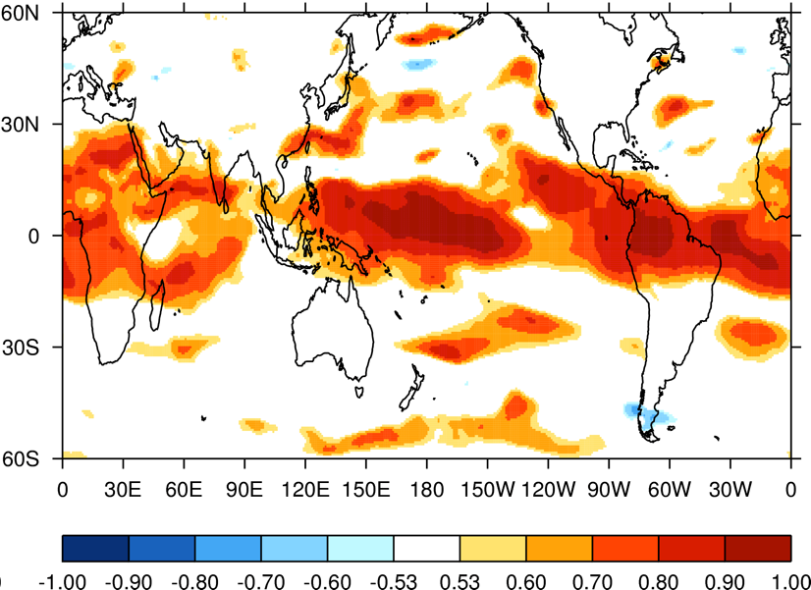
Prediction skill of zonal wind
Correlation of GloSea5 and ERA-Interim JJA Webster Yang DMI 1996 – 2009: 0.69
Correlation maps show more skill over Indian ocean and Africa in vertical wind shear than in precipitation
GloSea5 ensemble mean and ERA-Interim JJA zonal wind correlation
GloSea5 ensemble mean and ERA-Interim JJA zonal vertical wind shear correlation

Slide 11
Teleconnection to ENSO
Observations
Ensemble mean
Ensemble members
JJA Wang-Fan DMI anomaly
(horizontal wind shear m/s)
JJA all India rainfall anomaly (mm/day)
Nino 3.4 SST anomaly
Relationship between dynamical and rainfall indices in ensemble means is consistent with observations
However, ensemble means in individual years do not always match observations
Some ensemble members are outliers

Slide 12
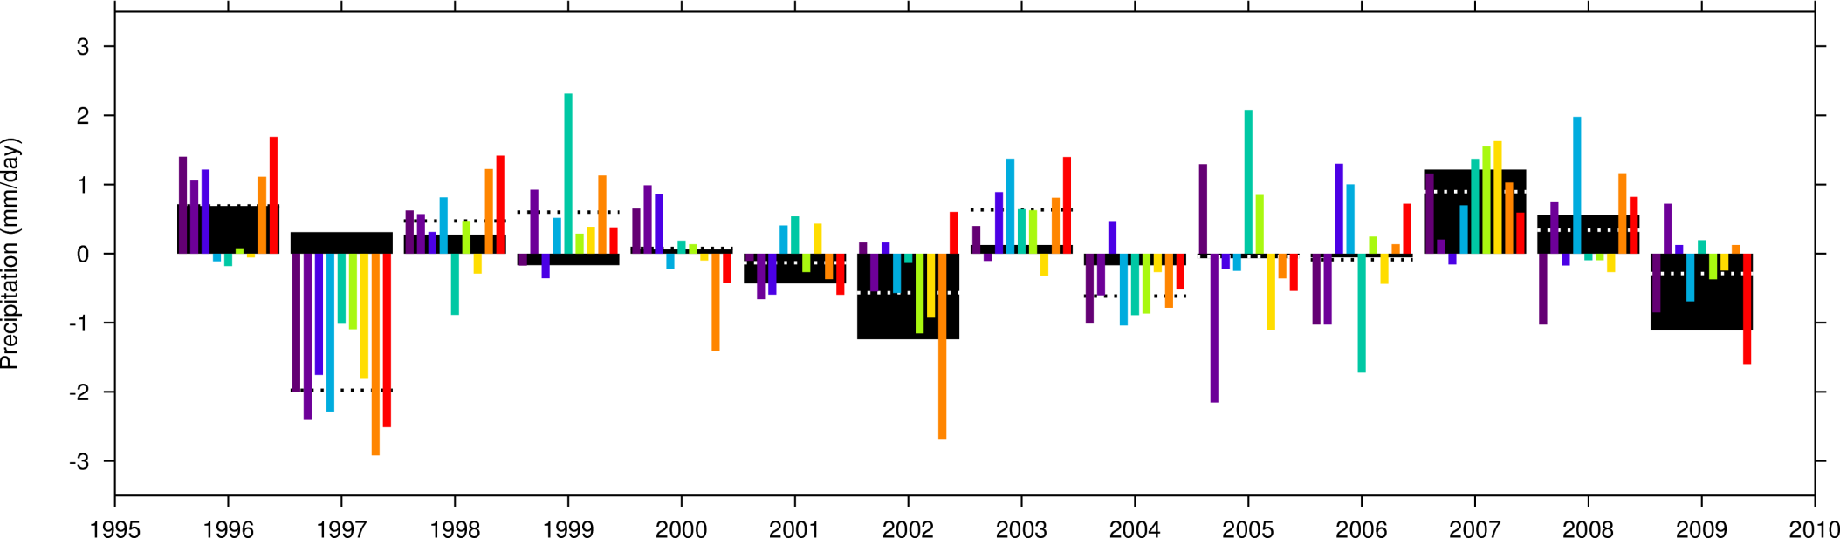
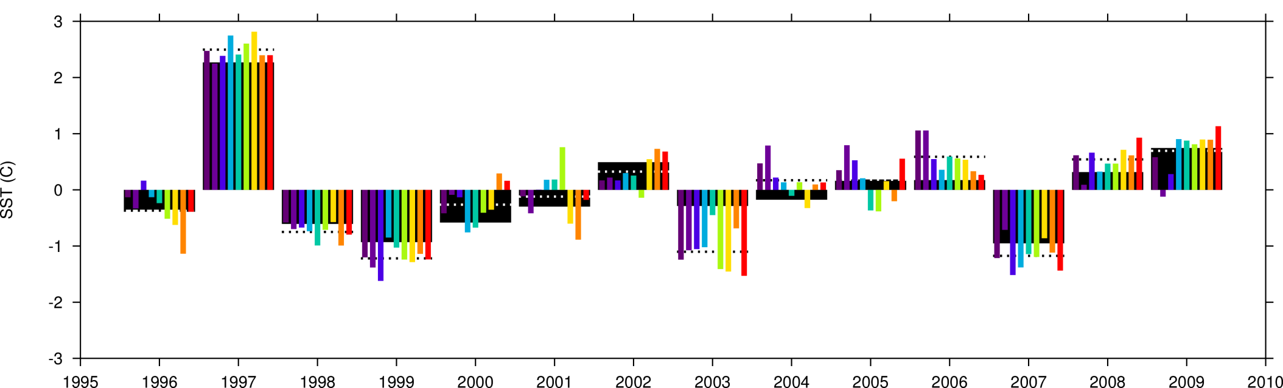
JJA All-India rainfall and Nino 3 SST anomalies
All India rainfall anomaly (mm/day)
Nino 3 SST anomaly (degrees C)

Slide 13
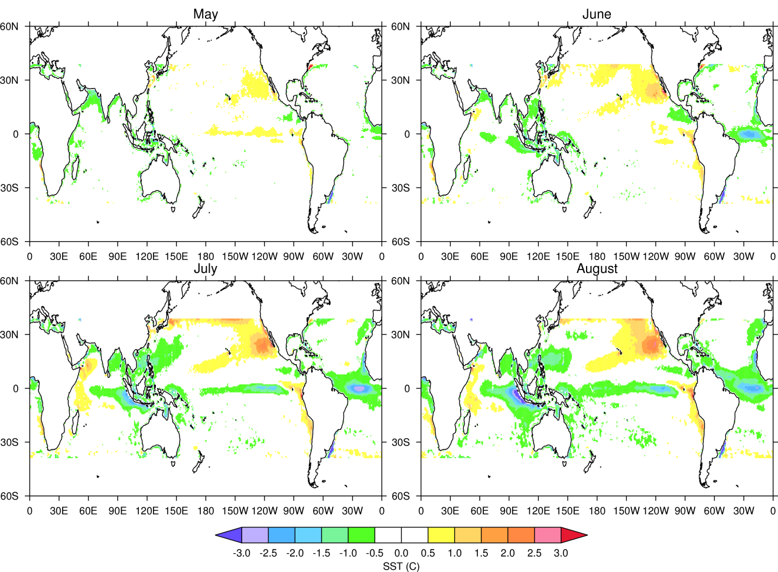
GloSea5 GC2 Monthly Ensemble Mean SST Bias

Slide 14
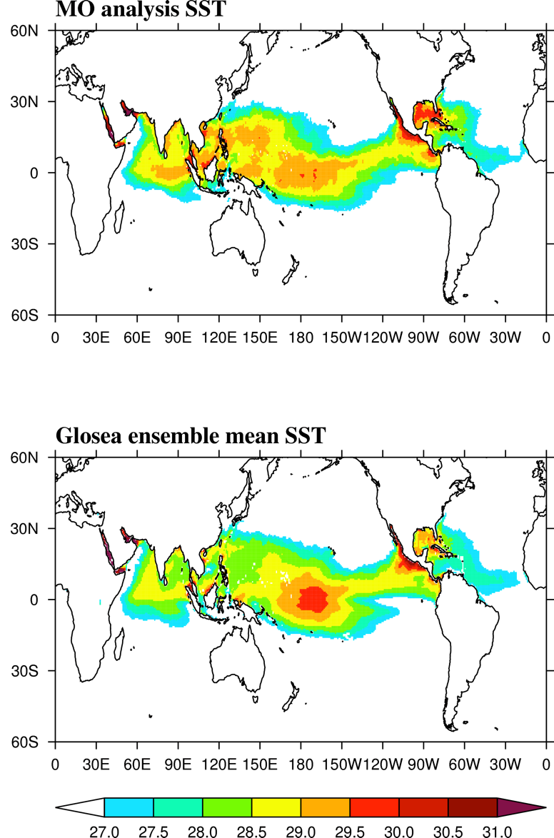
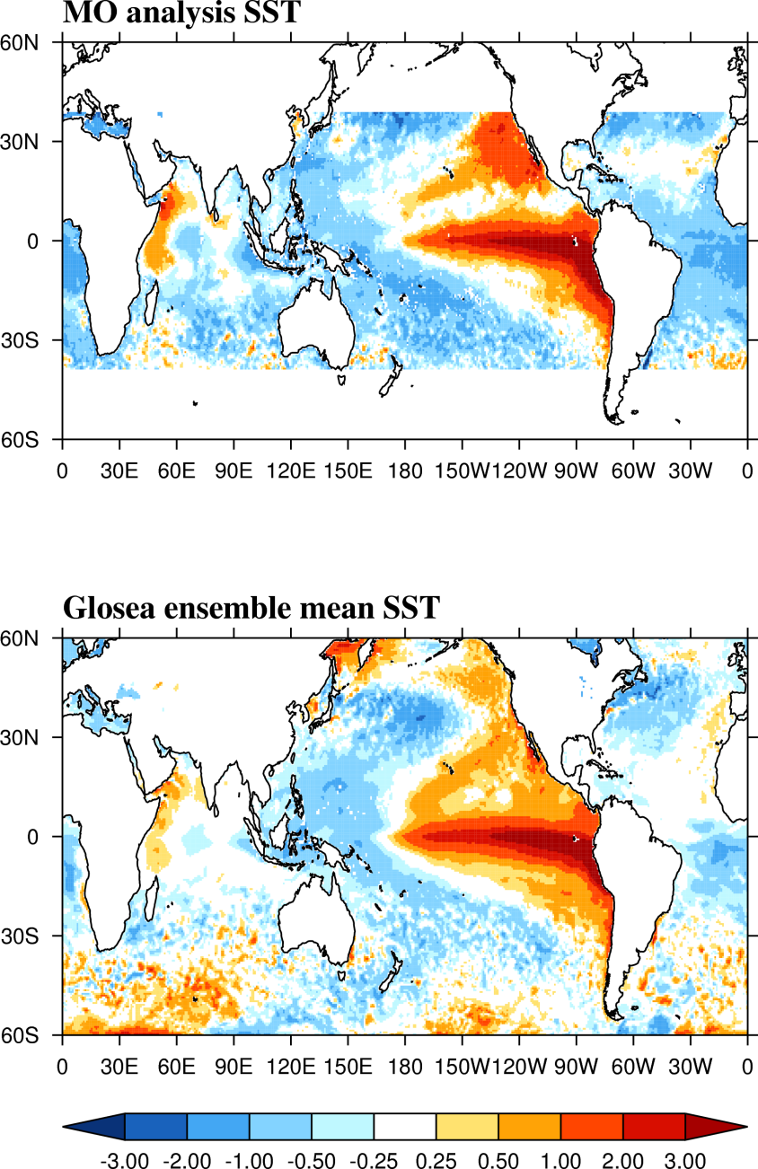
1997 – El Nino forecast bust
JJA SSTs
JJA SST anomalies
SST (degrees C)
SST (degrees C)
Notes:
Positive IOD

Slide 15
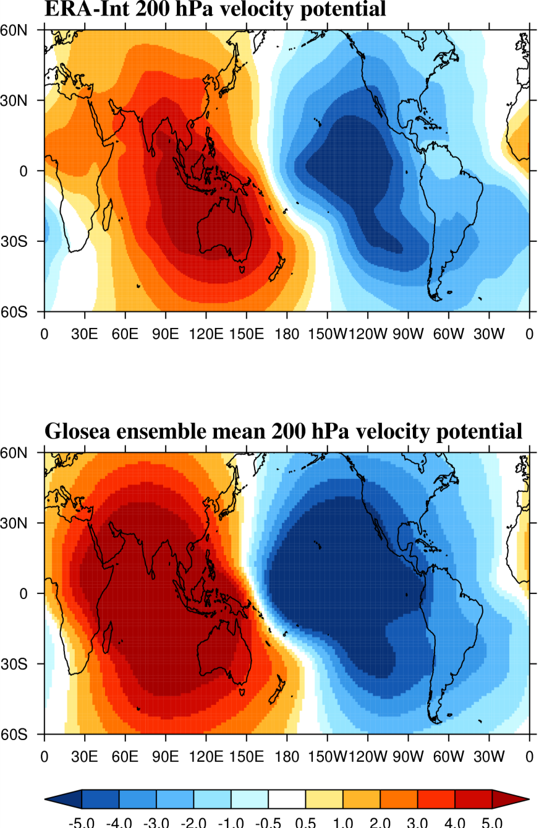
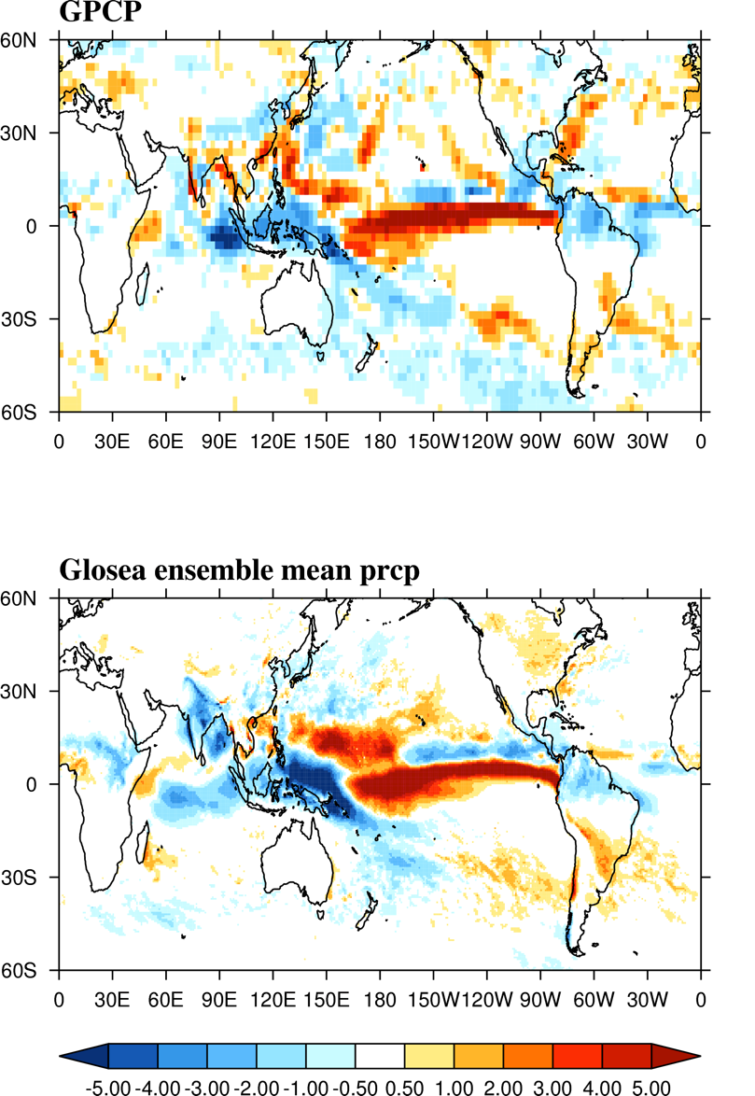
1997 – El Nino forecast bust
JJA velocity potential anomalies
JJA precipitation anomalies
VP (km^2/s)
P (mm/day)
Notes:
Blue - upper level divergence
Red – upper level convergence

Slide 16
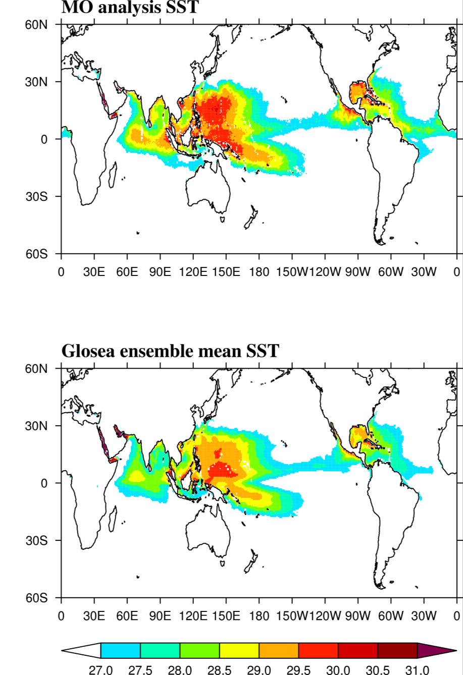
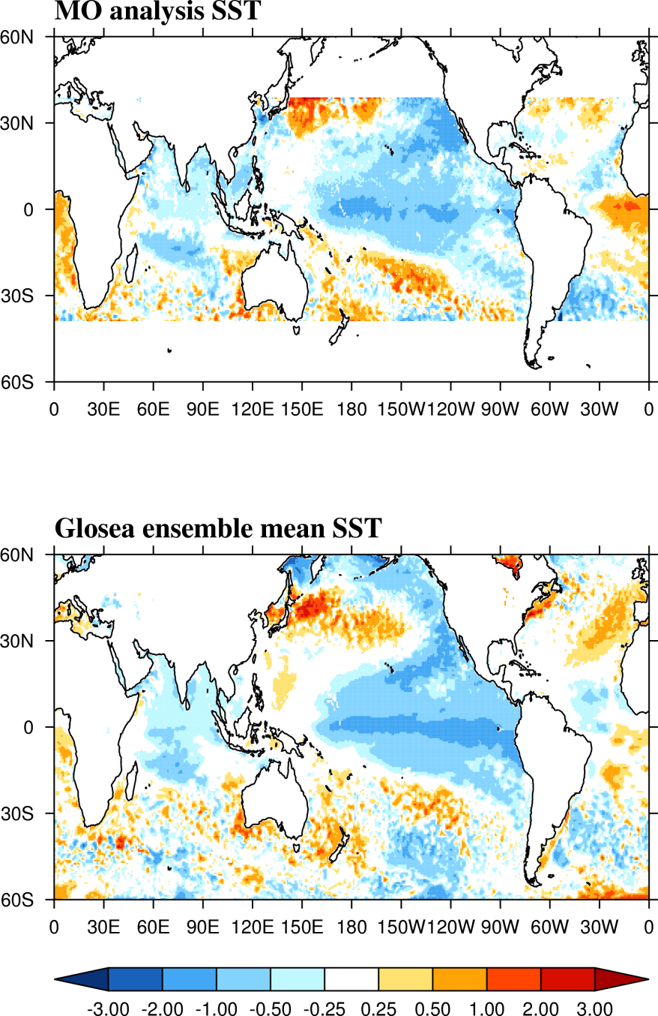
1999 – La Nina
JJA SSTs
JJA SST anomalies
SST (degrees C)
SST (degrees C)

Slide 17
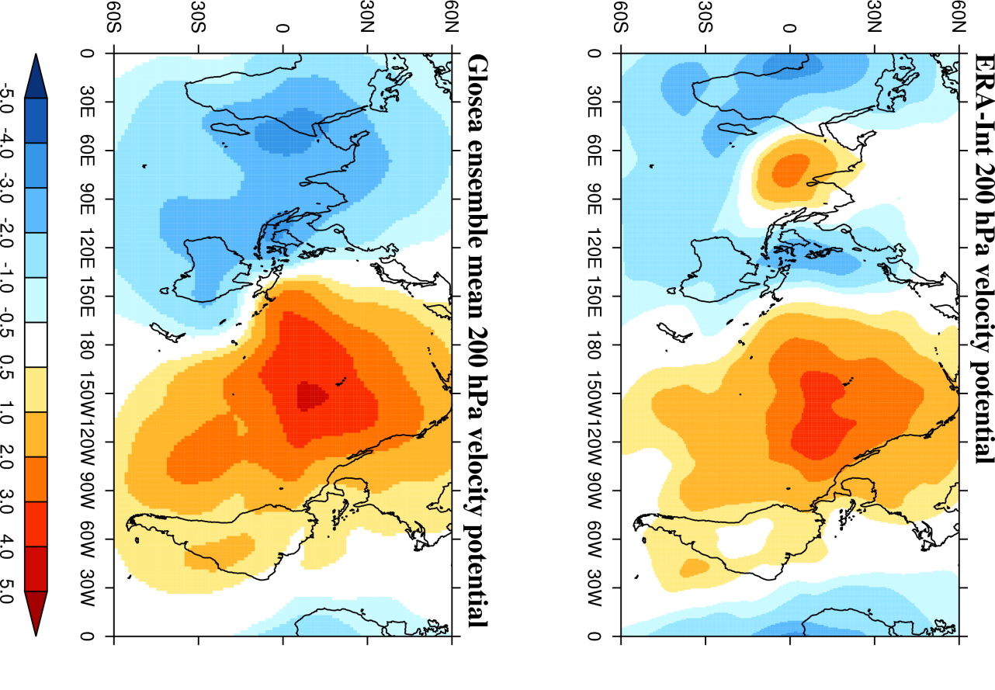
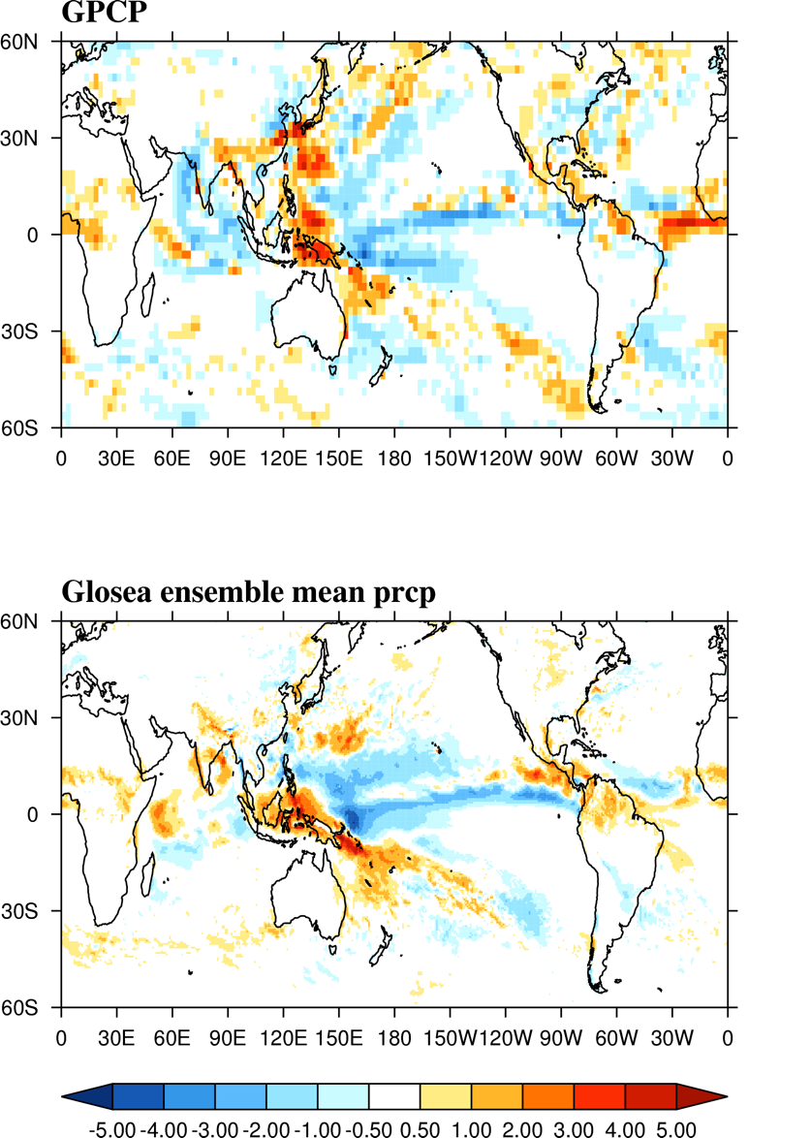
1999 – La Nina
JJA Velocity potential anomalies
JJA Precipitation anomalies
VP (km^2/s)
P (mm/day)
Notes:
Maybe some local process?
Maybe equatorial atlantic?

Slide 18
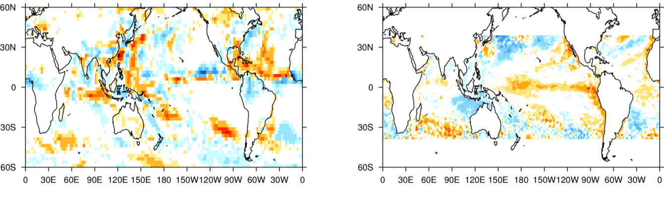
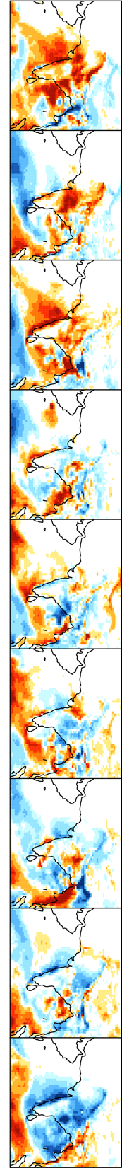
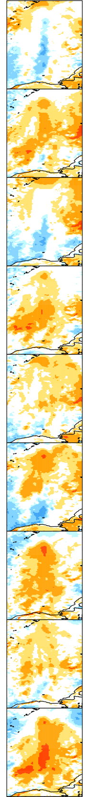
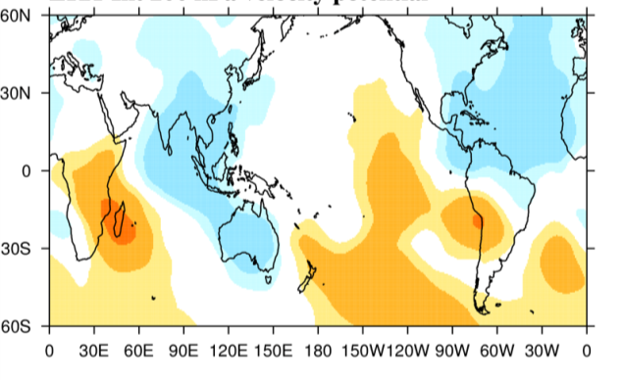
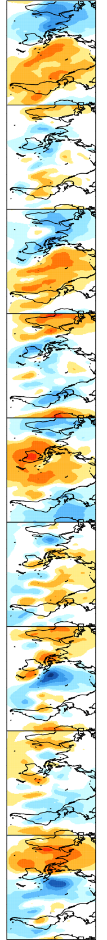
2005 Large ensemble scatter
GPCP precipitation anomaly
TMI SST anomaly
ERA-Int VP anomaly
GloSea5 JJA Indian precipitation anomaly
GloSea5 JJA equatorial Pacific SST anomaly
GloSea5 JJA 200 hPa velocity potential anomaly
Ordering: Positive AIR anomaly -> negitive AIR anomaly

Slide 19
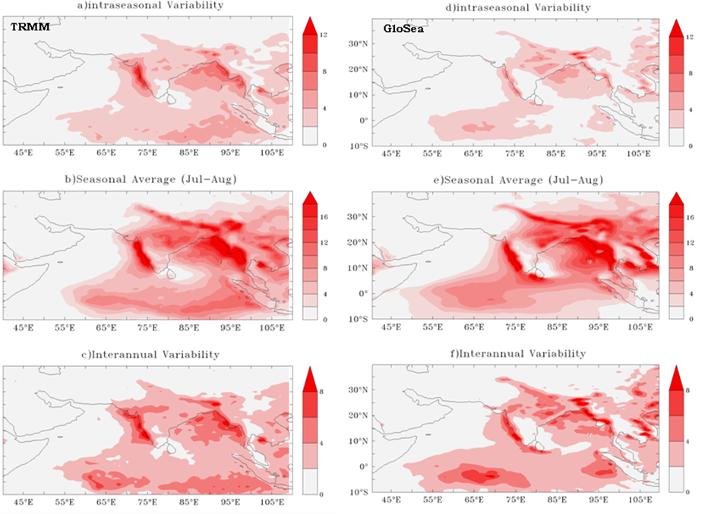
Seasonal mean versus intraseasonal and interannual variability
SD of 30-60 day filtered anomalies, climatological mean precipitation, amplitude of interannual variability
Deficiency in precipitation signal over EEIO in all fields

Slide 20
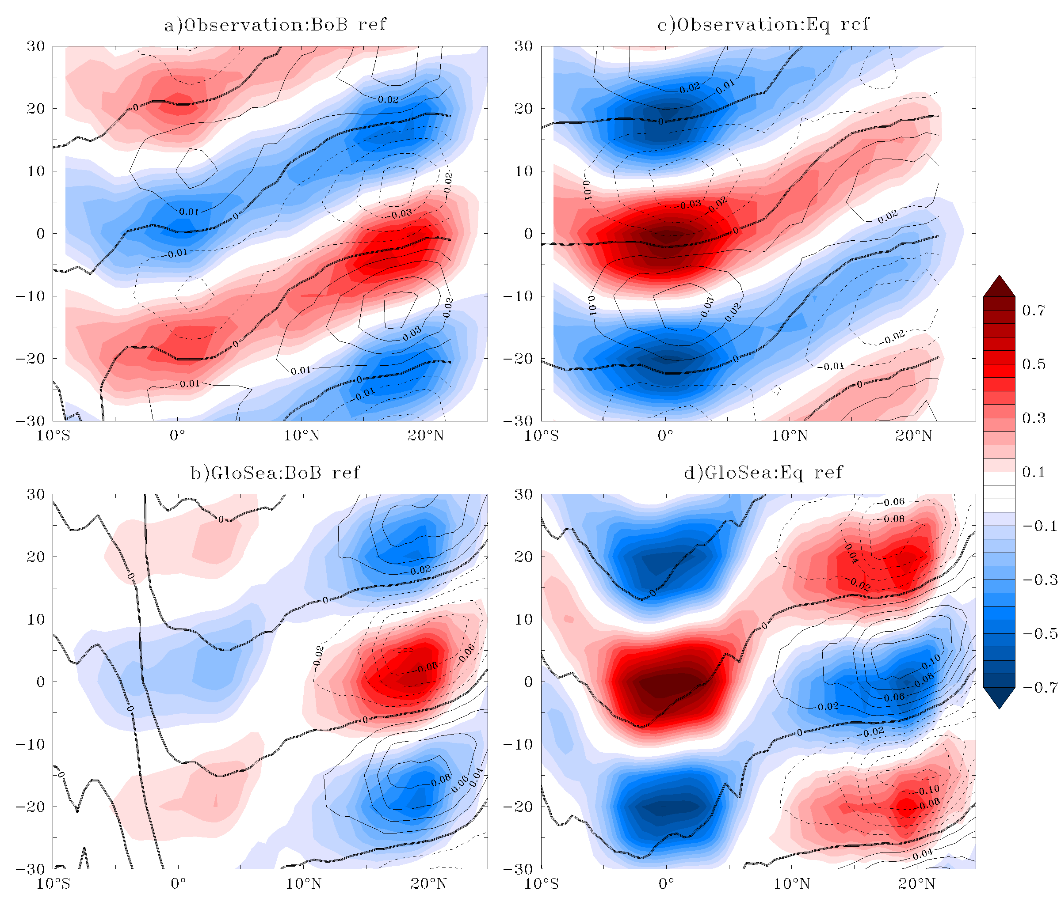
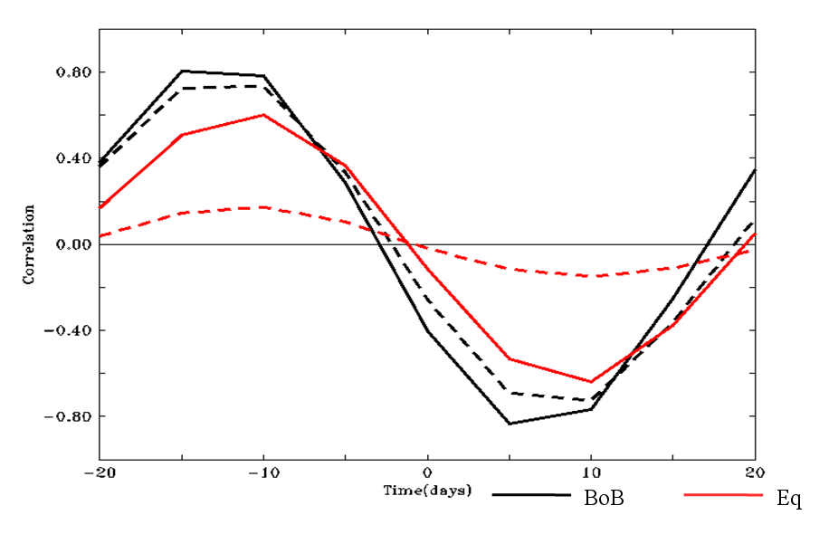
Northward propagation
Precipitation (shaded) and SST (contours) regressed upon reference precipitation in BoB and equatorial Indian ocean
Lead-lag correlation of filtered rain anomalies over north BoB (15-20N, 85-95E, black) and EEIO (2.5S-2.5N, 85-95E, red) for observations (solid) and GloSea5 (dash)

Slide 21
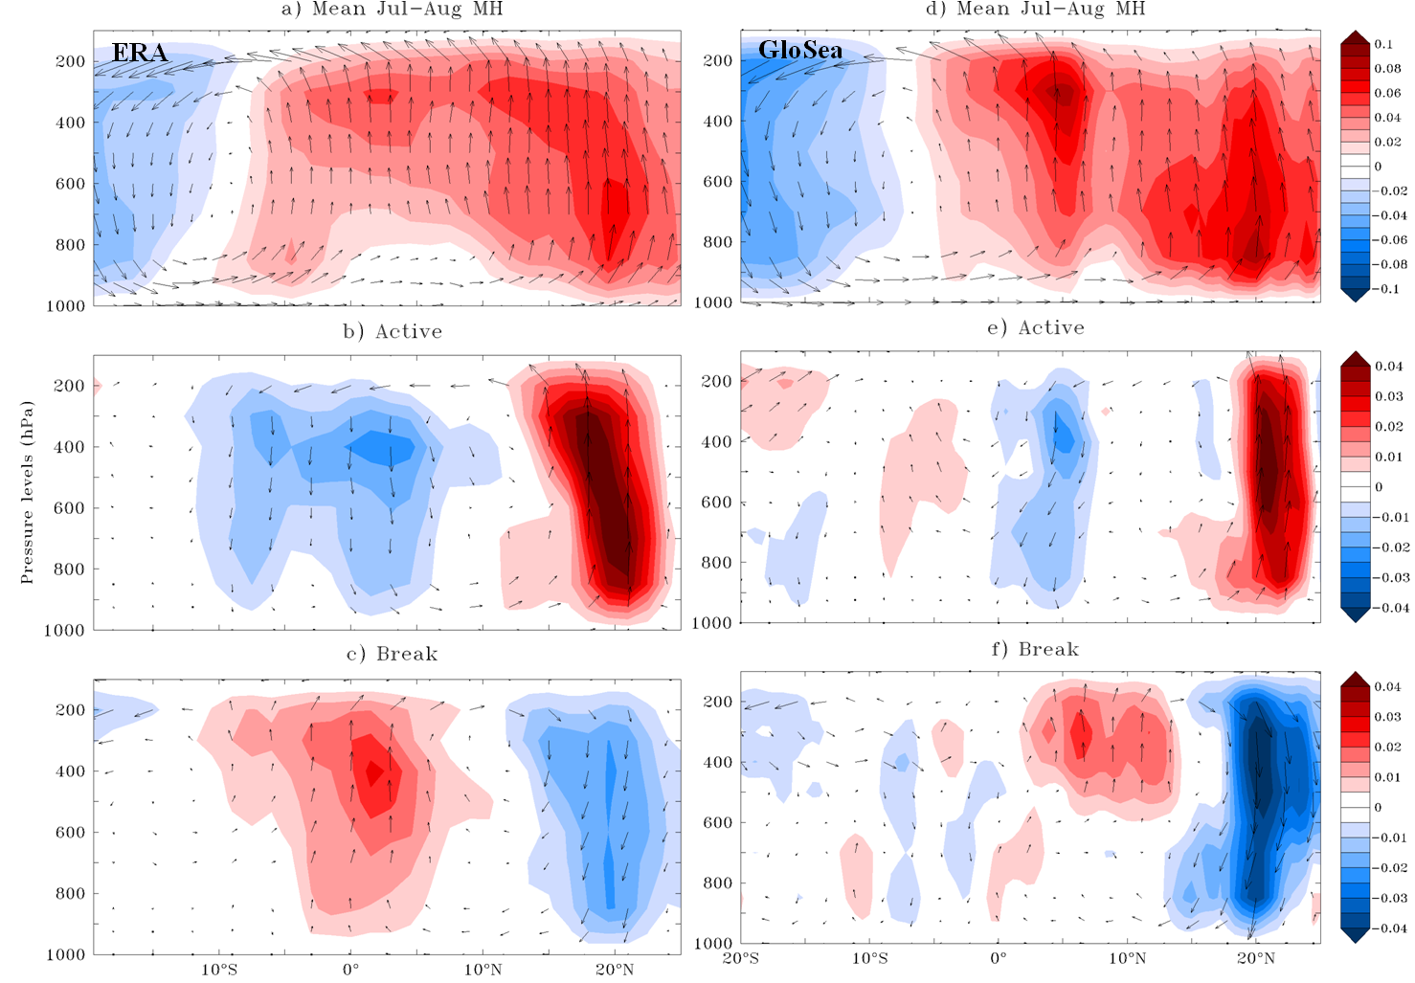
Intraseasonal variation of monsoon overturning circulation (70-90E)

Slide 22
Conclusions
GloSea5 performance in some years encouraging, but there are prominent forecast busts
Forecast of dynamical indices has higher skill than forecast of all India rainfall
Case study years indicate complex reasons for forecast failures and ensemble spread, which need detailed analysis
  Mean state SST biases
  Incorrect prediction of equatorial Pacific SSTs
  Local processes?
Poor propagation and representation of intraseasonal variability

Slide 23
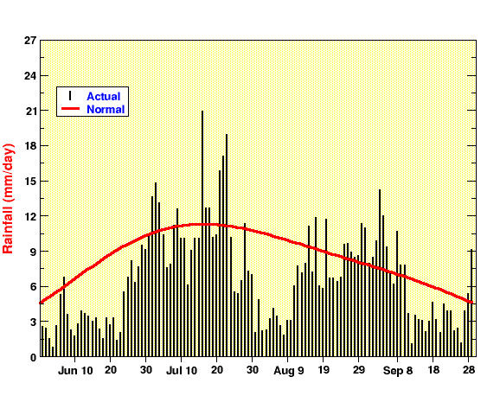
Future Work: Complete GloSea5 assessment
Complete GloSea5 assessment (next 3 – 6 months):
  With GC2 operational, a 14 year hindcast set is run initialized each week - new opportunities
  Finish seasonal case study analysis
  Analyse intraseasonal predictability as a function of lead time
  Analyse active/break event case studies
In 2009, worst monsoon drought in around 40 years. Several breaks occurred in 2009:

Slide 24
Future Work: Pragmatic correction techniques
Framework to test impact of mean state biases on prediction skill (Years 2 and 3)
  Wind stress corrections applied based on model bias relative to reanalysis. Lower tropospheric winds, SST and equatorial thermocline respond rapidly
  Has successfully been used to demonstrate the that the IOD is sensitive to the EqIO mean state (Marathayil thesis, 2013).
  If improved skill can be demonstrated, motivates possible operational implementation
  Nudging techniques will also be explored
Notes:
Figure 1: DJF sst biases in the northern Arabian Sea versus DJF meridional wind biases across from the northern coast. Cold biases are related to too strong meridional winter monsoon winds (north-easterly monsoon), which advect cold dry air from across the land, increasing the upward latent heat flux over the ocean and cooling the surface. The strong winds are related to cold land surface air temperature biases in Pakistan and NW India, creating a too-strong meridional temperature gradient. The strong winter monsoon winds also feed excessive convergence into the western equatorial Indian Ocean and strong precipitation there (blue contours).
Figure 2: DJF composite difference of surface temperatures, 850 winds, and precipitation in 7 coldest minus 7 warmest models based on northern Arabian Sea SST.

Slide 26
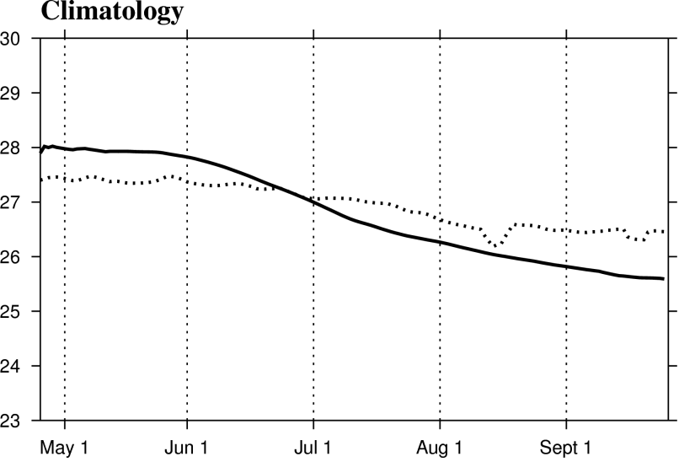
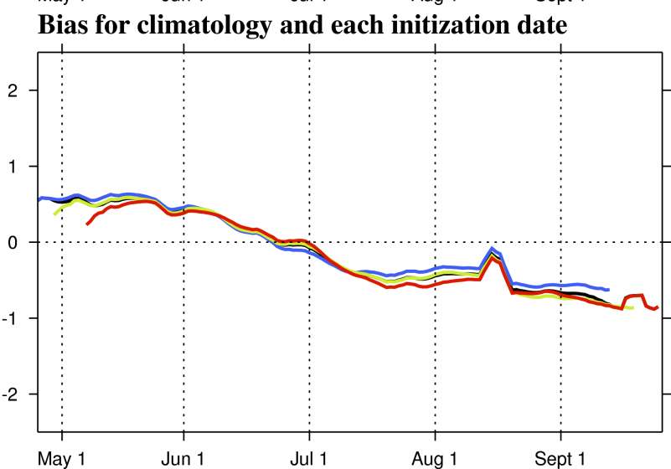
Plumes
Nino 3.4 – TMI SSTs and ensemble mean

Slide 27
Project background
A 3-year National Monsoon Mission project funded by the India Ministry of Earth Science
Aiming to improve monsoon simulation & forecasts at the beneath-seasonal scale in the MetUM
Project is 9 months old
testing

Slide 28
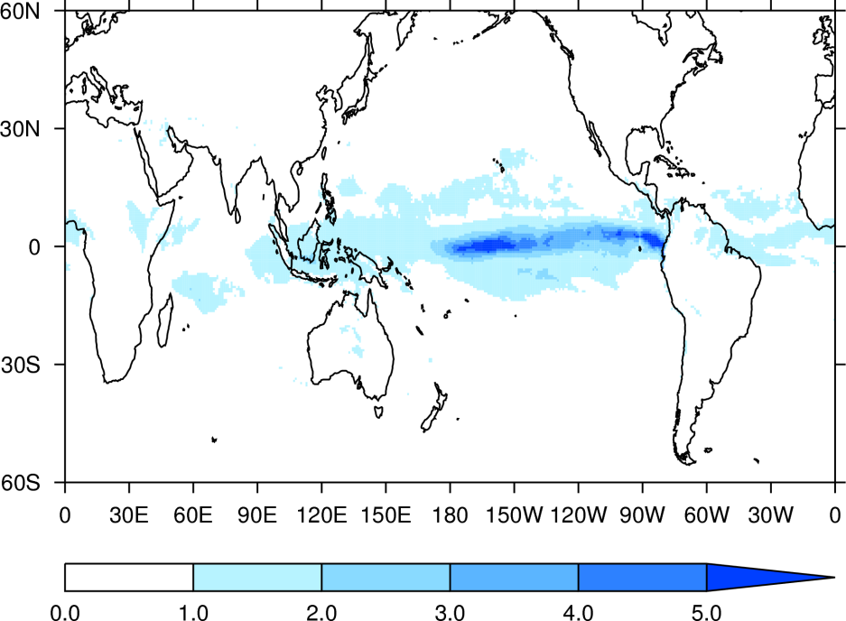
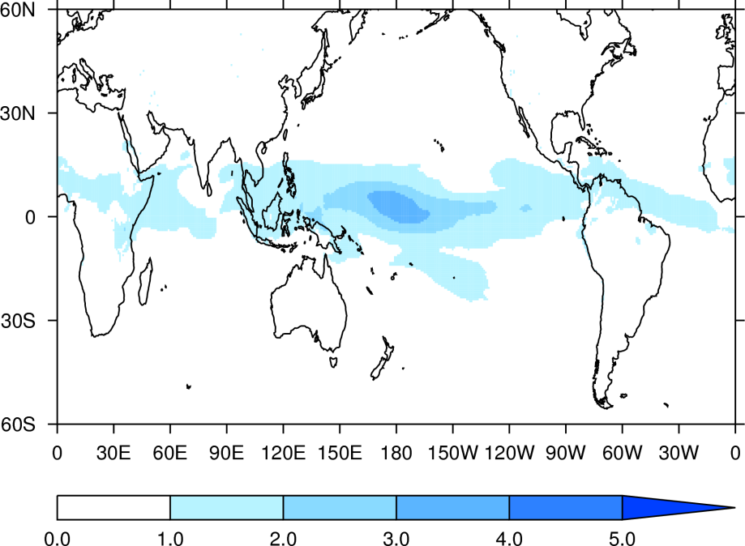
Ensemble agreement
JJA precipitation signal-to-noise ratio
JJA zonal wind signal-to-noise ratio

