Slide 1
Evaluation and Improvement of the Unified Model for Short- and Medium-Range Prediction of Monsoon Rain Systems
Beth Ebert (PI), Noel Davidson, Kamal Puri (CAWCR)
Raghavendra Ashrit, Gopal Iyengar, Kuldeep Sharma, Ashis Mitra, EN Rajagopal (NCMRWF)

Slide 2
Project goals
Overall objectives:
Provide information on the accuracy and reliability of the Unified Model (UM) rainfall predictions
  The UM is used by the following centres:
    Met Office
    NCMRWF – NCUM
    Bureau of Meteorology – ACCESS (Australian Community Climate and Earth System Simulator)
Conduct numerical experiments to guide improved model performance
Notes:
Both India and Australia use the Met Office Unified Model, which is one of the best modelling systems in the world. Nevertheless, it need further assessment and improvement in order to more accurately predict monsoon circulations and associated rainfall.
Note that good rainfall performance is often used as an indication of overall model health. We also use rainfall performance as a metric because we have a good network of rainfall observations and rain is one of the fields we are most interested in.
Need for timely and accurate predictions of monsoon weather and rainfall for water resource management, public safety, agriculture, industry, etc.
State-of-the-art verification methods to diagnose the sources and nature of the errors
Information for modellers to target model improvements
Information to assist forecasters in interpreting model results
Numerical experimentation to improve the representation of physical processes related to monsoon rainfall
Better simulation of low latitude meteorological processes
Assessment of UM-based ensemble prediction (MOGREPS)
Longer lead time for useful forecasts
Probabilistic forecasts for risk assessment and decision making

Slide 3
What is ACCESS
Schematic
OBS
Fully coupled system
Assimilation
(4DVAR)
NWP
Dynamic Veg.
(LPJ)
Seasonal
Climate
Atmosphere
(UM)
Climate
Earth system
Assimilation
Coupler
(OASIS)
Land surface
(CABLE)
Chemistry
(UKCA)
Ocean Carbon
(CSIRO)
Ocean
AusCOM (MOM4)
Sea-ice
(CICE4)
Collaborations key:
Met Office, GFDL
Australian Universities
Assimilation
(BODAS)
OBS
3

Slide 4
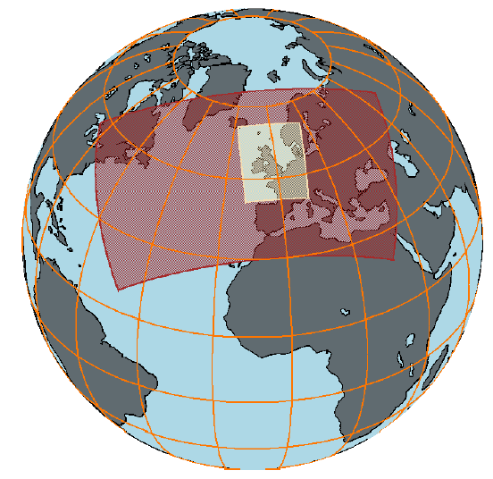
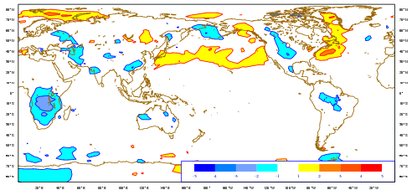
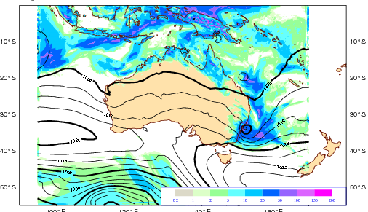
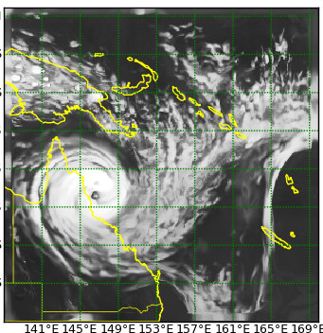
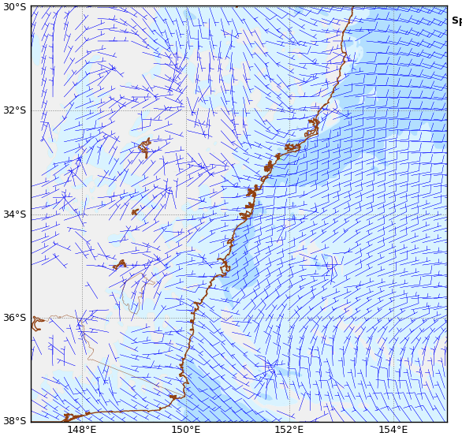
ACCESS
Seamless prediction
ACCESS-G
40km L70
Unified Model
25km L70
ACCESS-R
11KM L70
ACCESS- SREP, Fire Wx
ACCESS-TC
ACCESS-C
4km L70
1.5km L70
The Centre for Australian Weather and Climate Research
A partnership between CSIRO and the Bureau of Meteorology

Slide 5
Project goals
Areas of work:
Model verification and diagnostic evaluation of the UM rainfall forecasts for the monsoon and embedded weather systems
Numerical experimentation and sensitivity studies of selected rain events (e.g., monsoon onset, monsoon depressions, cyclones)
Application of ensemble methods to quantify the uncertainties in prediction of heavy rain
Notes:
Both India and Australia use the Met Office Unified Model, which is one of the best modelling systems in the world. Nevertheless, it need further assessment and improvement in order to more accurately predict monsoon circulations and associated rainfall.
Note that good rainfall performance is often used as an indication of overall model health. We also use rainfall performance as a metric because we have a good network of rainfall observations and rain is one of the fields we are most interested in.
Need for timely and accurate predictions of monsoon weather and rainfall for water resource management, public safety, agriculture, industry, etc.
State-of-the-art verification methods to diagnose the sources and nature of the errors
Information for modellers to target model improvements
Information to assist forecasters in interpreting model results
Numerical experimentation to improve the representation of physical processes related to monsoon rainfall
Better simulation of low latitude meteorological processes
Assessment of UM-based ensemble prediction (MOGREPS)
Longer lead time for useful forecasts
Probabilistic forecasts for risk assessment and decision making

Slide 6
Relevance
Need for timely and accurate predictions of monsoon weather and rainfall for water resource management, public safety, agriculture, industry, etc.
State-of-the-art verification methods to diagnose the sources and nature of the errors
  Information for modellers to target model improvements
  Information to assist forecasters in interpreting model results
Focussed numerical experimentation to improve the representation of physical processes related to monsoon rainfall
  Better simulation of low latitude meteorological processes
Assessment of UM-based ensemble prediction (MOGREPS)
  Longer lead time for useful forecasts
  Probabilistic forecasts for risk assessment and decision making

Slide 7
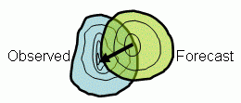
Spatial verification of monsoon rainfall
Verification of NCUM, ACCESS-G, UKMO
  Recent monsoon seasons
    DJF 2013-14 (Australia), JJA 2014 (India)
  Verification against merged gauge + TRMM 3B42 rainfall analyses
Standard and new categorical metrics
POD, FAR, FBI, ETS
Symmetric extremal dependency index SEDI
Contiguous rain area (CRA) method
  Verify properties of heavy rain systems
  Pattern matching to determine the location error
  Differences in location, area, intensity, and spatial pattern point to sources of error (dynamics or physics)
  Thresholds of 20mm and 40mm per day
Notes:
Observational data uses merged gauge and satellite information (0.25° grid):
India: Mitra's NWGM rainfall analysis (uses TRMM 3B42 background field for objective analysis of gauge observations)
Australia: Operational rain gauge analysis where available, TRMM 3B42 over sea and to fill data gaps over land

Slide 8
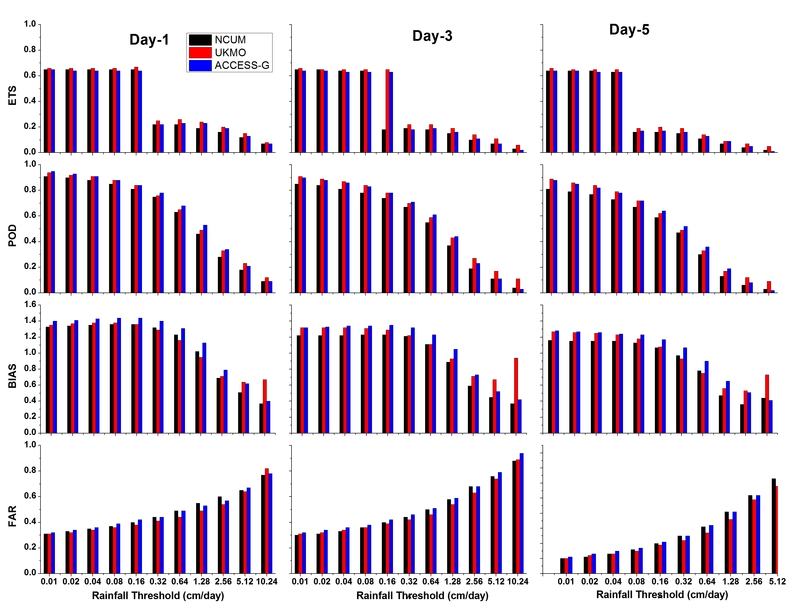
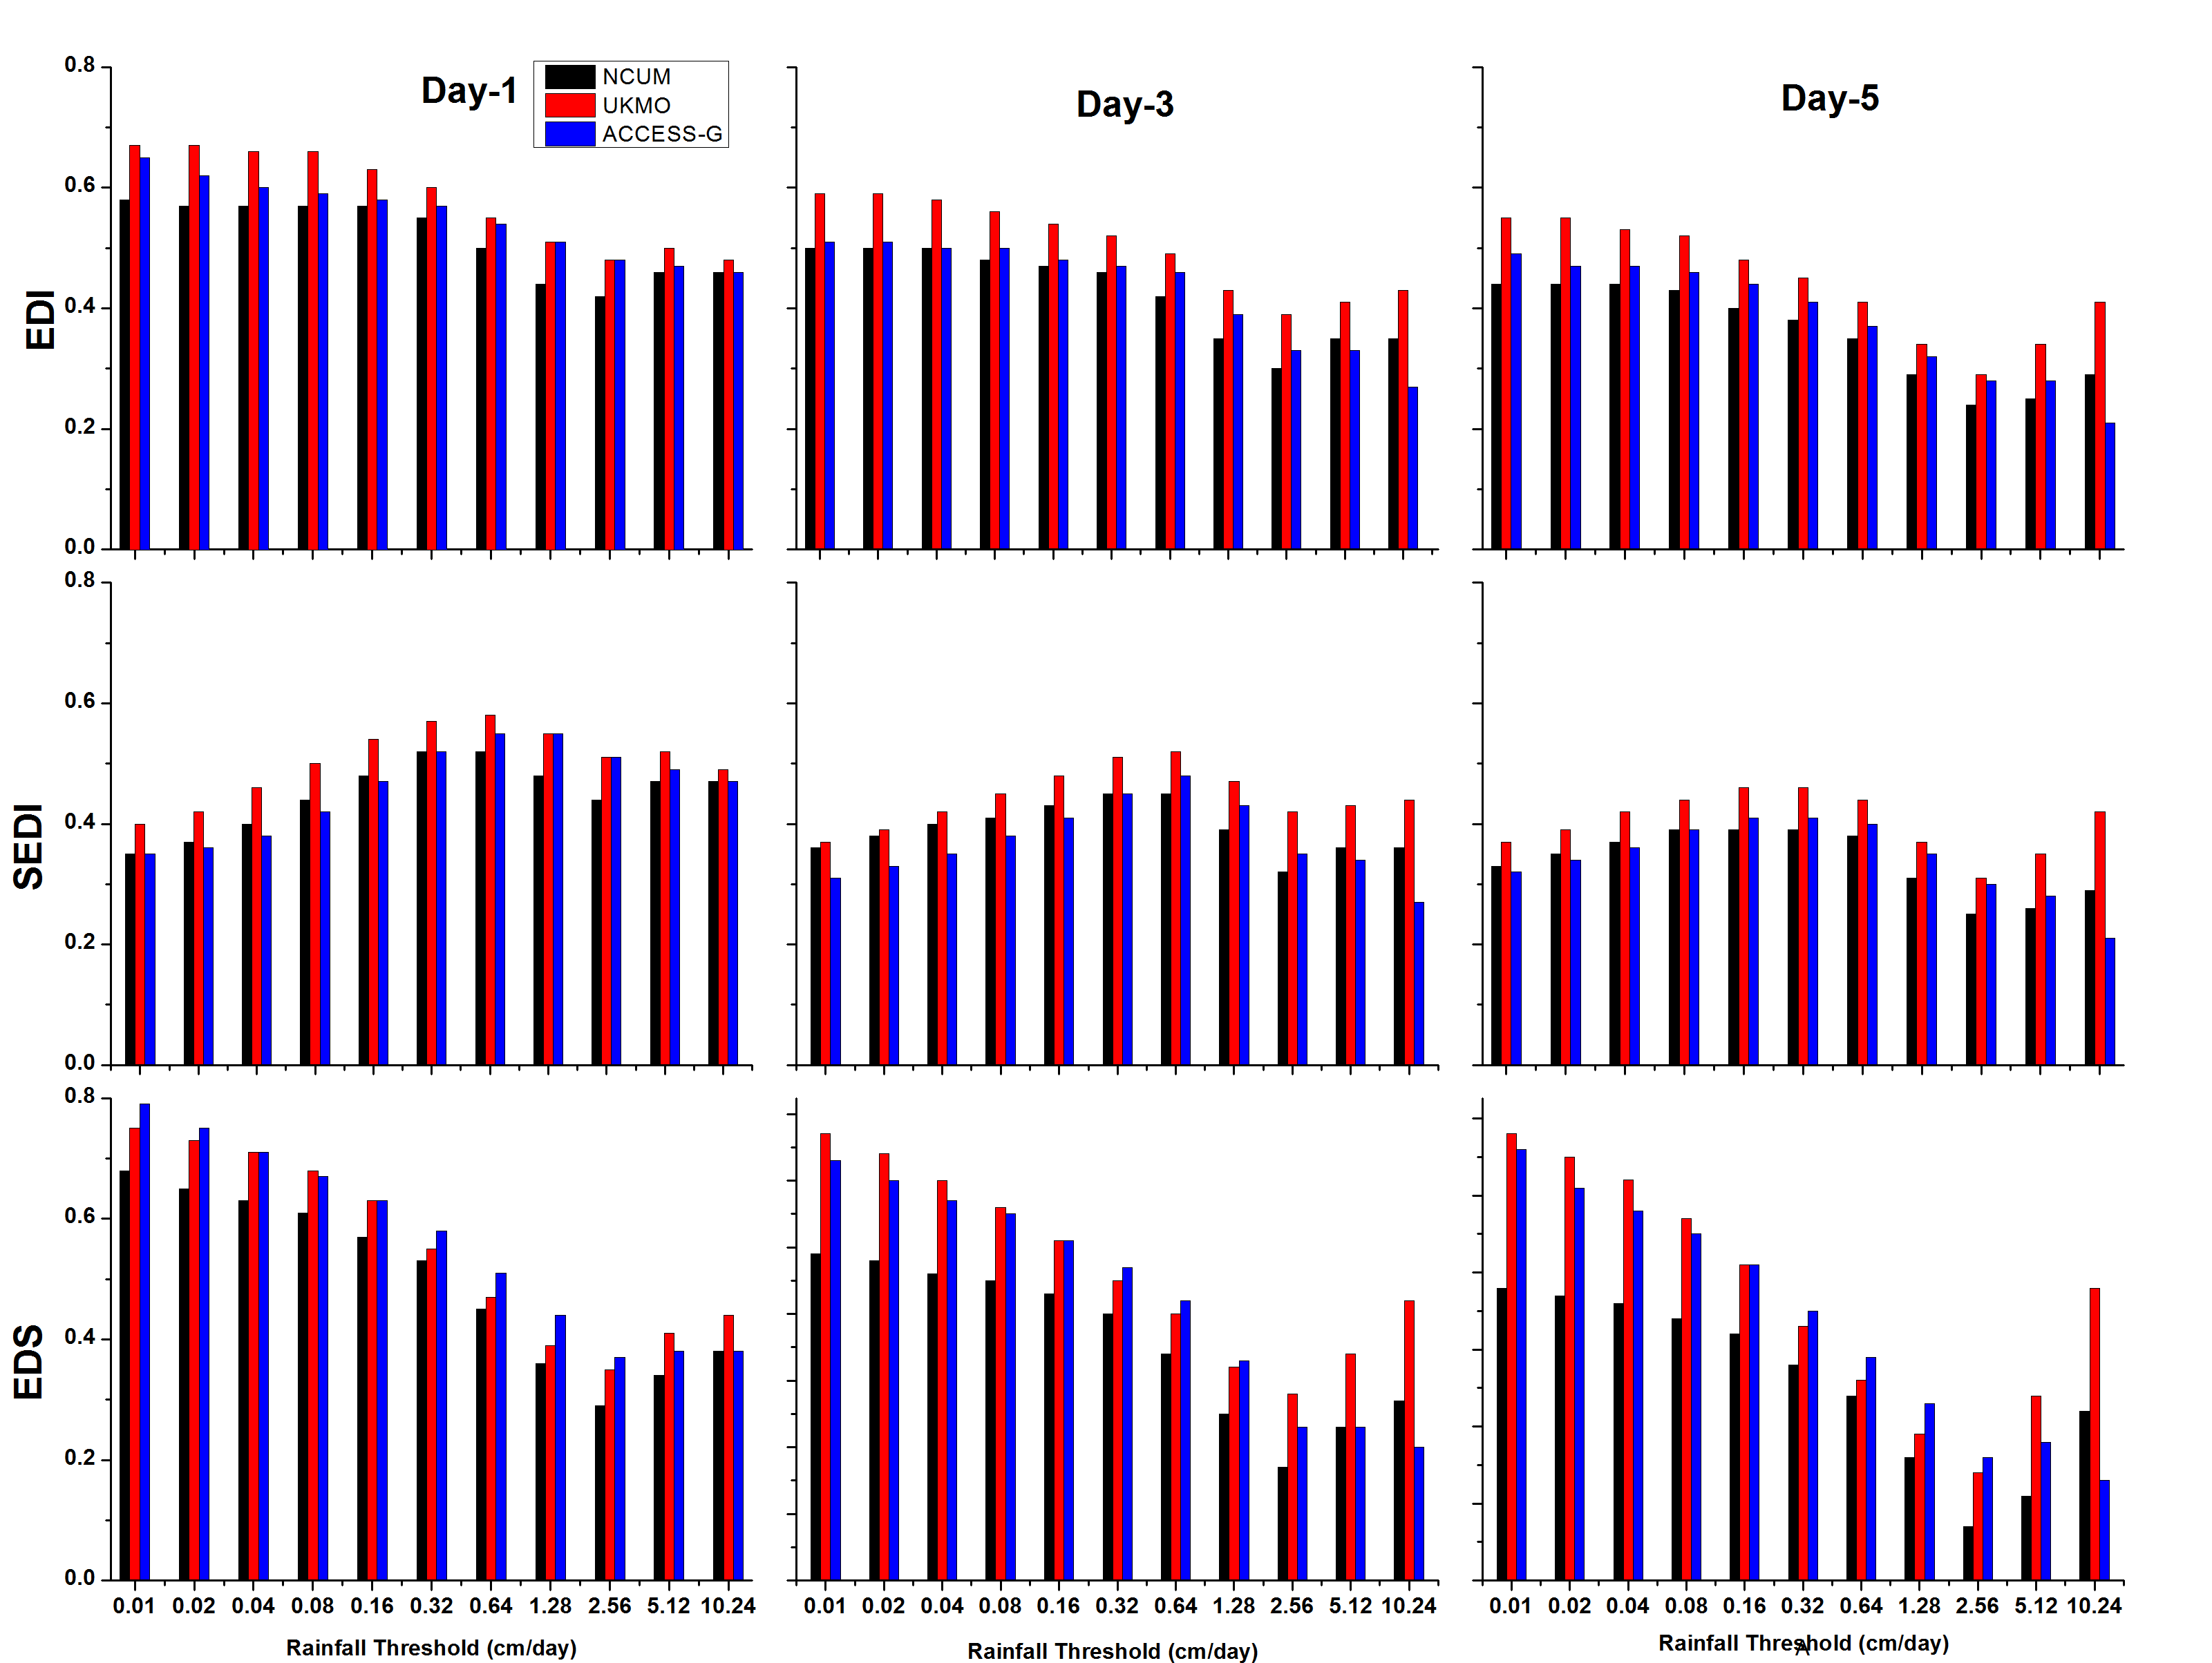


Global model performance for monsoon rainfall over India, JJA2014, land only
Symmetric Extremal Dependence Index
3 models perform similarly
  Heaviest rainfall hardest to predict
  UKMO better than NCUM and ACCESS-G for very heavy rain
  SEDI behaves better for rare events, distinguishes well between models
Notes:
Have only shown Day-3 results here.

Slide 9
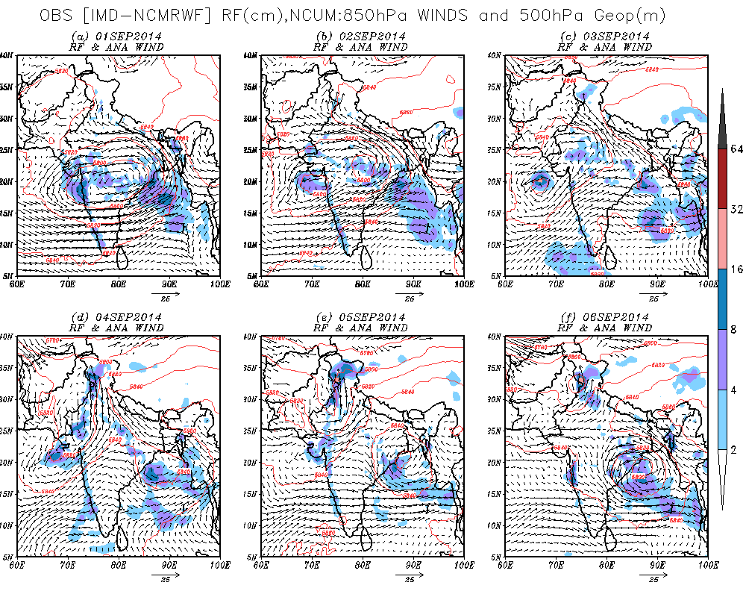
Example: Flooding in Srinagar (Kashmir)

Slide 10
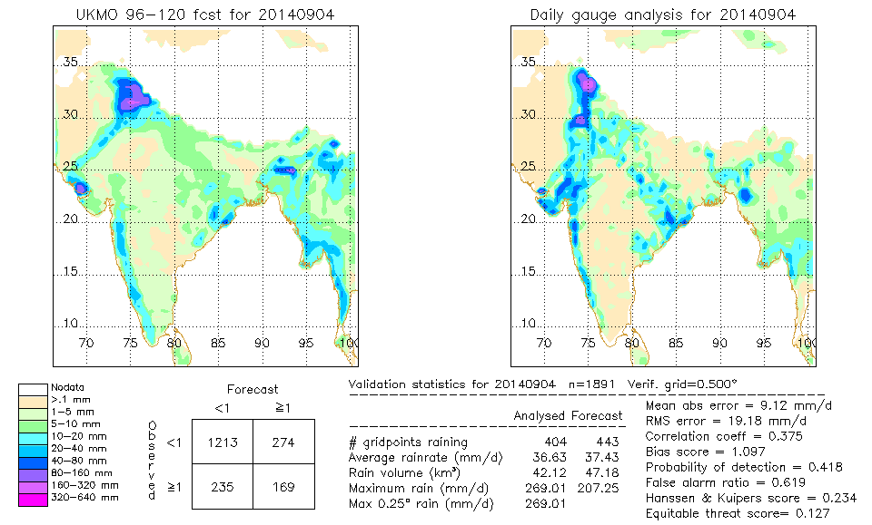
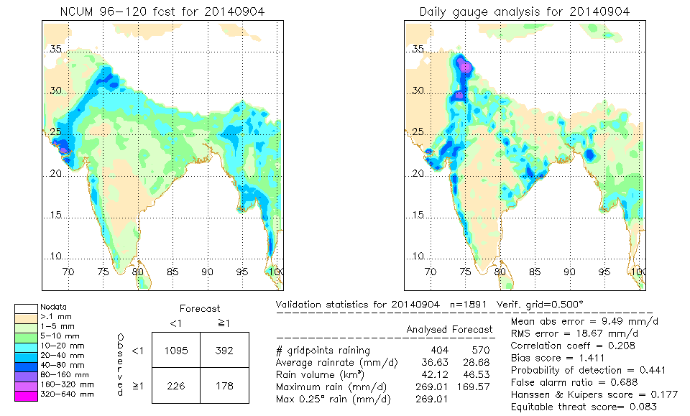
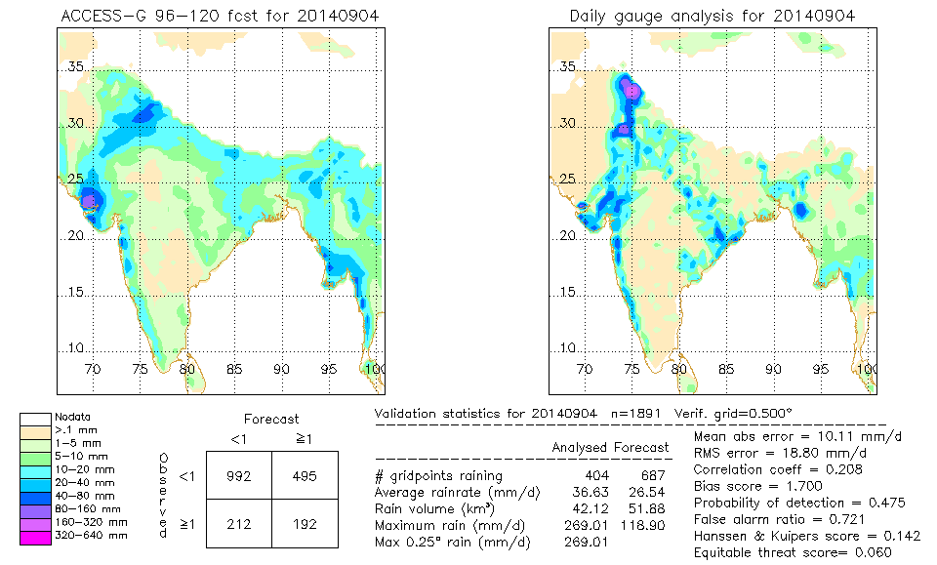
5-day forecasts from global models
UKMO
Analysis (NSGM)
NCUM
ACCESS-G
Notes:
5-day forecasts all picked the event

Slide 11
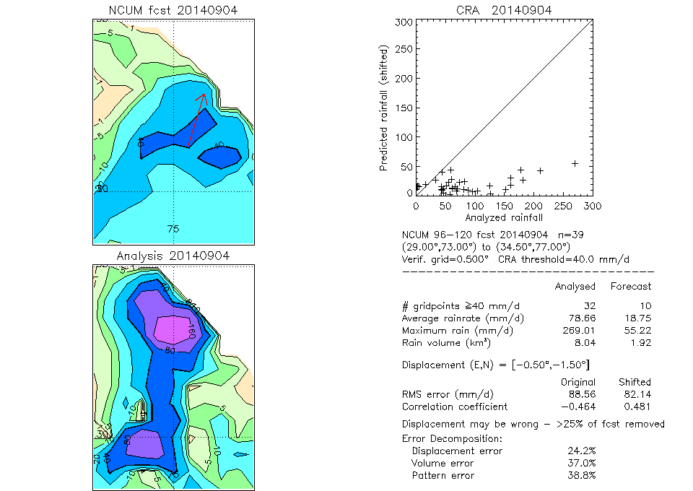
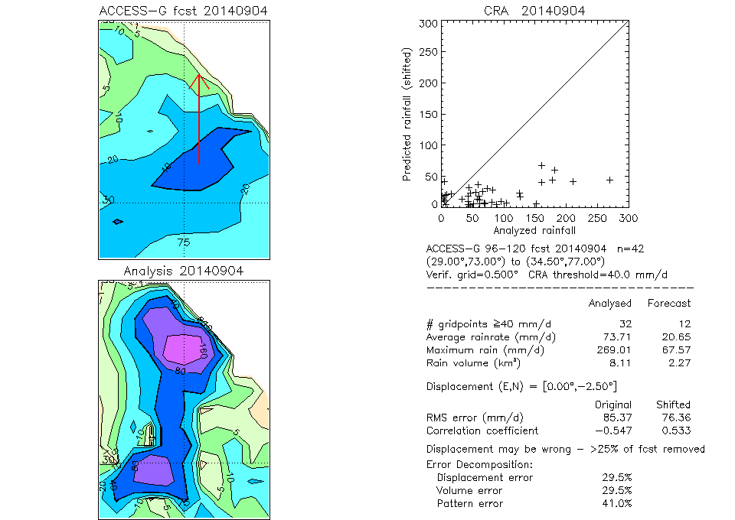
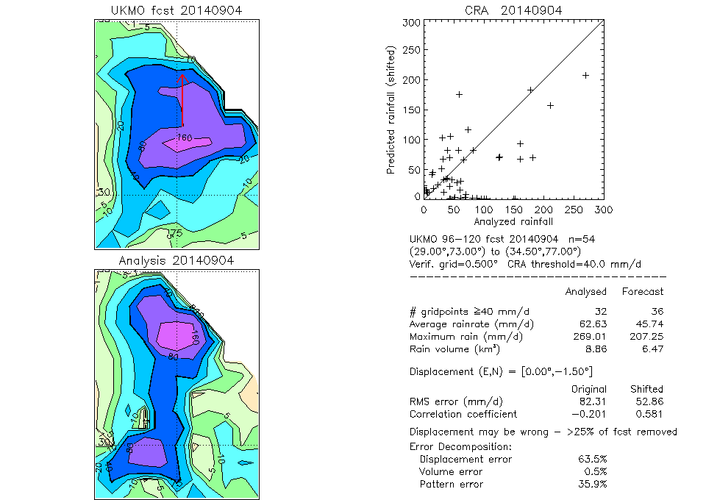
Zooming in…
NCUM
CRA verification (40mm threshold)
  Forecast heavy rain too far to the south, not intense enough
  Dominant sources of error
    ACCESS-G – pattern
    NCUM – volume and pattern
    UKMO – displacement
ACCESS-G
UKMO
Notes:
Results for many cases suggest (for global models):
For lower rain thresholds (≤20mm) pattern error tends to dominate – overall shape and spatial pattern is difficult to predict
For higher rain thresholds (≥40mm) displacement error tends to dominate – focuses on centre of heavy rain pattern, where pattern now less

Slide 12
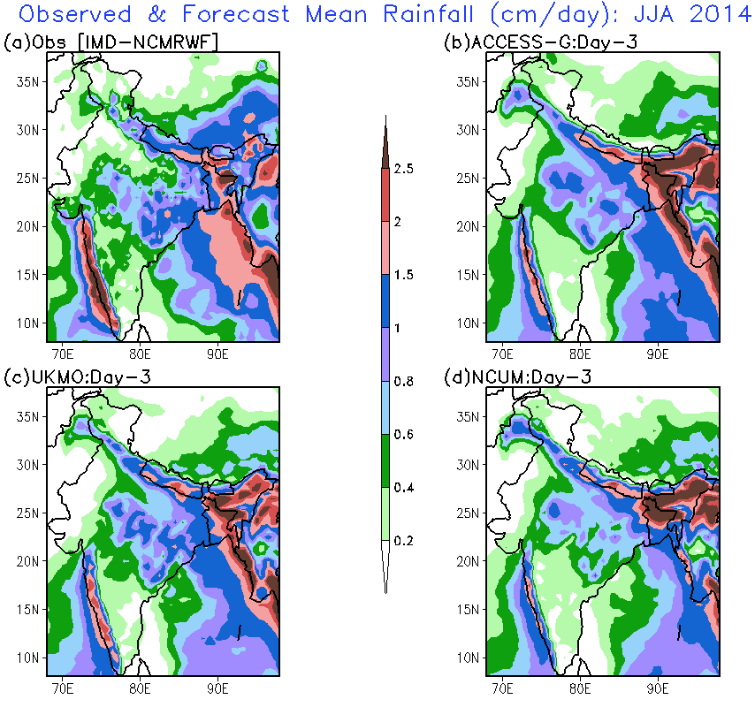
Seasonal performance comparison

Slide 13
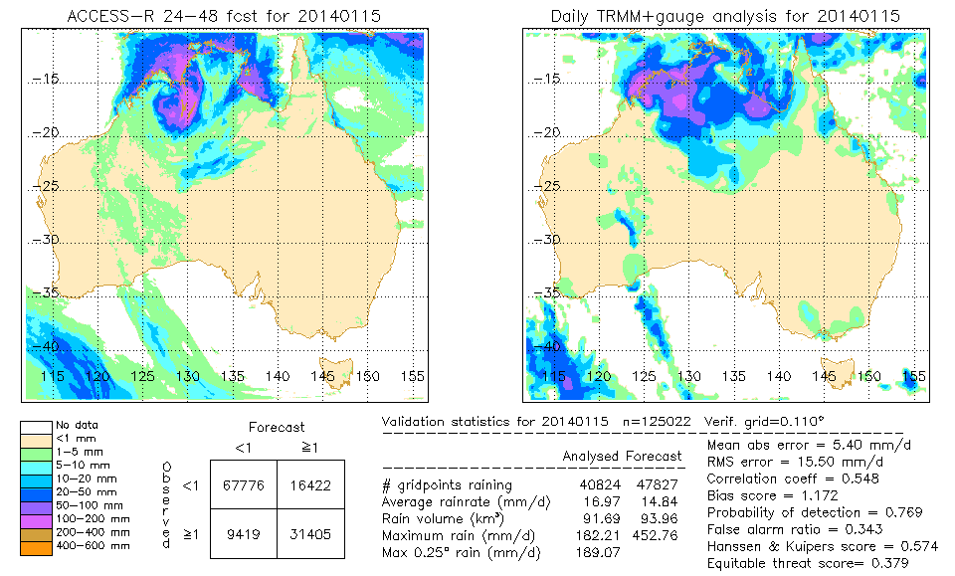
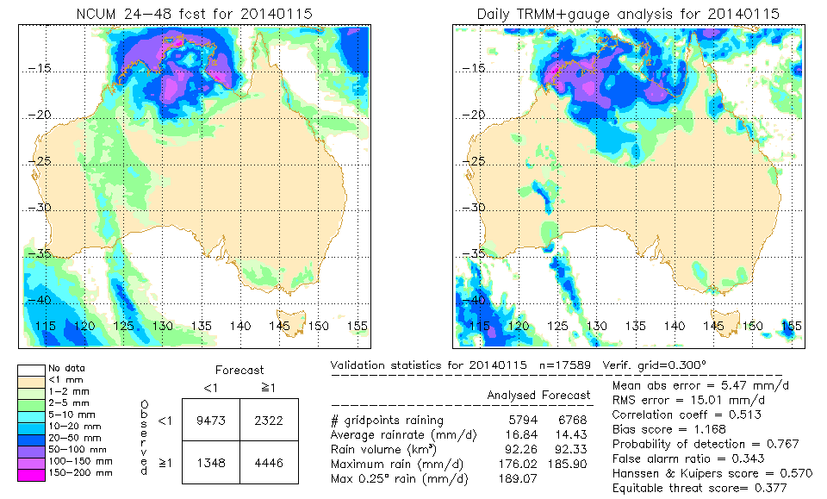
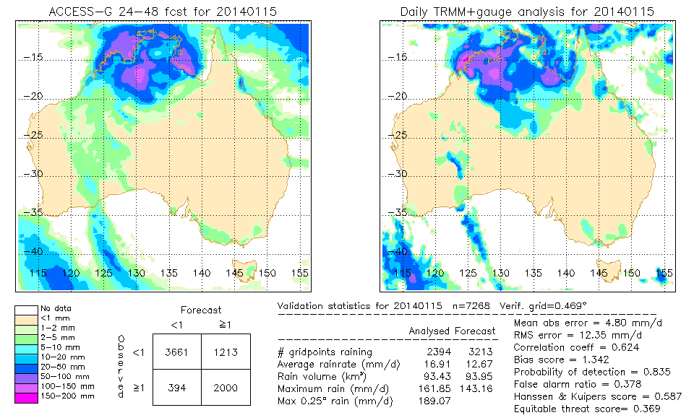
Monsoon example – Day 2 forecasts
ACCESS-R
Gauge+TRMM
NCUM
ACCESS-G

Slide 14
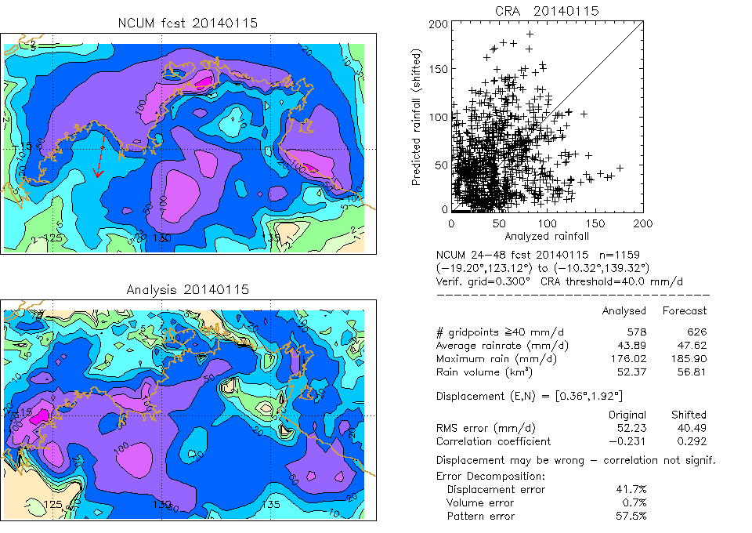
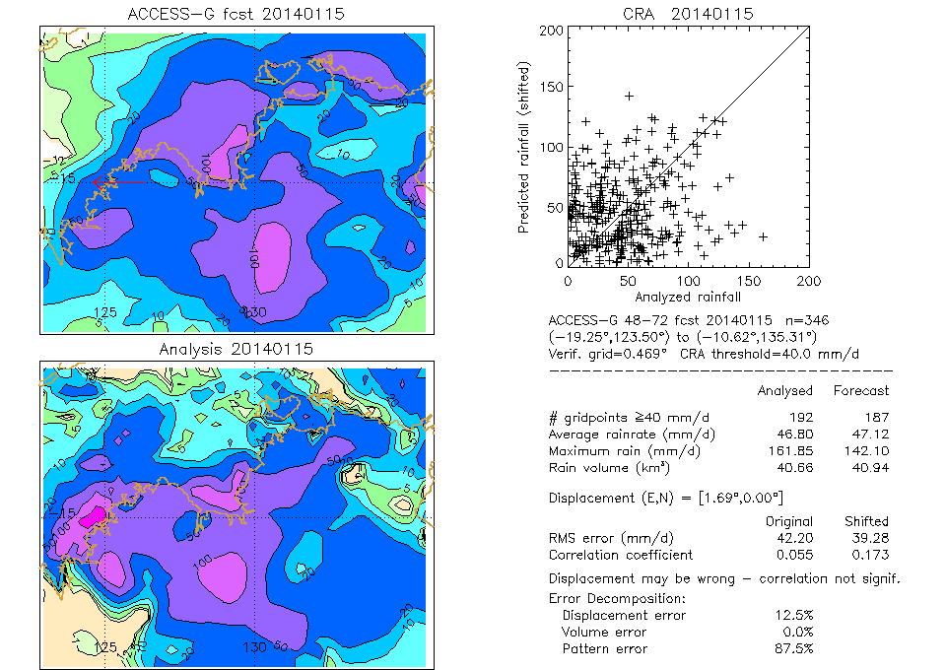
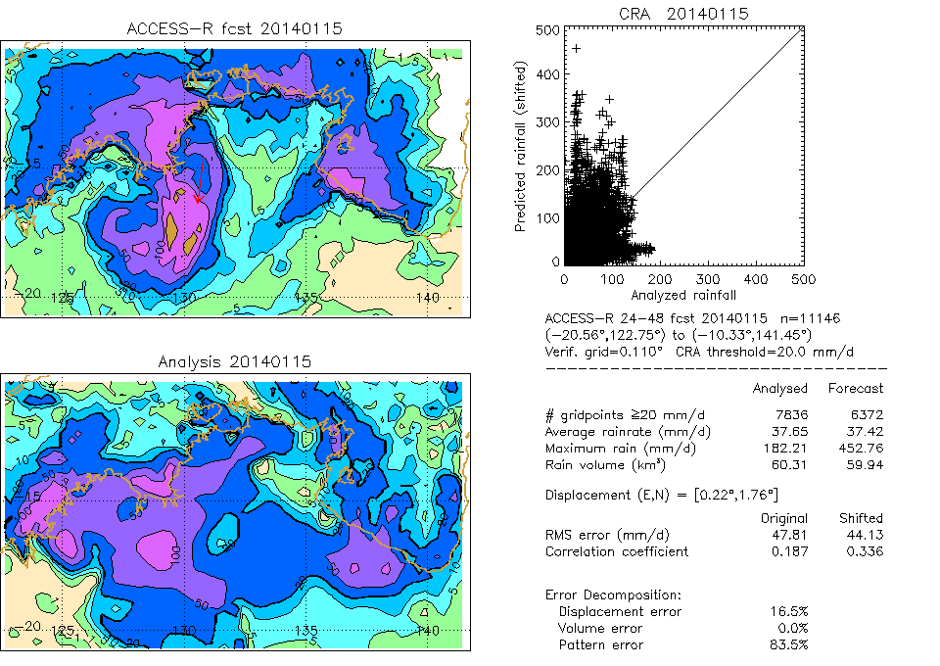
Zooming in…
NCUM
CRA verification (40mm threshold)
  Forecast heavy rain displaced a bit too far to the north (east),
  ACCESS-R maximum rain too great
  Dominant sources of error
    ACCESS-G – pattern
    NCUM – displacement and pattern
    ACCESS-R - pattern
ACCESS-G
ACCESS-R

Slide 15
Global model performance for Australian summertime rain, DJF2013-14, land + sea
Day 3
NCUM ACCESS
Broadly similar performance
Both models over-predict light rain, ACCESS has higher POD
Similar false alarm ratio for both models
ACCESS has higher skill according to ETS
* Not identical resolutions:
  ACCESS-G ~40km
  NCUM ~30km
Notes:
Only Day 3 results are shown.

Slide 16
Models get drier with lead time
NCUM, ACCESS
DJF 2013-14 verification against gauge+TRMM over Australian region
 | NCUM | ACCESS
Reduction in rain area day1 → day 5 | 7% | 6%
Reduction in rain rate day1 → day 5 | 9% | 7%
Reduction in rain volume day1 → day 5 | 6% | 4%

Slide 17
Conclusions about global model rainfall performance
General
  Models capture major features of monsoon rain
  Models dry with increasing lead time
  Over-forecasting at lower thresholds and under-forecasting at higher thresholds
  For lower CRA rain thresholds pattern error dominates, for higher thresholds displacement error dominates
India (JJA 2014)
  Rainfall over central India (UKMO realistic), ACCESS-G and NCUM underestimate
  Rainfall along the west coast underestimated
  UKMO forecasts have relatively better skill in predicting the extremes
Australia (DJF 2013-14)
  ACCESS has high bias, NCUM relatively unbiased

Slide 18
ACCESS-TC
  Designed specifically for tropical cyclone prediction
  Resolution: 0.11ºx0.11ºxL70, relocatable domain
  Vortex specification
    Structure based on observed location, central pressure and size
    Only synthetic MSLP obs used in the 4DVAR
  Initialization using 4DVAR Assimilation
    5 cycles of 4DVAR over 24 hours
    Defines the horizontal structure of the inner-core at the observed location
    Builds the vertical structure
    Constructs the secondary circulation
    Creates a balanced TC circulation
  Vortex specification code being implemented at NCMRWF
Notes:
18

Slide 19
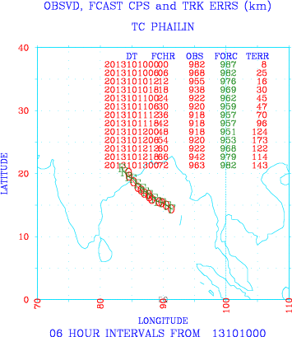
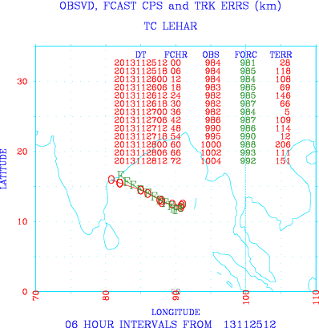
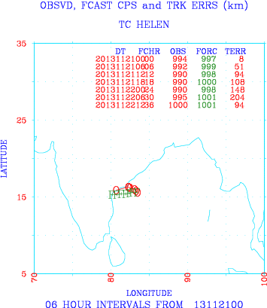
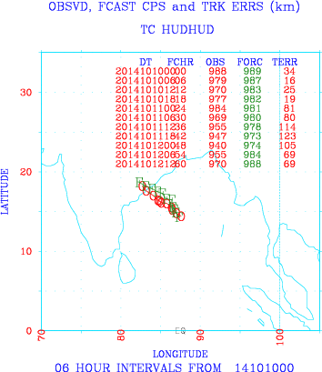
Observations
Forecasts
Phailin
Lehar
Selected operational landfall forecasts from ACCESS-TC, for Phailin, Lehar, Helen and Hudhud
Helen
Hudhud

Slide 20
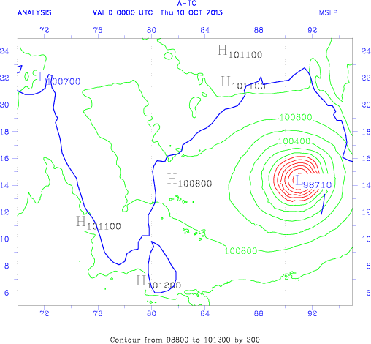
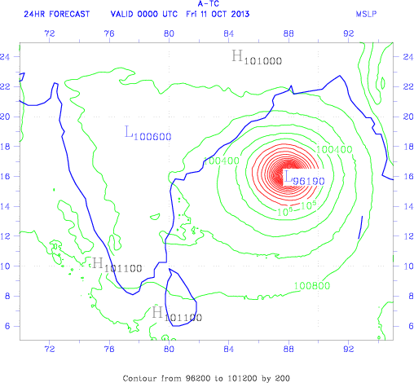
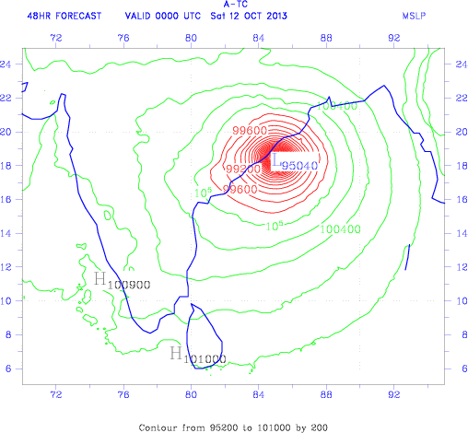
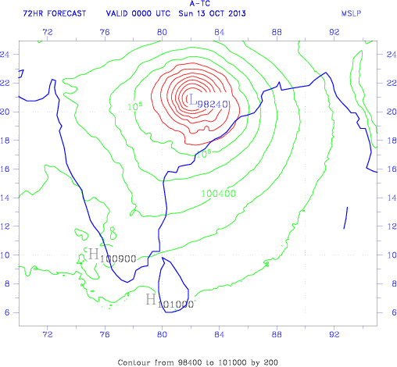
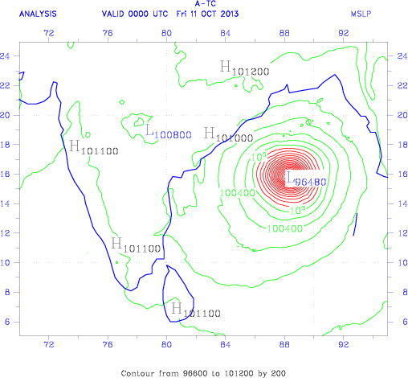
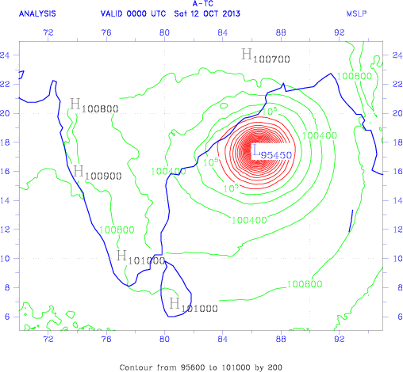
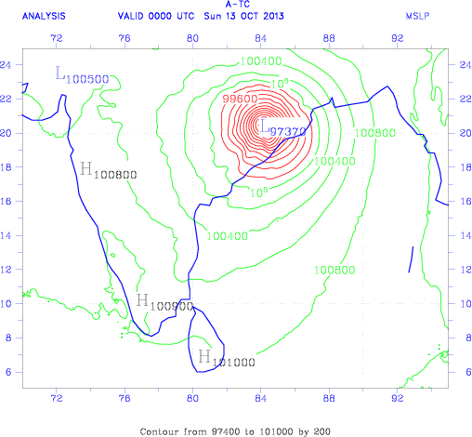
Initial analysis
TC Phailin:
ACCESS-TC Operational Forecast of MSLP
Base time 00UTC, 20131010.
< Initial condition
24-, 48-, 72- hour forecast
24-, 48-, 72- hour verifying, (initialized) analyses
IC + 24hr
IC + 48hr
IC + 72hr
Forecast
Verif. analysis

Slide 21
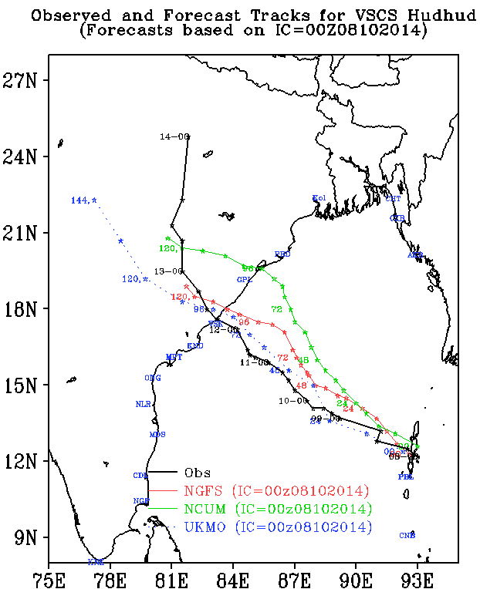
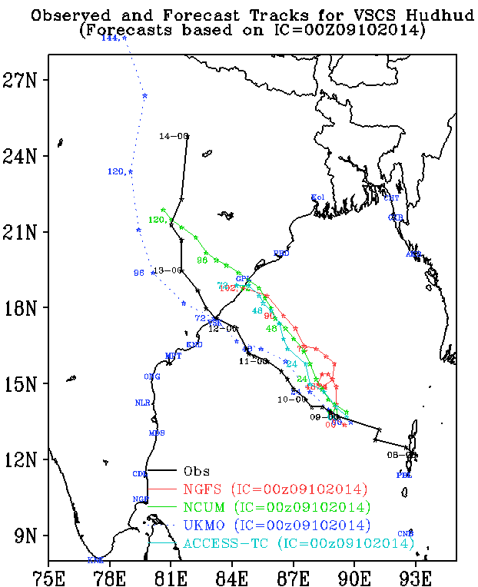
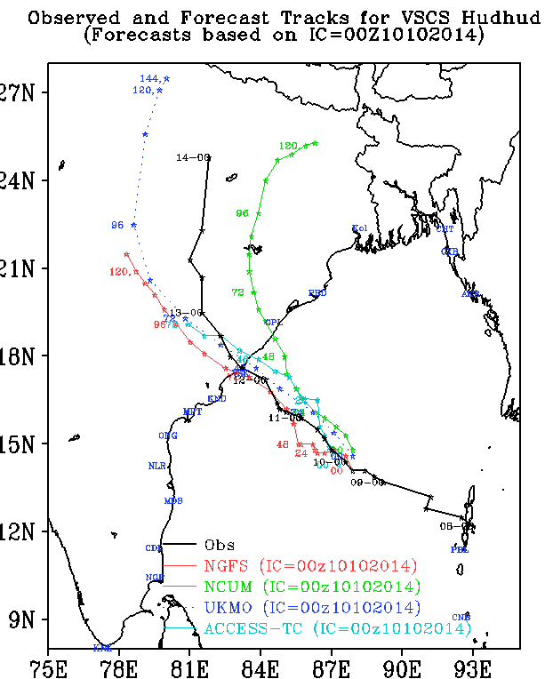
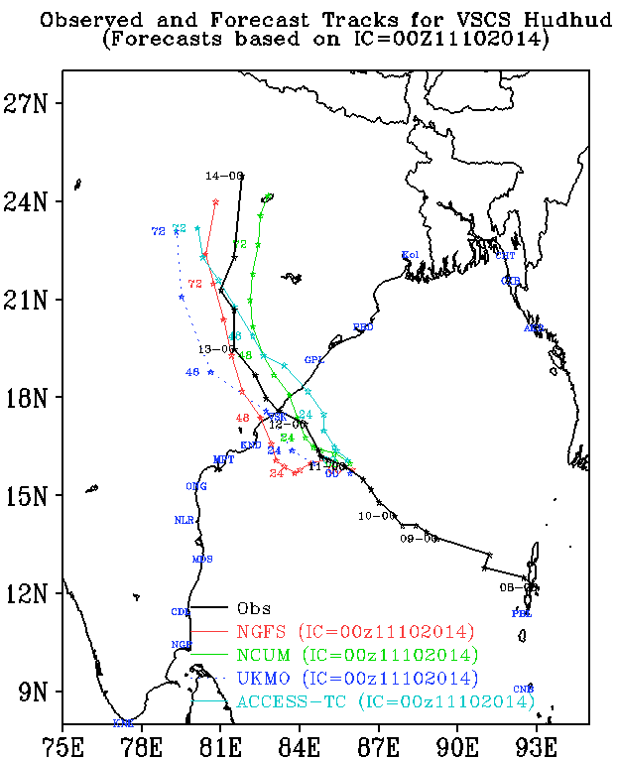
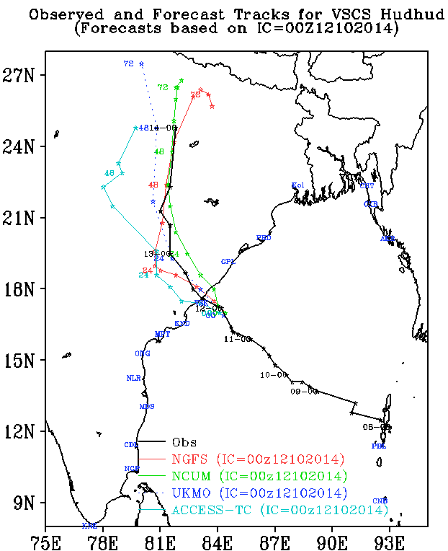
Forecast tracks for VSCS Hudhud
08 Oct 2014
09 Oct 2014
10 Oct 2014
11 Oct 2014
12 Oct 2014
Obs
NGFS
NCUM
UKMO
ACCESS-TC

Slide 22
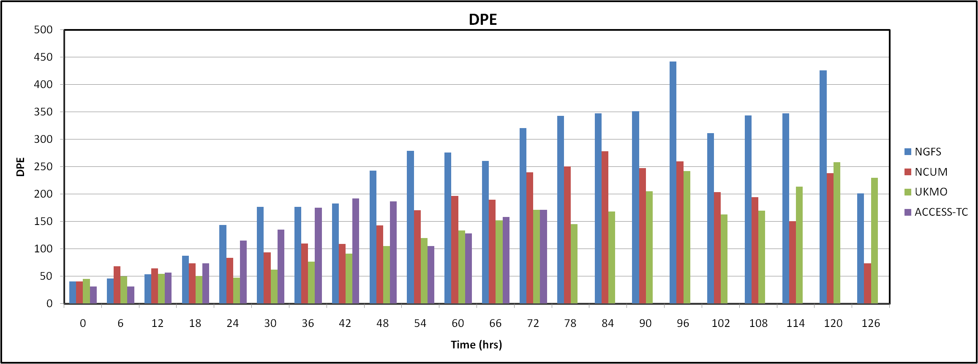
Track error for VSCS Hudhud
Direct Position Error (DPE)
  Errors are computed against the IMD best track data
  Average of track errors from 8-12 Oct 2014 is shown
  (9-12 Oct for ACCESS-TC)
  ACCESS-TC has least initial position error (33km)

Slide 23

Progress
Year 1
Year 2
Year 3
1. Diagnostic verification
UM rainfall performance assessed for 2 wet seasons Documentation of results | Interaction with forecasters on UM tropical rainfall quality
Diagnostic verification methods working at NCMRWF Dataset of verification statistics | Journal publication and conference presentation(s)
2. Numerical experimentation
Data preparation for selected rainfall cases | Numerical experimentation with UM | Further numerical experimentation
 | Dataset of verification results for case studies | Information to guide optimal UM model configuration & settings Journal publication and conference presentation(s)
3. Ensemble prediction
 | Probabilistic rainfall forecasts generated from MOGREPS | Verification of MOGREPS Documentation of results
 |  | Dataset of ensemble rainfall and verification statistics Journal publication and conference presentation(s)

Slide 24
Next steps
3-month visit to CAWCR by Vivek Singh
  Detailed examination of 3D rainfall structure
  Comparison to radar, Cloudsat/CALIPSO
Numerical experimentation with high resolution model
  Test configurations
  Verification using traditional and spatial (CRA, neighbourhood) methods
Ensemble modelling
  Spatial verification applied to ensembles
Model intercomparison of NCUM and ACCESS
  Tropical cyclone track, intensity, precipitation
  Global model precipitation
  Ensemble rainfall predictions

Slide 25

The Centre for Australian Weather and Climate Research
A partnership between CSIRO and the Bureau of Meteorology
Questions?
Thank you
www.cawcr.gov.au

Slide 26
Summary for Indian Monsoon, JJA2014
JJA Mean Rainfall
  NCUM: Day-1 to Day-5 drying
  Forecast skill (ETS) reasonable for lower rainfall thresholds
  Frequency bias : over-forecasting at lower thresholds and under-forecasting at higher thresholds.
JJA Maximum Rainfall
  Rainfall over central India (UKMO realistic), ACCESS-G and NCUM underestimate
  NCUM: Day-1 to Day-5 drying
  Rainfall along the west coast missing
EDS, EDI and SEDI
  Extreme dependency family of scores highlight relative skill at higher thresholds.
  UKMO forecasts have relatively better skill in predicting the extremes.
Notes:
This summary is based on a comprehensive verification of all models and lead times.

