Slide 1
Improved Ocean Initialization for Coupled Modelling for week-2 Monsoon forecast
SUNEET DWIVEDI
K Banerjee Centre of Atmospheric and Ocean Studies,
M N Saha Centre of Space Studies
University of Allahabad, Allahabad, INDIA

Slide 2
Objectives
Development, Configuration and Execution of Indian Ocean State Estimation system using Ocean component of Unified Model (UM) of Met Office (UK) and its associated Data Assimilation scheme (viz. NEMO and NEMOVAR)
Generation of quality controlled four-dimensional (three-dimensional time varying) geophysical state of the Indian Ocean (with emphasis on ocean’s upper hydrographic/thermal structure and flow field)
To provide coherent estimates of space-time varying upper Ocean mixed layer depth

Slide 3
RELEVANCE
To achieve better prediction ability for medium-range monsoon forecast, improved Indian ocean initializations are important.
Observing the physical state of the Indian ocean is however challenging: size, high variability, lack of extant quality observations continuous in space and time.
Research expeditions are conducted to study specific processes at a regional scale, but such data suffers from being too sparse in space and time.
The satellite measurements have superior space/time coverage, but are they restricted to surface variables only, and can be hard to combine with in-situ data.
approach: use a ocean circulation model NEMO and optimally combine it with the available observations using NEMOVAR data assimilation

Slide 4
Outline (First Year Progress Report):
Indian Ocean circulation modeling around AS and BoB at 25 km resolution using NEMO-AGRIF
Geophysical fields (3-D time evolving flow field and hydrographic structure) of the region [70-95E;0-20N] during 1996-2007 (12 years)
Upper Ocean mixed layer depth variability

Slide 5
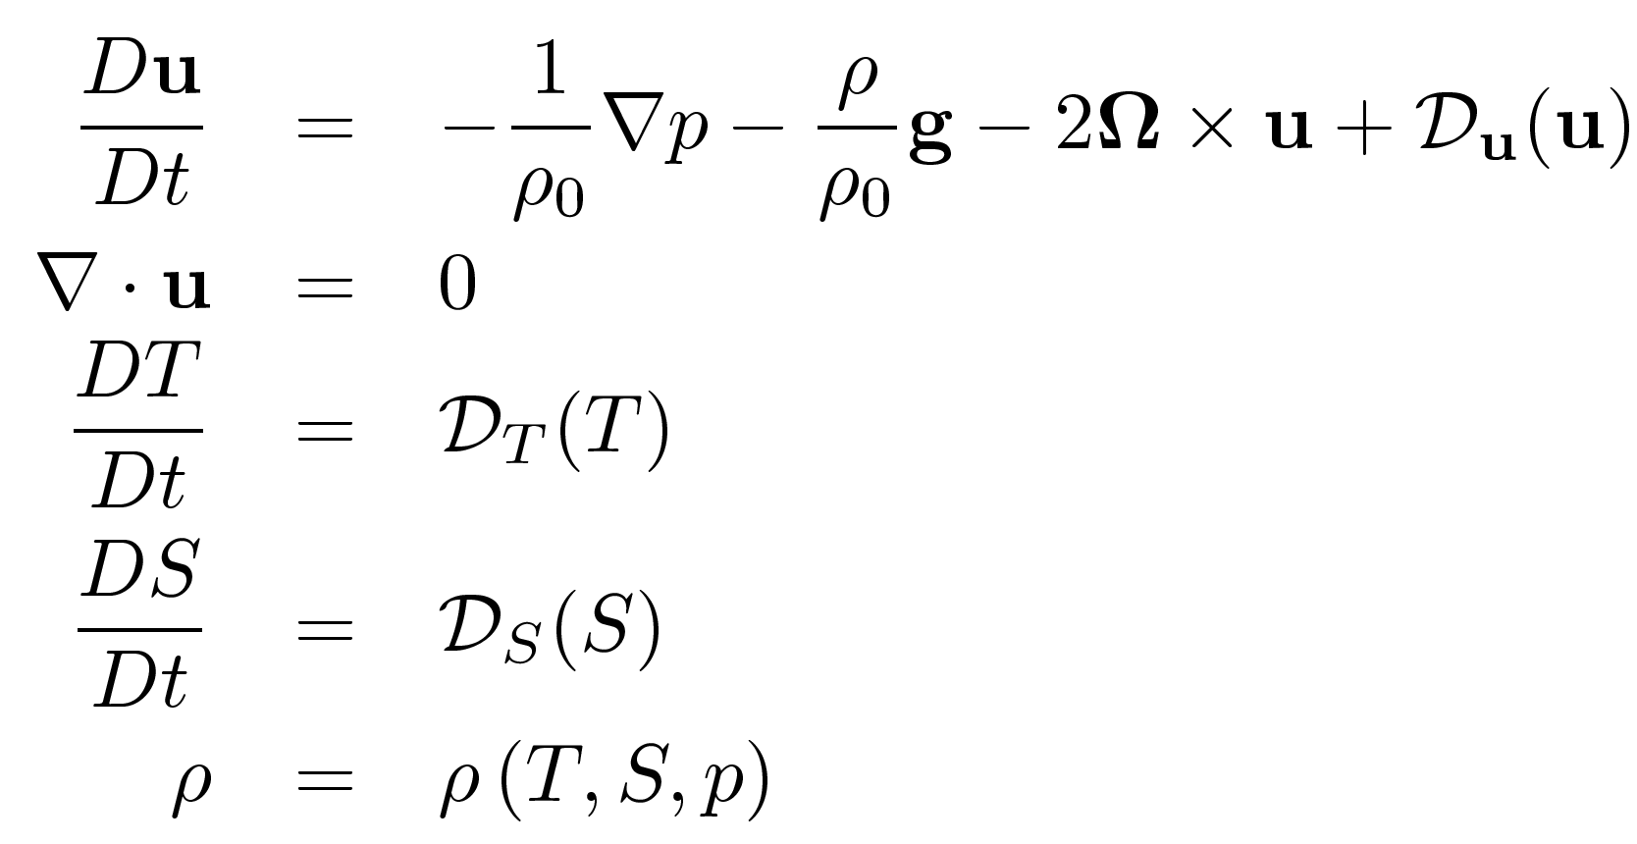
Indian Ocean Modeling
Eddy Resolving Forward Model:
Hydrostatic NEMO ocean model
ORCA-tripolar grid, Boussinesq, incompressible Navier-Stokes equations, thermodynamics equations
1 degree global run; Mesh refinement using AGRIF
Nested run with 25 Km horizontal resolution over IO: [70-95E, 0-20N];
46 levels in vertical (from 5m in the upper ocean to 500m near the floor)
6-hourly Coordinated Ocean-ice Reference Experiments (CORE)-II air-sea forcings
(atemp, rel. hum., downward LWR, downward SWR, precip, runoff, U wind, V wind)
Initial hydrographic state from WOA09 climatology
KPP boundary layer parameterization to represent subgrid scale processes: vertical mixing
Harmonic/Laplacian dissipation (viscosity/diffusion)
Two years spin-up [1994-1995]; Twelve years of simulation [1996-2007]

Slide 6
Methodology
Customization and Configuration of the Indian Ocean Modeling system
Ocean general circulation model:
(a) NEMO (global at 1 degree)
(b) NEMO-AGRIF is configured to run at eddy resolving scales (~25 Km) over the
northern Indian Ocean [70-95E;0-20N]
AGRIF:
package for the integration of adaptive mesh refinement (AMR) features within a multidimensional model
written in Fortran and discretized on a structured grid
nesting capability allows resolution to be focused over a region of interest by introducing additional grids
Global Run provides open boundary for the nested run in real-time: simultaneous integration
12 years model run during 1996-2007 with CORE-II forcings
Output: Time-evolving physical fields likely to be consistent with the observations
Hydrography (Temperature and Salinity) and Velocity
Mixed Layer Depth
Transport (Volume/Mass Flux, Heat Flux, Freshwater Flux)

Slide 7
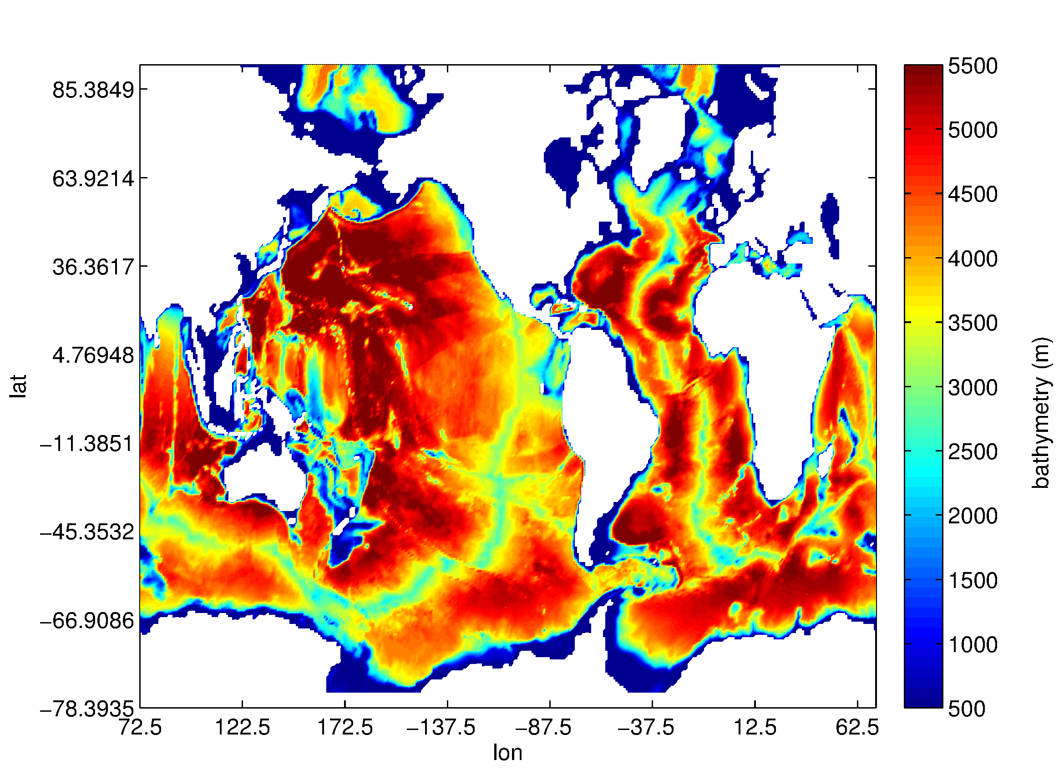
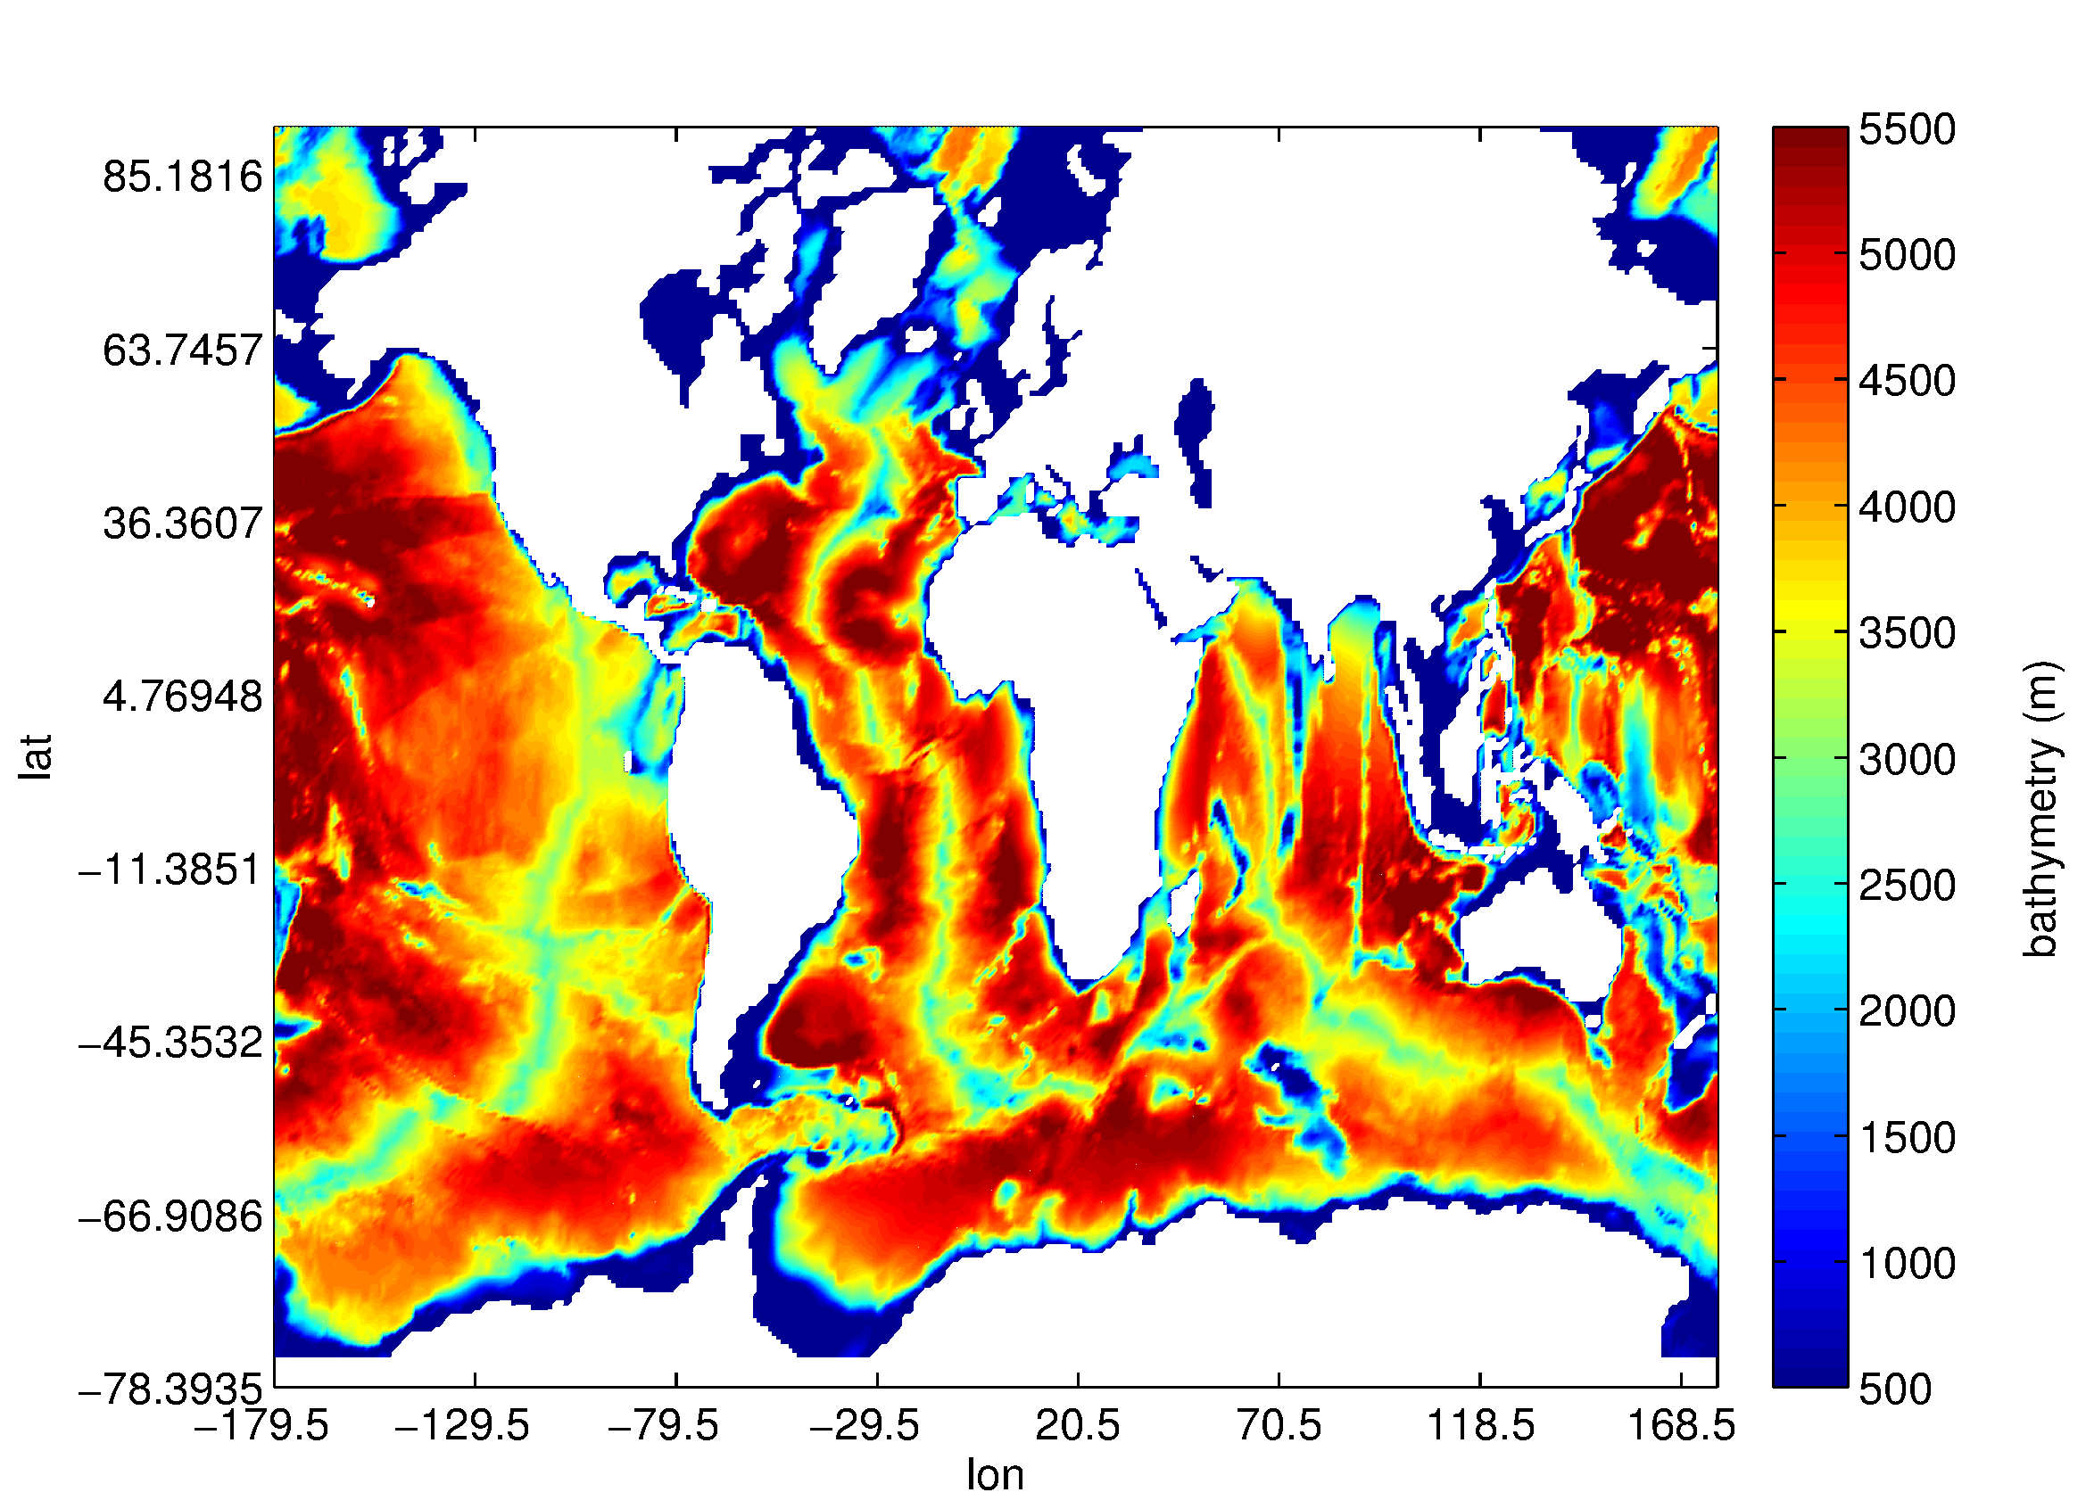
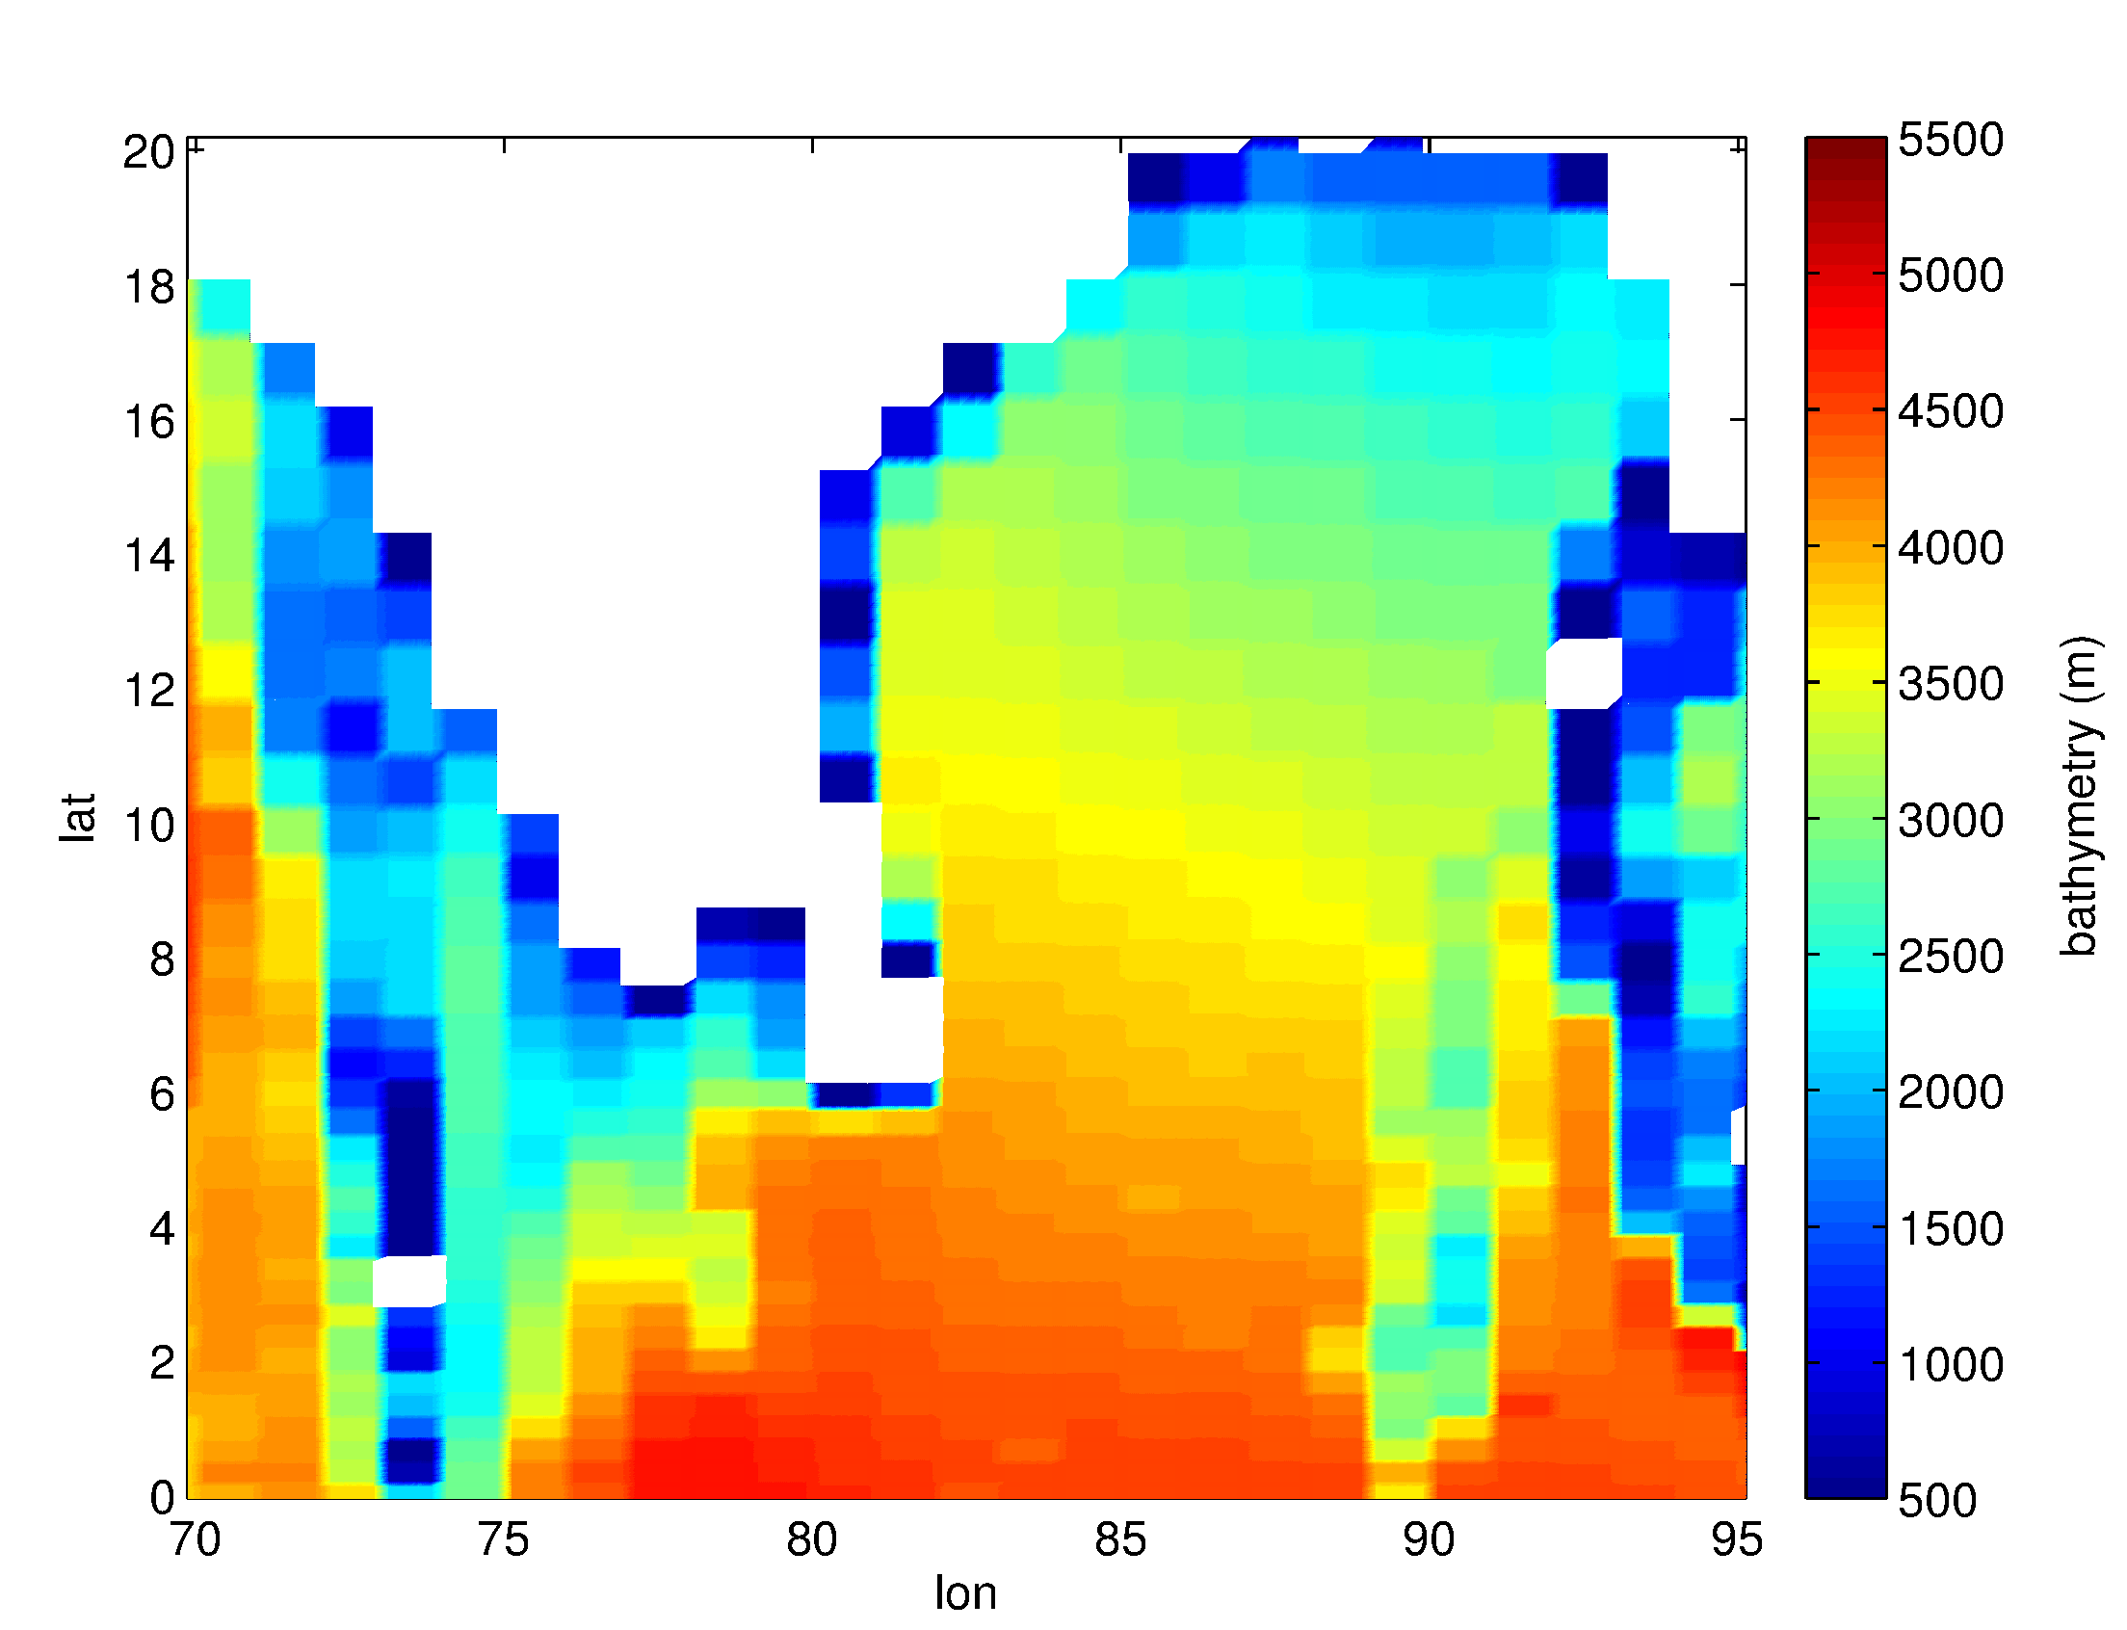
BATHYMETRY OF THE REGION OF INTEREST (ORCA tripolar grid)
Shifting of the ORCA grid: 1 degree
non-trivial: requires code development
AGRIF nesting: 25 km resolution

Slide 8
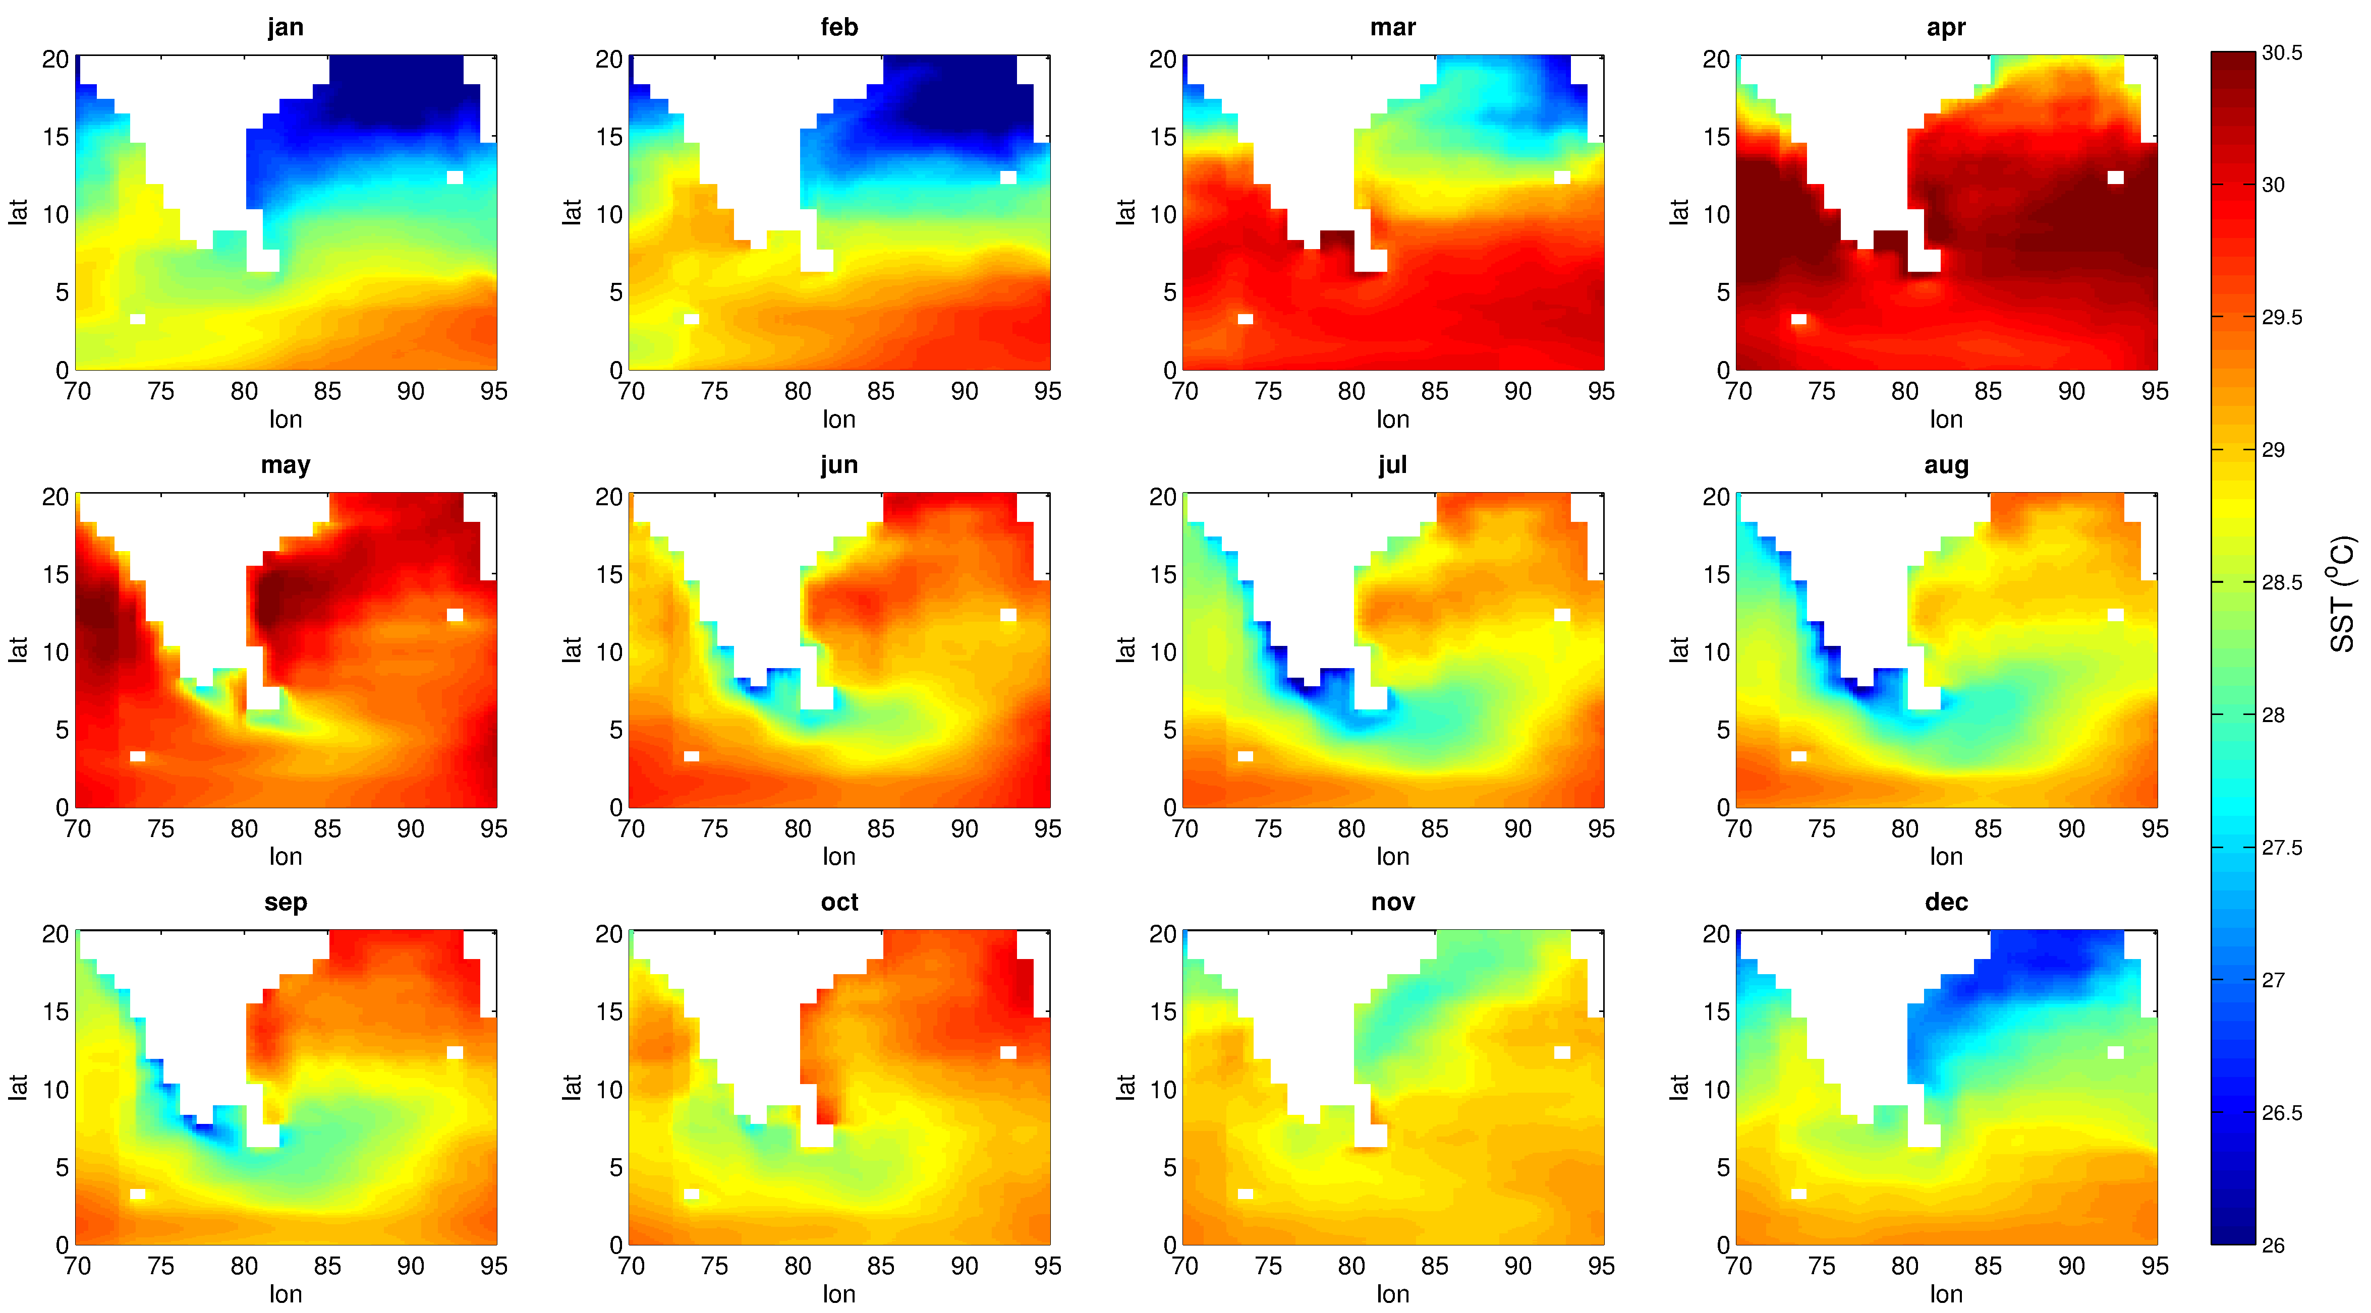
Model: Monthly variability of the SST [1996:2007]
min during DJF in upper BoB; max during Apr-May

Slide 9
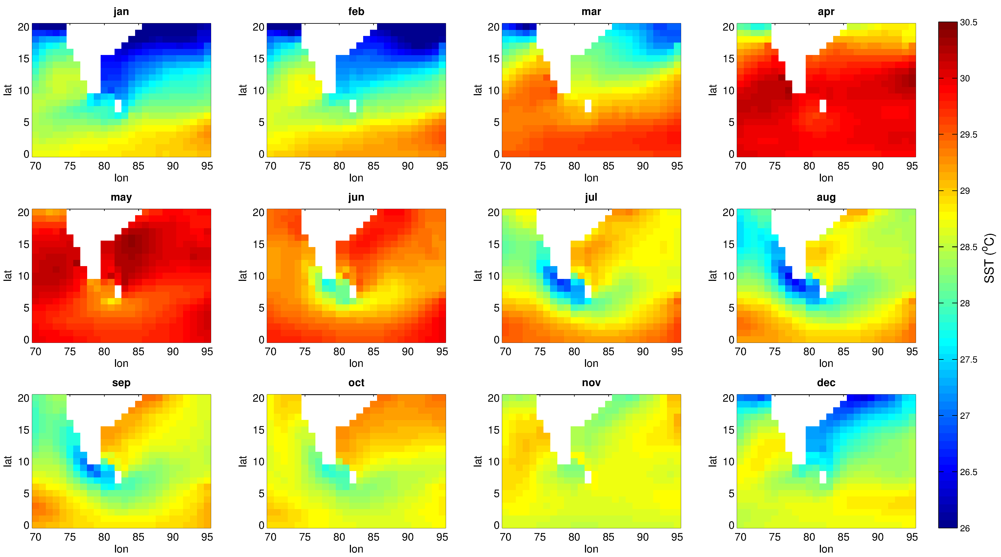
ORAS4: Monthly variability of the SST [1996:2007]
Model is able to reasonably capture the monthly variability of the SST
SST: r (model, ORAS4) = 0.96
Max SST bias is in the range of [-0.3 0.3]ºC : higher near coastal regions; bias is nearly zero in most of the grid points
SST mean square error between the model and ORAS4 is 0.3ºC; smaller than the std dev (0.9ºC) of the SST

Slide 10
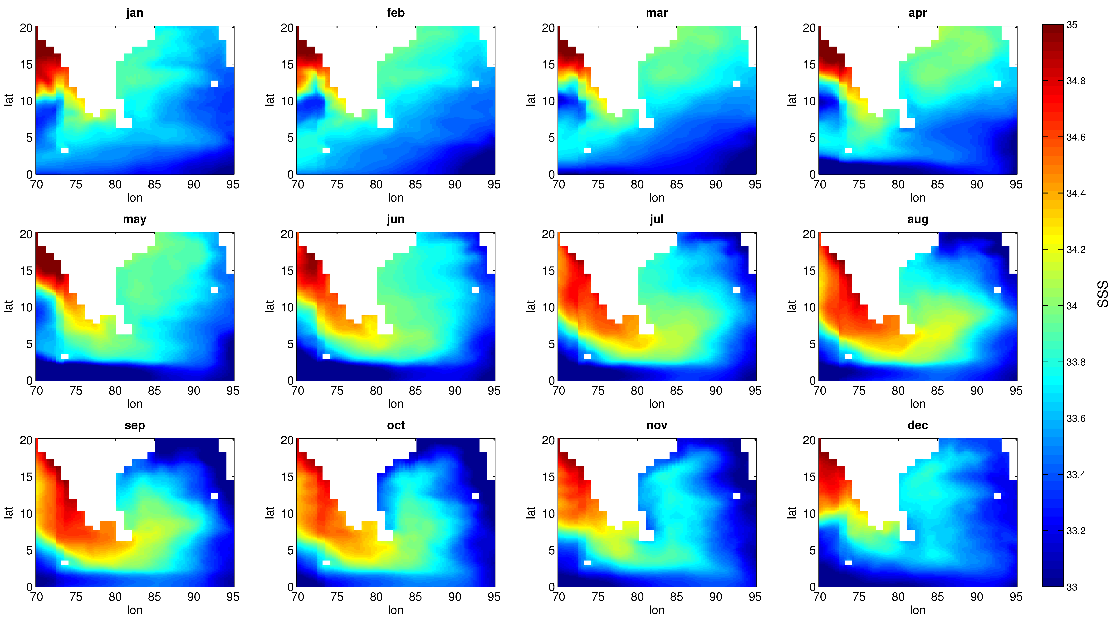
Model: Monthly variability of the SSS [1996:2007]

Slide 11
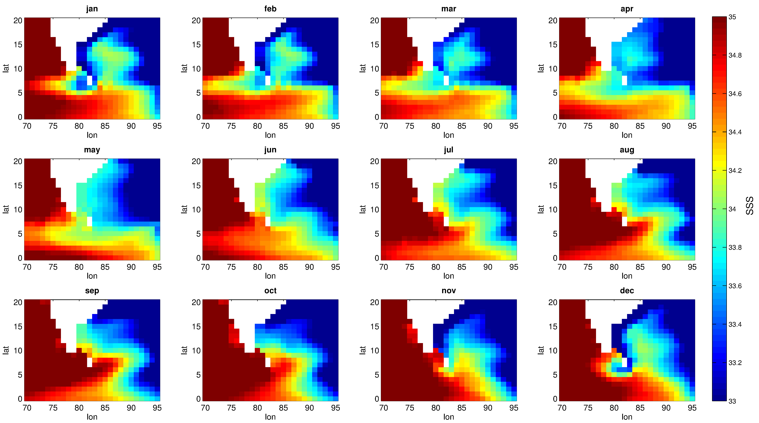
ORAS4: Monthly variability of the SSS [1996:2007]
model underestimates the SSS: 2-3 psu
incorrect mixing parametrization !!!!

Slide 12
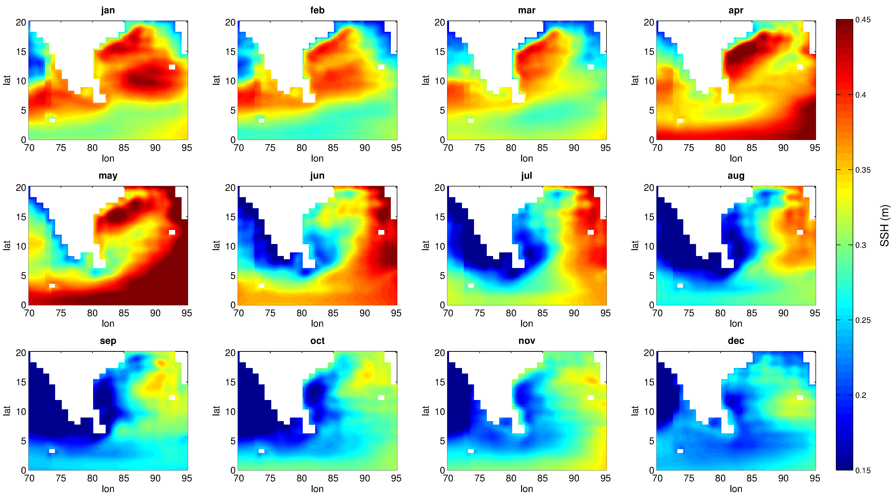
Model: Monthly variability of the SSH [1996:2007]
Arabian sea SSH is very small compared to BoB throughout the year
BoB: minimum SSH close to coast is during Aug-Oct; highest during Apr-May
SSH becomes as high as 50-60 cm in upper Bay and even higher near equator

Slide 13
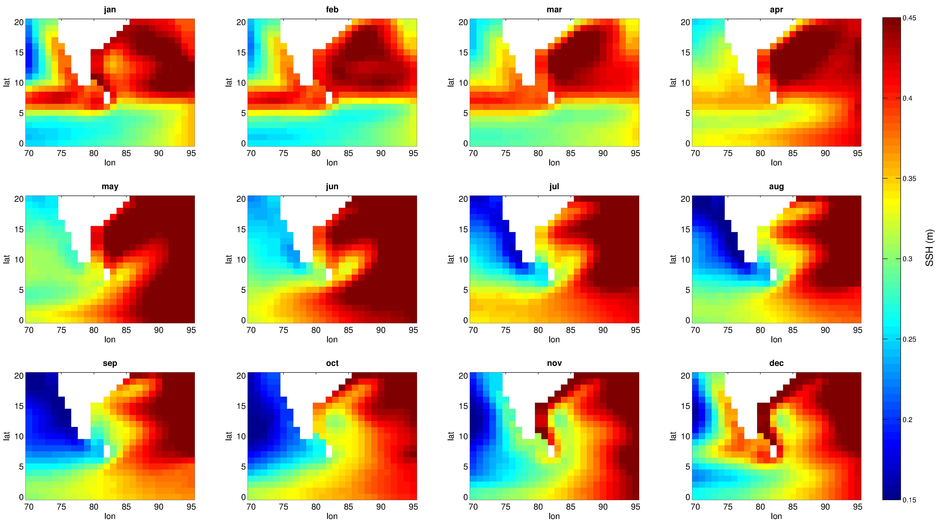
ORAS4: Monthly variability of the SSH [1996:2007]
Model SSH is underestimated in the BoB compared to ORAS4
Bias is small compared to in GODAS, however

Slide 14
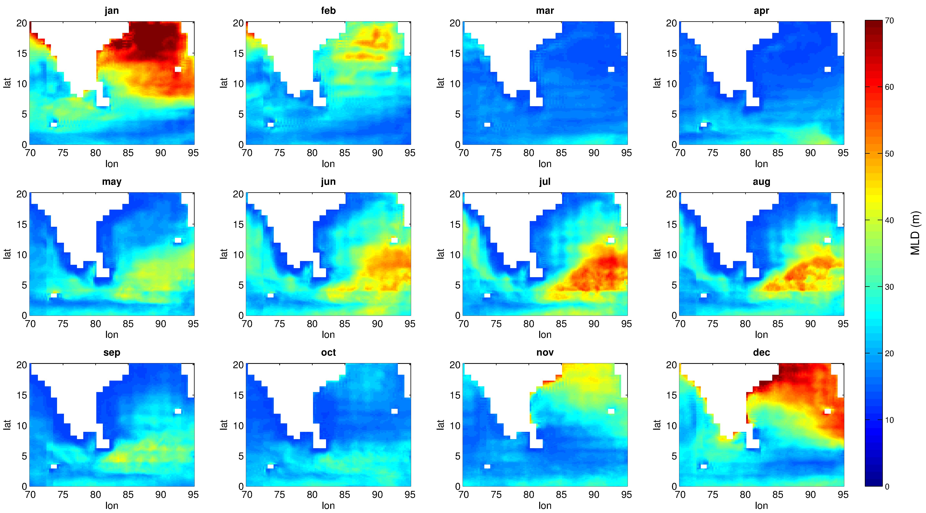
Model: Monthly variability of the MLD [1996:2007]
lowest in the months of Mar-Apr-May; dipole like structure (jan and jul, for example)
post-monsoon months: intermediate values as a result of increased freshwater flux; increased wind speed and lower shortwave radiation

Slide 15
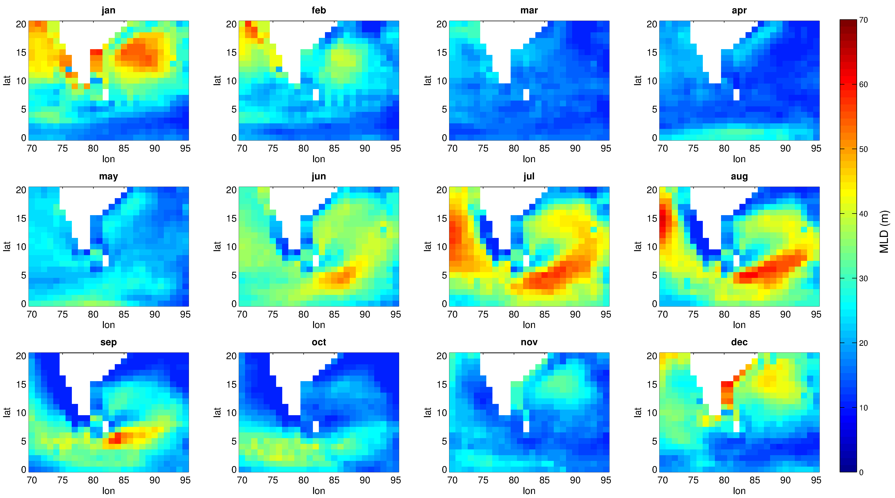
ORAS4: Monthly variability of the MLD [1996:2007]

Slide 16
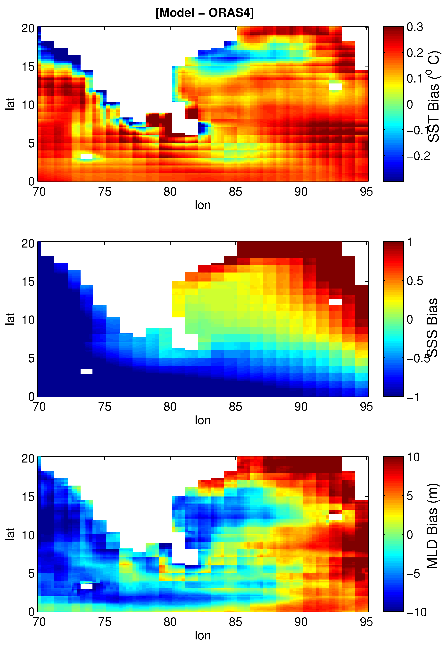
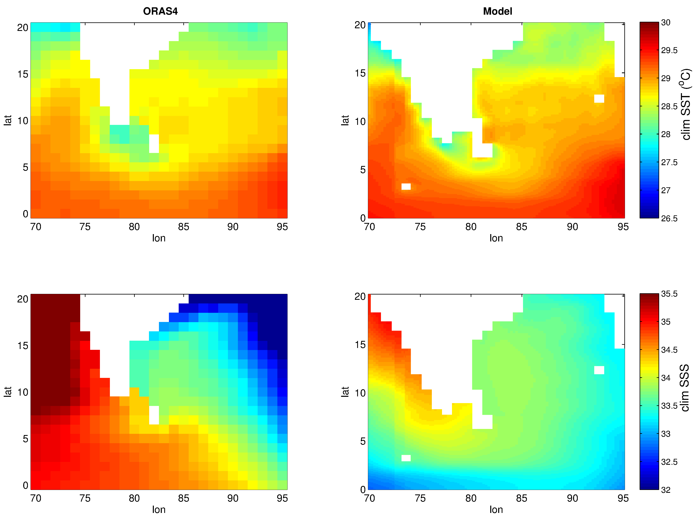
Mean State and Bias
Mean SST is well simulated (both in terms of magnitude and spatial variability)
mean SSS is not (mainly in terms of magnitude): large bias [-2 2]: underestimation !!
MLD bias is higher in the upper BoB and eastern coast

Slide 17
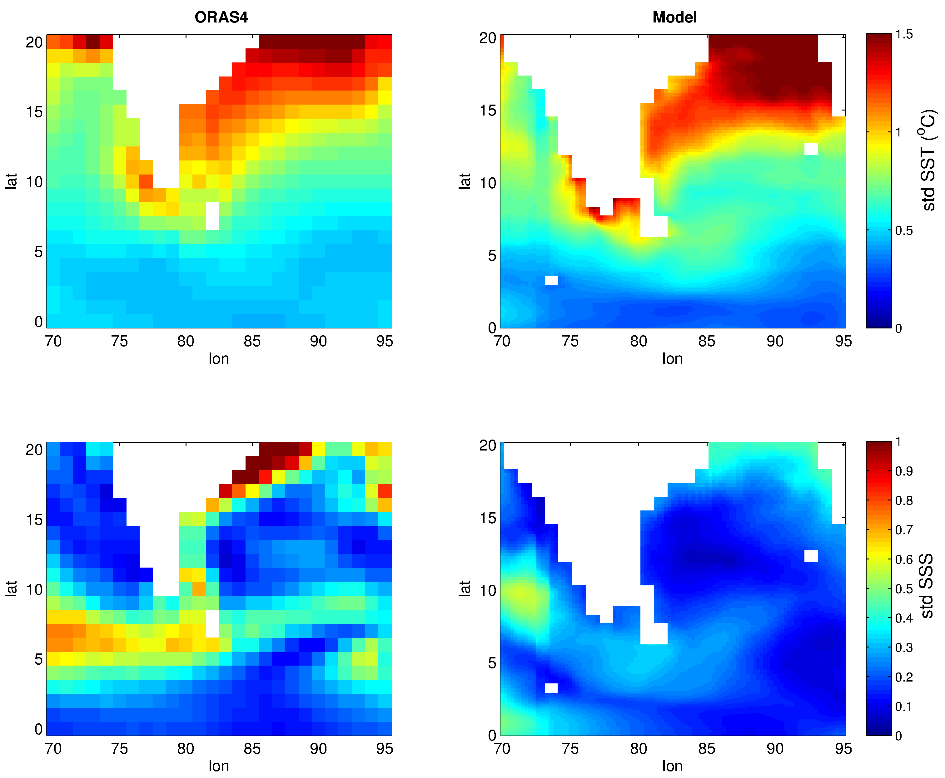
Spatio-temporal variability of the SST and SSS: standard deviation
Barring a few places, the model is able to distinguish the region of high and low SST and SSS variability
SST variability decreases from north to south of the domain
SST: Northern BoB & AS show higher variability; SSS: higher variability in southern AS as compared to northern AS
In the BoB region, however, the northern region shows higher SSS variability

Slide 18
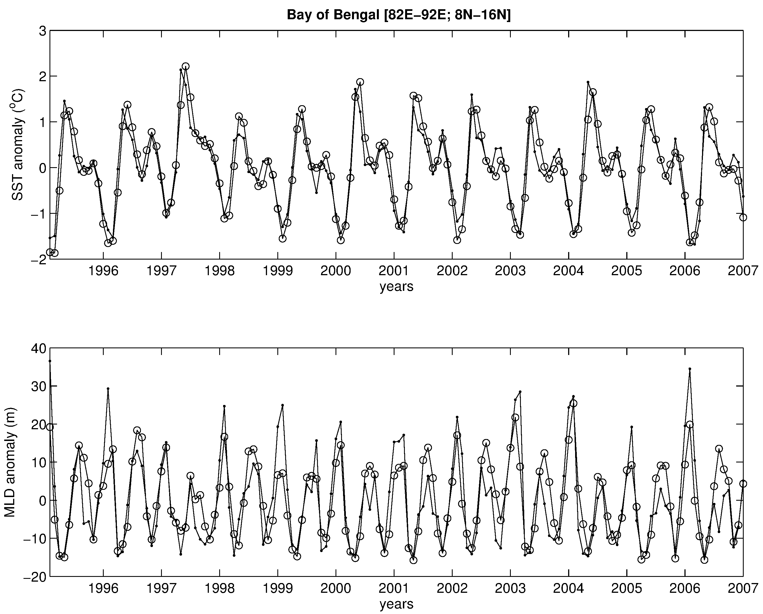
SST : highly correlated: 0.97 in the BoB
SST RMSE: 0.2ºC in the BoB
SST standard deviation: 0.8ºC
SST anomaly peaks during May with a smaller peak in Nov
lowest SST anomaly values are observed during Dec-Jan
Similar results for the SSS
Lowest MLD anomaly during April and Sept-Oct; highest MLD during Jul and Jan-Feb
MLD anomaly ranges in [-15 15] m
circle:ORAS4; dots: model

Slide 19
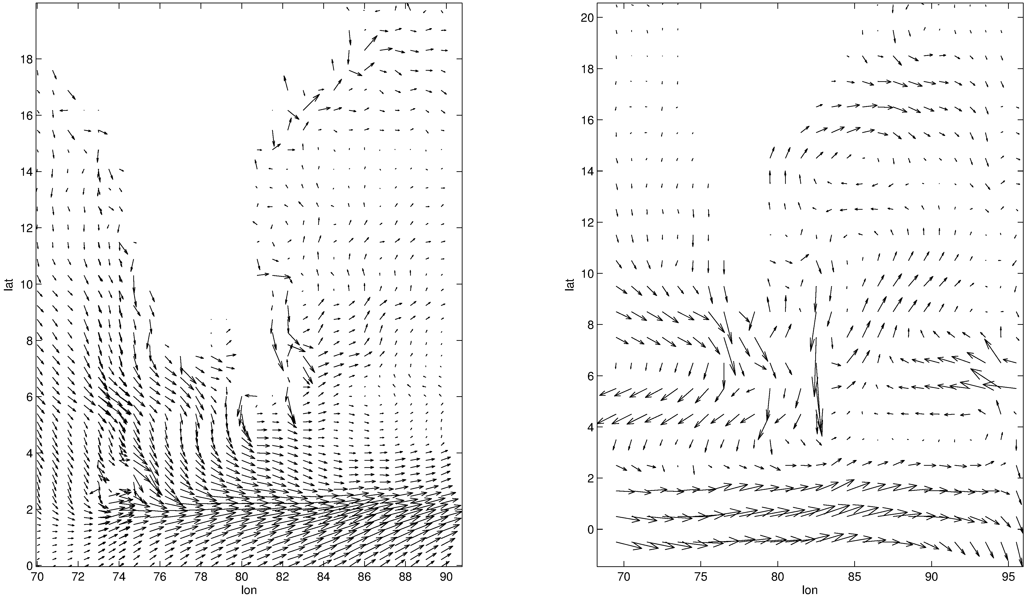
Model
ORAS4
mean current is also well simulated fluxes will be computed

Slide 20
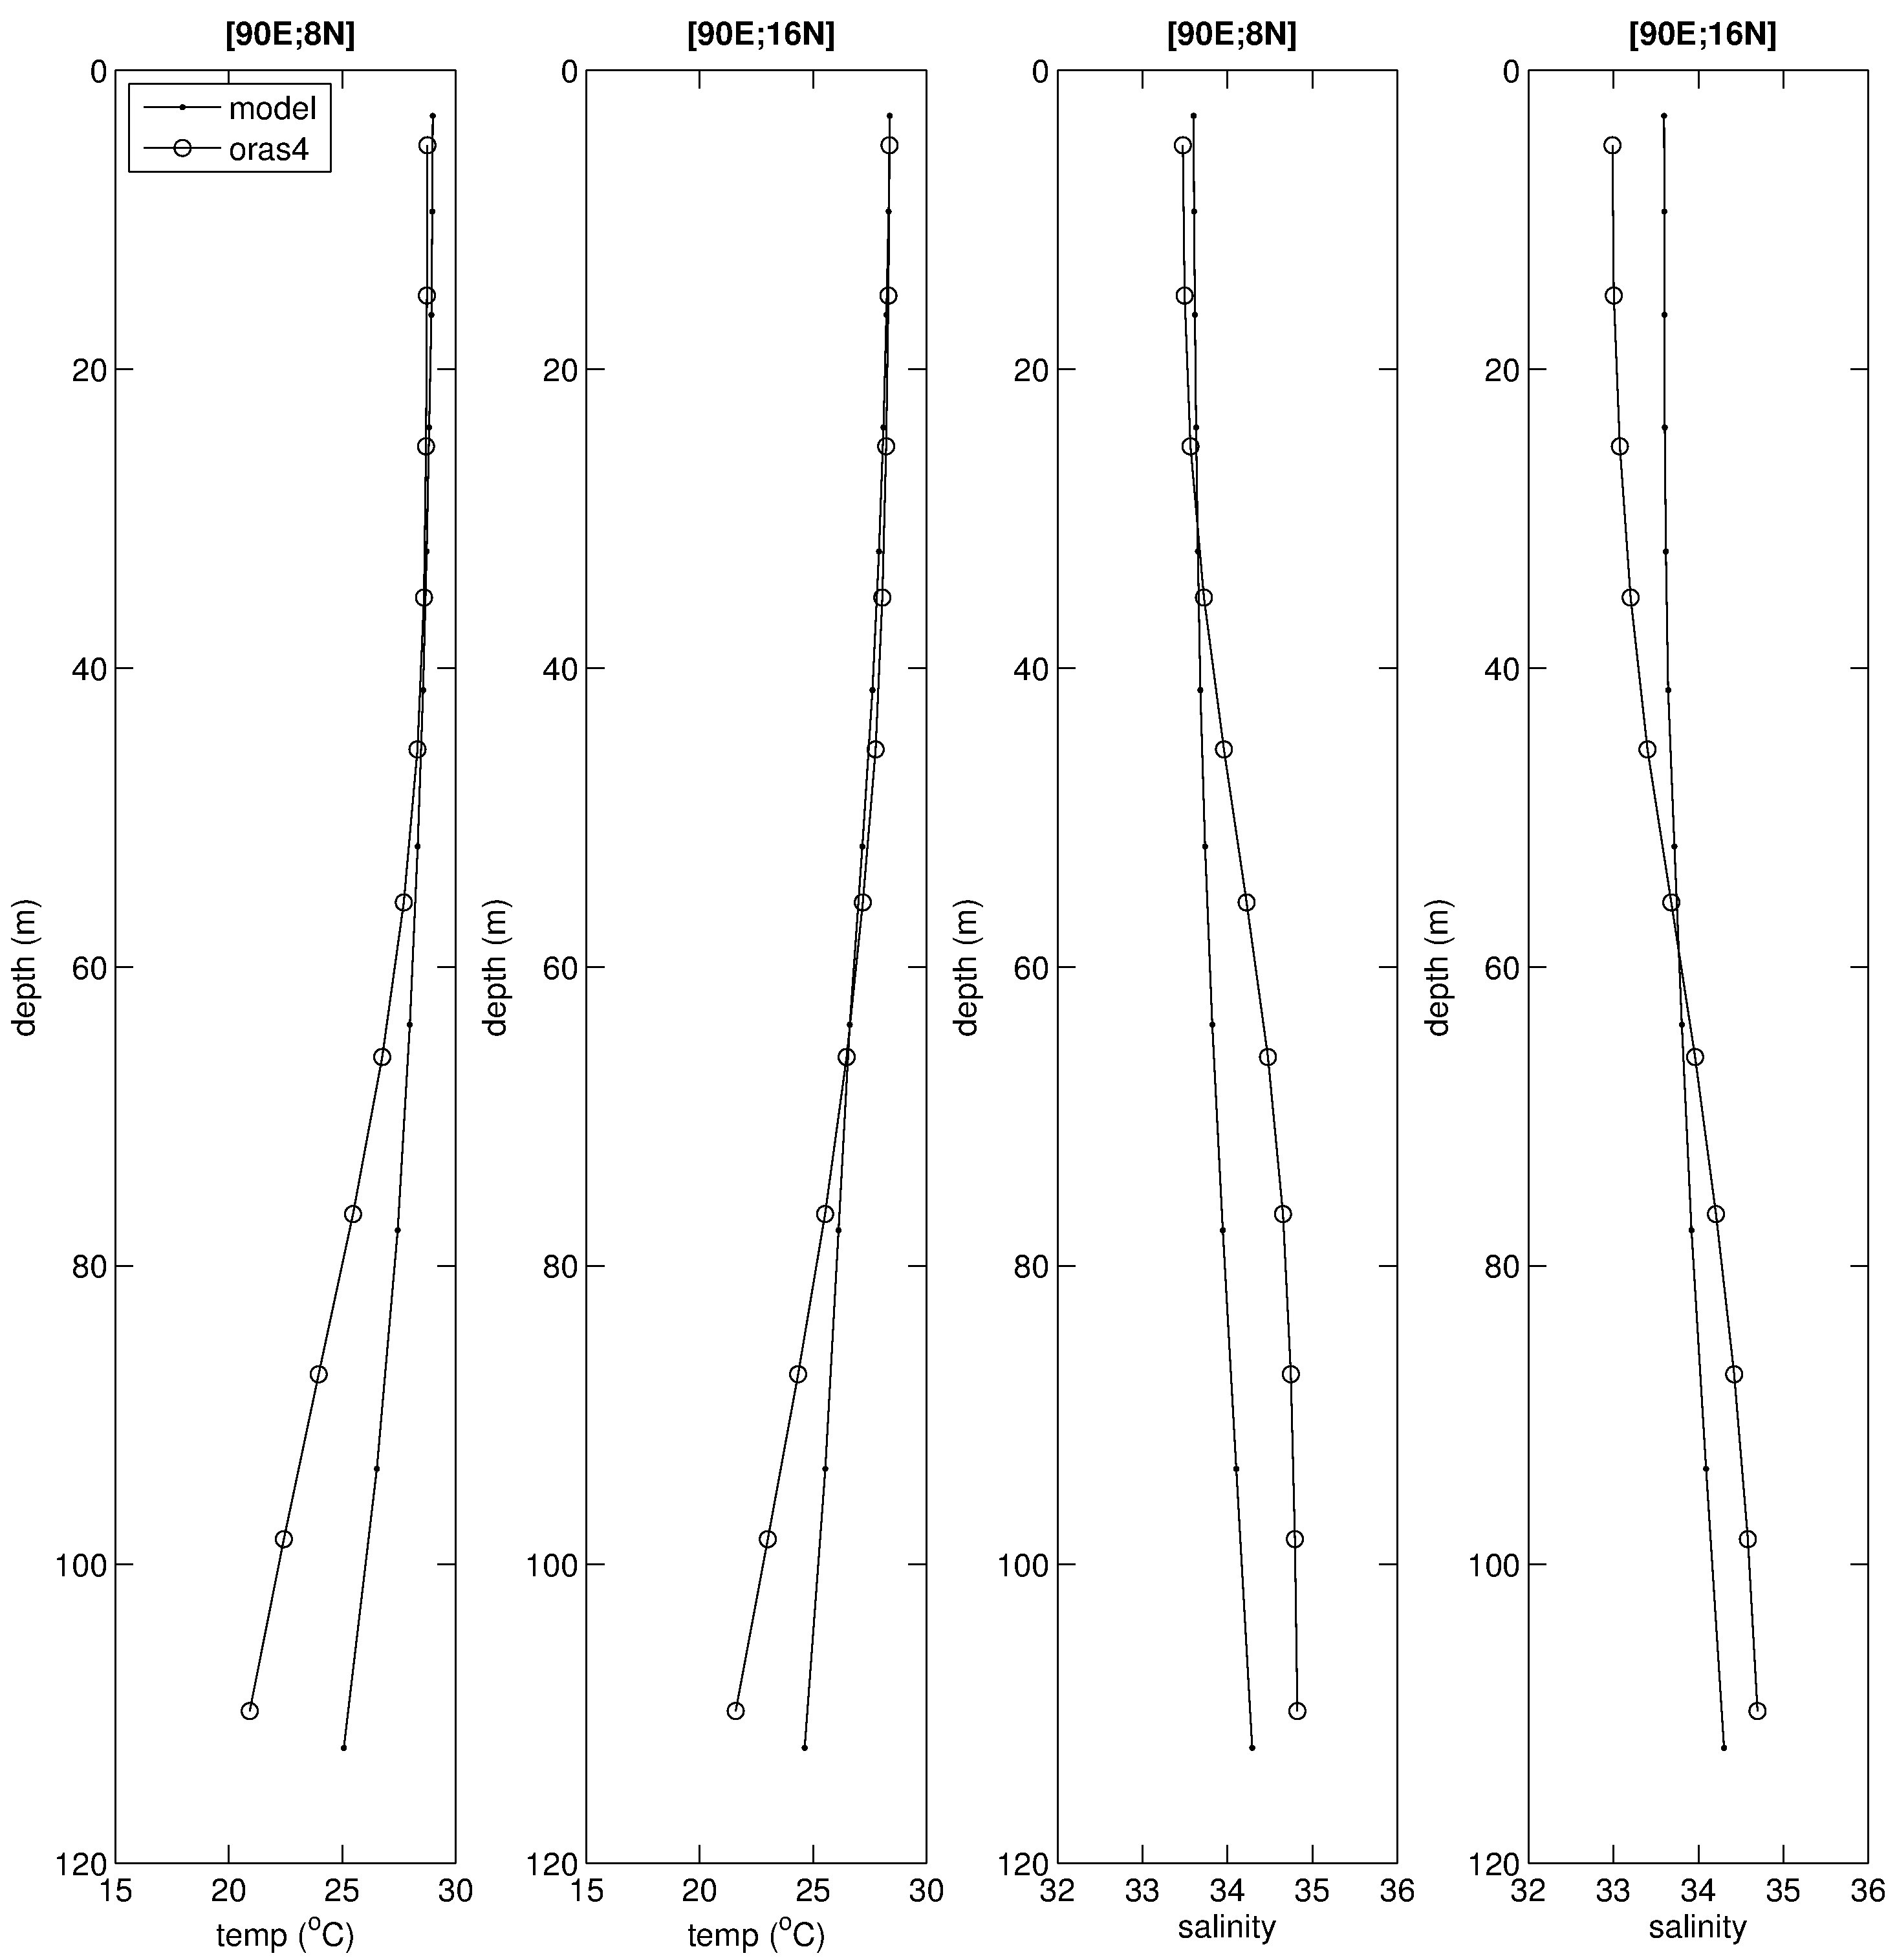

Slide 21
Future Work: High-resolution regional data assimilation using 4D-Var
Familiar Task: Customization, Configuration and Development of Ocean Data Assimilation system in the IO at a resolution of 10 km
ECCO and MITgcm groups have developed tools that produce state estimates using the 4D-Var assimilation technique.
Remotely Sensed observations of SST, SSS and SSH and in-situ data of T, S are combined with the MITgcm (with realistic physics) using 4D-Var for a period of 61 days [Jun-Jul 2013]
This method generates time-evolving fields that are statistically consistent with the observations, while obeying the model dynamics
It uses iterative procedure, which repeatedly integrates forward and adjoint model to minimize discrepancy between model and data
Adjoint Model / Data Assimilation:
Adjoint code using TAF
Unconstrained minimization/Lagrange Multiplier
Obs: SSH (AVISO), SST(GHRSST-OSTIA), SSS (Aquarius), T/S (ARGO)
Optimization (successive iteration) to minimize (least-square) objective/cost function (model-data misfit)

Slide 22
Indian Ocean Modeling and Data Assimilation
Problems!
dim(y)~10¹⁰, dim(x)~10¹⁰
Nonlinearity
Model bias
Noise (model/data) is not Gaussian
Do we want the least squares solution?
Scalar cost function
to be minimized - “least squares”
x(t+1) = L [x(t), Bq(t), u(t)]
(un)constrained minimization with
Lagrange multiplier vector
In practice:
Linearize the model
Integrate forward/adjoint system
Successively correct x
Repeat to minimise cost
Maximum-likelihood solution
- unbiased if assumptions are accurate

Slide 23
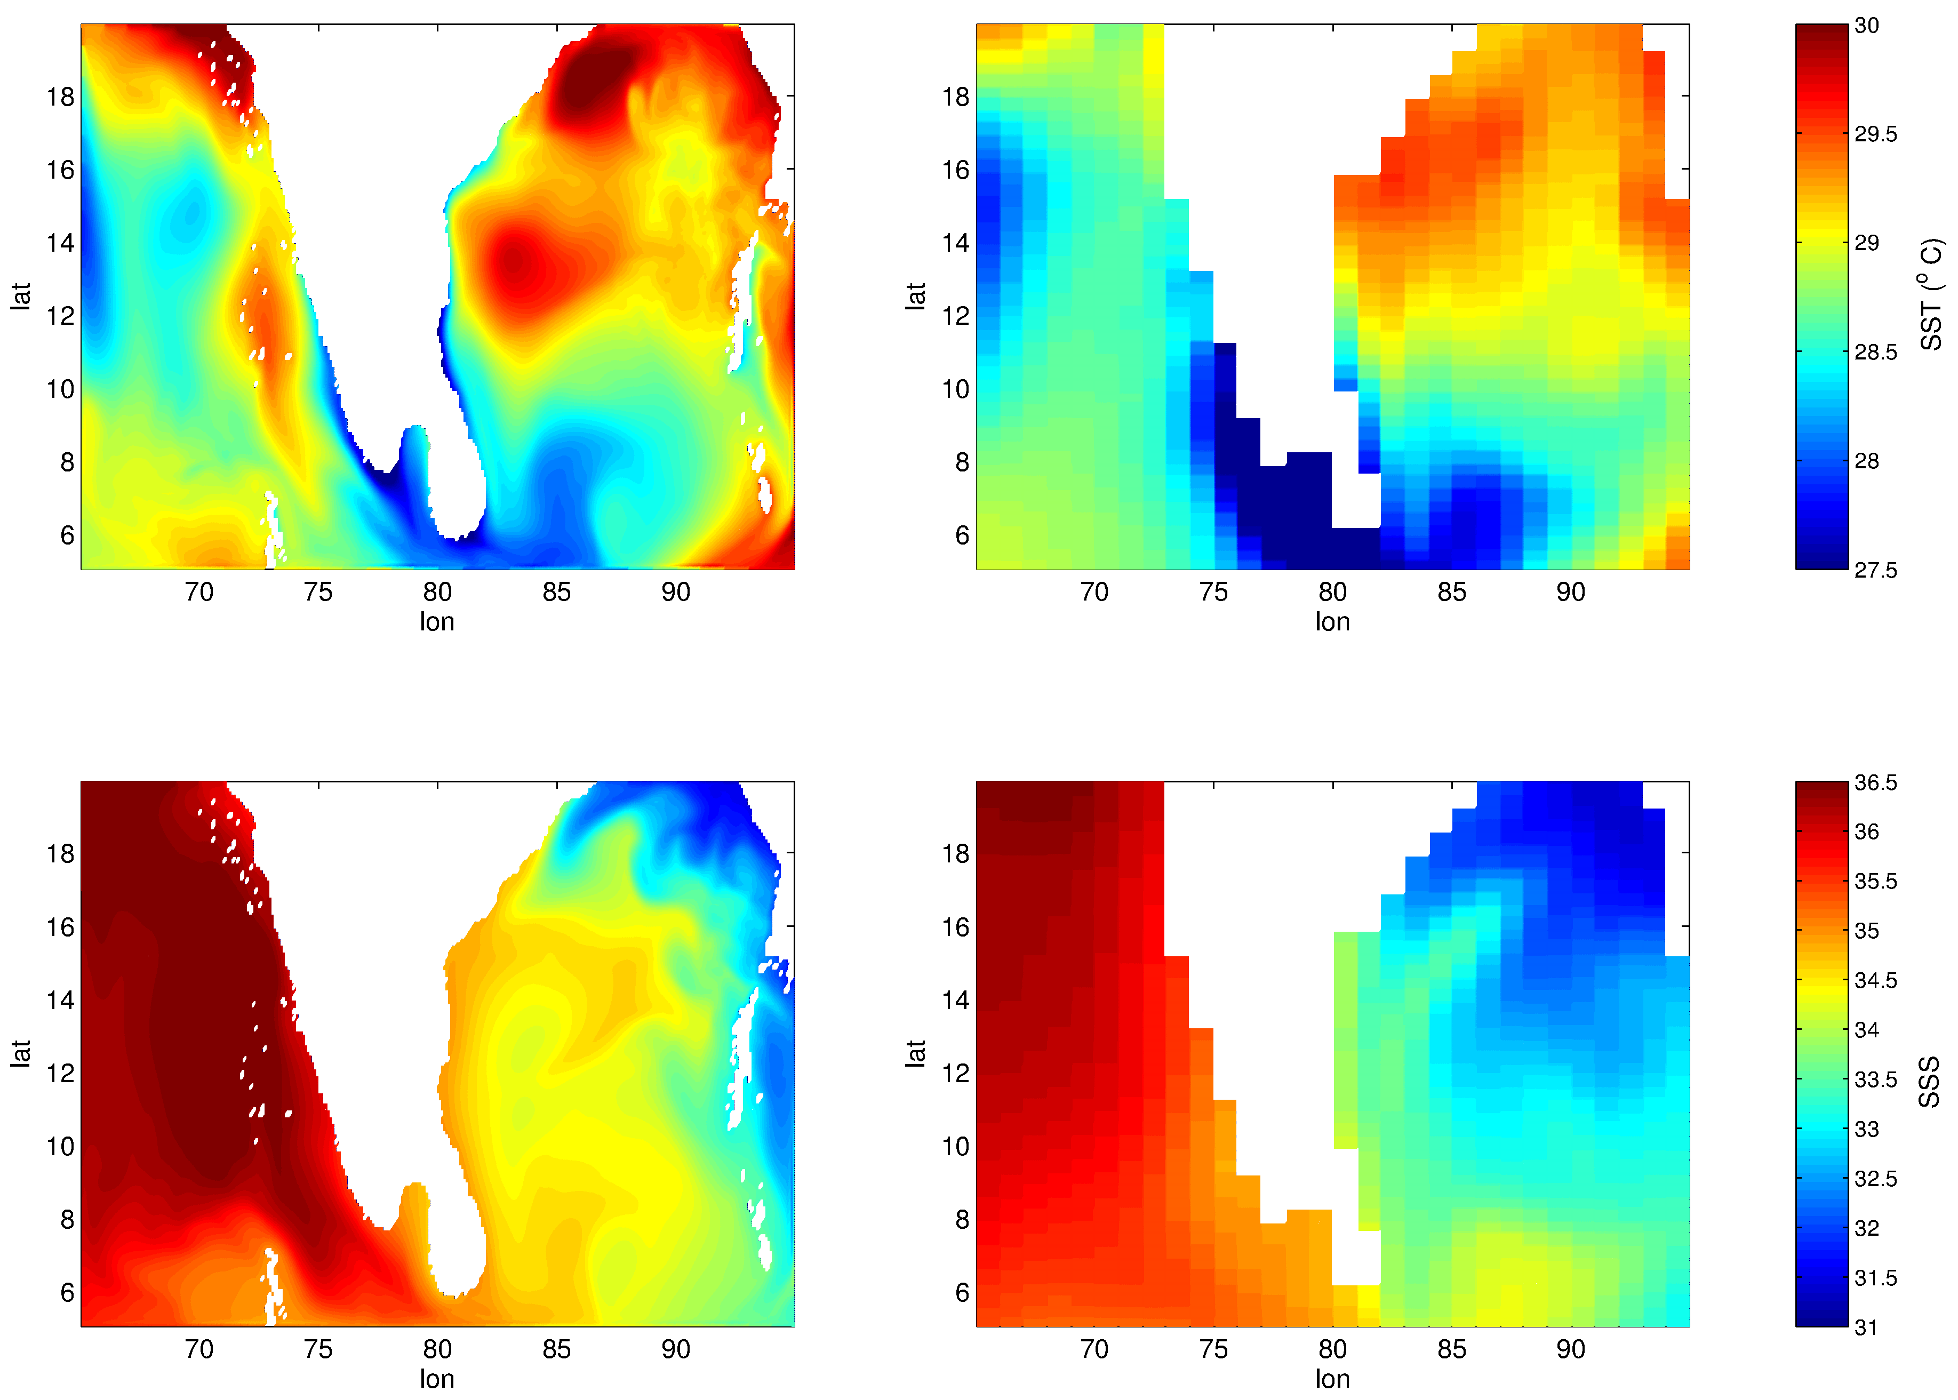
NIODA
GODAS
NIODA
ORAS4

Slide 24
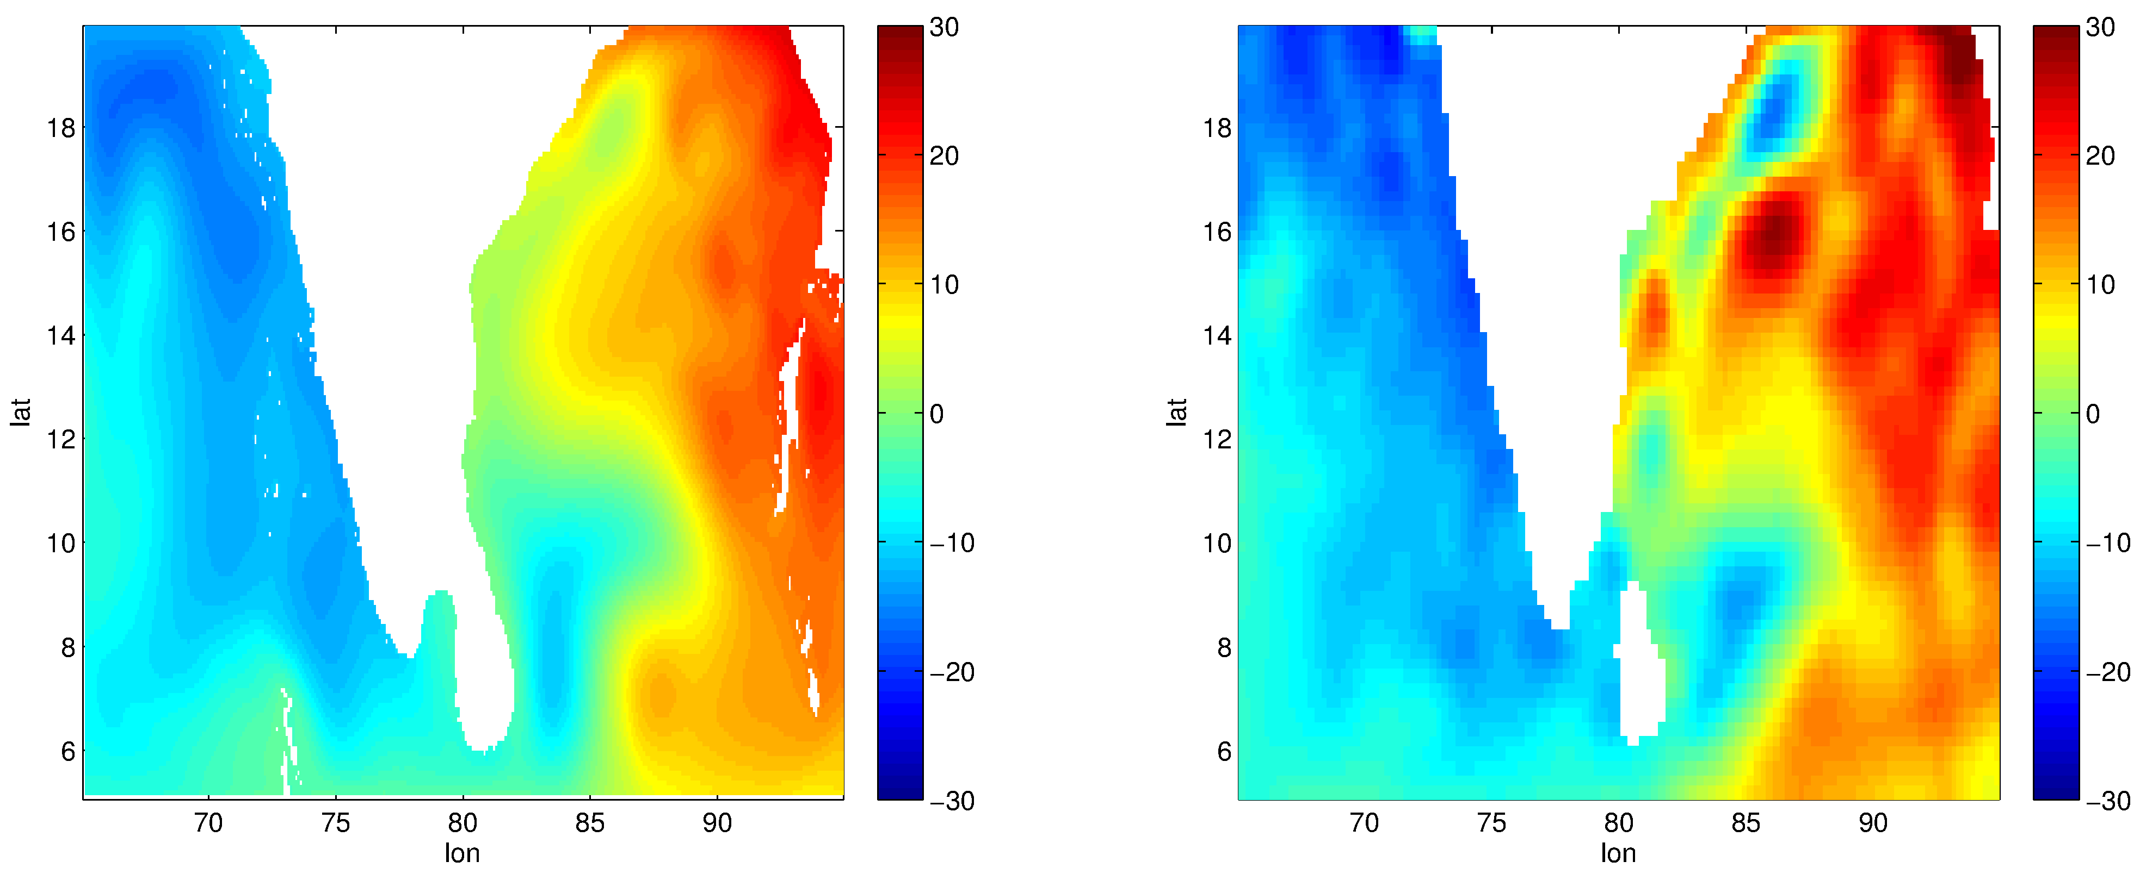
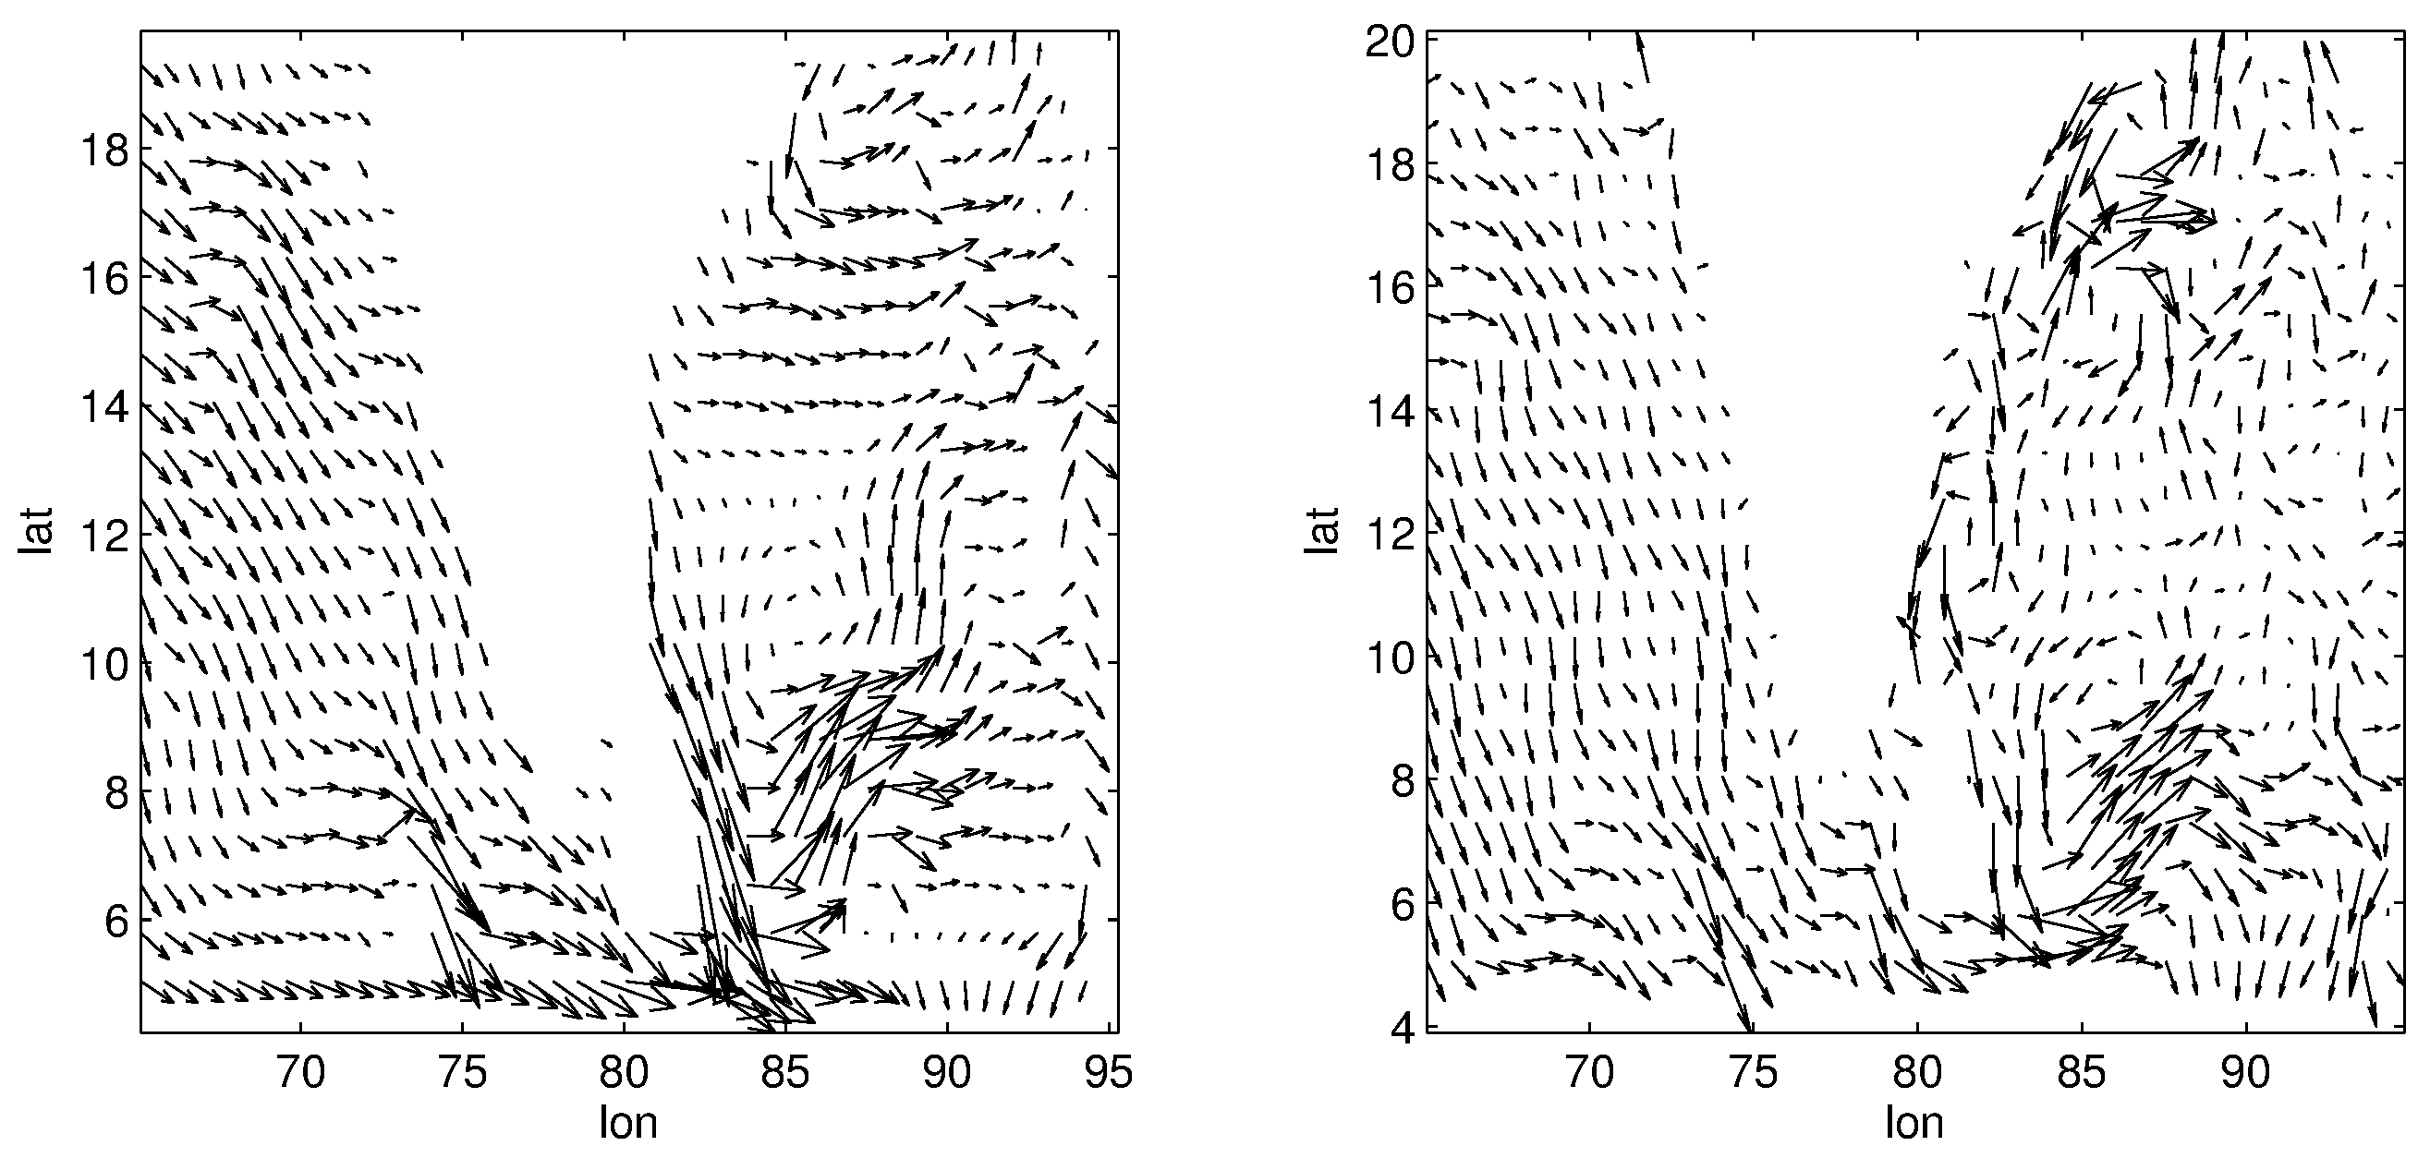
NIODA
AVISO
SSHA
(cm)
SSHA
(cm)
NIODA
OSCAR

Slide 25
Conclusions:
Configuration of a nested version of the NEMO model
Development of a prototype Indian Ocean Circulation Modeling system at a horizontal resolution of 25 Km
IO Modeling is performed for a period 12 years [1996-2007] using the CORE-II forcings and quality of model simulations is demonstrated
Model results match well with the observations
MLD spatio-temporal variability is studied
4-D Var data assimilation will be performed in the Indian Ocean using NEMOVAR for optimal combination of NEMO with satellite observations of SST, SSS, and SSH, and in-situ observations of T/S
A training program is being organized at the UK Met Office during 16-31 March 2015 for this purpose
First Year progress: The project is running as per the proposed time schedule of activities.

Slide 26
THANK YOU FOR YOUR PATIENCE

