Slide 1


Predictability of intraseasonal oscillatory modes and ENSO-monsoon relationship in NCEP CFS with reference to Indian & Pacific Ocean
Shailendra Rai (PI)
Avinash C. Pandey (Co-I)
Suneet Dwivedi (Co-I)
JRFs: Dhruva Kumar Pandey and Namendra Kumar Shahi
K. Banerjee Centre of Atmospheric and Ocean Studies
University of Allahabad, Allahabad, UP, India
A. K. Sahai (Collaborating Scientist)
Indian Institute of Tropical Meteorology, Pashan, Pune

Slide 2
Objective of the Proposal
Prediction and predictability of intra seasonal oscillatory components of Indian monsoon from NCEP CFS.
Relative roles of the persisting and intraseasonal oscillatory modes and their impact on large-scale dynamics of the monsoon.
Prediction of ENSO-monsoon tele-connection and identification of reasons responsible for its failure in NCEP CFS.

Slide 3
  Prediction and error growth in the daily forecast of precipitation from the NCEP CFS V2 over the subdivisions of Indian continent.
  Prediction of daily modes of South Asian Monsoon Variability and its association with Indian and Pacific Ocean SST in the NCEP CFS V2.

Slide 4
Prediction and error growth in the daily forecast of precipitation from the NCEP CFS V2 over the subdivisions of Indian continent.

Slide 5
Data and Model Description :
CFS version 2 coupled Model
Atmospheric Component: NCEP Global Forecast System (GFS) at T126 with 64 vertical levels.
Oceanic Component :- Modular Ocean Model version 4p0d of Geophysical Fluid Dynamics Laboratory(GFDL) at ~1 degree with 40 layers.
Ensembles Members: 11
Time Domain: 2001-2013
Forecast up to 45 days based on Initial Conditions on 31st May, 30th June, 30th July, 29th August and 28th September.
Verification Data:
GPCP and IMD observation for precipitation

Slide 6
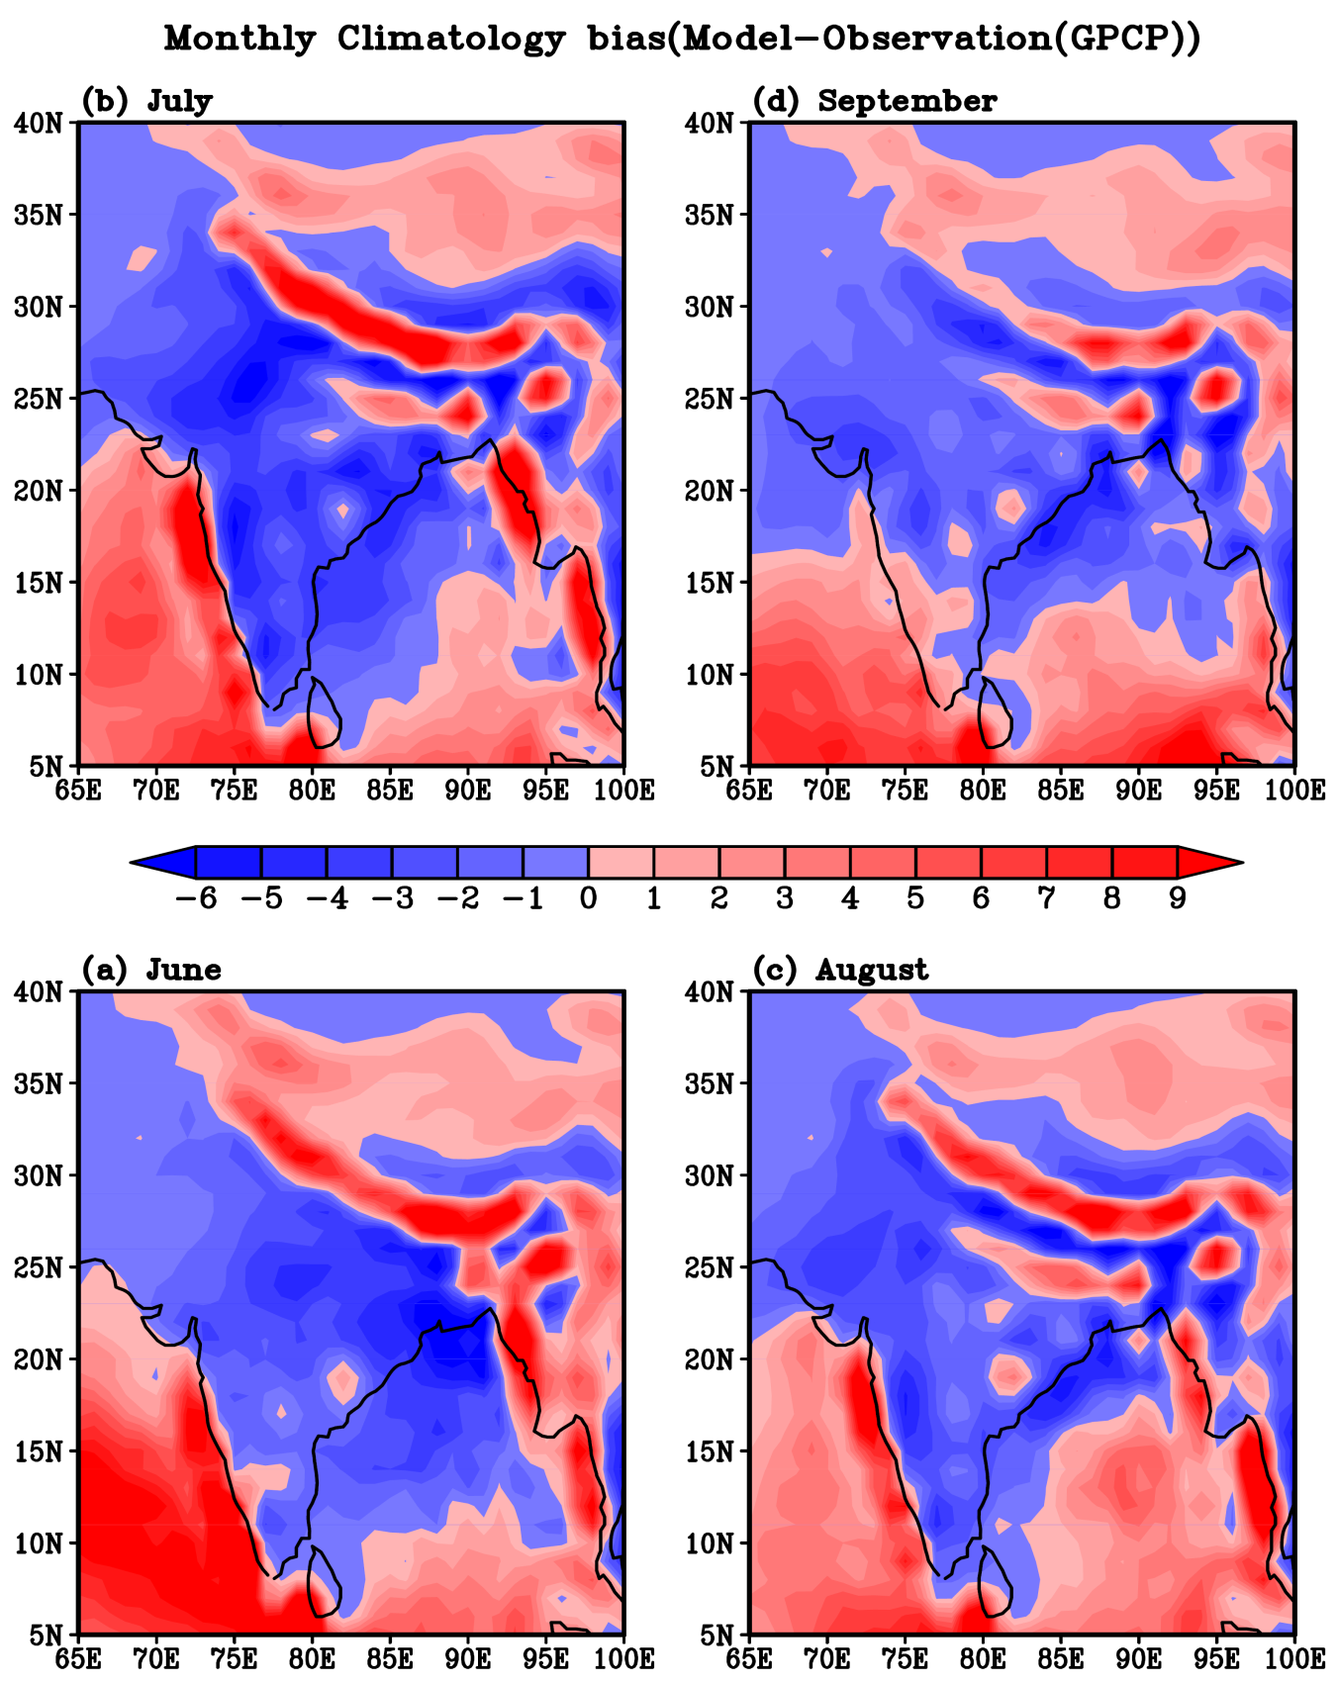
Monthly Model Bias (Model-GPCP Observation)

Slide 7
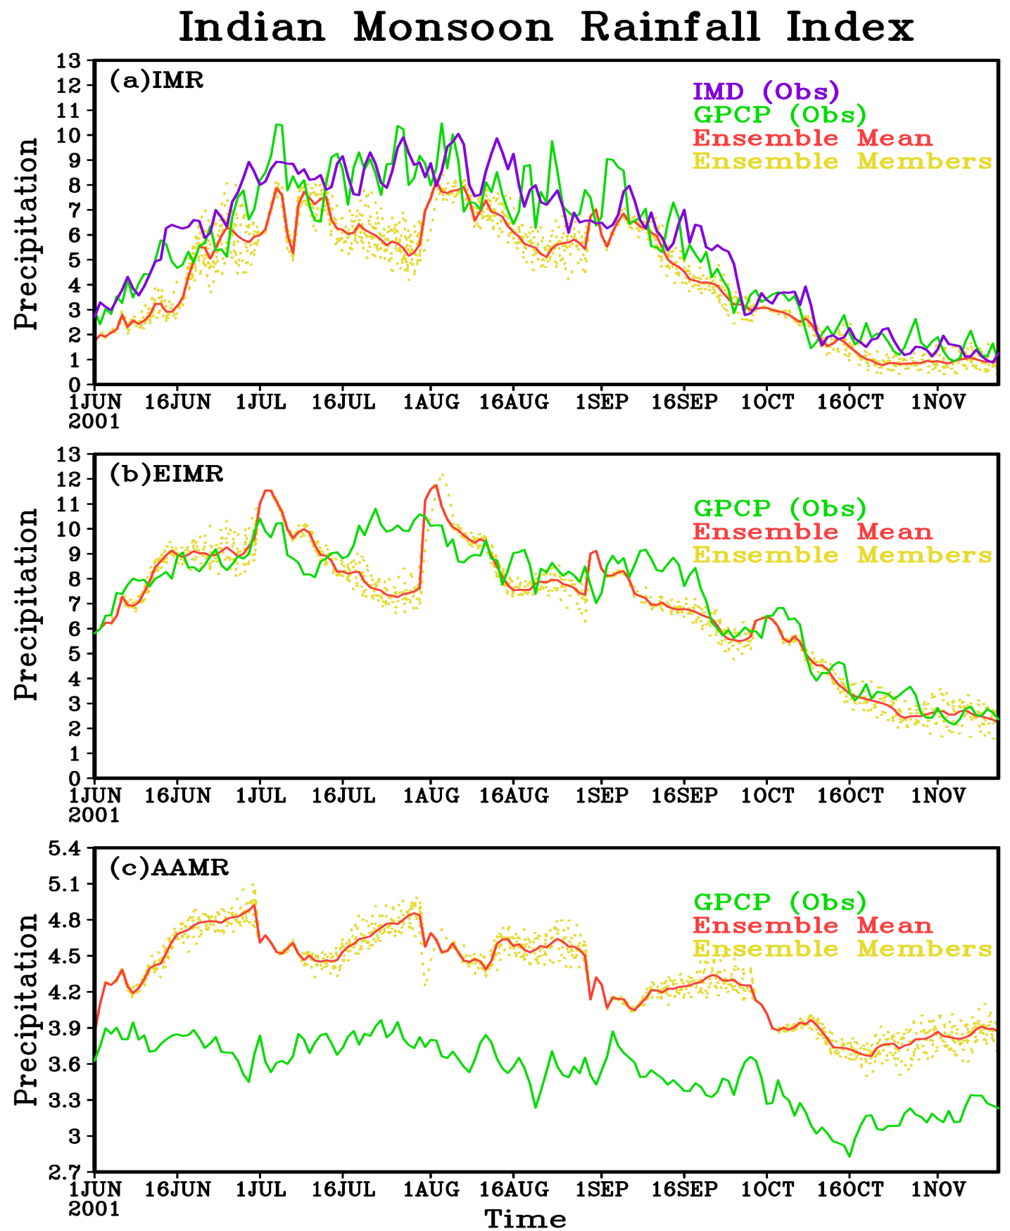
Daily precipitation climatology of different indices in CFS v2 forecast
Indian Monsoon Rainfall Index (IMR): The precipitation averaged over land points of India.
The extended Indian Monsoon Rainfall (EIMR): Averaged rainfall over the region 70°E-110°E, 10°N-30°N.
Asian-Australian monsoon rainfall index (AAMR): Averaged rainfall over the spatial domain 40°E-160°E, 40°S-40°N.

Slide 8
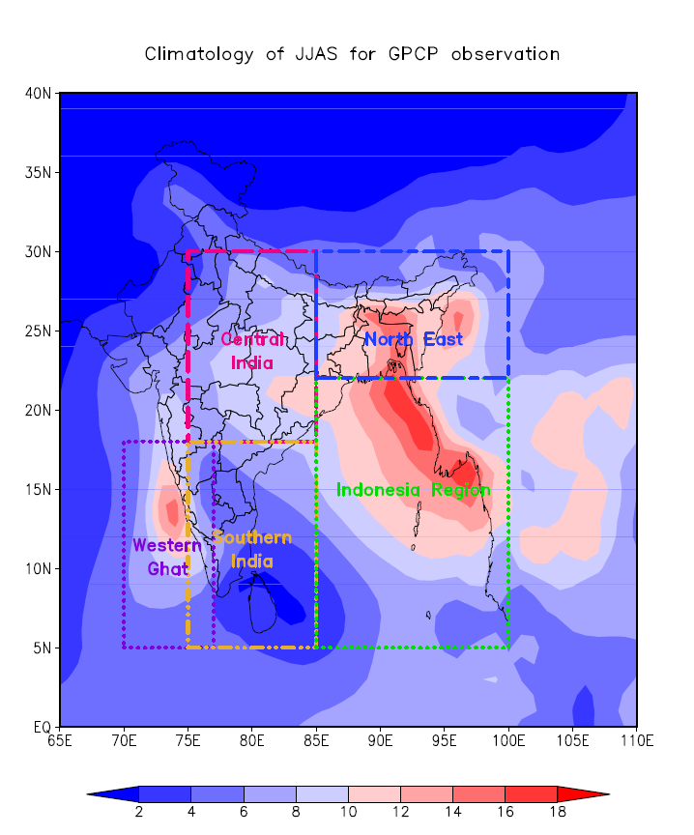

Slide 9
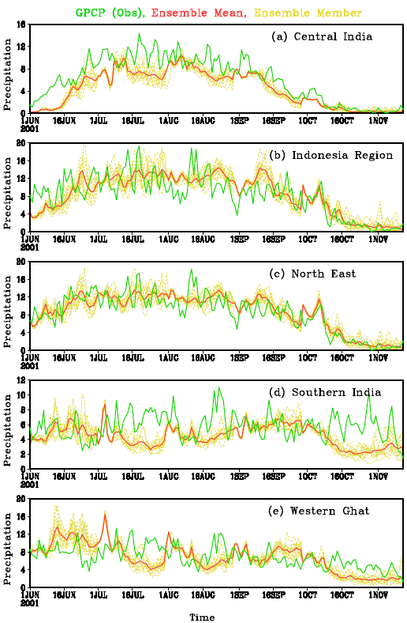
Daily precipitation climatology of different regions in CFSv 2 forecast (land points only)

Slide 10
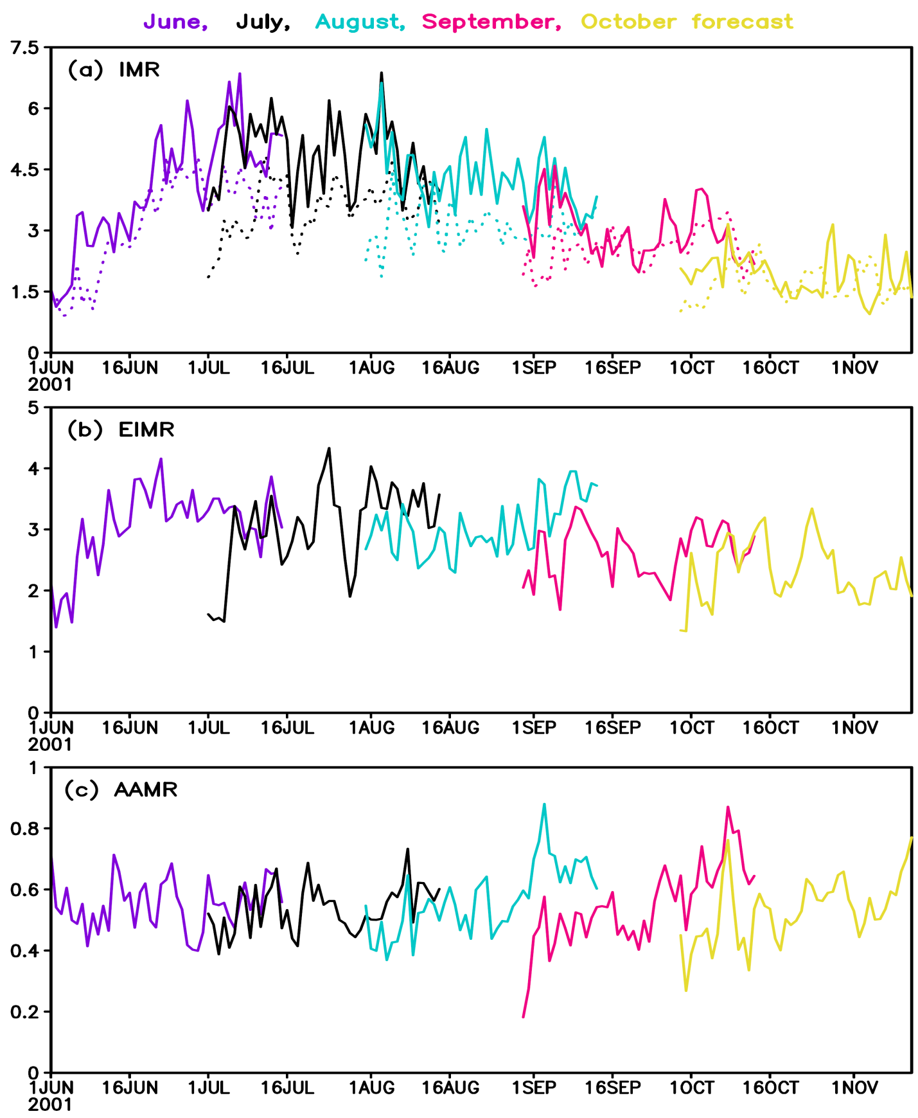
Forecast error growth rate of model forecast for different months
______ GPCP
……… IMD
Forecast error is defines as the difference between the predicted values and the observed values. Then we have computed root mean square error (RMSE) for all the ensemble member and each year.

Slide 11
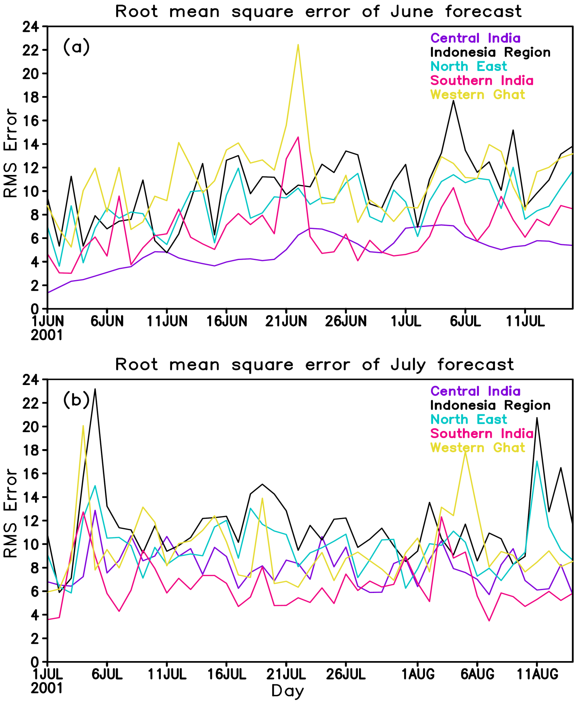

Slide 12
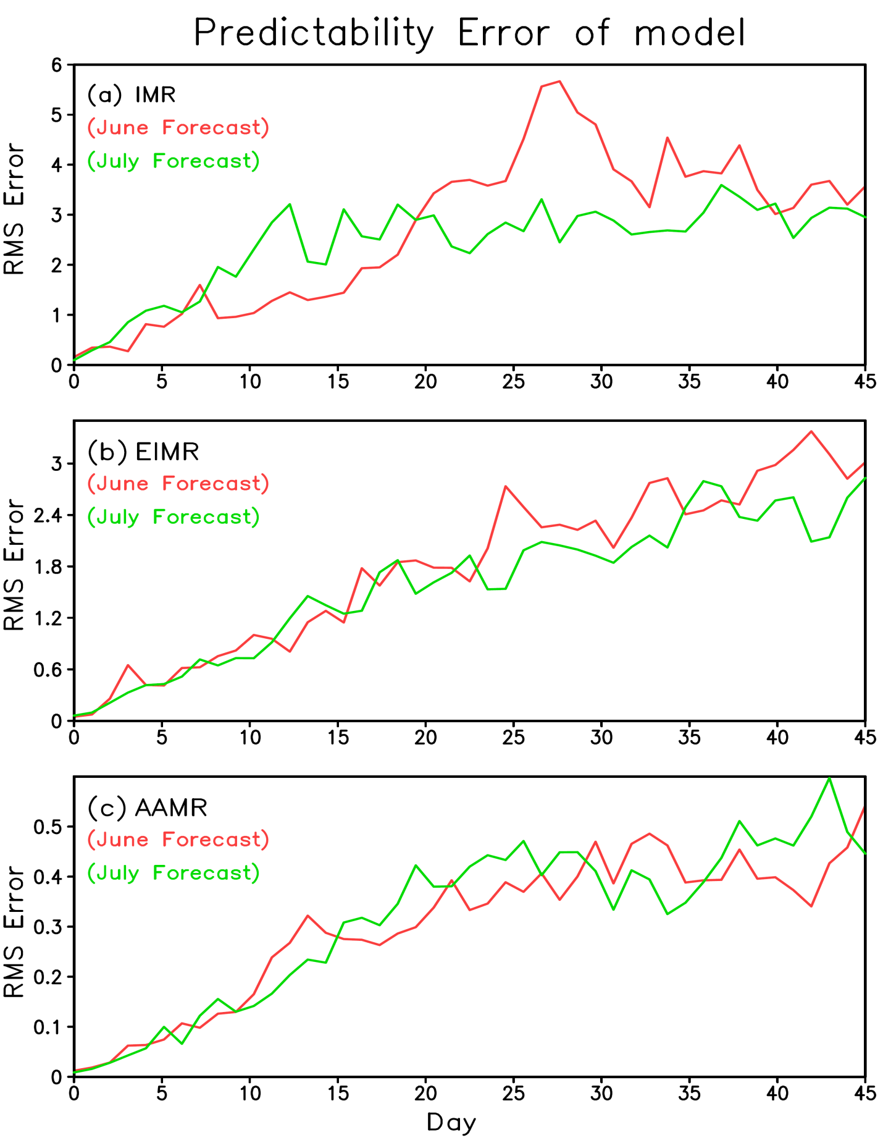
Predictability error of a model is computed by taking one ensemble member as truth and taken difference of precipitation from rest of the ensemble members with this member. Then RMSE is computed as in the case of Forecast error.

Slide 13
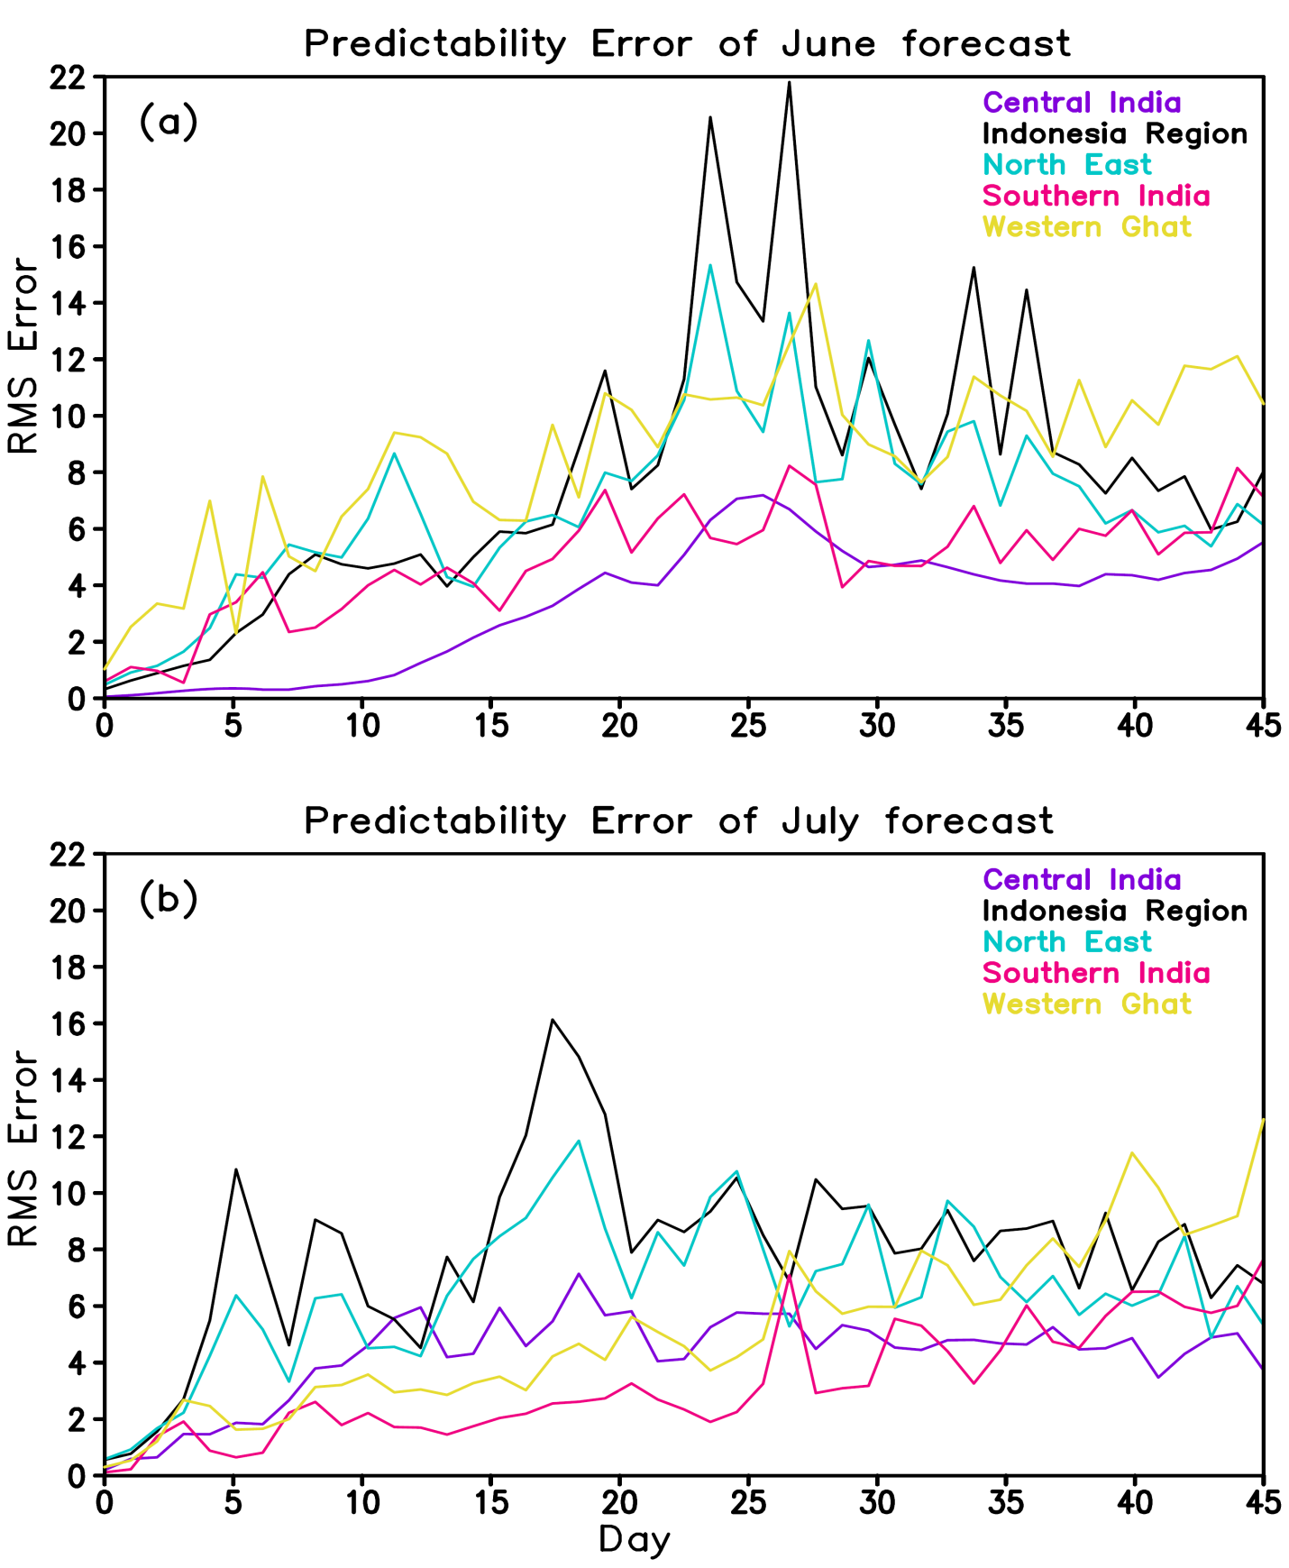

Slide 14
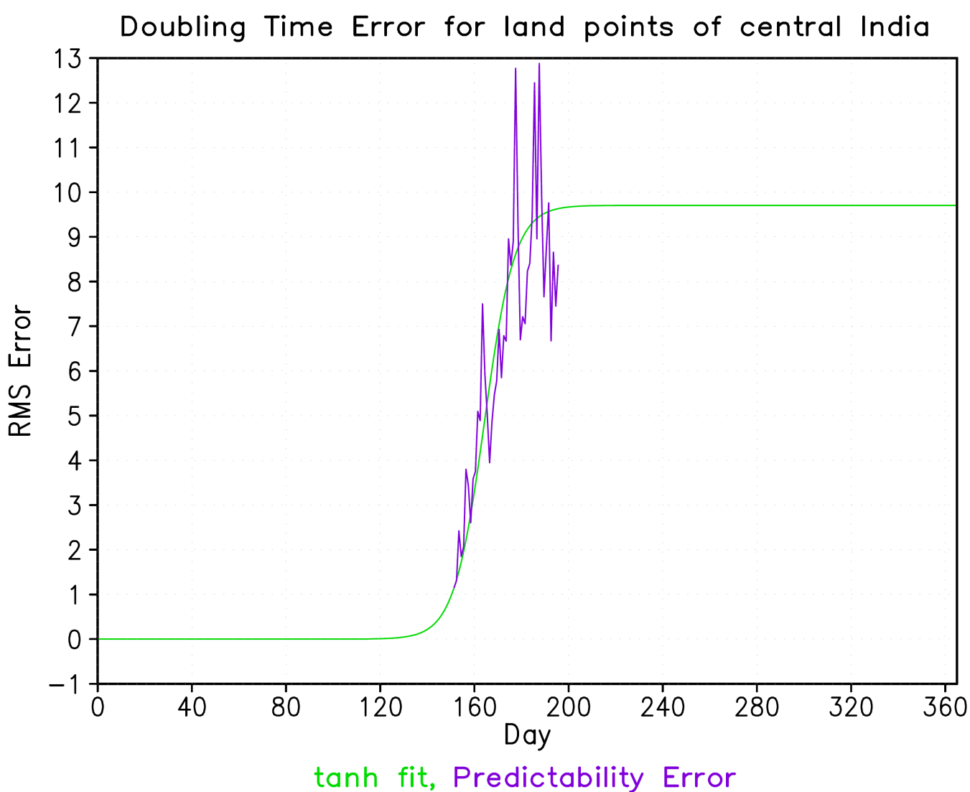
Error Growth Rate
Growth rate of errors using Lorenz’s formula
An approximate formula can be fitted to the error curve. If E is the mean error, the exponential growth is given by the equation
The errors do not grow forever. The modified error equation is
where s is so chosen that E_{s}= λ₁/s is the saturation value of E. The solution involves a tanh function.
The doubling time of the errors is
t_{d} = (ln2)/λ₁

Slide 15
The doubling time of Predictability errors of the NCEP CFSv2 forecast for different indices initialized on 31st May (June forecast) and 30th June (July forecast).
Regions | June Forecast |  | July Forecast
 | Land and Ocean | Land only | Land and Ocean | Land only
IMR | - | 4.4 | - | 3.5
EIMR | 3.5 | - | 3.5 | -
AAMR | 4.0 | - | 3.7 | -
Central India | 4.4 | 4.4 | 3.4 | 3.6
Indonesia Region | 3.1 | 3.9 | 3.5 | 3.4
North East | 3.1 | 3.7 | 3.7 | 3.4
Southern India | 3.4 | 3.3 | 4.1 | 3.6
Western Ghats | 3.9 | 3.2 | 3.4 | 3.4

Slide 16
Conclusion
The daily climatology of precipitation over the land point of India is underestimated with respect to observation.
Model shows the dry bias over land mass of India except the Himalayan region.
The error growth rate of model is slower in June forecast as compared to other forecast. The value of forecast error in IMR index is higher as compared to other two indices.
Forecast error growth rate of all the subdivisions over land region.
The doubling time of the predictability error in the range of 3-5 days was estimated in the all the regions.
It was found that the Southern India and Western Ghat are more predictable in the July forecast as compared to June forecast and opposite is true for IMR, North East, Central India and Indonesian region.

Slide 17
Prediction of daily modes of South Asian Monsoon Variability and its association with Indian and Pacific Ocean SST in the NCEP CFS V2.

Slide 18
Multi channel spectrum Analysis (MSSA) is used in the present analysis. The detail review of the scheme can be found in (Ghil et. al., Rev. Geophysics, 2002). MSSA is the extensions of the EOF analysis but include temporal lags of spatial data.
This method extracts space-time structure of oscillatory modes and persisting modes and has been applied in many previous studies related to climate.
An oscillation in the time series is identifiable when two consecutive modes with nearly equal eigenvalues are in phase quadrature.
In the present work, MSSA was carried out using daily rainfall anomalies for JJAS of each year with a lag window length of 61 days from the CFSv2 data and GPCP Observation data.

Slide 20
Reconstructed Components (RCs)
The part of the original time series corresponding to a particular eigenmode can be extracted as space–time reconstructed components (RCs) defined by Plaut and Vautard (1994).
The sum of all the RCs reproduces the original time series.
For an oscillation represented by a pair of eigenmodes, the RC is sum of the individual RCs of the pair.
The phase angle varies from 0 to 360 for each cycle of the oscillation.

Slide 21
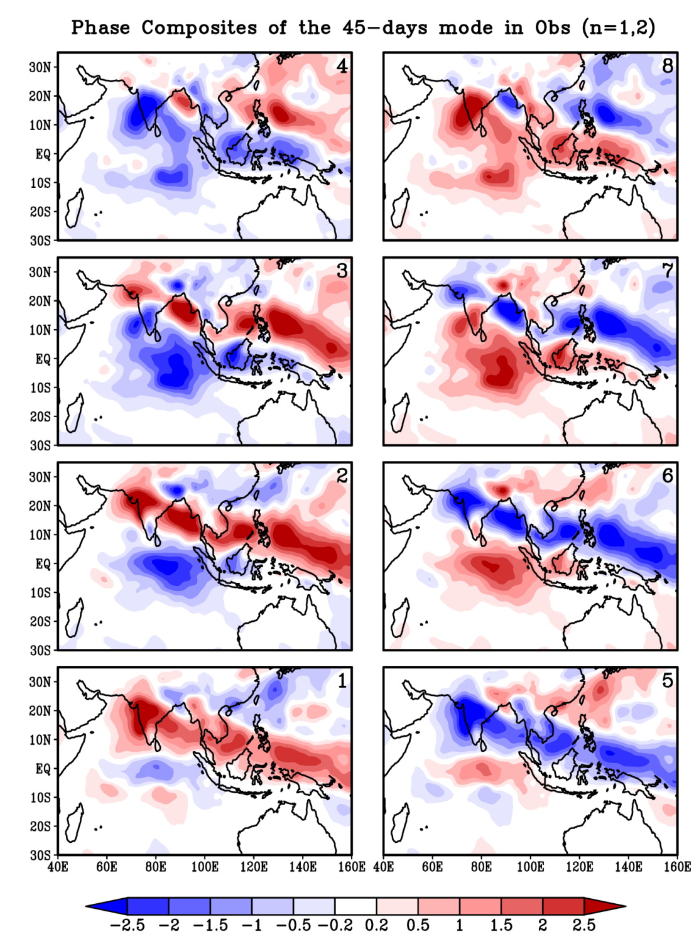
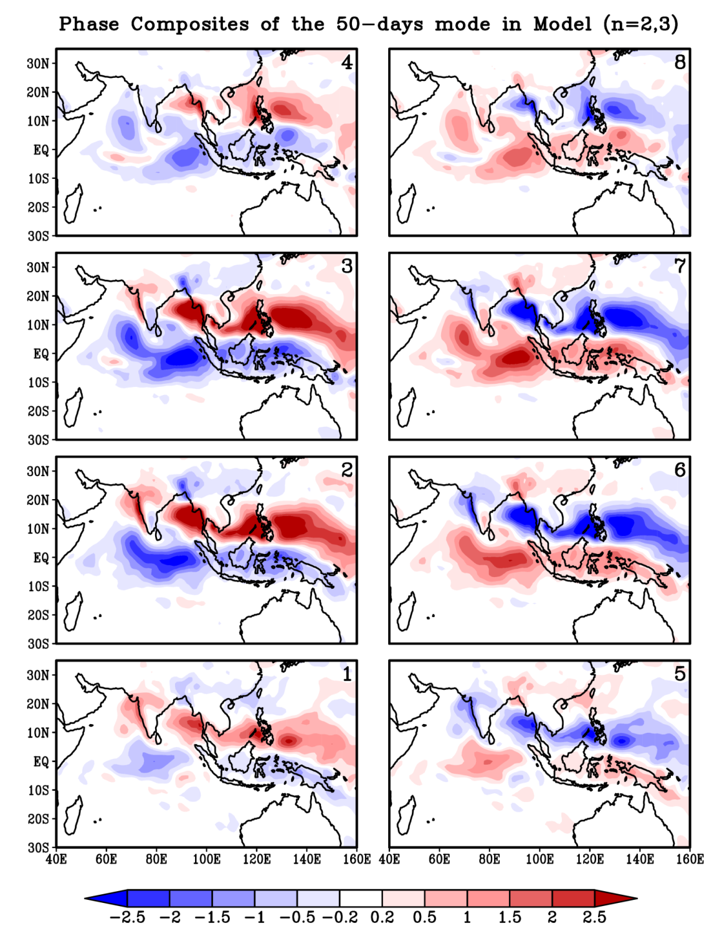

Slide 22
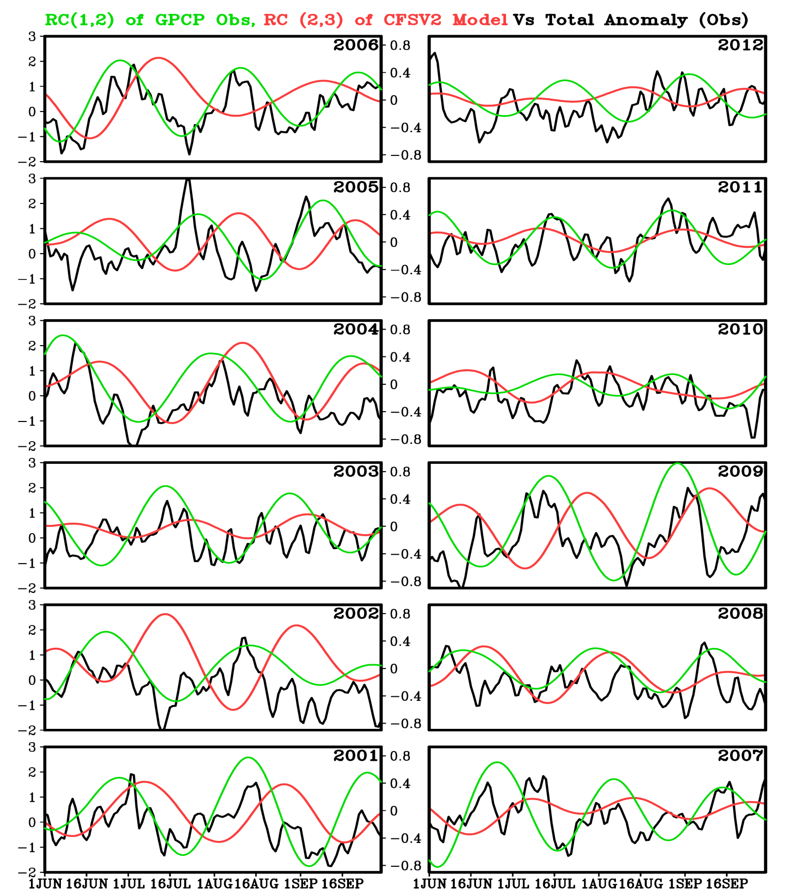
Rainfall averaged over the region 60°E-140°E, 0°-35°N for total daily anomalies for Observation (black, left y-axis scale), green represent the 45-days oscillatory modes for Observation and red represent the 50-days oscillatory modes for Model (right y-axis scale) for the first 12 years. Simulation year is noted at the top right corner. Units are in mm days⁻¹.

Slide 23
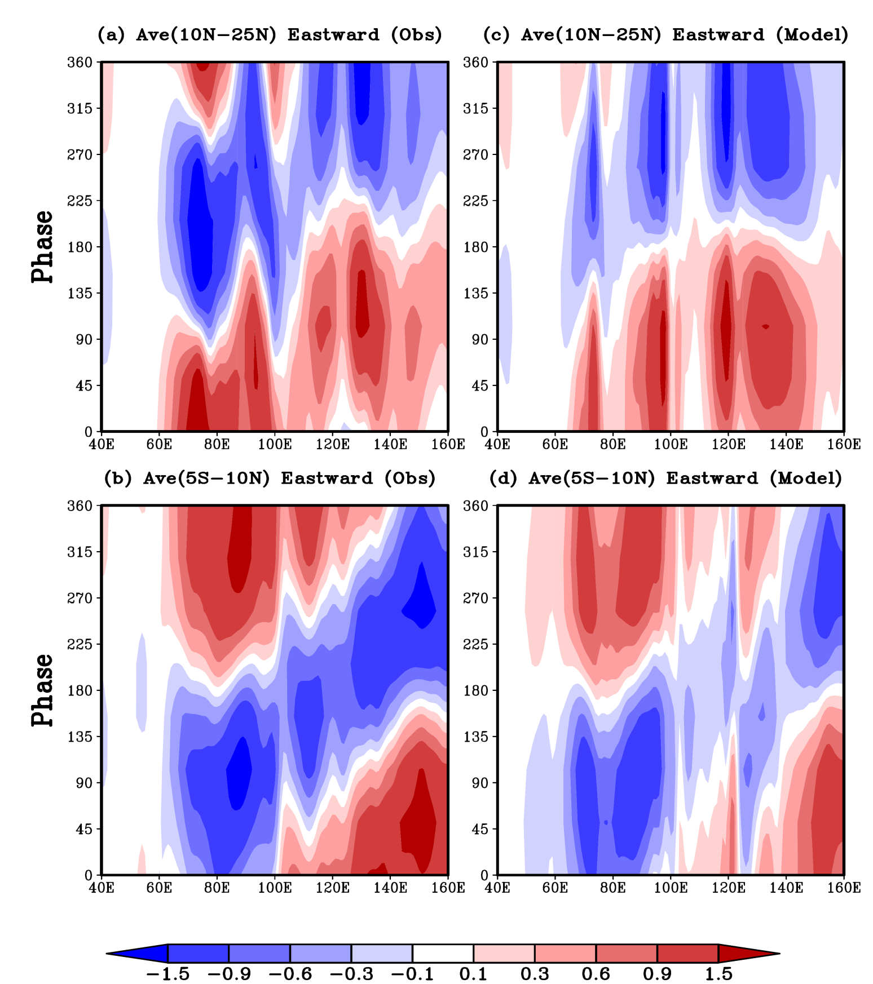
The longitude-phase cross-sections of the 45-days and 50-days mode by averaging its RCs across the latitudes 10°N-25°N and 5°S-10°N for Observation (a);(b) and Model (c); (d) respectively. Y-axis panels represent the phase angles for a complete oscillation. Units are in mm days⁻¹.
The propagation signals are not clear in the latitude belt of 10°N-25°N from the Observation as well as Model.
The eastward propagation of the oscillatory mode in Indian and Pacific Ocean is clearly seen in Observation and Model captured it correctly.

Slide 24
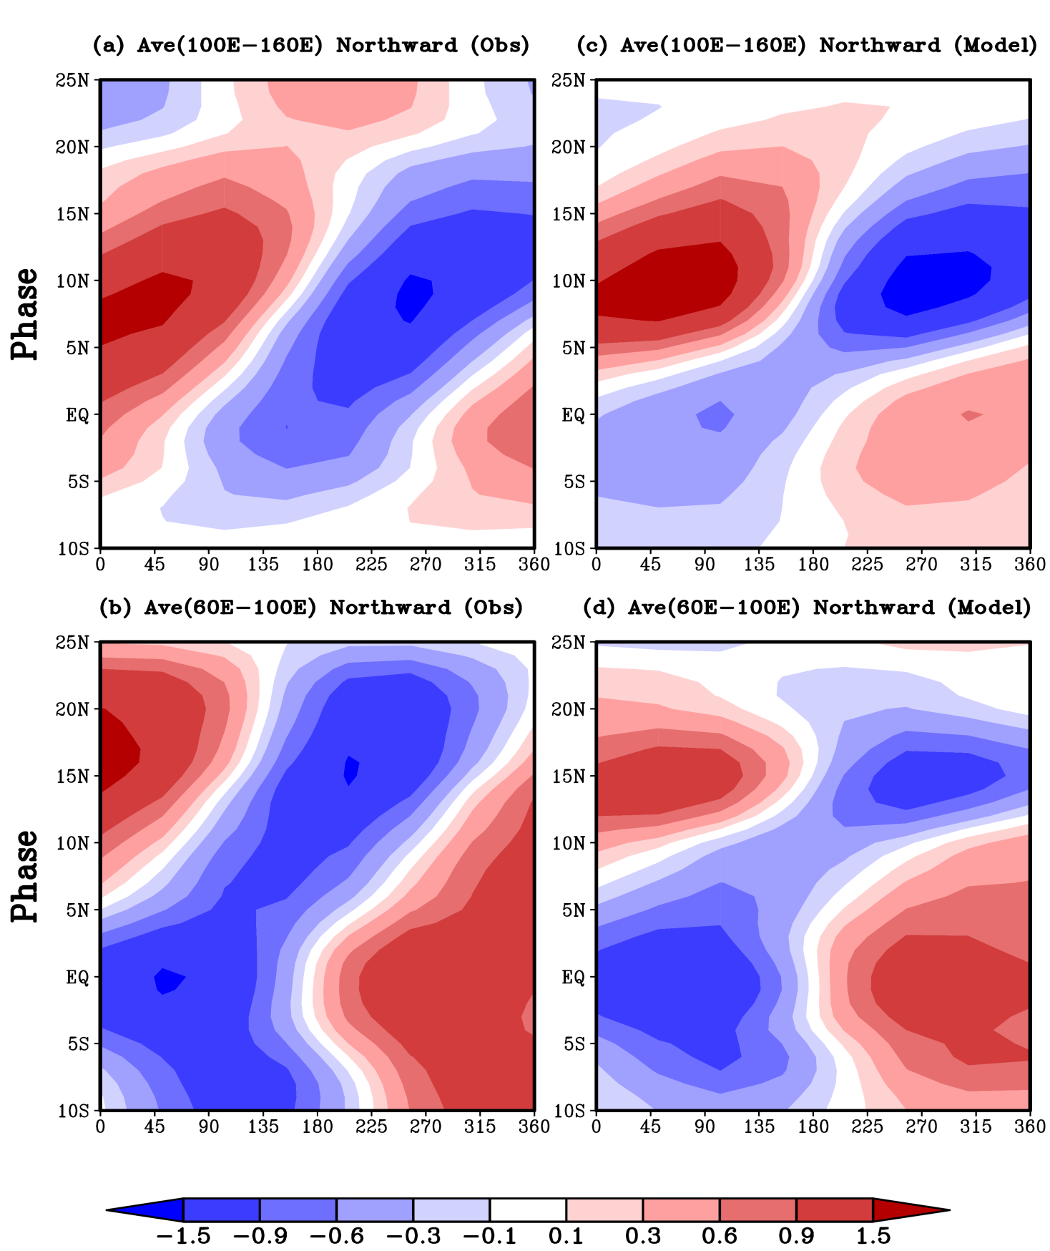
The latitude-phase cross-sections of the 45-days and 50-days mode by averaging its RC across the latitudes 100°E-160°E and 60°E-100°E for Observation (a); (b) and Model (c); (d) respectively. X-axis panels represent phase angles for a complete oscillation. Units are in mm days⁻¹.
The southward propagation to the south of equator and northward propagation to the north of equator in the longitude belt of 60°E-100°E which includes Indian Ocean and Indian subcontinent is simulated by the Model.
The western Pacific Ocean region, northward propagation in the latitude belt of 5°S-15°N is observed from Observation and is well simulated by the Model.
Phase
Phase

Slide 25
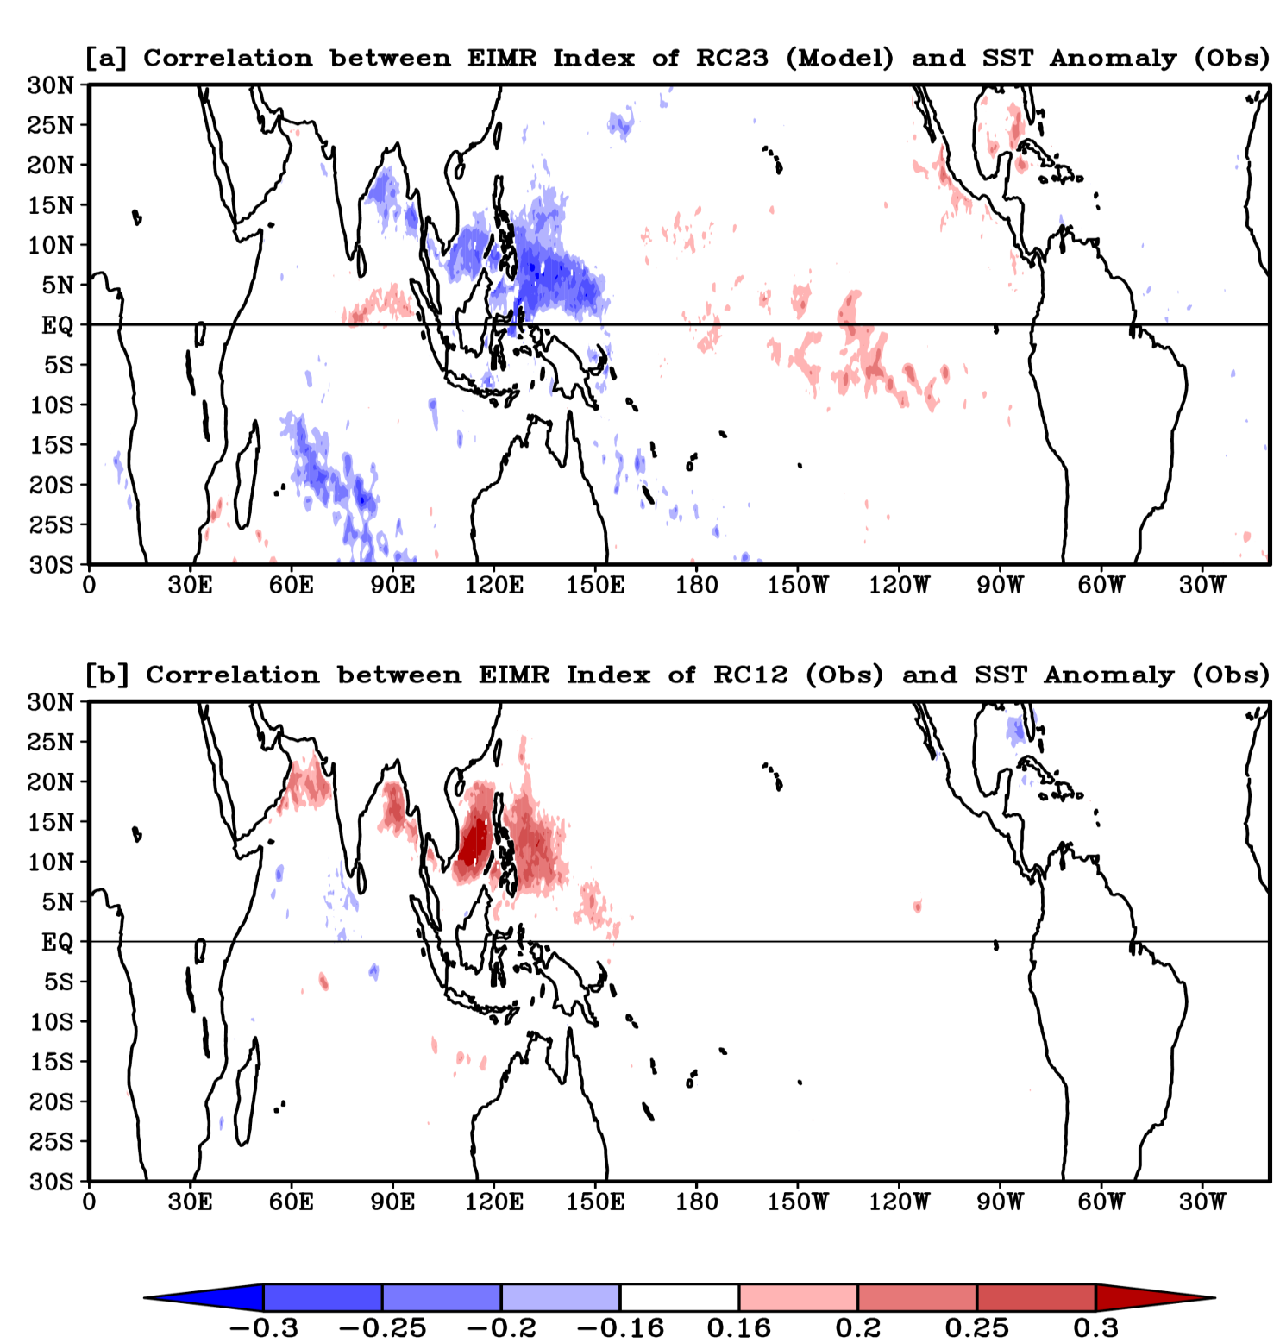
Daily point correlation between the daily anomalies of SST and EIMR index of the RCs of the (a) 50-days, and (b) 45-days oscillatory modes in the JJAS season for 13 years of the control simulation. The correlation values above 90% confidence level are shown

Slide 26
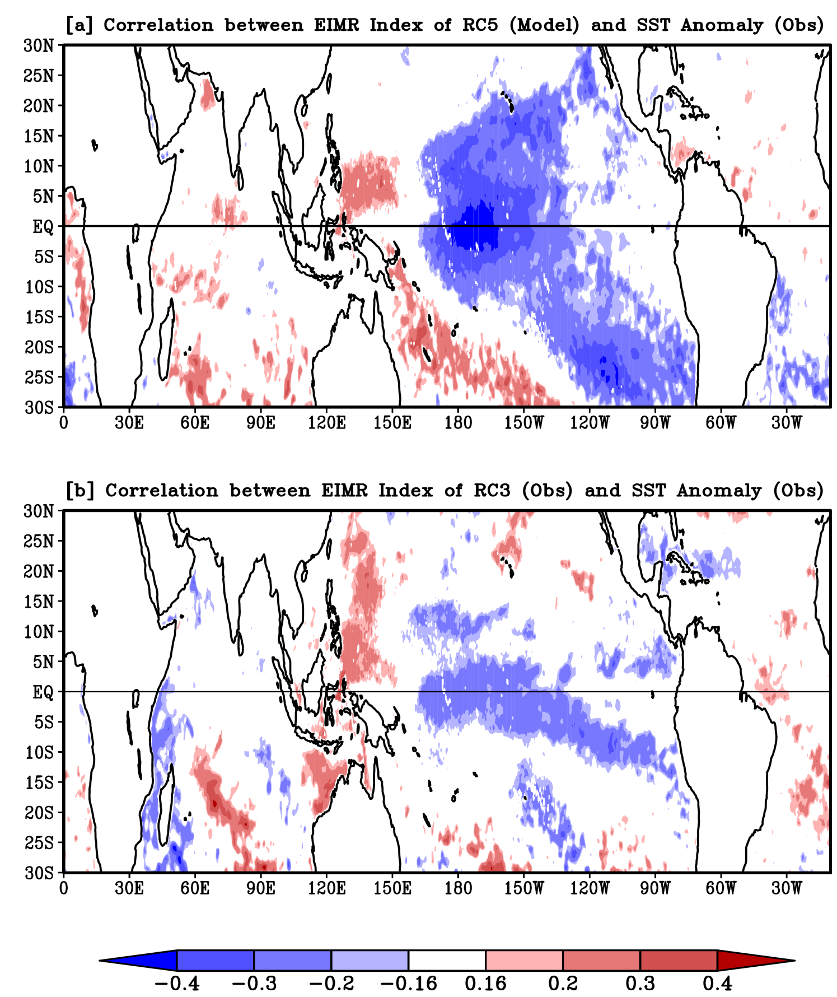

Slide 27
Conclusion
Model and Observation has dominant mode of intraseasonal variability with nearly equal time period.
The space-time structure of the oscillatory modes observed in the observation is well represented by the Model.
Significant improvement in the space time structure, period of oscillation and propagation of oscillatory modes was found with respect to the previous version of the Model.
It was found that the oscillatory mode obtained from the model and observation is independent of the SST in Pacific Ocean.
Model is able to predict the observed ENSO-monsoon relationship from the persisting mode.
The significant negative correlation between EIMR index of persisting mode of Model and observed SST throughout the latitudinal belt of 30°S to 30°N in the Pacific Ocean was observed but it was absent in the observation and will be further investigated.

Slide 28
Thanks

