Slide 1
Basics concepts of Convective parameterization
&
related issues
P. Mukhopadhyay

Slide 2
Climate v. Numerical Weather Prediction
NWP:
  Initial state is CRITICAL
  Don’t really care about whole PDF, just probable phase space
  conservation of mass/energy to match observed state
Climate
  Get rid of any dependence on initial state
  Conservation of mass & energy critical
  Want to know the PDF of all possible states
  Don’t really care where we are on the PDF
  Really want to know tails (extreme events)

Slide 3
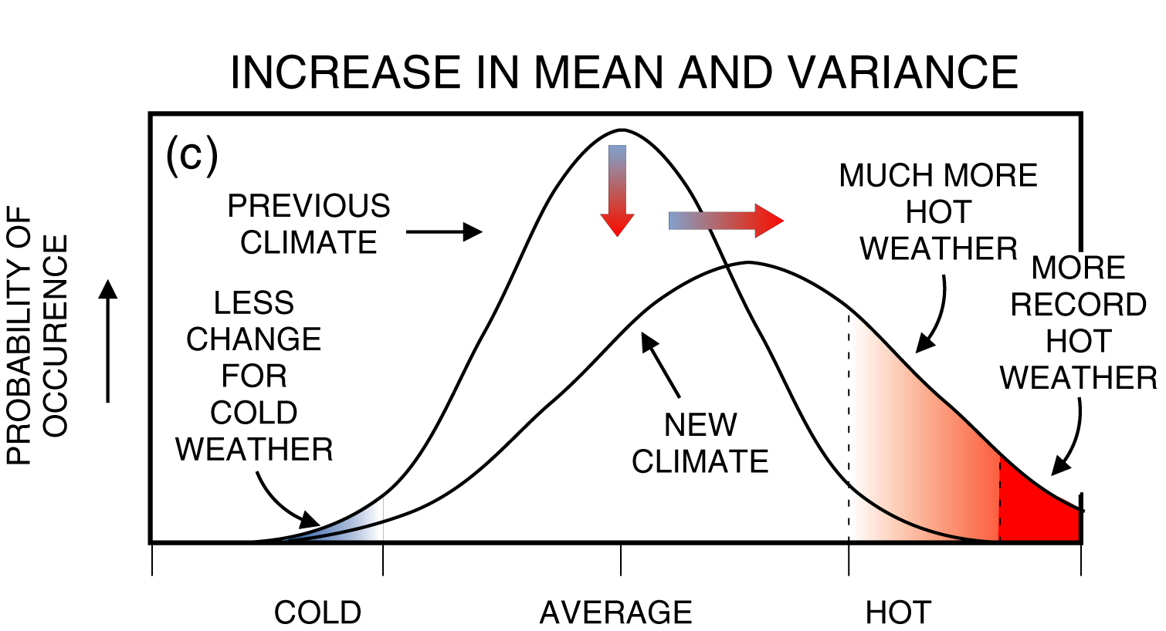
How can we predict Climate (50 yrs)
if we can’t predict Weather (10 days)?
Statistics!

Slide 4
Conceptual Framework for Modeling
Can’t resolve all scales, so have to represent them
Energy Balance / Reduced Models
  Mean State of the System
  Energy Budget, conservation, Radiative transfer
Dynamical Models
  Finite element representation of system
  Fluid Dynamics on a rotating sphere
  Basic equations of motion
  Advection of mass, trace species
  Physical Parameterizations for moving energy
Scales: Cloud Resolving/Mesoscale/Regional/Global
  Global= General Circulation Models (GCM’s)

Slide 5
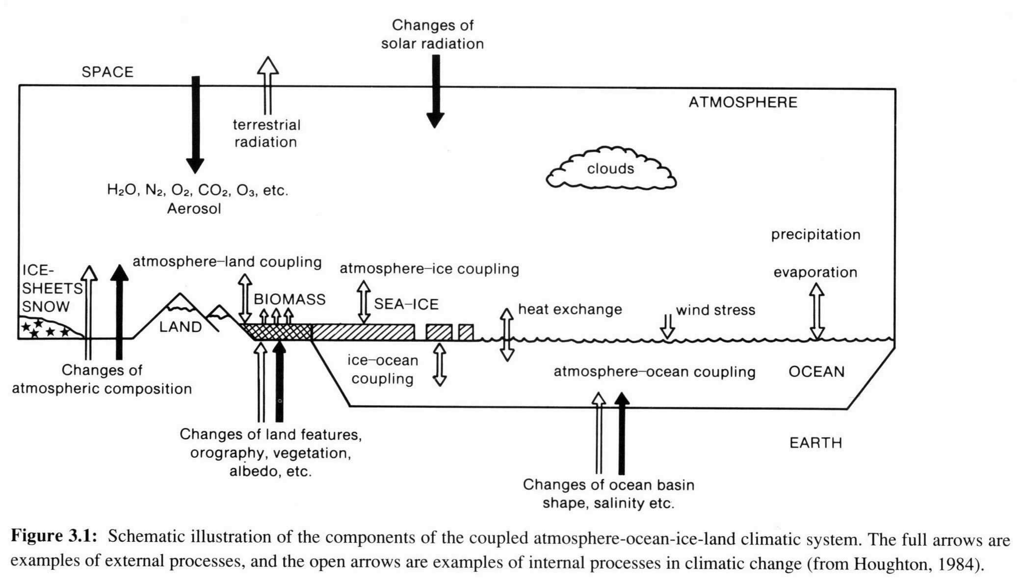
Physical processes regulating climate

Slide 6
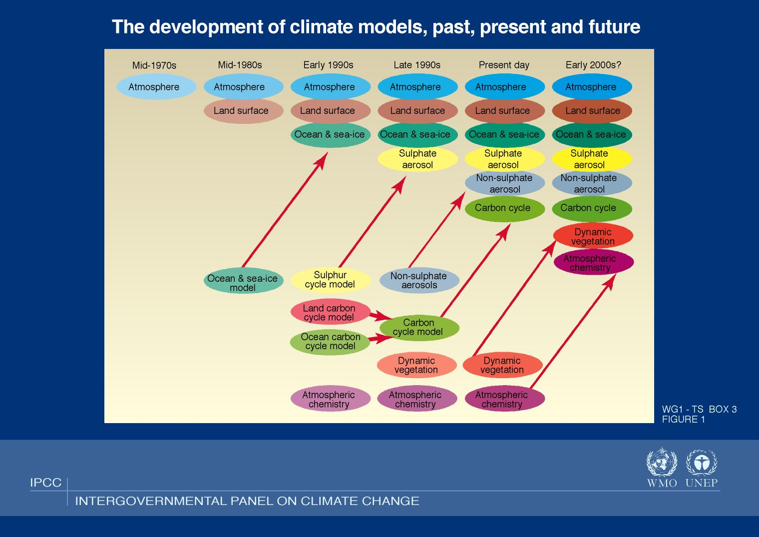
Earth System Model ‘Evolution’
2000 2005

Slide 7
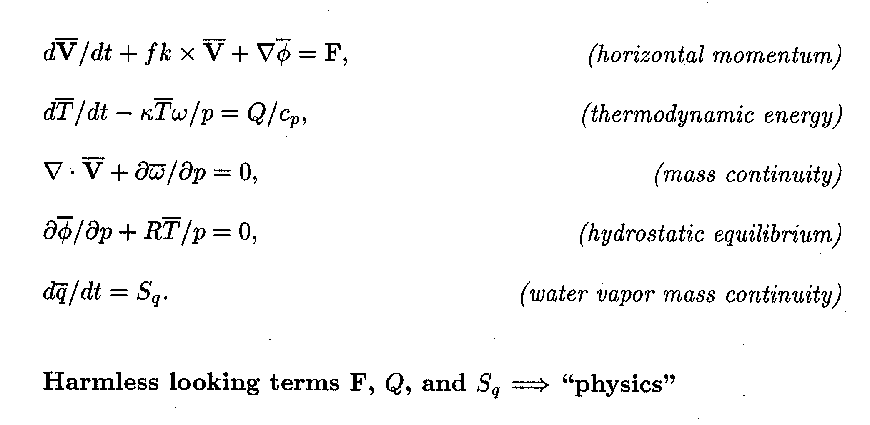
Meteorological Primitive Equations
Applicable to wide scale of motions; > 1hour, >100km

Slide 8
Global Climate Model Physics
Terms F, Q, and S_{q} represent physical processes
Equations of motion, F
  turbulent transport, generation, and dissipation of momentum
Thermodynamic energy equation, Q
  convective-scale transport of heat
  convective-scale sources/sinks of heat (phase change)
  radiative sources/sinks of heat
Water vapor mass continuity equation
  convective-scale transport of water substance
  convective-scale water sources/sinks (phase change)

Slide 9
Grid Discretizations
Equations are distributed on a sphere
Different grid approaches:
  Rectilinear (lat-lon)
  Reduced grids
  ‘equal area grids’: icosahedral, cubed sphere
  Spectral transforms
Different numerical methods for solution:
  Spectral Transforms
  Finite element
  Lagrangian (semi-lagrangian)
Vertical Discretization
  Terrain following (sigma)
  Pressure
  Isentropic
  Hybrid Sigma-pressure (most common)

Slide 10
Model Physical Parameterizations
Physical processes:
Moist Processes
  Moist convection, shallow convection, large scale condensation
Radiation and Clouds
  Cloud parameterization, radiation
Surface Fluxes
  Fluxes from land, ocean and sea ice (from data or models)
Turbulent mixing
  Planetary boundary layer parameterization, vertical diffusion, gravity wave drag

Slide 11
Basic Logic in a GCM (Time-step Loop)
For a grid of atmospheric columns:
‘Dynamics’: Iterate Basic Equations
  Horizontal momentum, Thermodynamic energy,
  Mass conservation, Hydrostatic equilibrium,
  Water vapor mass conservation
Transport ‘constituents’ (water vapor, aerosol, etc)
Calculate forcing terms (“Physics”) for each column
  Clouds & Precipitation, Radiation, etc
Update dynamics fields with physics forcings
Gravity Waves, Diffusion (fastest last)
Next time step (repeat)

Slide 12
Physical Parameterization
To close the governing equations, it is necessary to incorporate the effects of physical processes that occur on scales below the numerical truncation limit
Physical parameterization
  express unresolved physical processes in terms of resolved processes
  generally empirical techniques
Examples of parameterized physics
  dry and moist convection
  cloud amount/cloud optical properties
  radiative transfer
  planetary boundary layer transports
  surface energy exchanges
  horizontal and vertical dissipation processes
  ...

Slide 13
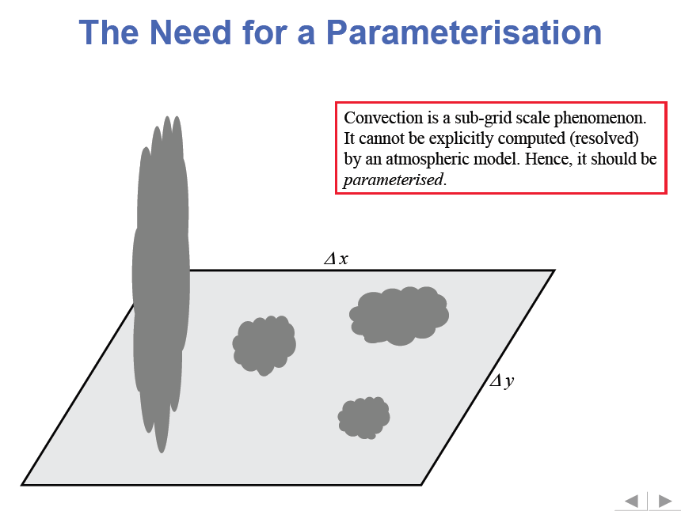

Slide 14
Flow chart of lecture on Convective parameterization
What comes to the mind when we talk of moist convection?
Why is it important and what are the different types of moist convection?
Moist process-A multi-scale problem
What is convective parameterization and why is it necessary?
Point of uncertainties in convective parameterization
Few well known schemes: KUO scheme, Arakawa-Schubert, Betts-Miller-Janjic and Kain-Fritsch

Slide 15
What comes to our mind when we think of moist convection?
It could be severe thunderstorms with strong and gusty wind, heavy rain, lightning etc.
Sometimes these storms can merge to form lines of organized deep convective storms with trailing stratiform rainfall regions.
It could be stratocumulus seen near coastline or stratus cloud producing light rainfall over a large area.
Thus convection varies widely in shape and sizes and its manifestation is seen in the atmosphere in the form of clouds of different shapes and sizes.

Slide 16
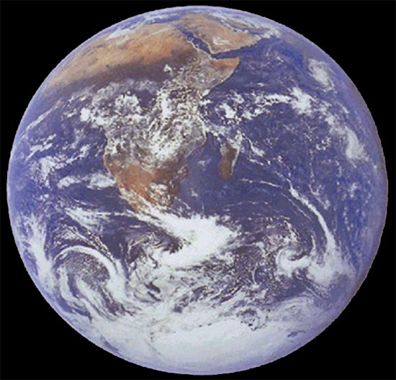
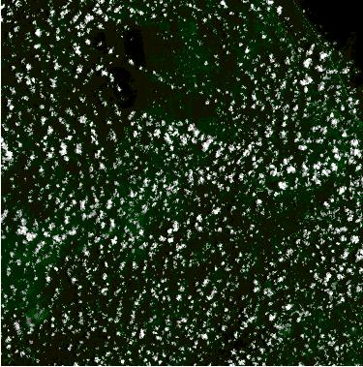
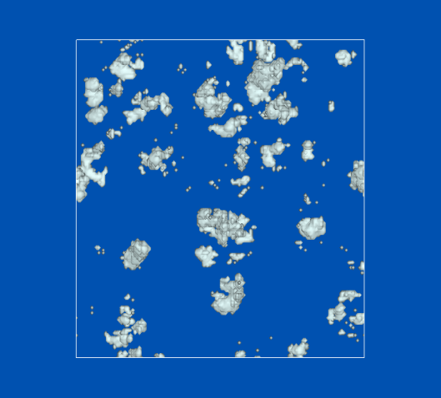
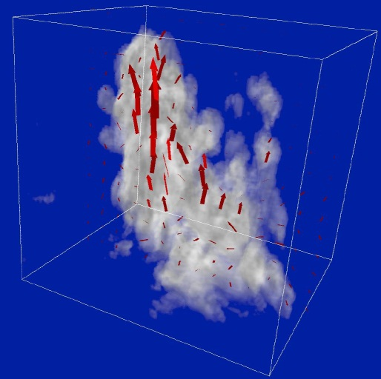
Length scales in the atmosphere
Earth 10³ km
Landsat 60 km 65km
LES 10 km
~1μm-100μm
~mm
~100m
16

Slide 17
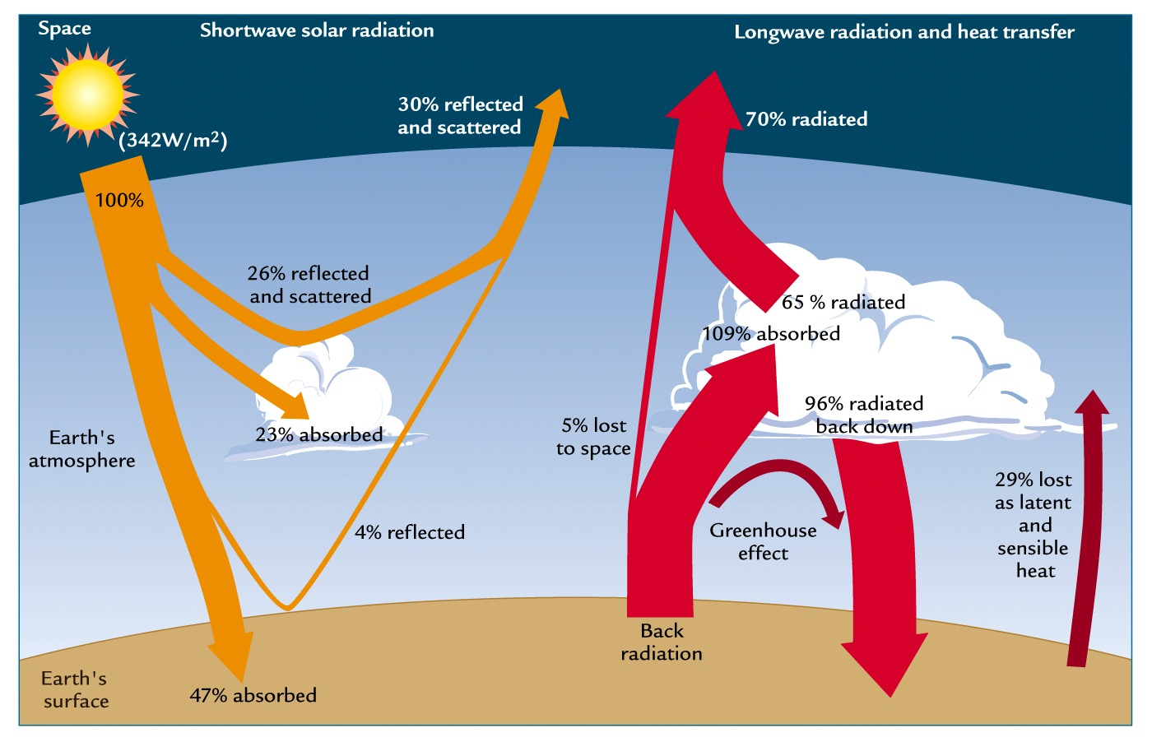
Global mean turbulent heat fluxes
17
source: Ruddiman, 2000

Slide 18


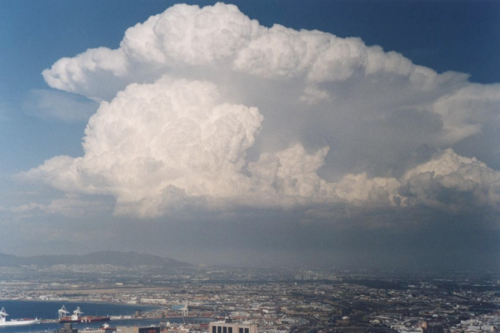
No single model can encompass all relevant processes
mm
10 m
100 m
1 km
10 km
100 km
1000 km
10000 km
Cloud microphysics
⬅
turbulence
Cumulus
clouds
Cumulonimbus
clouds
Mesoscale
Convective systems
Extratropical
Cyclones
Planetary
waves
DNS
Subgrid
Large Eddy Simulation (LES) Model
Cloud System Resolving Model (CSRM)
Numerical Weather Prediction (NWP) Model
Global Climate Model
18
Notes:
18

Slide 19
Why is it important and what are the types of moist convection?
Moist convection is important to the prediction of atmospheric circulation for many reasons.
Large scale horizontal gradients of latent heating produced by deep moist convection help to drive large scale vertical circulations e. g. Hadley cell, Walker cell.
Deep convection also is a major component in ENSO and it can influence the seasonal climate in the northern hemisphere. The SST in the tropical eastern Pacific are warmer than normal, during ENSO. Associated with this, deep convection develops, releasing latent heating in a deep atmospheric column and producing upper level divergence. The upper level divergence excites Rossby waves that alter the hemispheric flow (Tribbia 1991).

Slide 20
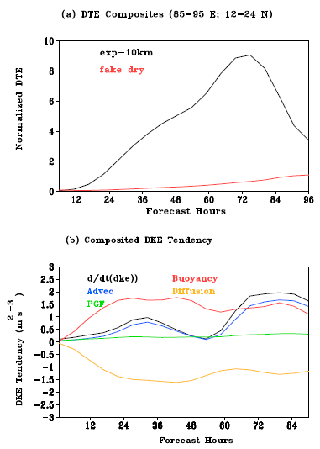
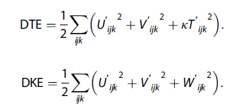
Time evolution of normalized Difference of Total Energy (DTE) in
exp-10 km (black line) and fake dry (red line) at 10 km resolution averaged over 85°–95°E and 12°–24°N. Normalization is performed with respect to the natural variability. (b) The time evolution of DKE tendency (m² s⁻³) and each of the source/sink term estimated from the 10 km grids in exp-10
km. Vertical integration is done between 950 and 150 hPa in both panels
Taraphdar et al. 2014, JGR, 10.1002/2013JD021265

Slide 21
Shallow convection
In contrast to deep convection, shallow cumulus clouds are the most frequently observed tropical cloud (Johnson et al. 1999).
Shallow convection modifies the surface radiation budget, influences the structure and turbulence of the PBL and thereby also affect the global climate (Randall et al 1985).
Shallow convection also occurs in mid-latitude particularly when cold air moves over warm water. Shallow cumulus cloud develop over water which commonly align themselves in the form of bands or streaks (Houze 1993)

Slide 22
Stratiform convection
Deep convection can be further sub divided into convective and stratiform components (Houze, 1997, Chattopadhyay etal, 2009). The convective components refer to convection associated with individual cells, horizontally small regions of more intense updrafts and down drafts in association with young and active convection.
The stratiform component refers to convection associated with older, less active convection with vertical motion generally less than 1ms⁻¹.

Slide 23
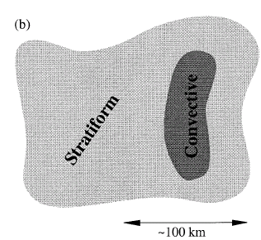
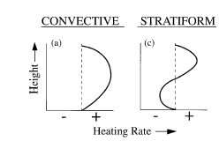

Slide 24
Multi-scale nature
Essentially moist convection is comprised of two components namely convective and stratiform which has different spatio-temporal scale. This is the reason why convection is a multi-scale process.
The present day challenge is to devise a scheme (parameterization) that can resolve the multi-scale nature of convection in a realistic way.

Slide 25
What is parameterization and why is it necessary?
The basic physical equations describe the behavior of the atmosphere on small scales.
From these we derive equations that describe the behavior of the system on larger scales.
The large-scale equations contain terms that represent the effects of smaller-scale processes.
A “parameterization” is designed to represent the effects of the smaller-scale processes in terms of the large-scale state.
Since cumulus parameterization is an attempt to formulate the statistical effects of cumulus convection without predicting individual clouds, it is a closure problem in which we seek a limited number of equations that govern the statistics of a system with huge dimensions. Therefore, the core of the cumulus parameterization problem, as distinguished from the dynamics and thermodynamics of individual clouds, is in the choice of appropriate closure assumptions. (Arakawa, Met. Monograph, 1993)
Parameterizations are much more than curve fits. They are statistical theories that describe the interactions of small scales with larger scales. Parameterizations typically involve idealizations as well as “closure assumptions” that are, at best, only approximately valid.

Slide 26
Arakawa, Met. Mono. No.46, 1993

Slide 27
Conceptualizing cumulus parameterization
Since convective parameterization represents the effects of sub-grid scale processes on the grid variables, it is called an implicit parameterization
Convective parameterization can be conceptualized in many ways and can be separated into some basic types (Mapes 1997).
Convective parameterization can be grouped as deep-layer control schemes and low level control schemes.
Deep layer control schemes relates the creation of CAPE by large scale processes to the development of convection. These schemes could be termed “supply side” approaches as it is assumed that convection consumes the CAPE that is created.
Low level control schemes tie the development of convection to the initiation processes by which CINE is removed.

Slide 28
Types of convection schemes
Schemes based on moisture budgets
  Kuo, 1965, 1974, J. Atmos. Sci.
Adjustment schemes
  moist convective adjustement, Manabe, 1965, Mon. Wea. Rev.
  penetrative adjustment scheme, Betts and Miller, 1986, Quart. J. Roy. Met. Soc., Betts-Miller-Janic
Mass-flux schemes (bulk+spectral)
  entraining plume - spectral model, Arakawa and Schubert, 1974, J. Atmos. Sci.
  Entraining/detraining plume - bulk model, e.g., Bougeault, 1985, Mon. Wea. Rev., Tiedtke, 1989, Mon. Wea. Rev., Gregory and Rowntree, 1990, Mon. Wea . Rev., Kain and Fritsch, 1990, J. Atmos. Sci., Donner , 1993, J. Atmos. Sci., Bechtold et al 2001, Quart. J. Roy. Met. Soc.
  episodic mixing, Emanuel, 1991, J. Atmos. Sci.

Slide 29
Point of uncertainties
There are a number of uncertainties in modeling clouds and their associated processes such as those shown below fig.
we do not adequately understand what determines the rate of entrainment of “environmental” air into the updrafts, or how entrainment affects the evolution of a convective cloud system.
Cumulus entrainment entails the dilution of convective updraft by dry, cool environmental air.
Current parameterizations incorporate the effects of entrainment through simple assumptions (e.g., Lin and Arakawa 1997a b)
The environment of the hot towers is typically assumed to be uniform, but in reality its properties vary on unresolved scales, due in part to the humid corpses of deceased cumuli.
The properties of the entrained air must, therefore, depend on which part of the variable environment in which an updraft happens to find itself. In addition, the representation of microphysical processes is extremely crude.
The cloud dynamics is highly simplified in large-scale models.
Arakawa 2004

Slide 30
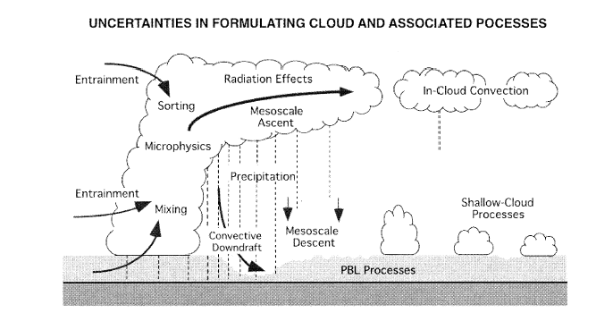
Arakawa 2004, Jour. Of Climate

Slide 31
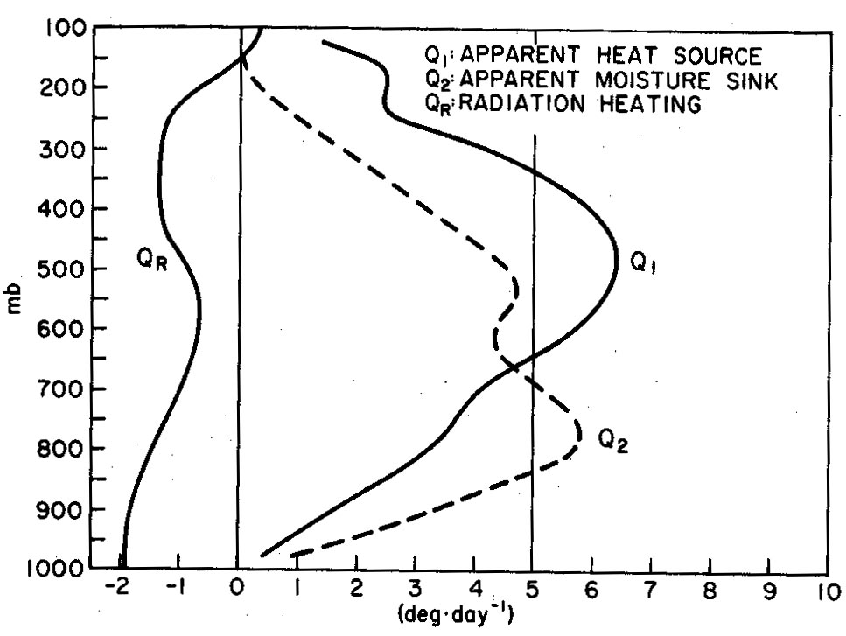
Task of convection parametrization
total Q1 and Q2
To calculate the collective effects of an ensemble of convective clouds in a model column as a function of grid-scale variables
These effects are represented by Q₁-Q_{R}, Q₂
Hence: parametrization needs to describe CONVECTIVE CONTRIBUTIONS to Q1/Q2: condensation/evaporation and transport terms and their vertical distribution.

Slide 32
Task of convection parametrization
Determine occurrence/localization of convection
Trigger
Determine vertical distribution of heating, moistening and momentum changes
Cloud model
Determine the overall amount of the energy conversion, convective precipitation=heat release
Closure

Slide 33
KUO Type convection (1965, JAS, Vol. 22, 40-63)
The effect on large scale motions of latent heat release by deep cumulus convection in a conditionally unstable atmosphere
It relates convective activity to total column moisture convergence, and come under deep-layer control scheme. It is a static scheme as it is not concerned with the details of convective processes and a moisture control scheme since it is closely tied to the available moisture.
They have shown that deep cumulus convective motions bring the moist surface air directly to higher levels, the time changes of temperature and mixing ratio can be determined from the horizontal advection of humidity and the vertical temperature and humidity distributions.
The derivation of the KUO scheme begins from the large scale equations in pressure co-ordinates (x,y,p) for the potential temperature and the water vapour mixing ratio.

Slide 34
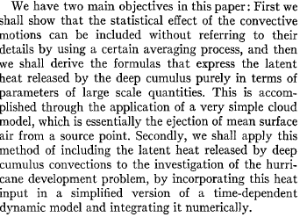
Objectives of KUO paper

Slide 35
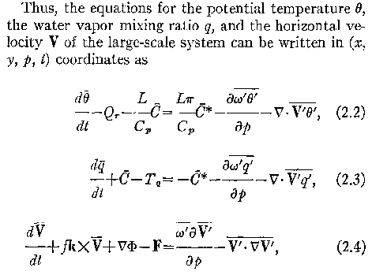
Governing equations
(1)
(2)
(3)

Slide 36
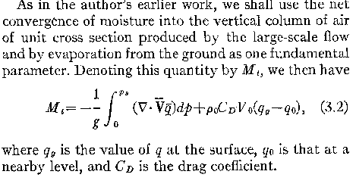
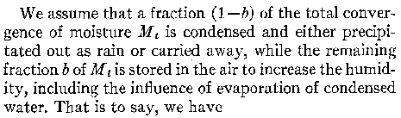
(4)

Slide 37
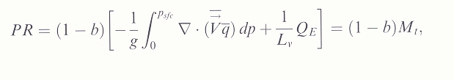
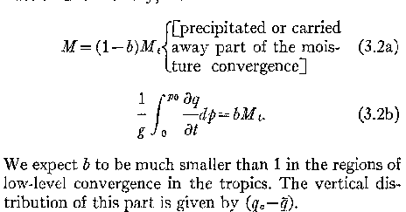
(5)
p_{s}
(6)
Q_{E} is the latent heat flux, b is a constant

Slide 38
The “Kuo” scheme
Closure: Convective activity is linked to large-scale moisture convergence. The rate of precipitation is balanced by the rate of horizontal convergence of moisture and surface evaporation.
Main problem: here convection is assumed to consume water and not energy
Too simple, can not represent the realistic physical behavior of convection.
Can not represent shallow convection

Slide 39
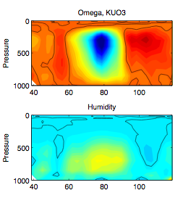
Kuo simulations
never show
tilted omega or
humidity.
Adopted from Frierson et al.

Slide 42
The horizontal area must be large enough to contain an ensemble of cumulus cloud but small enough to cover only a fraction of large scale disturbance. The existence of such an area is one of the basic assumptions of this paper

Slide 43
As acoustic waves are not of concern, the mass continuity equation in quasi-Boussinesq form
Density ρ is a function of height only, V is the horizontal velocity, is horizontal del operator
W is the vertical velocity and z the vertical coordinate.
Let σ_{i}(z,t) be the fractional area covered by the ith cloud, in a horizontal cross section at level z and time t.
The vertical mass flux through σ_{i} is

Slide 44
Trigger:
To trigger convection, the scheme requires some boundary-layer CAPE.
Although it varies in specific implementations, the general formulation requires the presence of large-scale atmospheric destabilization with time. The process by which the scheme attempts to assess destabilization is complex; for example, it must account for the effects of entrainment and clouds of various depths.

Slide 45
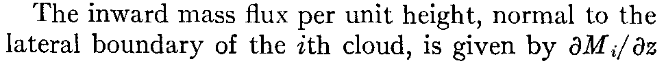
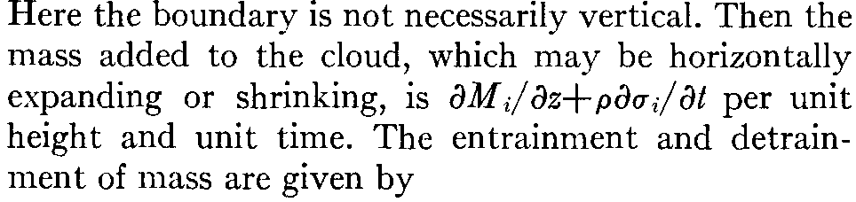

Slide 47
E_{i} can be rewritten as
Mass flux
Expansion of cloud
Thus entrainment of mass which is caused by turbulent mixing at the cloud boundary appears either as a vertical divergence of mass flux within the cloud, as a horizontal expansion of the cloud as it rises or as a combination of these two depending on the dynamics of the clouds.

Slide 48
The total vertical mass flux by all of the clouds in the ensemble is

Slide 49
In general the total vertical mass flux is M_{c} in the clouds is not the same as the large scale net vertical mass flux through the unit large scale horizontal area ρω. The difference between Mc and ρω is equal to the downward mass flux between the clouds
At a given height some clouds may be detraining and some others are entraining. Total entrainment and total detrainment are defined as E and D respectively.
~ deonotes a value
In the env. Overbar
Denotes ave over
Large scale area

Slide 50
Arakawa-Schubert , 1974, JAS, 674-701

Slide 51
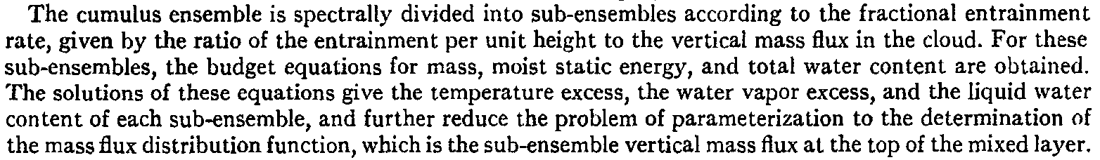

Slide 52
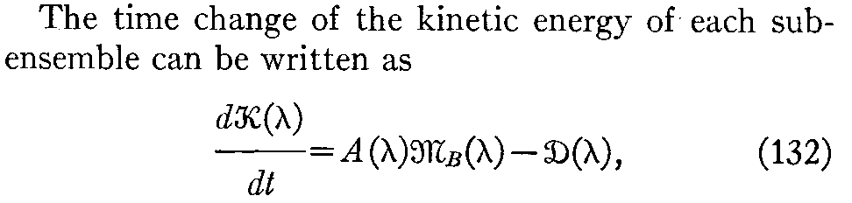

Slide 56
Betts-Miller-Janjic Adjustment schemes
When atmosphere is unstable to parcel lifted from PBL and there is a deep moist layer - adjust state back to reference profile over some time-scale, i.e.,
T_{ref} is constructed from moist adiabat from cloud base

Slide 57
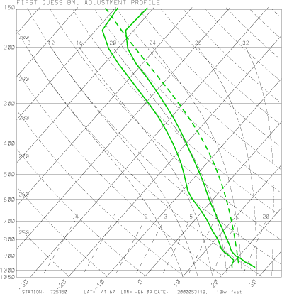
Procedure followed by BMJ scheme…
Draw a moist adiabat
Compute a first-guess temperature-adjustment profile (T_{ref})
Compute a first-guess dewpoint-adjustment profile (q_{ref})

Slide 58
The Next Step is an Enthalpy Adjustment
First Law of Thermodynamics:
With Parameterized Convection, each grid-point column is treated in isolation. Total column latent heating must be directly proportional to total column drying, or dH = 0.

Slide 59
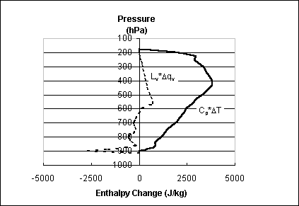
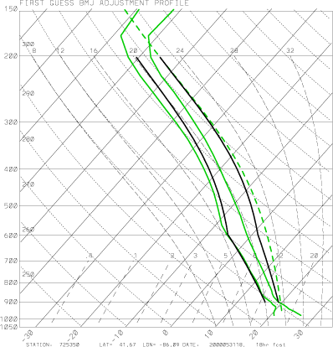
Enthalpy is not conserved for first-guess profiles for this sounding!
Must shift T_{ref} and q_{vref} to the left…

Slide 60
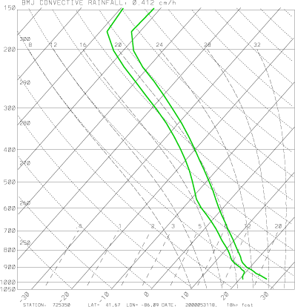
Imposing Enthalpy Adjustment:

Slide 61
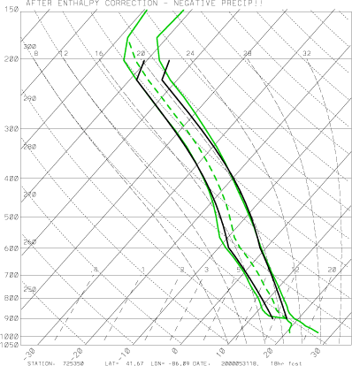

Slide 62
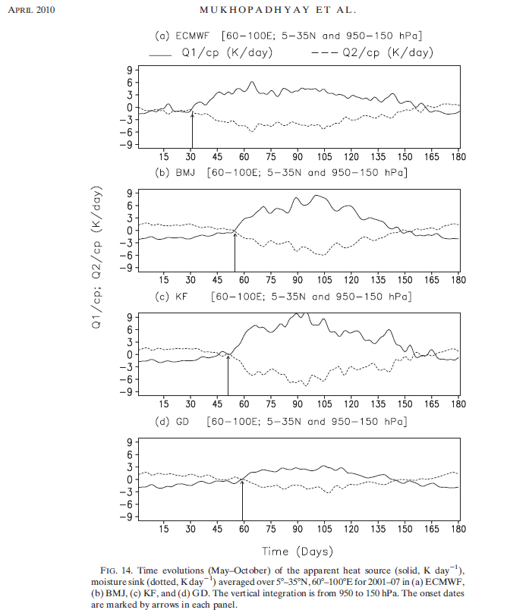

Slide 63
Thank you

